Slide 1
Wake Up, Get Ready, GO!
Sunday, July 24, 2022
Ephesians 5:14 Therefore it says: "Awake you,
the one sleeping, and rise up out from the dead,
and Christ will shine upon you."
Notes:
Next slide when Geoff comes up to front and says his greeting.

Slide 2
God’s Mercies & Blessings
My Family
Notes:
Next slide when Geoff says, “We have 4 incredible children, and just celebrated tons of graduations and a wedding! “

Slide 3
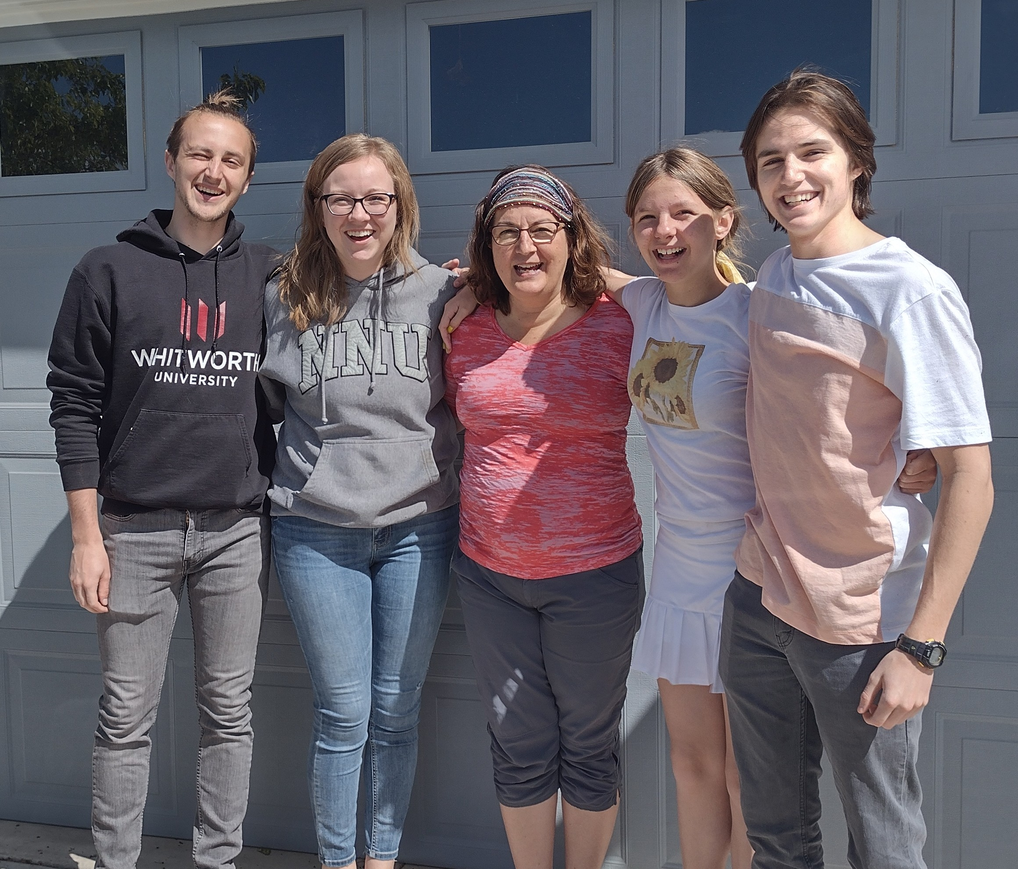
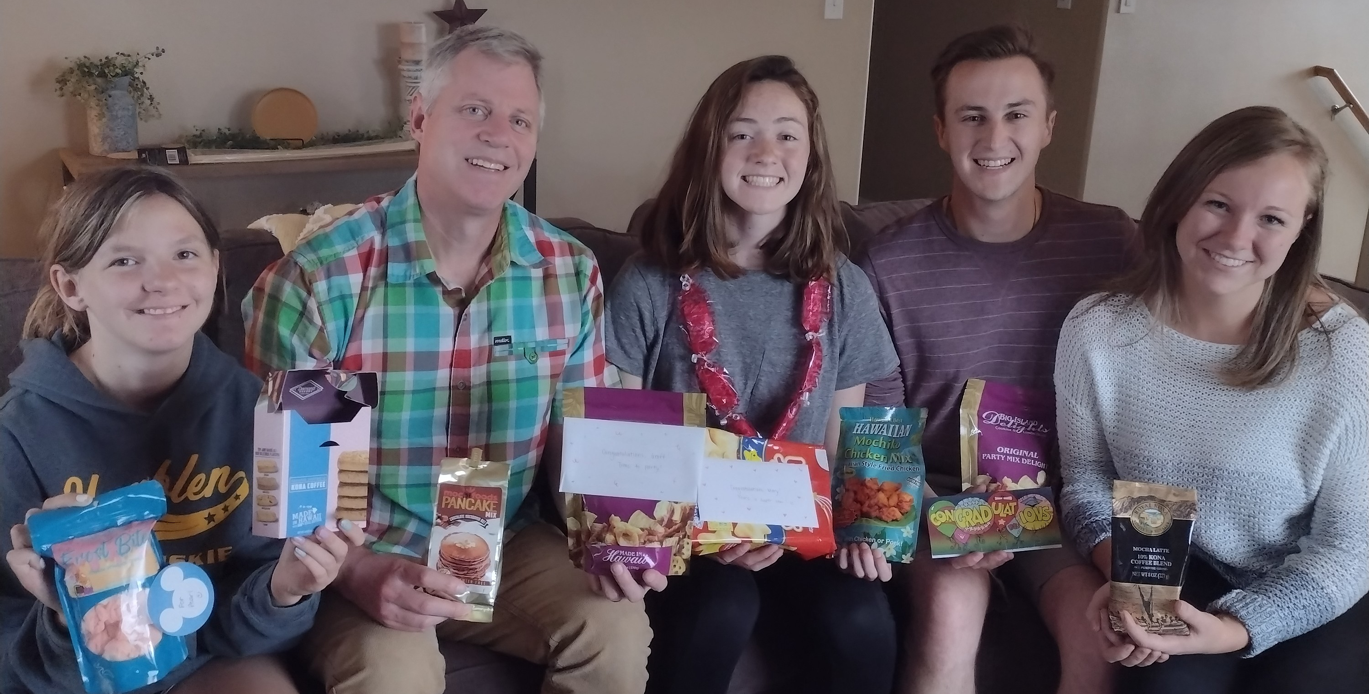
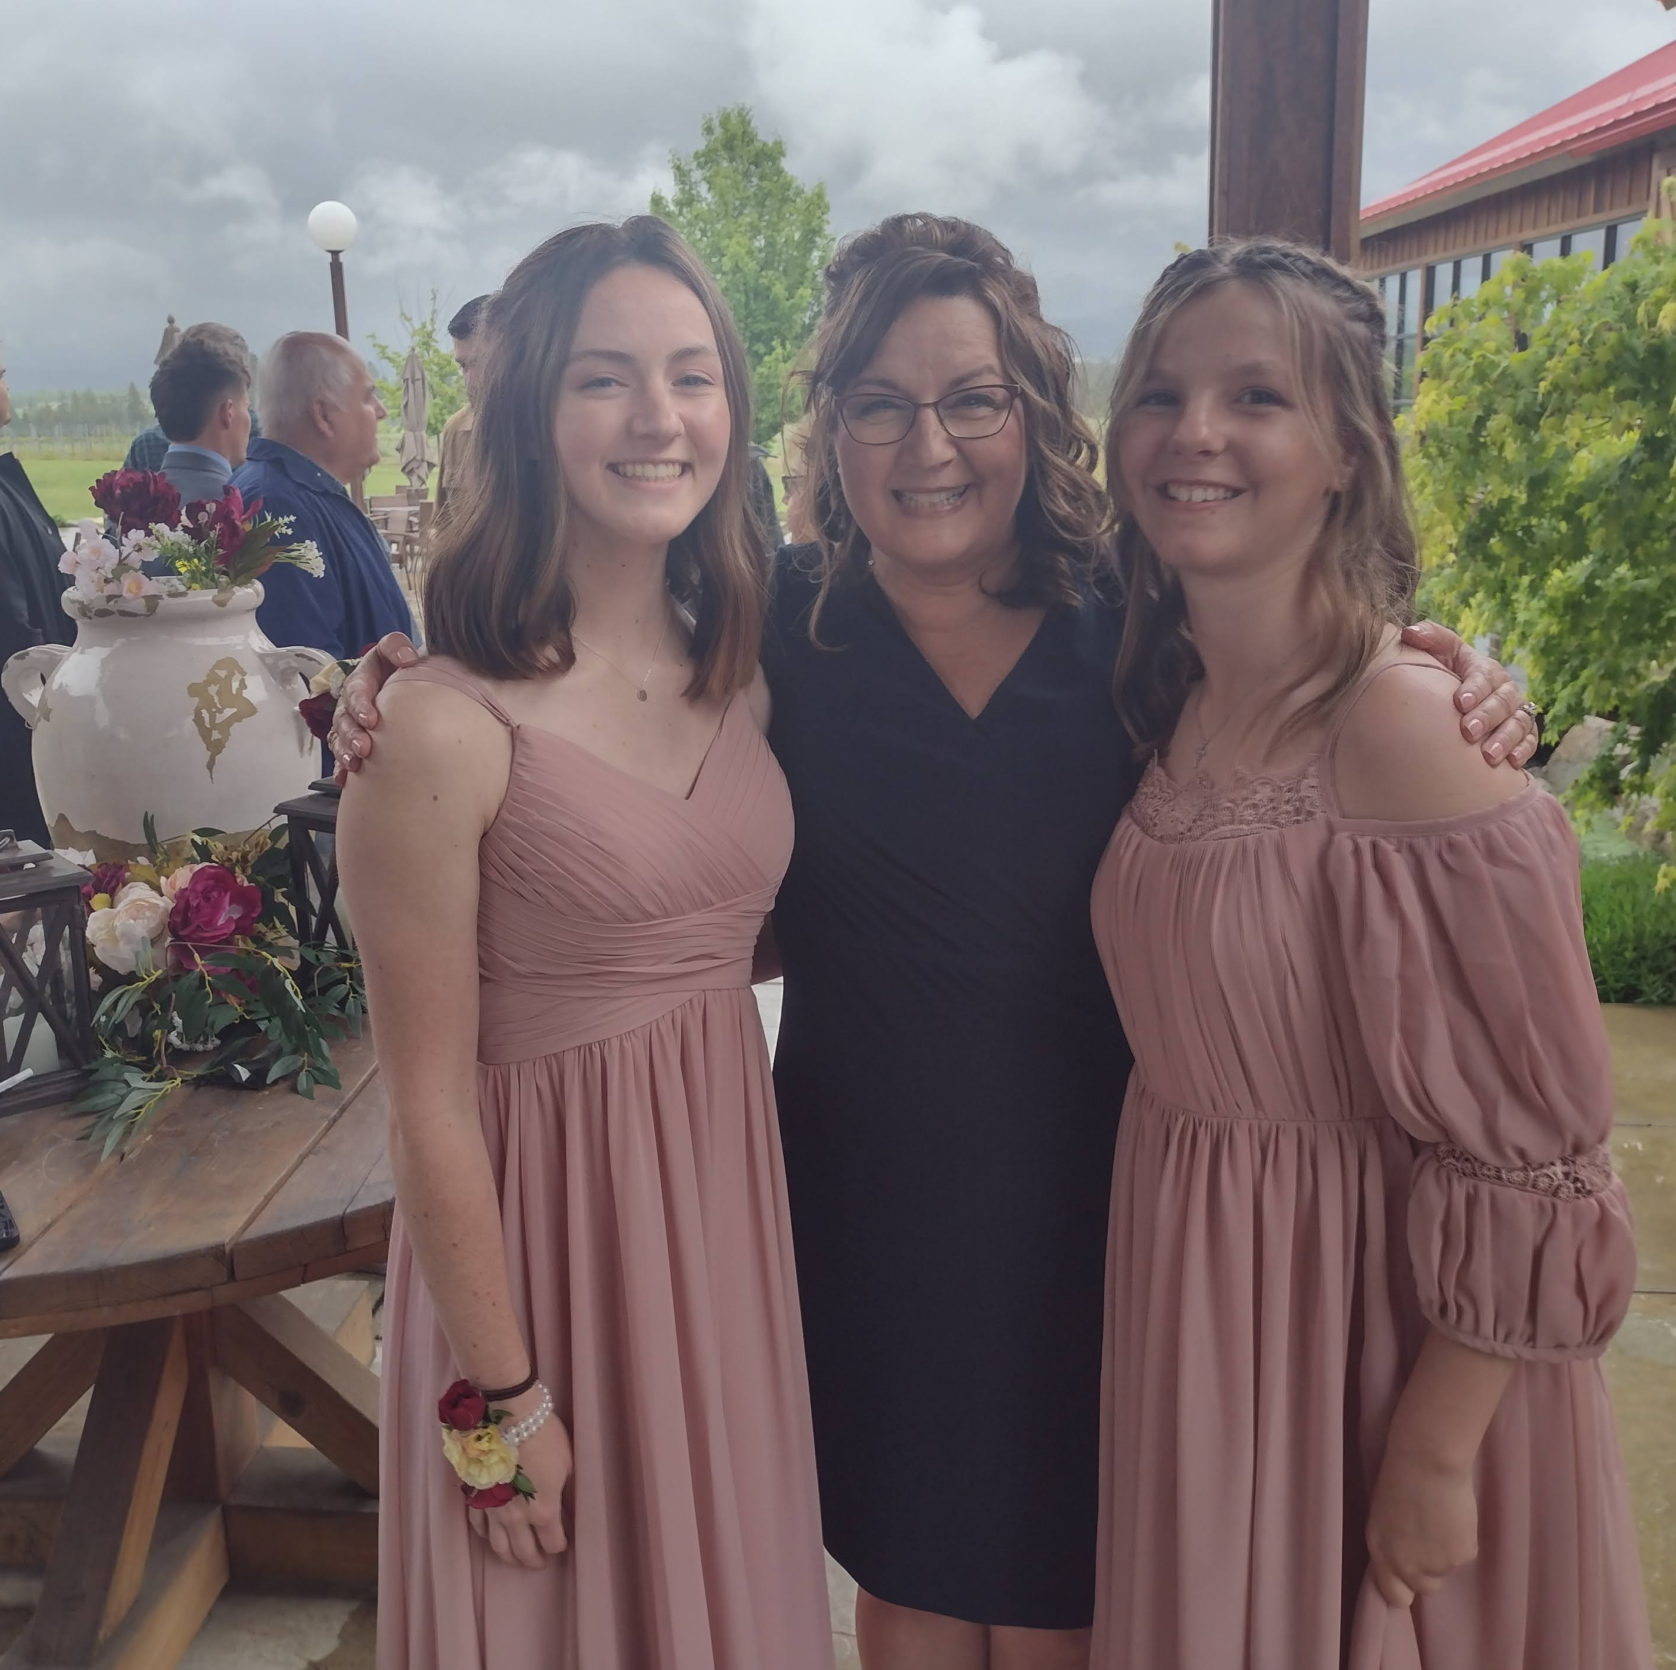
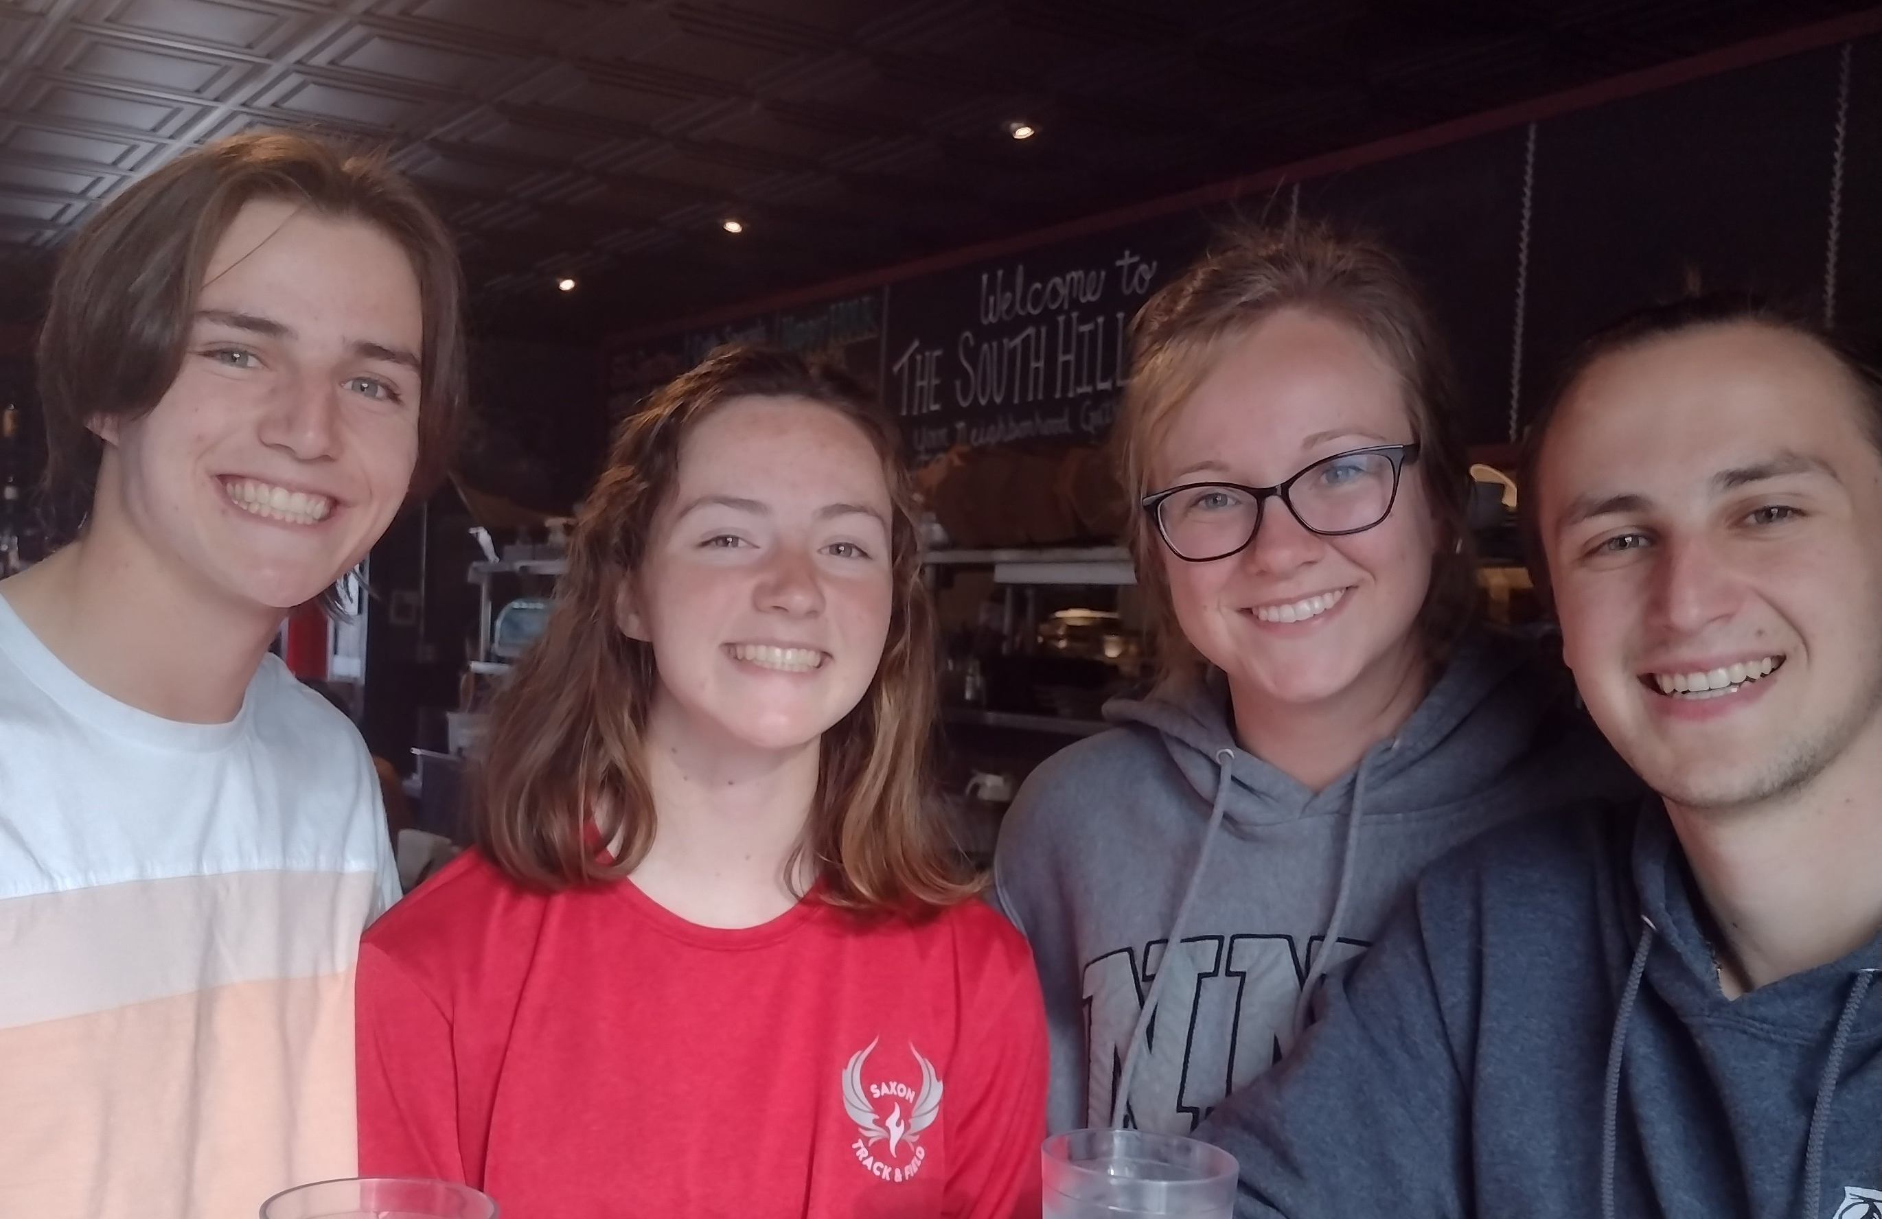
Notes:
Next slide when Geoff says, “Now we’re your missionaries in Idaho.”

Slide 4
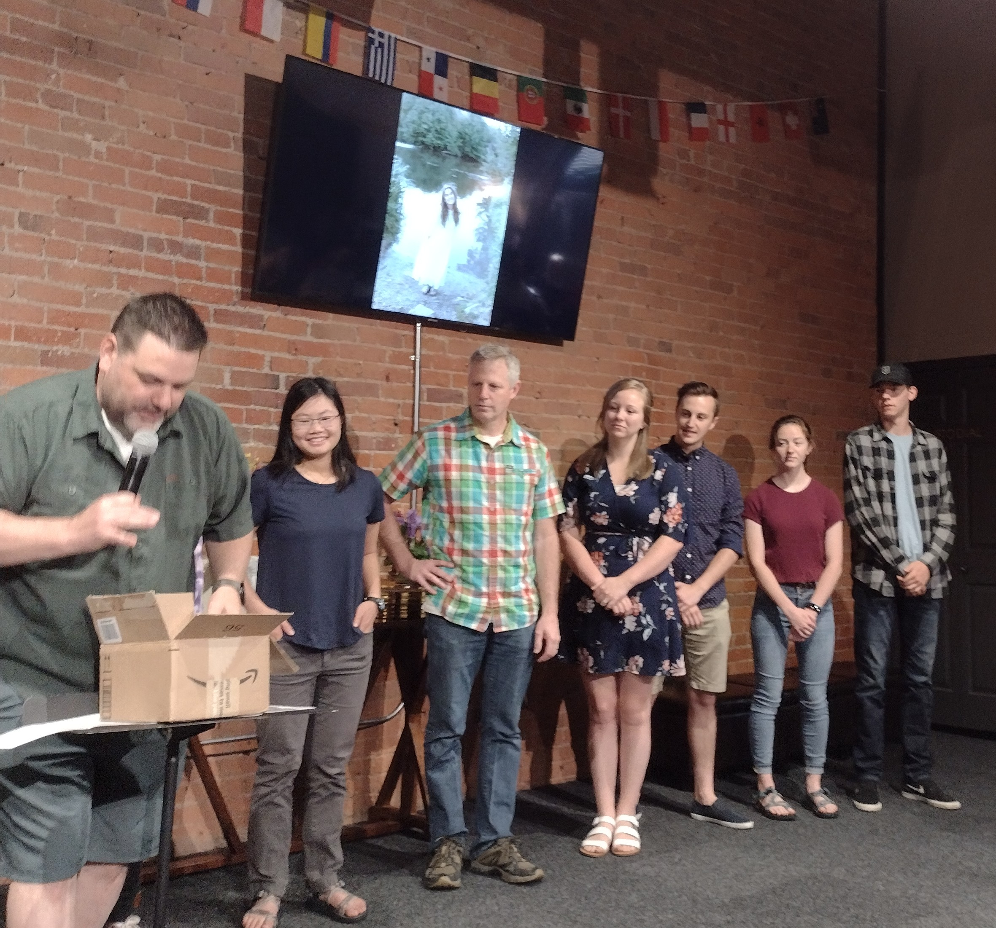
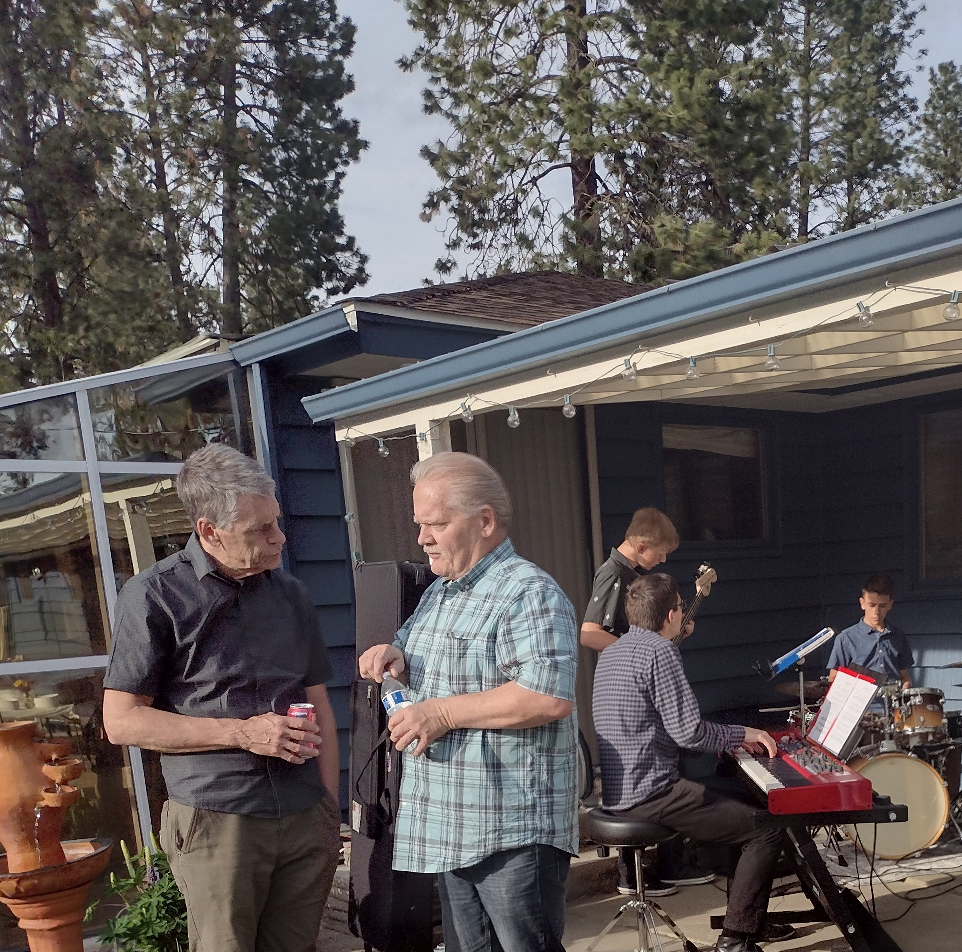
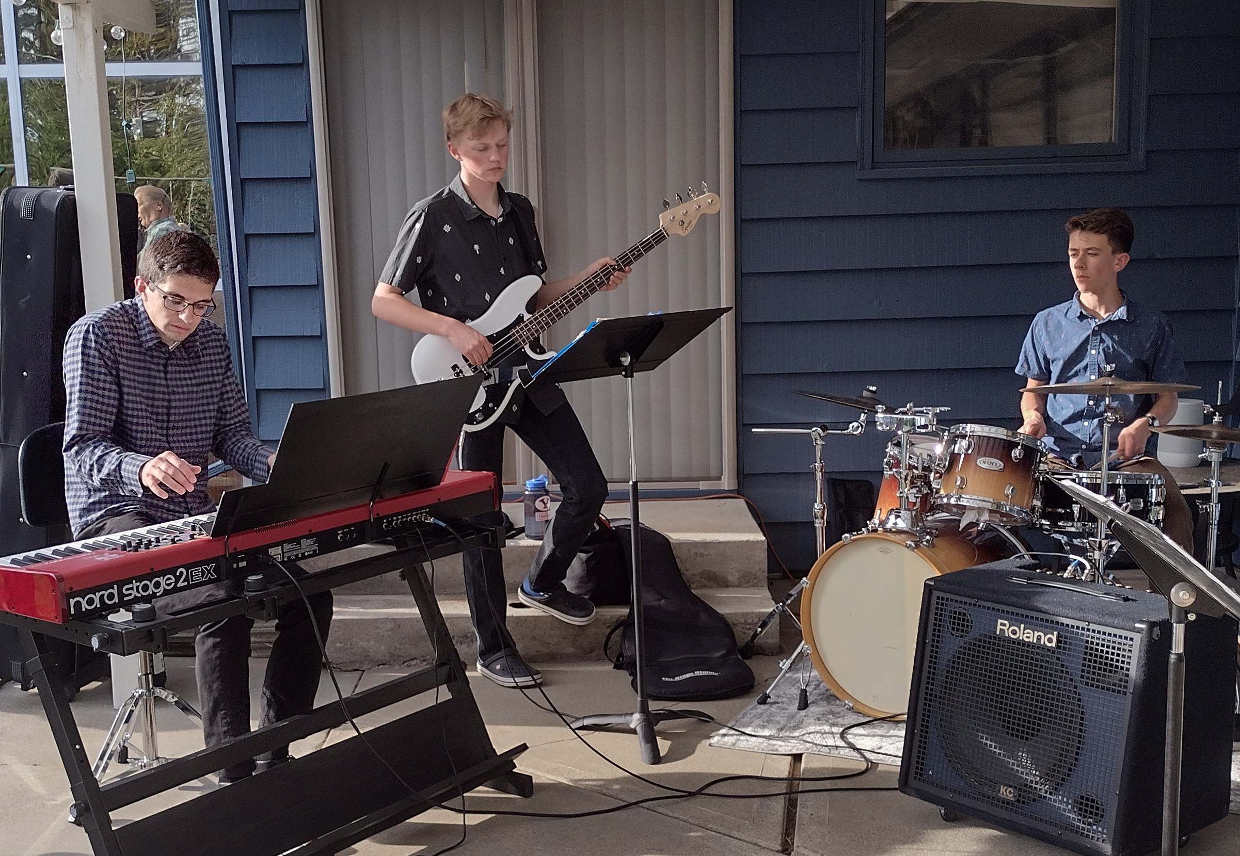
1 THESSALONIANS 1:2-3
We always thank God for all of you and continually mention you in our prayers.
We remember before our God and Father your work produced by faith, your labor prompted by love, and your endurance inspired by
hope in our Lord Jesus Christ.
Notes:
Next picture when Geoff says, “God saved me from decades of addictions.”

Slide 5
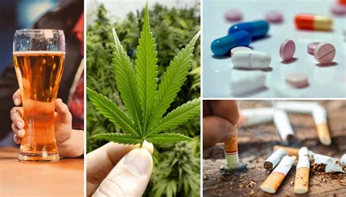
Be gracious to me, God, according to Your faithfulness; According to the greatness of Your compassion, wipe out my wrongdoings. Wash me thoroughly from my guilt, And cleanse me from my sin.
PSALM 51:1-2
XXX Pictures/Movies/Videos
Notes:
Next slide when Geoff says “I tried numbing myself and tried to checkout of life’s difficulties. ”

Slide 6
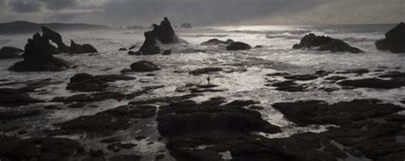
PROVERBS 3:5-7
Trust in the LORD with all your heart, And do not lean on your own understanding. In all your ways acknowledge Him, And He will make your paths straight. Do not be wise in your own eyes;
Fear the LORD and turn away from evil.
Notes:
Next slide when Geoff says ”the rest of the talk about get ready and GO! Won’t really apply yet.”

Slide 7
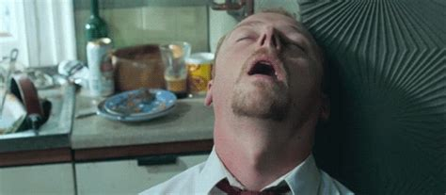
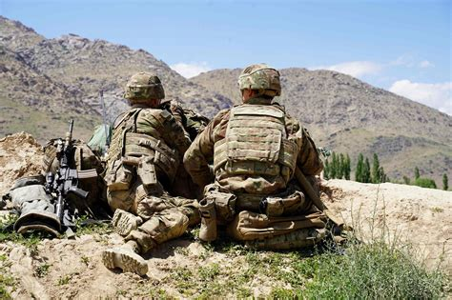
1 THESSALONIANS 5:5-6
For you are all sons of light and sons of day. We are not of night nor of darkness; so then, let’s not sleep as others do, but let’s be alert and sober.
ROMANS 13:11
This is all the more urgent, for you know how late it is; time is running out.
WAKE UP,
for our salvation is nearer now than when we first believed.
Notes:
Next slide when Geoff says something to the effect of “so let’s wake up!”

Slide 8
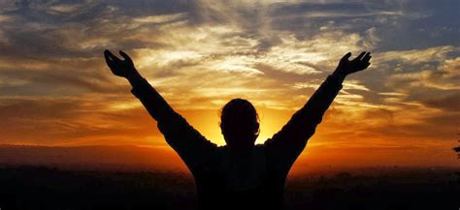
EPHESIANS 5:14
Therefore it says: "Awake you, the one sleeping, and rise up out from the dead, and Christ will shine upon you."
Notes:
Next slide when Geoff says “One of my life verses comes from the book of Titus.”

Slide 9
TITUS 2:11-14
(11)For the grace of God has appeared that offers salvation to all people. (12)It teaches us to say “No” to ungodliness and worldly passions, and to live self-controlled, upright and godly lives in this present age, (13)while we wait for the blessed hope—the appearing of the glory of our great God and Savior, Jesus Christ, (14)who gave himself for us to redeem us from all wickedness and to purify for himself a people that are his very own, eager to do what is good.
Notes:
Next slide when Geoff says “Moses tells us in…”

Slide 10
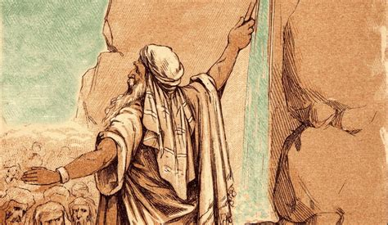
DEUTERONOMY 30:19-20
(19)This day I call the heavens and the earth as witnesses against you that I have set before you life and death, blessings and curses. Now choose life, so that you and your children may live (20)and that you may love the Lord your God, listen to his voice, and hold fast to him. For the Lord is your life…
Notes:
Next slide when Geoff says, “and it’s not to live for ourselves.”

Slide 11
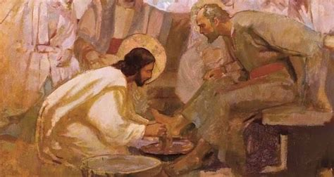
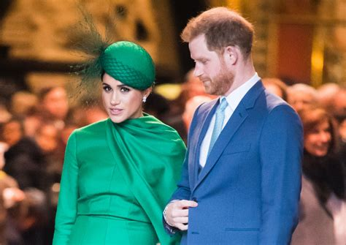
Serving Self
vs.
Serving God
Notes:
Next slide when Geoff says, “building His Kingdom here on earth.”

Slide 12
EPHESIANS 2:10
For we are his workmanship, created in
Christ Jesus to do good works,
which God prepared beforehand,
that we should walk in them.
Notes:
Next slide when Geoff says “engage in daily battles and live victoriously in Jesus!”

Slide 13
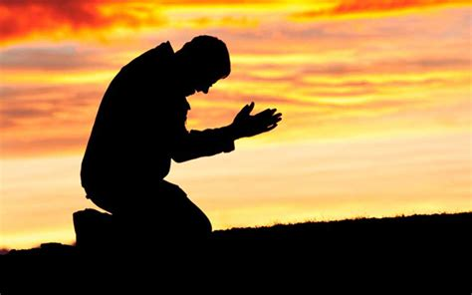
Notes:
Next slide when Geoff says “God is calling His warriors to be ready!”

Slide 14
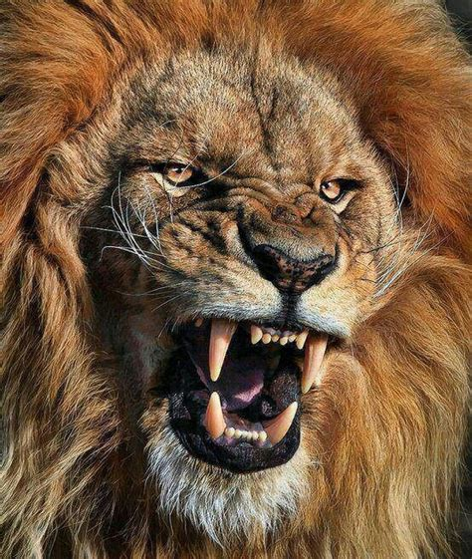
1 PETER 5:8-9
(8)Be alert and of sober mind. Your enemy the devil prowls around like a roaring lion looking for someone to devour.
(9)Resist him, standing firm in the faith, because you know that the family of believers throughout the world is undergoing the same kind of sufferings.
Notes:
Next slide when Geoff says “But the spiritual battle isn’t something we can see with our eyes.”

Slide 15
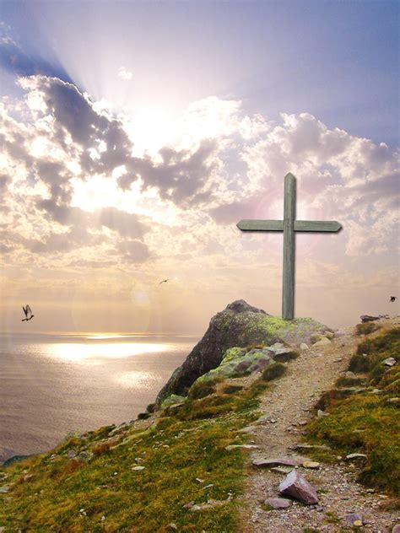
2 CORINTHIANS 4:18
So we fix our eyes
not on what is seen,
but on what is unseen.
For what is seen
is temporary,
but what is unseen
is eternal.
Notes:
Next slide when Geoff says, “Elisha is being attacked by the King of Syria.”

Slide 16
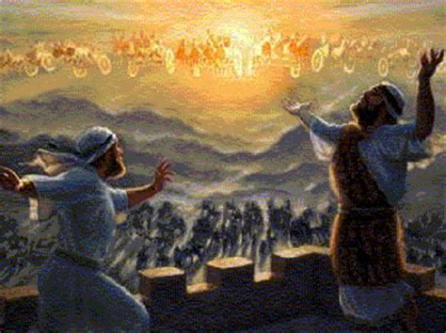
2 KINGS 6:15-17
(15)When the servant of the man of God got up and went out early the next morning, an army with horses and chariots had surrounded the city. “Oh no, my lord! What shall we do?” the servant asked.
(16)“Don’t be afraid,” the prophet answered. “Those who are with us are more than those who are with them.”
(17)And Elisha prayed, “Open his eyes, Lord, so that he may see.” Then the Lord opened the servant’s eyes, and he looked and saw the hills full of horses and chariots of fire all around Elisha.
Notes:
Next slide when Geoff says, “He then enters the Armory of God.”

Slide 17
EPHESIANS 6:10-18
(10)Finally, be strong in the Lord and in the strength of His might. (11)Put on the full armor of God, so that you will be able to stand firm against the schemes of the devil. (12)For our struggle is not against flesh and blood, but against the rulers, against the powers, against the world forces of this darkness, against the spiritual forces of wickedness in the heavenly places.
(13)Therefore, take up the full armor of God, so that you will be able to resist on the evil day, and having done everything, to stand firm. (14)Stand firm therefore, having belted your waist with truth, and having put on the breastplate of righteousness, (15)and having strapped on your feet the preparation of the gospel of peace; (16)in addition to all, taking up the shield of faith with which you will be able to extinguish all the flaming arrows of the evil one.
(17)And take the helmet of salvation and the sword of the Spirit, which is the word of God. (18)With every prayer and request, pray at all times in the Spirit, and with this in view, be alert with all perseverance and every request for all the saints…
Notes:
Next slide when Geoff says, “and we pretend to live at peace with this world.”

Slide 18
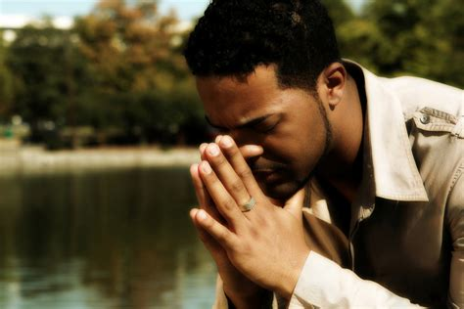
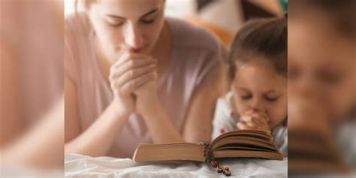
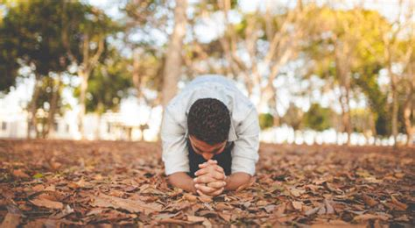
2 CORINTHIANS 10:3-5
(3) For though we live in the world, we do not wage war as the world does. (4)The weapons we fight with are not the weapons of the world. On the contrary, they have divine power to demolish strongholds. (5)We demolish arguments and every pretension that sets itself up against the knowledge of God, and we take captive every thought to make it obedient to Christ.
Notes:
Next slide when Geoff says, “This is the mission of God!”

Slide 19
JOHN 17:14-18
(14)I have given them your word and the world has hated them, for they are not of the world any more than I am of the world. (15)My prayer is not that you take them out of the world but that you protect them from the evil one.
(16)They are not of the world, even as I am not of it.
(17)Sanctify them by the truth; your word is truth.
(18)As you sent me into the world, I have sent them into the world.
Notes:
Next slide when Geoff says, “As Americans we have willingly accepted comfort and conveniences to be our gods and idols.”

Slide 20
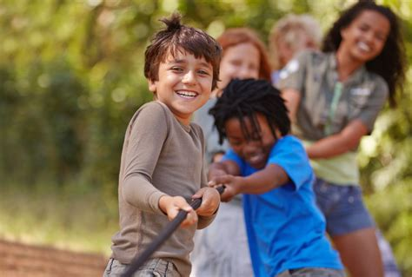
AMUSED Vs. MUSED
Notes:
Next slide when Geoff says, “Or maybe we have an obsession with safety?”

Slide 21
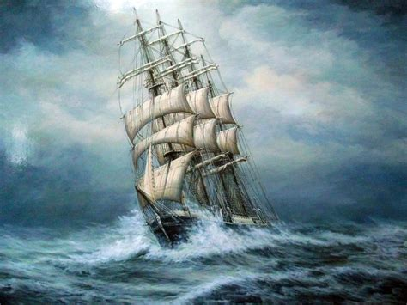
A ship is safest in its harbor,
but that’s not what
the ship was built for.
Notes:
Next slide when Geoff says, “our culture has somehow surpassed the sins of the people who lived in Sodom and Gomorrah.”

Slide 22
ROMANS 1:28-32
(28)Furthermore, just as they did not think it worthwhile to retain the knowledge of God, so God gave them over to a depraved mind, so that they do what ought not to be done. (29)They have become filled with every kind of wickedness, evil, greed and depravity. They are full of envy, murder, strife, deceit and malice. They are gossips, (30)slanderers, God-haters, insolent, arrogant and boastful; they invent ways of doing evil; they disobey their parents; (31)they have no understanding, no fidelity, no love, no mercy. (32)Although they know God’s righteous decree that those who do such things deserve death, they not only continue to do these very things but also approve of those who practice them.
Notes:
Next slide when Geoff says, “More persecution is coming and we need to be ready…”

Slide 23
1 PETER 4:12
Dear friends, do not be surprised at the fiery ordeal that has come on you to test you, as though something strange were happening to you.
Notes:
Next slide when Geoff says, “Now the world is bringing the spiritual fight to us.”

Slide 24
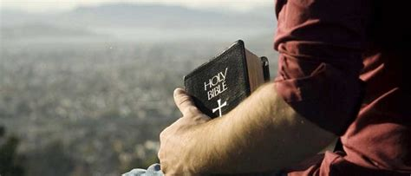
Notes:
Next slide when Geoff says, “God is victorious!”

Slide 25
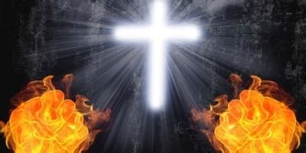
MATTHEW 16:18
And I tell you, you are Peter, and on this rock I will build my church, and the gates of hell shall not prevail against it.
Notes:
Next slide when Geoff says, “All the more reason we need to continue to gather together.”

Slide 26
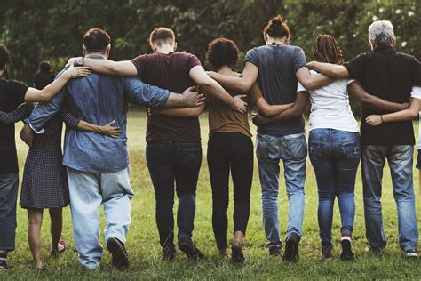
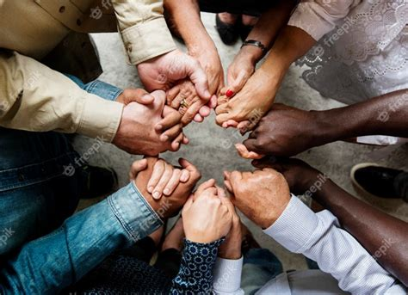
HEBREWS 10:24-25
(24)And let us consider how to spur one another on to love and good deeds.
(25)Let us not neglect meeting together, as some have made a habit, but let us encourage one another, and all the more as you see the Day approaching.
Notes:
Next slide when Geoff says, “Let me give you this encouragement from the book of Deuteronomy…”

Slide 27
DEUTERONOMY 20:1, 3-4
(1)When you go out to battle against your enemies and see horses, chariots, and people more numerous than you, do not be afraid of them; for the LORD your God, who brought you up from the land of Egypt, is with you…
(3)He shall say to them, ‘Hear, Israel, you are approaching the battle against your enemies today. Do not be fainthearted. Do not be afraid, or panic, or be terrified by them,
(4)for the LORD your God is the One who is going with you, to fight for you against your enemies, to save you.’
Notes:
Next slide when Geoff says, “It’s time to get prepared and put our faith into action.”

Slide 28
1 CORINTHIANS 9:24-27
(24)Do you not know that in a race all the runners run, but only one receives the prize? So run that you may obtain it. (25)Every athlete exercises self-control in all things. They do it to receive a perishable wreath, but we an imperishable. (26)So I do not run aimlessly; I do not box as one beating the air. (27)But I discipline my body and keep it under control, lest after preaching to others I myself should be disqualified.
Notes:
Next slide when Geoff says, “We don’t just become godly because we thought about wanting to be godly.”

Slide 29
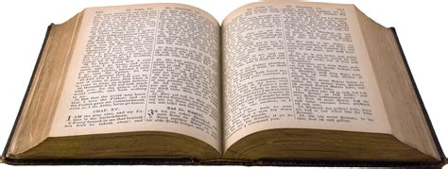
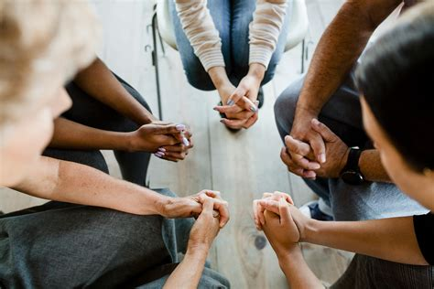
1 TIMOTHY 4:7-8
Do not waste time arguing over godless ideas and old wives’ tales. Instead, train yourself to be godly. For physical training is of some value, but godliness has value for all things, holding promise for both the present life
and the life to come.
Notes:
Next slide when Geoff gives the example of Paul’s life…

Slide 30
PHILIPPIANS 3:12-14
(12)Not that I have already obtained all this, or have already arrived at my goal, but I press on to take hold of that for which
Christ Jesus took hold of me.
(13)Brothers and sisters, I do not consider myself yet to have taken hold of it. But one thing I do: Forgetting what is behind
and straining toward what is ahead,
(14)I press on toward the goal to win the prize for which
God has called me heavenward in Christ Jesus.
Notes:
Next slide when Geoff says, “Not just once in awhile, or when we feel like it, but everyday.”

Slide 31
Are you spiritually awake? Have you surrendered your life to Jesus as Lord and Savior?
How are you preparing for life’s trials and tests?
What are you willing to do today to train yourself in godliness?
Who is God asking you to fight for today?
REMEMBER – God has the victory and we are victorious in HIM!
Apply It
QUESTIONS
Notes:
Next slide when Geoff says, “Please stand and receive the benediction from Hebrews and Mark.”

Slide 32
THE BENEDICTION
HEBREWS 12:28-29
Therefore, since we are receiving a kingdom that cannot be shaken, let us be thankful, and so worship god acceptably with reverence and awe, for our “God is a consuming fire.”
MARK 16:15
Jesus says to us,
“GO into all the world and preach the gospel to all creation.”
Notes:
Amen! Praise Jesus! Thank you ☺

