Slide 1
Psalm 32
[Congregation]
Blessed is the one whose transgressions are forgiven, whose sins are covered. ² Blessed is the one whose sin the Lord does not count against them and in whose spirit is no deceit.

Slide 2
Psalm 32
[Reader]
³ When I kept silent, my bones wasted away through my groaning all day long. ⁴ For day and night your hand was heavy on me; my strength was sapped as in the heat of summer.

Slide 3
Psalm 32
[Congregation]
⁵ Then I acknowledged my sin to you and did not cover up my iniquity. I said, “I will confess my transgressions to the Lord.” And you forgave the guilt of my sin.

Slide 4
Psalm 32
[Reader]
⁶ Therefore let all the faithful pray to you while you may be found; surely the rising of the mighty waters will not reach them.

Slide 5
Psalm 32
[Congregation] ⁷ You are my hiding place; you will protect me from trouble and surround me with songs of deliverance.

Slide 6
Psalm 32
[Reader]
⁸ I will instruct you and teach you in the way you should go; I will counsel you with my loving eye on you. ⁹ Do not be like the horse or the mule, which have no understanding but must be controlled by bit and bridle or they will not come to you.

Slide 7
Psalm 32
[All] ¹⁰ Many are the woes of the wicked, but the Lord’s unfailing love surrounds the one who trusts in him.
¹¹ Rejoice in the Lord and be glad, you righteous; sing, all you who are upright in heart!

Slide 8
Psalms
Psalm 32

Slide 9
What do songs do that other verbal communication doesn’t?

Slide 10
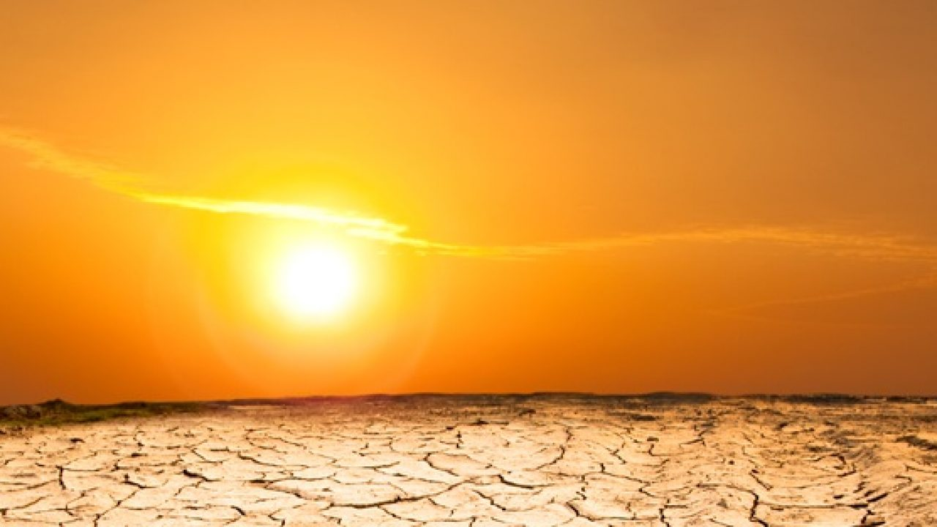
What it does to us.
What we need to do with it.
SIN

Slide 11
What has sin brought into your life?

Slide 12
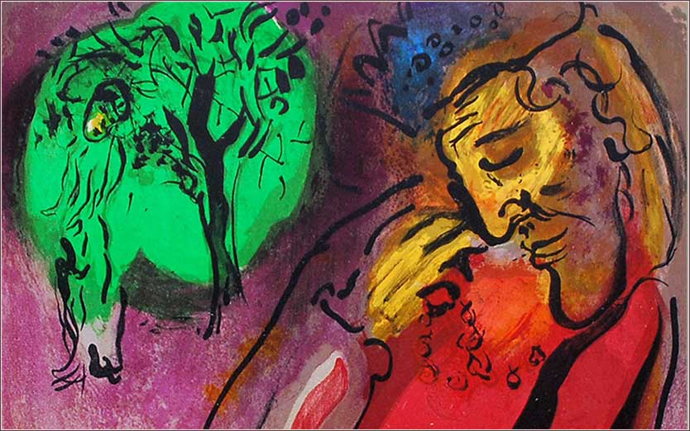
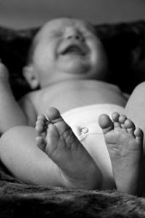
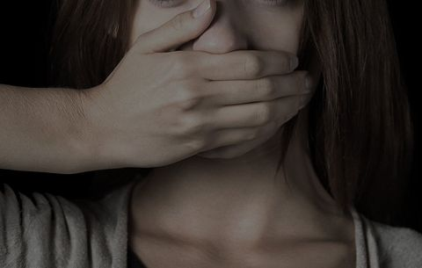

Slide 13
Psalm 32
³ When I kept silent, my bones wasted away through my groaning all day long. ⁴ For day and night your hand was heavy on me; my strength was sapped as in the heat of summer.

Slide 14
Psalm 32
⁹ Do not be like the horse or the mule, which have no understanding but must be controlled by bit and bridle or they will not come to you.
¹⁰ Many are the woes of the wicked…

Slide 15
What does sin do to us?
Vs. 3—“When I kept silent….”
DECEPTION
Vs. 3—“When I kept silent,
my bones wasted away”
PHYSICAL SUFFERING

Slide 16
What does sin do to us?
Vs. 3—“When I kept silent,
my bones wasted away
through my groaning all day long.”
EMOTIONAL & SPIRITUAL DISCOMFORT

Slide 17
What does sin do to us?
Vs. 4--
For day and night your hand was heavy on me; my strength was sapped as in the heat of summer.

Slide 18
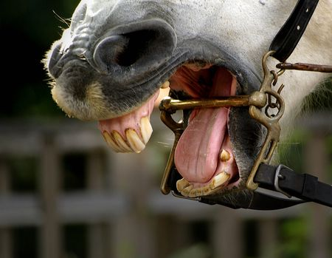
⁹ Do not be like the horse or the mule, which have no understanding but must be controlled by bit and bridle or they will not come to you.

Slide 19
What are we to do with our sin?
⁵ Then I acknowledged my sin to you and did not cover up my iniquity. I said, “I will confess my transgressions to the Lord.”
⁶ Therefore let all the faithful pray to you while you may be found;

Slide 20
What sin does to us.
That we need to do with sin.
What God does with us, repentant sinners.
What we get to do with God!

Slide 21
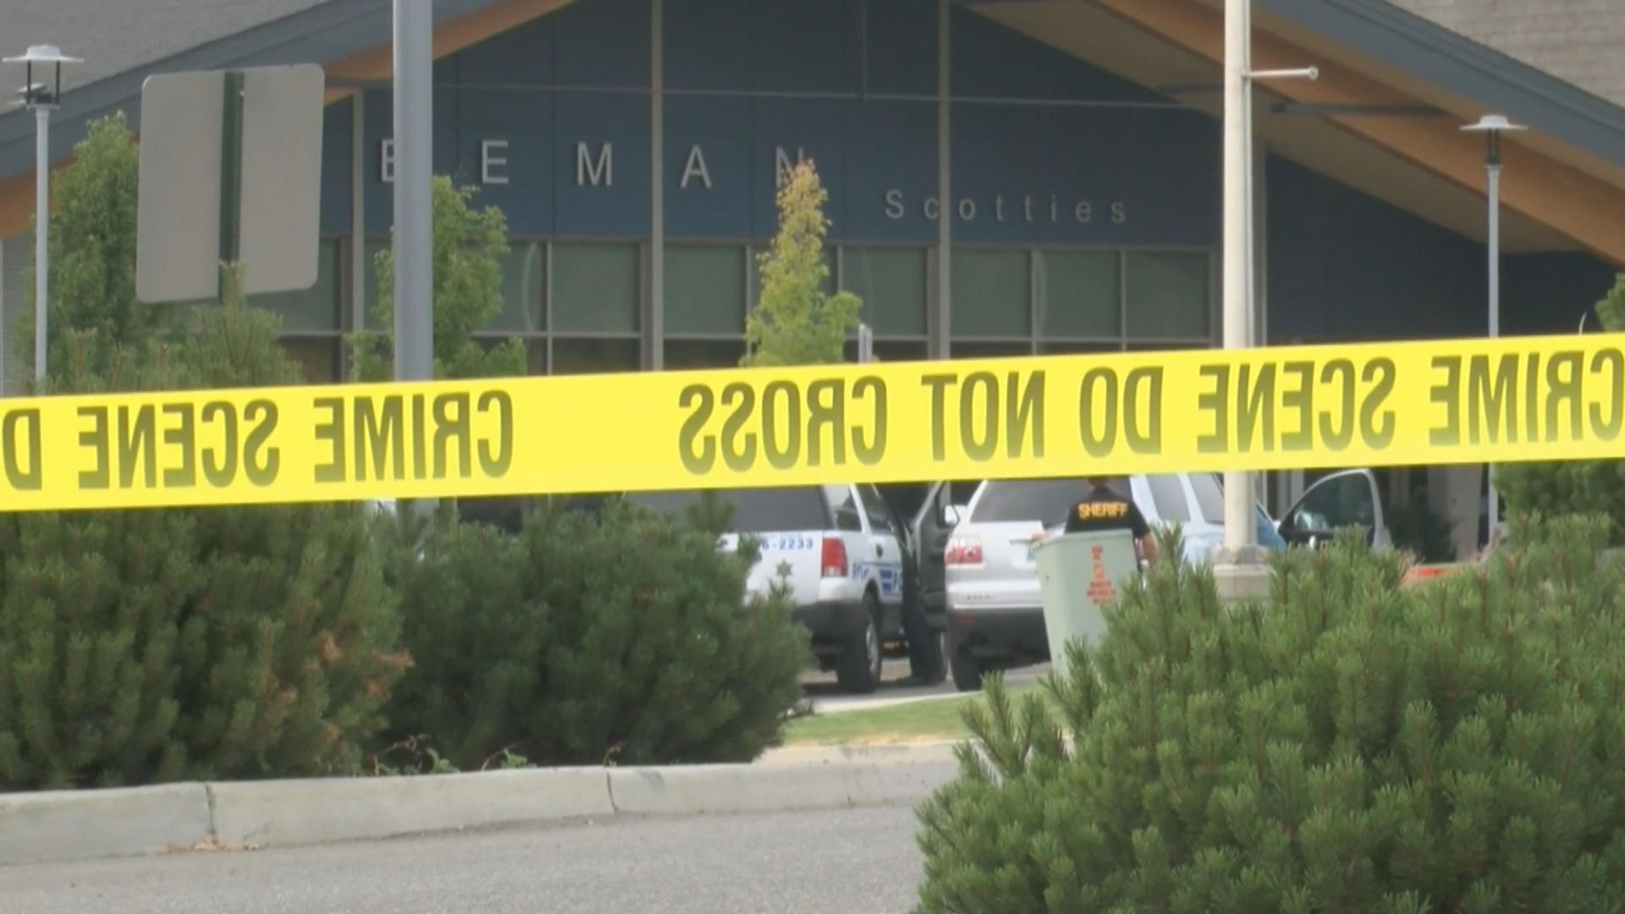
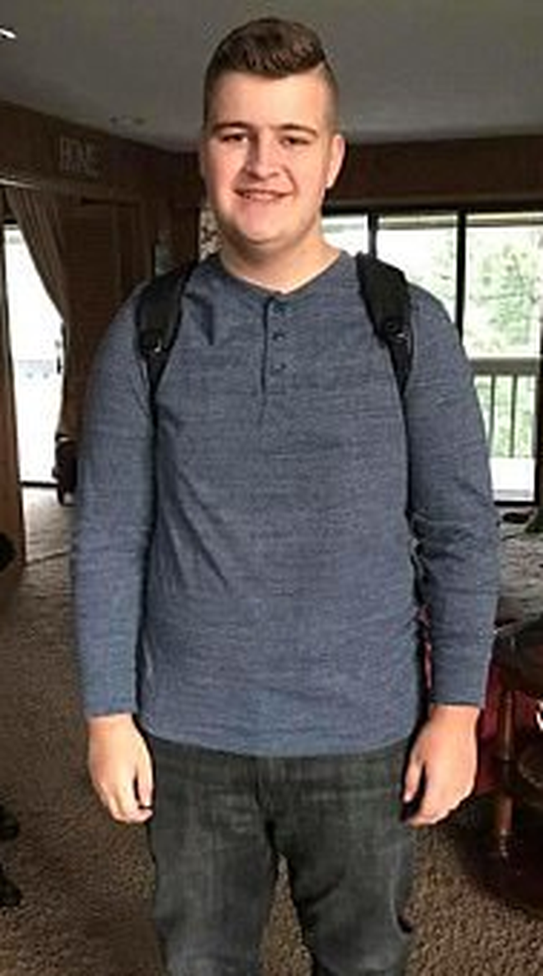
What God does with us, repentant sinners.

Slide 22
Psalm 32
Blessed is the one whose transgressions are forgiven, whose sins are covered. ² Blessed is the one whose sin the Lord does not count against them and in whose spirit is no deceit.

Slide 23
Psalm 32
…And you forgave the guilt of my sin.
⁷ You are my hiding place; you will protect me from trouble and surround me with songs of deliverance.

Slide 24
Psalm 32
⁸ I will instruct you and teach you in the way you should go; I will counsel you with my loving eye on you.

Slide 25
Psalm 32:1
Blessed is the one whose transgressions are forgiven,
Psalm 32:5
…I said, “I will confess my transgressions to the Lord.” And you forgave the guilt of my sin.

Slide 26
Psalm 32:1
Blessed is the one… whose sins are covered. [Atonement]
Psalm 32:5
…I said, “I will confess my transgressions to the Lord.” And you forgave the guilt of my sin.

Slide 27
Romans 5:9-11
Much more then, being now justified by his blood, we shall be saved from wrath through him. For if, when we were enemies, we were reconciled to God by the death of his Son, much more, being reconciled, we shall be saved by his life. And not only so, but we also joy in God through our Lord Jesus Christ, by whom we have now received the atonement.”

Slide 28
Psalm 32:2
Blessed is the one whose sin the Lord does not count against them…

Slide 29
Psalm 32
¹ Blessed is the one whose transgressions are forgiven, whose sins are covered. ² Blessed is the one whose sin the Lord does not count against them and in whose spirit is no deceit.

Slide 30
Psalm 32
⁶ Therefore let all the faithful pray to you while you may be found; surely the rising of the mighty waters will not reach them.
⁷ You are my hiding place; you will protect me from trouble and surround me with songs of deliverance.

Slide 31
Psalm 32
⁸ I will instruct you and teach you in the way you should go; I will counsel you with my loving eye on you.

Slide 32
Psalm 32
¹¹ Rejoice in the Lord and be glad, you righteous; sing, all you who are upright in heart!

