Slide 1
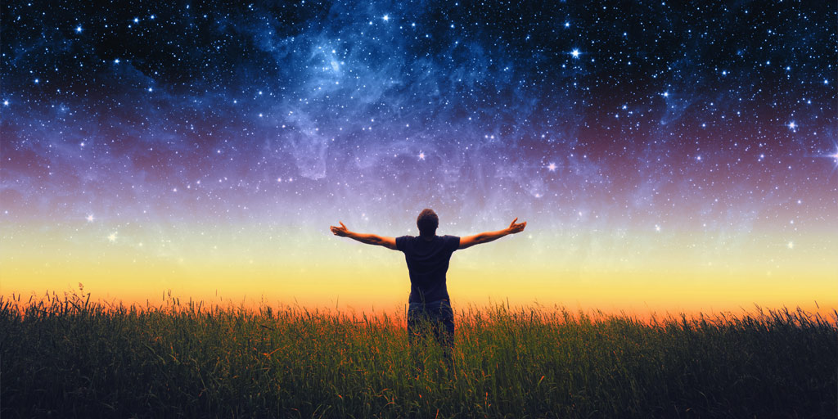
What are you looking forward to in eternity? Anything you’re not looking forward to in eternity?

Slide 2
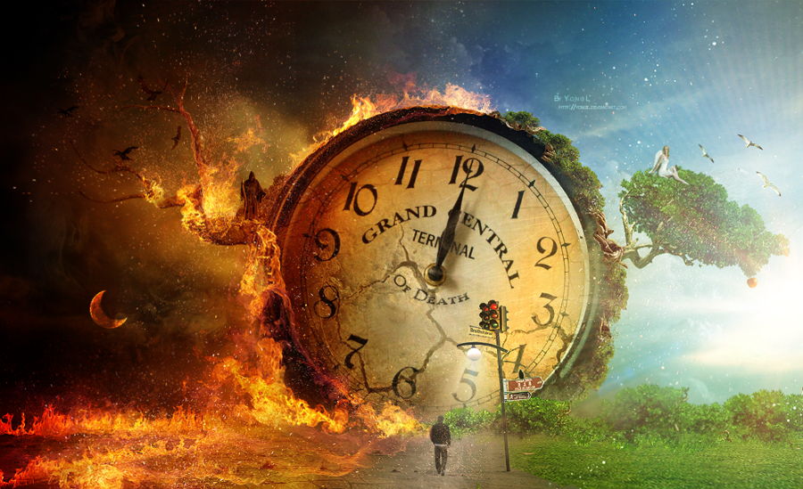
PARABLES OF JUDGMENT

Slide 3
Romans 14:10-12
You, then, why do you judge your brother or sister? Or why do you treat them with contempt? For we will all stand before God’s judgment seat. ¹¹ It is written:
“‘As surely as I live,’ says the Lord, ‘every knee will bow before me; every tongue will acknowledge God.’”
So then, each of us will give an account of ourselves to God.

Slide 4
2 Corinthians 5:9, 10
So we make it our goal to please him, whether we are at home in the body or away from it. ¹⁰ For we must all appear before the judgment seat of Christ, so that each of us may receive what is due us for the things done while in the body, whether good or bad.

Slide 5
Hebrews 6:1, 2
Therefore let us move beyond the elementary teachings about Christ and be taken forward to maturity, not laying again the foundation of repentance from acts that lead to death, and of faith in God, ² instruction about cleansing rites, the laying on of hands, the resurrection of the dead, and eternal judgment.

Slide 6
Hebrews 9:27, 28
Just as people are destined to die once, and after that to face judgment, ²⁸ so Christ was sacrificed once to take away the sins of many; and he will appear a second time, not to bear sin, but to bring salvation to those who are waiting for him.

Slide 7
2 Corinthians 5:10
For we must all appear before the judgment
seat of Christ, so that each of us may receive what is due us for the things done while in the body, whether good or bad.

Slide 8
Revelation 20
Then I saw a great white throne and him who was seated on it. The earth and the heavens fled from his presence, and there was no place for them. ¹² And I saw the dead, great and small,
standing before the throne, and books were opened. Another book was opened, which is the book of life. The dead were judged according to what they had done as recorded in the books. ¹³ The sea gave up the dead that were in it, and death and Hades gave up the dead that were in them, and each person was judged according to what they had done. ¹⁴ Then death and Hades were thrown into the lake of fire. The lake of fire is the second death. ¹⁵ Anyone whose name was not found written in the book of life was thrown into the lake of fire.

Slide 9
A.) What does this parable teach about the judgment of the righteous? B.) What does it teach about the judgment of the unrighteous? C.) Since that is true for both groups of people, how should that change the way WE live this week and beyond? What steps could we take to effect that change?

Slide 10
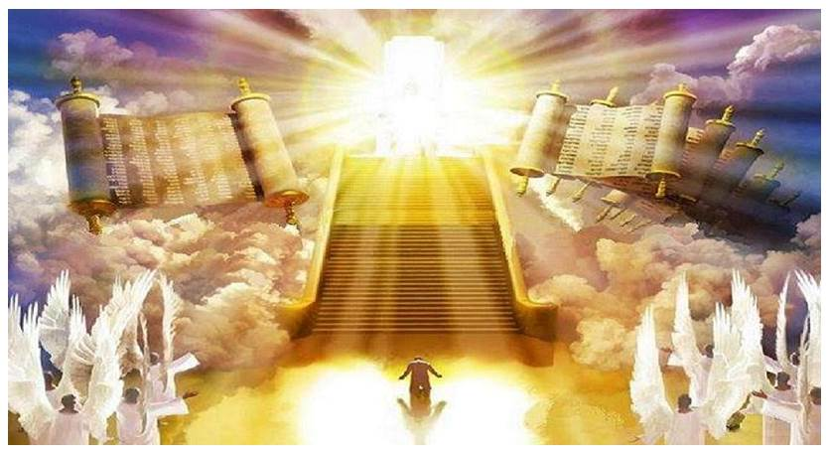
WHY do we tend to resist this truth of divine eternal judgment?

Slide 11
Since what Jesus told us in these parables is true for both saved and unsaved people, how should that change the way WE live this week and beyond? What steps could we take to effect those changes?

Slide 12
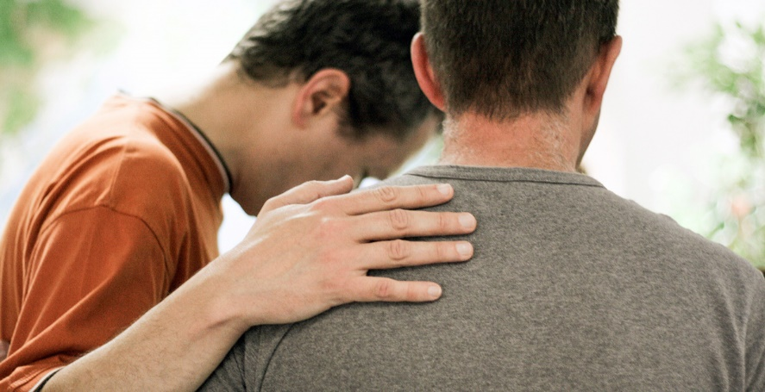
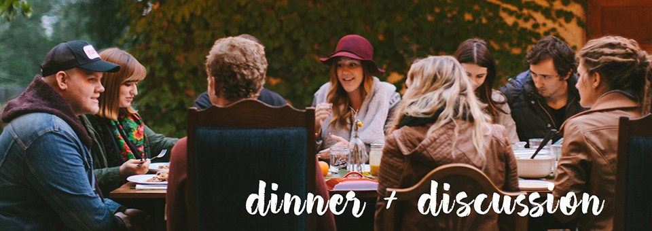
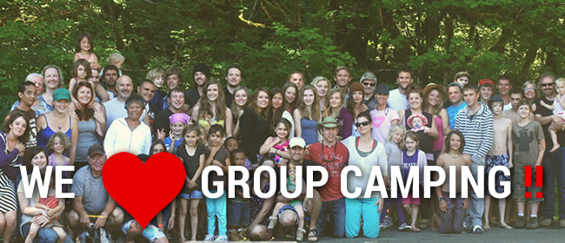
OPPORTUNITIES TO SHARE CHRIST THIS SUMMER

