Slide 2
2 CORNTHIANS 10
³ For though we live in the world, we do not wage war as the world does. ⁴ The weapons we fight with are not the weapons of the world. On the contrary, they have divine power to demolish strongholds.

Slide 3
2 CORNTHIANS 10
⁵ We demolish arguments and every pretension that sets itself up against the knowledge of God, and we take captive every thought to make it obedient to Christ. ⁶ And we will be ready to punish every act of disobedience, once your obedience is complete.

Slide 4
Luke 12:34
For where your treasure is, there your heart will be also.

Slide 5
Luke 12:34
For where _________’s treasure is, there her/his heart will be also.

Slide 6
Customized Prayer Strategy

Slide 7
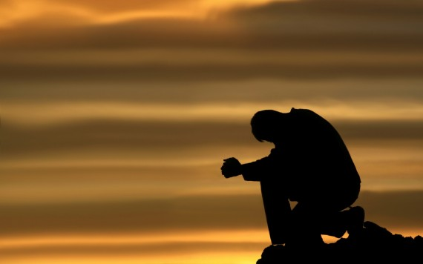
Deuteronomy 6
⁴ Hear, O Israel: The Lord our God, the Lord is one. ⁵ Love the Lord your God with all your heart and with all your soul and with all your strength. ⁶ These commandments that I give you today are to be on your hearts. ⁷ Impress them on your children.

Slide 8
Deuteronomy 6
Talk about them when you sit at home and when you walk along the road, when you lie down and when you get up. ⁸ Tie them as symbols on your hands and bind them on your foreheads. ⁹ Write them on the doorframes of your houses and on your gates.

Slide 9
2 Chronicles 7:14
If my people, who are called by my name, will humble themselves and pray and seek my face and turn from their wicked ways, then I will hear from heaven, and I will forgive their sin and will HEAL THEIR LAND.

Slide 10
2 Chronicles 7:14
If _____________, who is called by my name, will humble himself/herself and pray and seek my face and turn from his/her wicked ways, then I will hear from heaven, and I will forgive ______’s sin and will heal ________’s land.

Slide 11
Philippians 4:19
And my God will meet all your needs according to his glorious riches in Christ Jesus.

Slide 12
Philippians 4:19
And my God will meet all of _______’s needs according to his glorious riches in Christ Jesus.

Slide 13
Psalm 51:10
Create in me a clean heart, O God, and renew a steadfast spirit within me.

Slide 14
Psalm 51:10
Create in _________ a clean heart, O God, and renew a steadfast spirit within ______________.

Slide 15
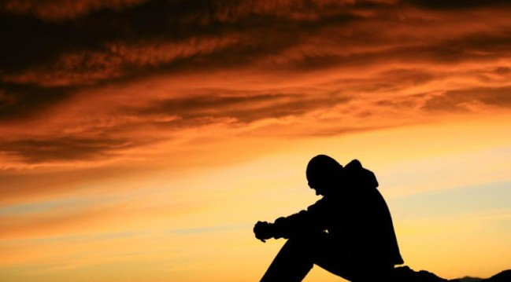
Jeremiah 29:12, 13 Then you will call on me and come and pray to me, and I will listen to you. ¹³ You will seek me and find me when you seek me with all your heart.

Slide 16
Jeremiah 29:12, 13 Call on me, ____________, and come and pray to me, and I will listen to __________. ¹³ ___________will seek me and find me when _________searches for me with all ___________’s heart.

Slide 17
Matthew 6:21 For where __________’s treasure is, there ________’s heart will be also.

Slide 18
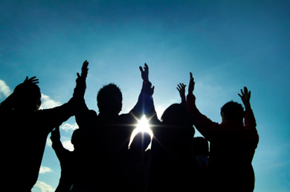
Matthew 18:19, 20 Again, truly I tell you that if two of you on earth agree about anything they ask for, it will be done for them by my Father in heaven. For where two or three gather in my name, there am I with them.

Slide 19
John 15:7 If you remain in me and my words remain in you, ask whatever you wish, and it will be given you.

Slide 22
Hosea 6:3
He will come to us like the rain,
like the spring rain
watering the earth.

Slide 25
Isaiah 40:28-31
Do you not know? Have you not heard? The Lord is the everlasting God, the Creator of the ends of the earth. He will not grow tired or weary, and his understanding no one can fathom. ²⁹ He gives strength to the weary and increases the power of the weak.

Slide 26
Isaiah 40
³⁰ Even youths grow tired and weary, and young men stumble and fall; ³¹ but those who hope in the Lord will renew their strength. They will soar on wings like eagles; they will run and not grow weary, they will walk and not be faint.

Slide 27
Lamentations 3:22, 23
Because of the Lord’s great love we are not consumed, for his compassions never fail. They are new every morning; great is your faithfulness.

Slide 28
Isaiah 49:16
See, I have engraved you on the
palms of my hands; your walls are ever before me.

Slide 30
Joshua 1:8-9
Keep this Book of the Law always on your lips; meditate on it day and night, so that you may be careful to do everything written in it. Then you will be prosperous and successful. ⁹ Have I not commanded you? Be strong and courageous. Do not be afraid; do not be discouraged, for the Lord your God will be with you wherever you go.”

Slide 31
2 Timothy 1:7
God has not given us a spirit of fear, but of power and of love and of a sound mind.

Slide 32
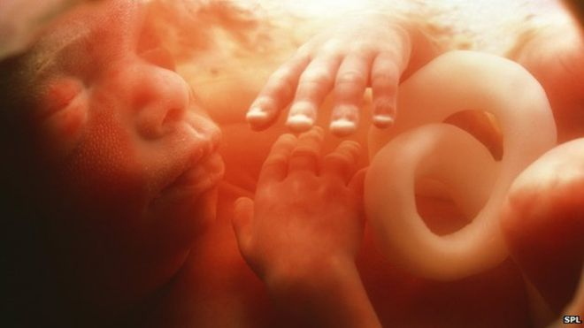
Jeremiah 1:4-8
⁴ The Lord said to me,
⁵ “Before I formed you in your mother’s womb I chose you. Before you were born I set you apart. I appointed you to be a prophet to the nations.”

Slide 33
Jeremiah 1:4-8
I answered, “Oh, Lord God, I really do not know how to speak well enough for that, for I am too young.” ⁷ The Lord said to me, “Do not say, ‘I am too young.’ But go to whomever I send you and say whatever I tell you. ⁸ Do not be afraid of those to whom I send you, for I will be with you to protect you,” says the Lord.

Slide 34
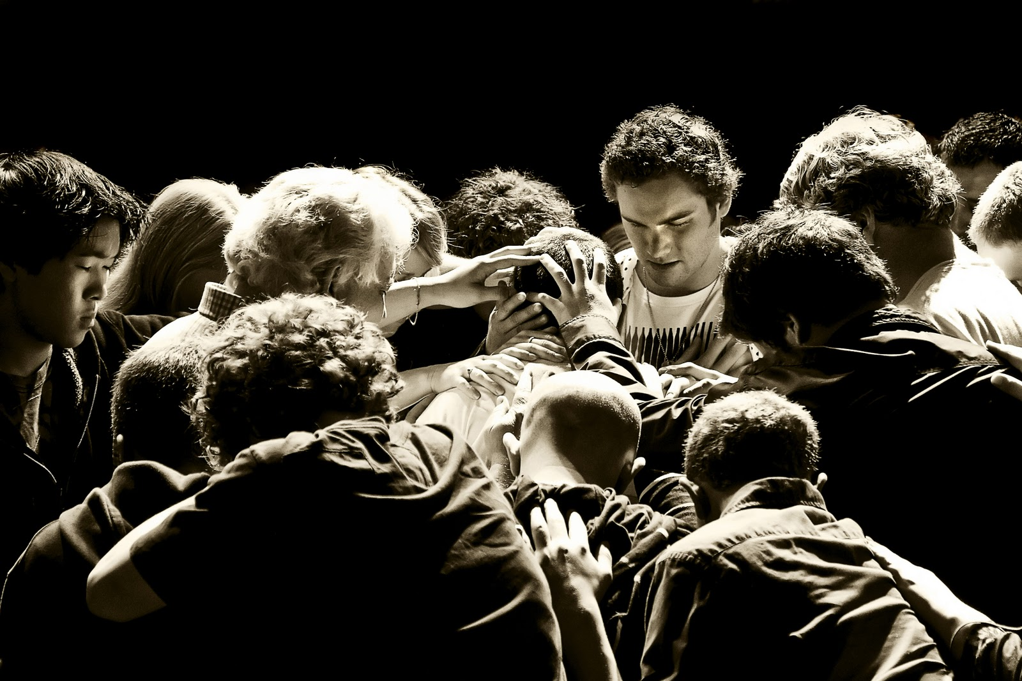
James 5:16, 17
Therefore confess your sins to each other and pray for each other so that you may be healed. The prayer of a righteous person is powerful and effective.

Slide 35
Romans 3:10—
There is none righteous, no not one.
I John 1:9—
If we confess our sins, he is faithful and just to forgive us our sins and to cleanse us from all unrighteousness.

Slide 36
Psalm 139:23-24
Search me, O God, and know my heart; try me, and know my anxieties; and see if there is any wicked way in me, and lead me in the way everlasting.

Slide 37
Philippians 4:6-7
Don’t worry about anything; instead pray about everything, tell God your needs and don’t forget to thank Him for His answers. If you do this you will experience God’s peace, which is far more wonderful than the human mind can understand. His peace will keep your thoughts and your hearts quiet and at rest as you trust in Christ Jesus.

Slide 38
Psalm 145:18, 19
The Lord is near all who call out to Him, all who call out to Him with integrity. He fulfills the desires of those who fear Him. He hears their cry for help and saves them.

Slide 39
2 Corinthians 2:5-7
If anyone has caused grief, he has not so much grieved me as he has grieved all of you, to some extent—not to put it too severely. The punishment inflicted on him by the majority is sufficient for him. Now instead, you ought to forgive and comfort him, so that he will not be overwhelmed by excessive sorrow. I urge you, therefore, to reaffirm your love for him.

Slide 40
Galatians 5:1
It was for freedom that Christ set us free.

Slide 41
Ephesians 1:15-20
Therefore I also, after I heard of your faith in the Lord Jesus and your love for all the saints, do not cease to give thanks for you, making mention of you in my prayers; that the God of our Lord Jesus Christ, the Father of glory, may give to you the spirit of wisdom and revelation in the knowledge of Him…

Slide 42
Ephesians 1:15-20
…the eyes of your understanding being enlightened; that you may know what is the exceeding greatness of His power toward us who believe, according to the working of His mighty power which He worked in Christ when he raised Him from the dead and seated Him at His right hand in the heavenly places.

Slide 43
Romans 5:1,2
Therefore, since we have been justified through faith, we have peace with God through our Lord Jesus Christ, through whom we have gained access by faith into this grace in which we now stand.

Slide 44
Romans 3:23
For all have sinned and fall short of the glory of God.
Romans 6:23
For the wages of sin is death, but the gift of God is eternal life in Jesus Christ our Lord.

Slide 45
John 3:16
For God so loved the world that he gave his only son, that whoever believes in him shall have eternal life.

Slide 46
John 14:27
Peace I leave with you; my peace I give you; I do not give to you as the world gives. Do not let your hearts be troubled and do not be afraid.

Slide 47
John 16:33
I have told you these things, so that in me you may have peace. In this world you will have trouble. But take heart! I have overcome the world.

Slide 48
Colossians 3:15-17
Let the peace of Christ rule in your hearts, since as members of one body you were called to peace. And be thankful. Let the word of Christ dwell in you richly as you teach and admonish one another with all wisdom and as you sing psalm, hymns and spiritual songs with gratitude in your hearts to God.

Slide 49
Colossians 3:15-17
And whatever you do, whether in word or deed, do it all in the name of the Lord Jesus, giving thanks to God the Father through him.

Slide 50
Ephesians 3:12
In him and through faith in him, ________ may approach God with freedom and confidence.
Psalm 20:4
May he give __________ the desires of his/her heart and make all his/her plans succeed.

Slide 51
Psalm 40:2
He lifted _______ out of the pit of despair, out of the mud and mire.
He set ________’s feet on solid ground and steadied him/her as he/she walked along.

Slide 52
Psalm 18:30
As for God, His way is perfect:
The word of Jehovah is tried;
He is a shield unto __________ who takes refuge in Him.

Slide 53
Psalm 55:22
_______, case your burden on the Lord and He will sustain you.
Psalm 143:1
Lord, hear _________’s prayer. Listen to _________’s cry for mercy. Come to help _________ because of you are loyal and good.

Slide 54
Psalm 92:4
For you, O Lord, have made _________ glad by what You have done. ________ will sing for joy at the works of your hands.
3 John 2
Dear ________, I pray that you may enjoy good health and that all may go well with you, even as your soul is getting along well.

Slide 55
3 John 4
I have no greater joy than to hear that my [grand]children are walking in the truth.
2 Corinthians 5:17
Therefore, if _______ is in Christ, ______ is a new creature. The old things passed away; behold, new things have come.

Slide 56
Ezekiel 36:26
I will give _________ a new heart and put a new spirit within him/her. I will remove _______’s heart of stone and give ______ a heart of flesh.

Slide 57
John 8:31, 32
The Jesus said to _______ who believed Him, “If _______ abides in my word, _______ is my disciple indeed. And _______ shall know the truth and the truth shall make _______ free.

Slide 58
Ephesians 3:16-19
I pray that out of his glorious riches he may strengthen you with power through his Spirit in your inner being so that Christ may dwell in your hearts through faith. And I pray that you, being rooted and established in love, may have power, together with all the saints, to grasp…

Slide 59
Ephesians 3:16-19
…how wide and long and high and deep is the love of Christ, and to know this love that surpasses knowledge—that you may be filled to the measure of all the fullness of God.

Slide 60
