Slide 1
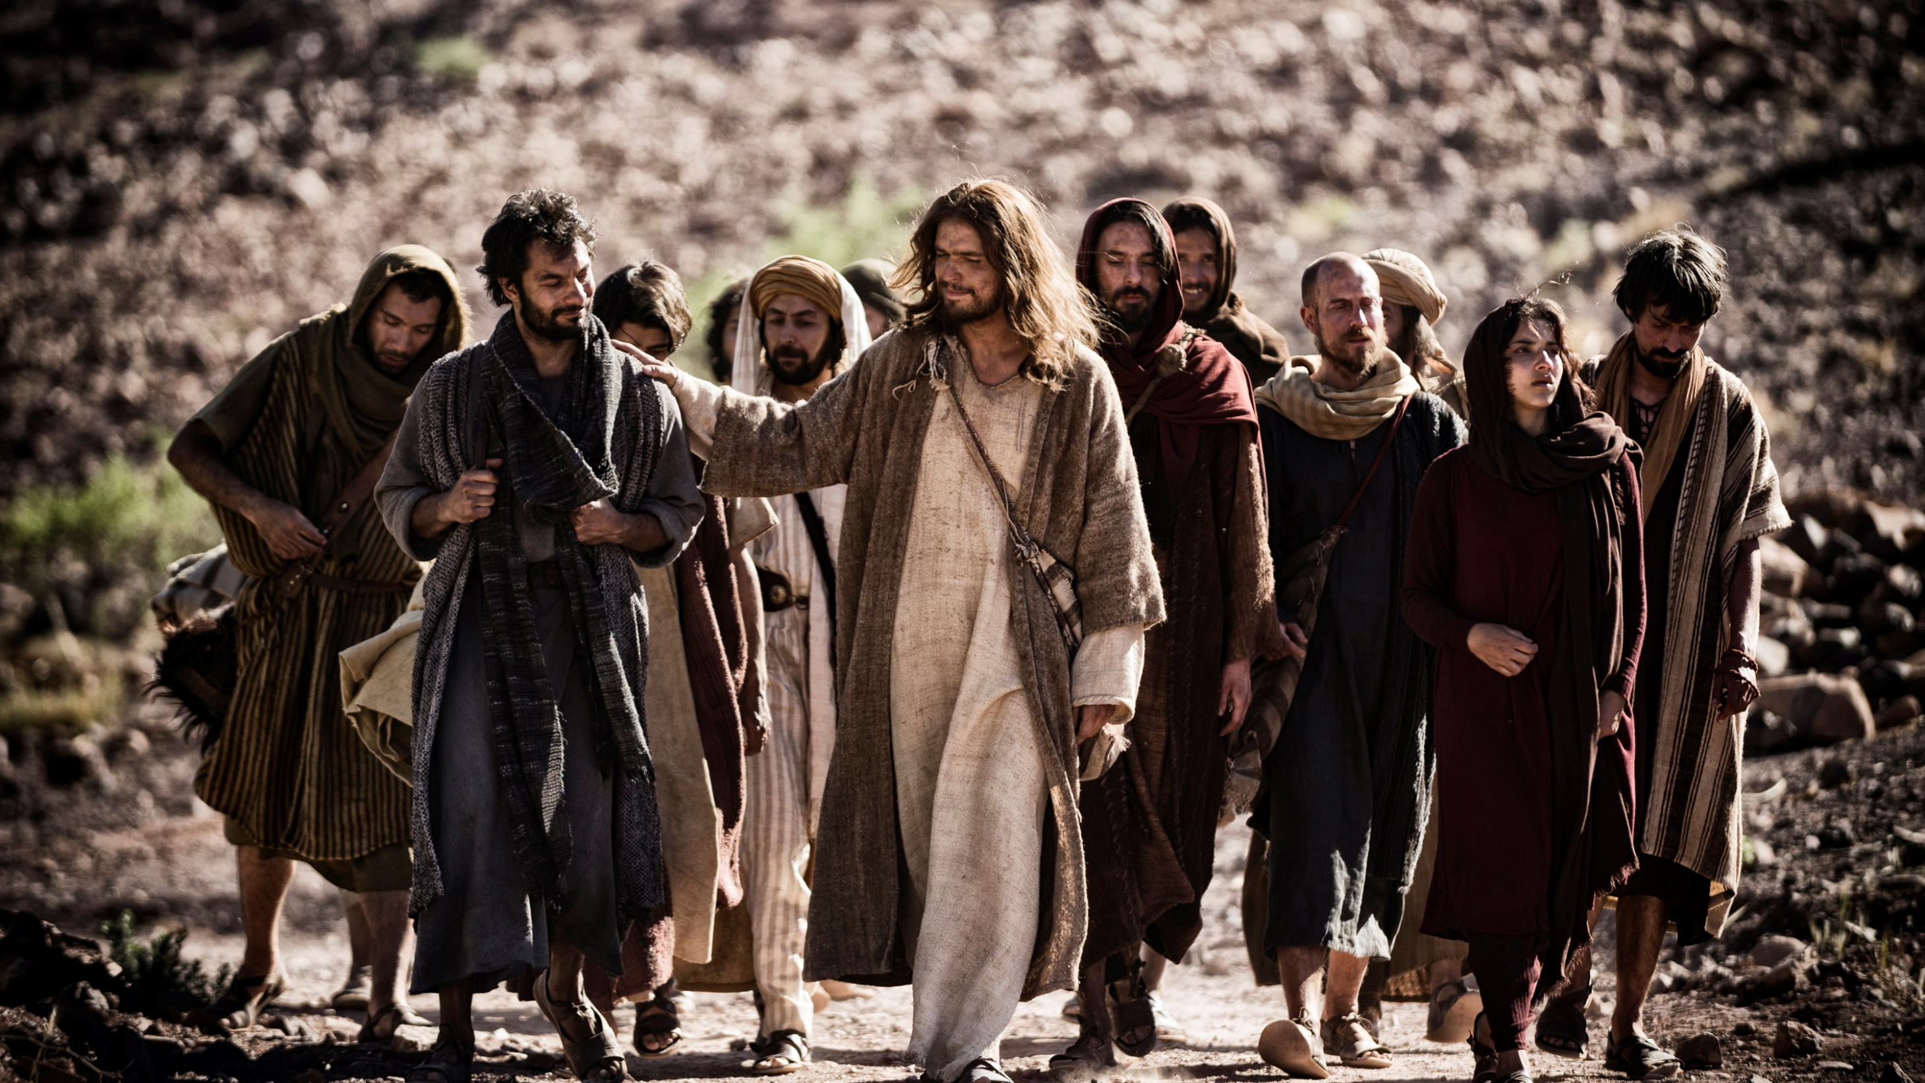

Slide 2
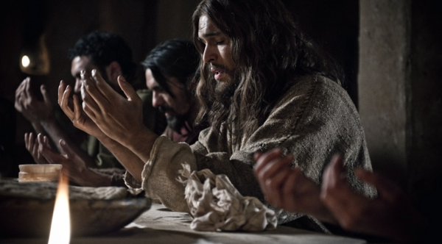
John 17:6-19

Slide 3
“I have revealed you to those whom you gave me out of the world.” – John 17:6

Slide 4
Who did you reveal this week to the people around you?

Slide 5
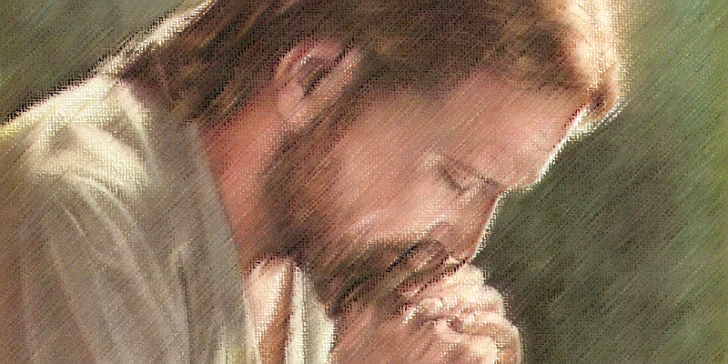

Slide 6
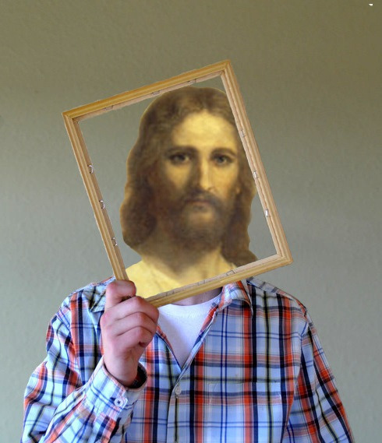
Make Jesus known through me!

Slide 8
John 17:6—
“I have revealed you to those whom you gave me out of the world. They were yours; you gave them to me….”
Vs. 6—“I have revealed you to those whom you gave me out of the world. They were yours; you gave them to me….”

Slide 9
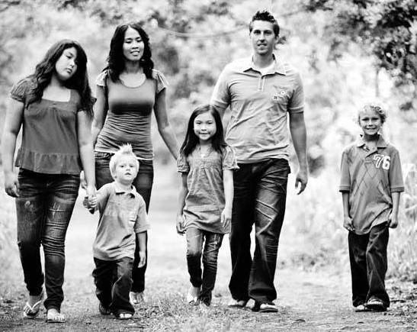
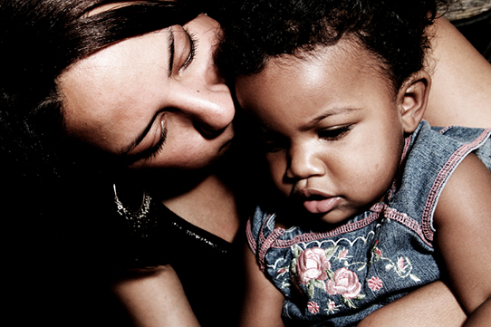
Who has God given YOU to shepherd?

Slide 10
John 17:6b— “They were yours; you gave them to me and they have obeyed your word.”

Slide 11
John 17:7— Now they know that everything you have given me comes from you. For I gave them the words you gave me and they accepted them. They knew with certainty that I came from you, and they believed that you sent me.

Slide 12
James 1:17— “Every good and perfect gift is from above, coming down from the Father of the heavenly lights, who does not change like shifting shadows.”

Slide 13
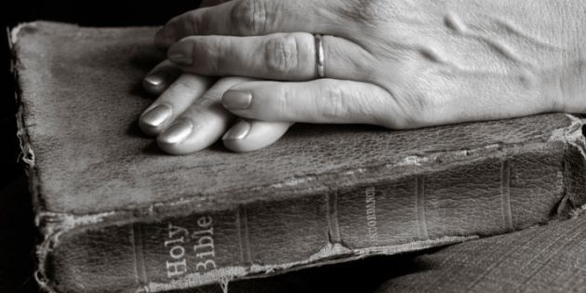
Test everything
through
the filter of God’s word.

Slide 14
John 17:9 “I pray for them. I am not praying for the world, but for those you have given me, for they are yours.

Slide 15
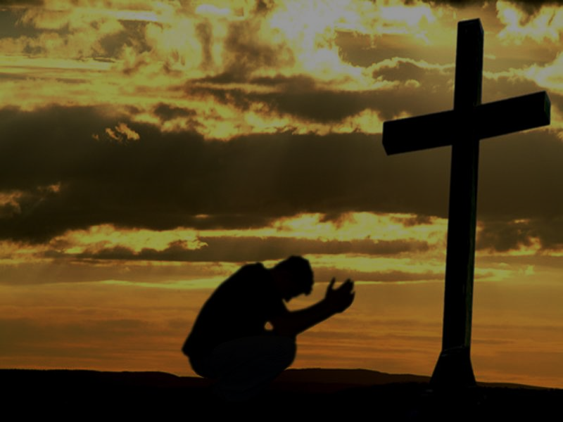
John 17:10 “All I have is yours, and all you have is mine. And glory has come to me through them.”

Slide 16
John 17:11 & 12 “I will remain in the world no longer, but they are still in the world, and I am coming to you. Holy Father, protect them by the power of your name, the name you gave me, so that they may be one as we are one. ¹² While I was with them, I protected them and kept them safe by that name you gave me. None has been lost except the one doomed to destruction so that Scripture would be fulfilled.”

Slide 17
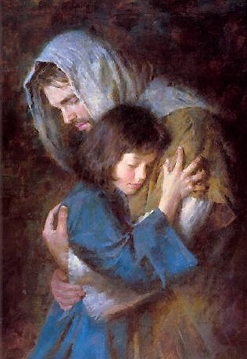
I Corinthians 1:8 & 9 He will also keep you firm to the end, so that you will be blameless on the day of our Lord Jesus Christ. ⁹ God is faithful, who has called you into fellowship with his Son, Jesus Christ our Lord.

Slide 18
I Thessalonians 5:23, 24 ²³ May God himself, the God of peace, sanctify you through and through. May your whole spirit, soul and body be kept blameless at the coming of our Lord Jesus Christ. ²⁴ The one who calls you is faithful, and he will do it.

Slide 19
2 Thessalonians 3:3 But the Lord is faithful, and he will strengthen you and protect you from the evil one.

Slide 20
Jude 24 & 25 To him who is able to keep you from stumbling and to present you before his glorious presence without fault and with great joy— ²⁵ to the only God our Savior be glory, majesty, power and authority, through Jesus Christ our Lord, before all ages, now and forevermore! Amen.

Slide 21
John 17:11 Holy Father, protect them by the power of your name, the name you gave me, so that they may be one as we are one.

