Slide 1
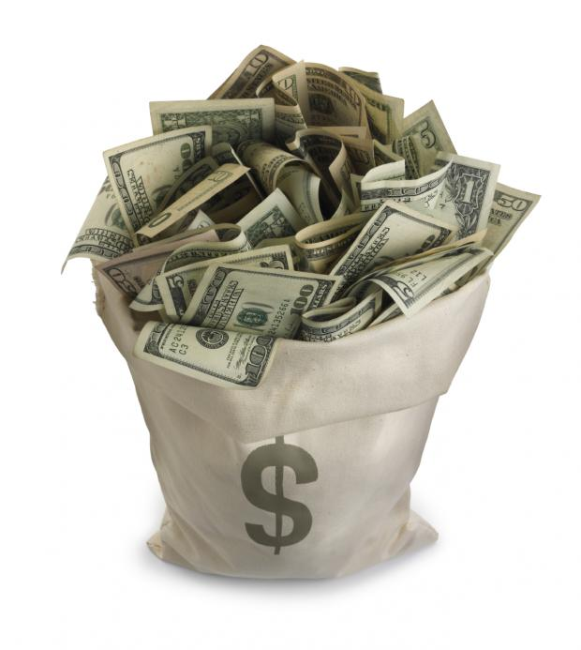
If you were loaned $10,000 and told to make as much return on that money as possible in the next 5 years, what would you do to invest it well?

Slide 2
PARABLE of DIVINE INVESTING Matthew 15:14-30

Slide 3
God has entrusted every one of us with resources to invest.

Slide 4
Matthew 25:14-30 “Again, it [the kingdom of heaven] will be like a man going on a journey, who called his servants and entrusted his wealth to them. ¹⁵ To one he gave five bags of gold, to another two bags, and to another one bag, each according to his ability. Then he went on his journey.

Slide 5
Matthew 25:14-30 ¹⁶ The man who had received five bags of gold went at once and put his money to work and gained five bags more. ¹⁷ So also, the one with two bags of gold gained two more. ¹⁸ But the man who had received one bag went off, dug a hole in the ground and hid his master’s money.

Slide 6
Matthew 25:14-30 ¹⁹ “After a long time the master of those servants returned and settled accounts with them. ²⁰ The man who had received five bags of gold brought the other five. ‘Master,’ he said, ‘you entrusted me with five bags of gold. See, I have gained five more.’ ²¹ “His master replied, ‘Well done, good and faithful servant! You have been faithful with a few things; I will put you in charge of many things. Come and share your master’s happiness!’

Slide 7
Matthew 25:14-30 ²² “The man with two bags of gold also came. ‘Master,’ he said, ‘you entrusted me with two bags of gold; see, I have gained two more.’ ²³ “His master replied, ‘Well done, good and faithful servant! You have been faithful with a few things; I will put you in charge of many things. Come and share your master’s happiness!’

Slide 8
Matthew 25:14-30 ²⁴ “Then the man who had received one bag of gold came. ‘Master,’ he said, ‘I knew that you are a hard man, harvesting where you have not sown and gathering where you have not scattered seed. ²⁵ So I was afraid and went out and hid your gold in the ground. See, here is what belongs to you.’

Slide 9
Matthew 25:14-30 ²⁶ “His master replied, ‘You wicked, lazy servant! So you knew that I harvest where I have not sown and gather where I have not scattered seed? ²⁷ Well then, you should have put my money on deposit with the bankers, so that when I returned I would have received it back with interest.

Slide 10
Matthew 25:14-30 ²⁸ “‘So take the bag of gold from him and give it to the one who has ten bags. ²⁹ For whoever has will be given more, and they will have an abundance. Whoever does not have, even what they have will be taken from them. ³⁰ And throw that worthless servant outside, into the darkness, where there will be weeping and gnashing of teeth.’

Slide 11
Matthew 25:14 “Again, it [the kingdom of heaven] will be like a man going on a journey, who called his servants and entrusted his wealth to them.”

Slide 12
Vs. 30—”And throw that worthless servant outside, into the darkness, where there will be weeping and gnashing of teeth.”
WHO are the “servants”? Sinners? Saints? Or both?
Similarity of all three parables in Matthew 25—Parable of the 10 Virgins; Parable of the Bags of Gold; Parable of the Sheep & the Goats

Slide 13
Ephesians 2:8-10 For it is by grace you have been saved, through faith—and this is not from yourselves, it is the gift of God— ⁹ not by works, so that no one can boast. ¹⁰ For we are God’s handiwork, created in Christ Jesus to do good works, which God prepared in advance for us to do.

Slide 14
Romans 3:24—“All are justified freely by his grace through the redemption that came by Christ Jesus.”
Romans 3:28—“For we maintain that a person is justified by faith apart from the works of the law.”
Romans 5:1—“Therefore, since we have been justified through faith, we have peace with God through our Lord Jesus Christ….”

Slide 15
Galatians 2:16—“ Know that a person is not justified by the works of the law, but by faith in Jesus Christ. So we, too, have put our faith in Christ Jesus that we may be justified by faith in Christ and not by the works of the law, because by the works of the law no one will be justified.”
Galatians 3:11—“Clearly no one who relies on the law is justified before God, because “the righteous will live by faith.”

Slide 16
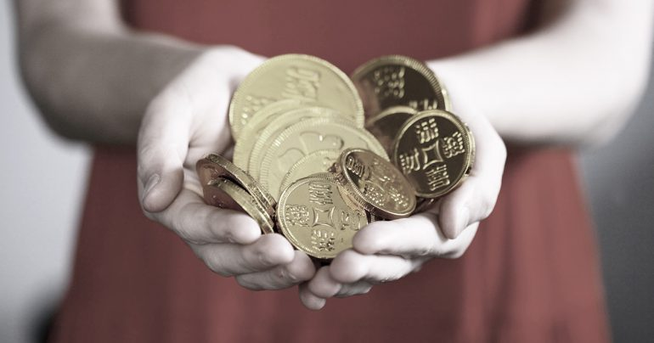
Matthew 25:14 “Again, it [the kingdom of heaven] will be like a man going on a journey, who called his servants and entrusted his wealth to them.”

Slide 17
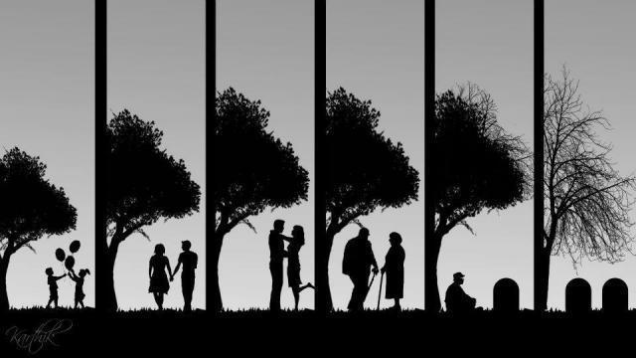
What does this wealth signify?

Slide 18
Matthew 25:15 “To one he gave five bags of gold, to another two bags, and to another one bag, each according to his ability.”

Slide 19
Matthew 25 ¹⁶ The man who had received five bags of gold went at once and put his money to work and gained five bags more. ¹⁷ So also, the one with two bags of gold gained two more. ¹⁸ But the man who had received one bag went off, dug a hole in the ground and hid his master’s money.

Slide 20
URGENCY… TOTALITY… LONGEVITY…

Slide 21
URGENCY… TOTALITY… LONGEVITY…

Slide 22
URGENCY… TOTALITY… LONGEVITY…

Slide 23
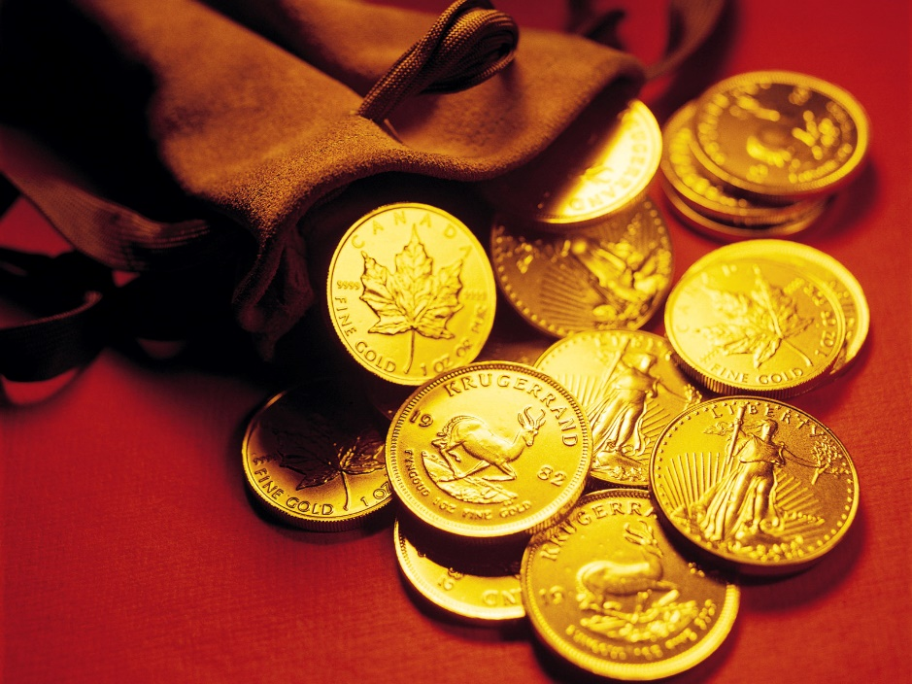
What ‘golden currency’ are we given in life to spend?
Opportunities
Spiritual Gifting
Income
Work life
Retirement
Skills
People
Time
Home
Health

Slide 24
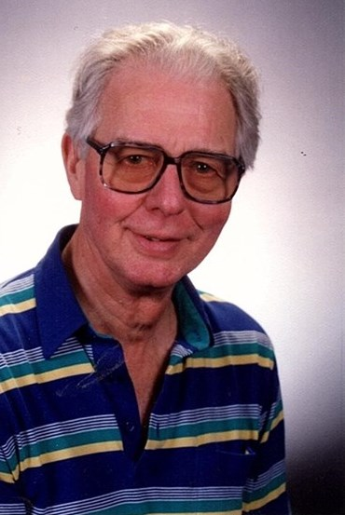
LONGEVITY…
Dick Shanks
March 10, 1923 – April 25, 2018

Slide 25
Matthew 25:14-30 ¹⁹ “After a long time the master of those servants returned and settled accounts with them.”
2 Corinthians 5:10
“For we must all appear before the judgment
seat of Christ, so that each of us may receive what is due us for the things done while in the body, whether good or bad.”

Slide 26
Revelation 20:12-13 “…the dead were judged according to what they had done as recorded in the books…each person was judged according to what they had done.”

Slide 27
Matthew 25:21 “His master replied, ‘Well done, good and faithful servant! You have been faithful with a few things; I will put you in charge of many things. Come and share your master’s happiness!’

Slide 28
1st Corinthians 2:9 That is what the Scriptures mean when they say, “No eye has seen, no ear has heard, and no mind has imagined what God has prepared for those who love him.”

Slide 29
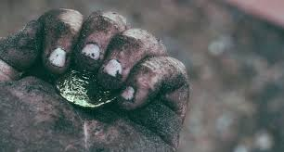
What have YOU decided to do with the life God has given you?

