Slide 1
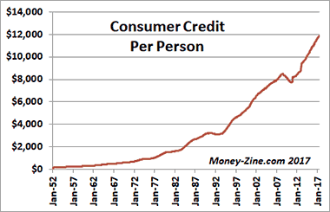
80 % of Americans
Average Credit Card Debt in America per household: $15,654

Slide 2
Average mortgage debt: $196,014
Average College Student Loan Debt: $37,173

Slide 3
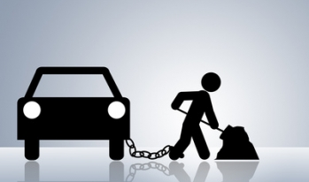
Auto loan debt: $30,534
Payday Loans: 400-700% APR

Slide 4
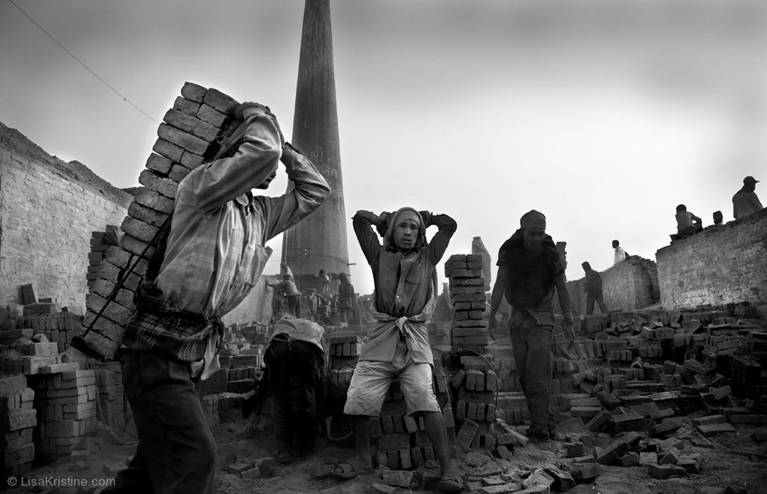
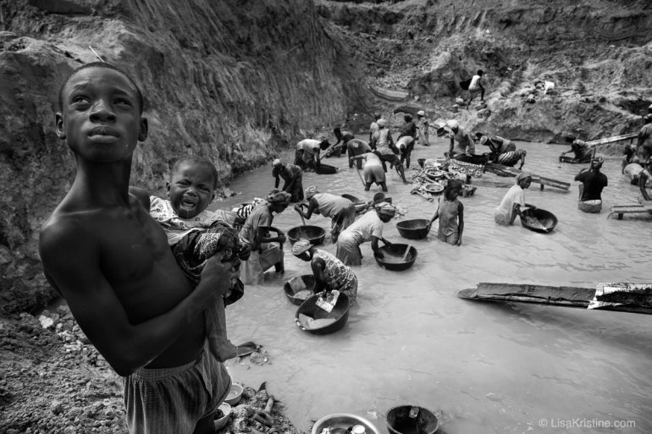

Slide 5
Matthew 18 ²¹ Then Peter came to Jesus and asked, “Lord, how many times shall I forgive my brother or sister who sins against me? Up to seven times?” ²² Jesus answered, “I tell you, not seven times, but seventy-seven times.

Slide 6
Matthew 18 ²³ “Therefore, the kingdom of heaven is like a king who wanted to settle accounts with his servants. ²⁴ As he began the settlement, a man who owed him ten thousand bags of gold was brought to him. ²⁵ Since he was not able to pay, the master ordered that he and his wife and his children and all that he had be sold to repay the debt.

Slide 7
Matthew 18 ²⁶ “At this the servant fell on his knees before him. ‘Be patient with me,’ he begged, ‘and I will pay back everything.’ ²⁷ The servant’s master took pity on him, canceled the debt and let him go. ²⁸ “But when that servant went out, he found one of his fellow servants who owed him a hundred silver coins. He grabbed him and began to choke him. ‘Pay back what you owe me!’ he demanded.

Slide 8
Matthew 18 ²⁹ “His fellow servant fell to his knees and begged him, ‘Be patient with me, and I will pay it back.’ ³⁰ “But he refused. Instead, he went off and had the man thrown into prison until he could pay the debt. ³¹ When the other servants saw what had happened, they were outraged and went and told their master everything that had happened.

Slide 9
Matthew 18 ³² “Then the master called the servant in. ‘You wicked servant,’ he said, ‘I canceled all that debt of yours because you begged me to. ³³ Shouldn’t you have had mercy on your fellow servant just as I had on you?’ ³⁴ In anger his master handed him over to the jailers to be tortured, until he should pay back all he owed. ³⁵ “This is how my heavenly Father will treat each of you unless you forgive your brother or sister from your heart.”

Slide 10
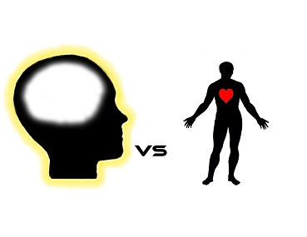

Slide 11
Matthew 18 ²¹ Then Peter came to Jesus and asked, “Lord, how many times shall I forgive my brother or sister who sins against me? Up to seven times?”
²² Jesus answered, “I tell you, not seven times, but seventy-seven times.”

Slide 12
Matthew 18 ²³ “Therefore, the kingdom of heaven is like a king who wanted to settle accounts with his servants.

Slide 13
Matthew 18 ²³ “Therefore, the kingdom of heaven is like a king who wanted to settle accounts with his servants. ²⁴ As he began the settlement, a man who owed him ten thousand bags of gold was brought to him. ²⁵ Since he was not able to pay, the master ordered that he and his wife and his children and all that he had be sold to repay the debt.

Slide 14
What is the debtor’s emotional state now?

Slide 15
Matthew 18 ²⁶ “At this the servant fell on his knees before him. ‘Be patient with me,’ he begged, ‘and I will pay back everything.’

Slide 16
Matthew 18 ²⁶ “At this the servant fell on his knees before him. ‘Be patient with me,’ he begged, ‘and I will pay back everything.’ ²⁷ The servant’s master took pity on him, canceled the debt and let him go.
Master’s emotion?
Debtor’s emotion?

Slide 17
Matthew 18 ²⁸ “But when that servant went out, he found one of his fellow servants who owed him a hundred silver coins. He grabbed him and began to choke him. ‘Pay back what you owe me!’ he demanded.” ²⁹ “His fellow servant fell to his knees and begged him, ‘Be patient with me, and I will pay it back.’ ³⁰ “But he refused. Instead, he went off and had the man thrown into prison until he could pay the debt.

Slide 18
Our treatment of others is the most accurate measure of how much of God’s treatment of us we have actually embraced.

Slide 19
Matthew 18 ³² “Then the master called the servant in. ‘You wicked servant,’ he said, ‘I canceled all that debt of yours because you begged me to. ³³ Shouldn’t you have had mercy on your fellow servant just as I had on you?’ ³⁴ In anger his master handed him over to the jailers to be tortured, until he should pay back all he owed.

Slide 20
What God does for us and extends to us is never just about us.

Slide 21
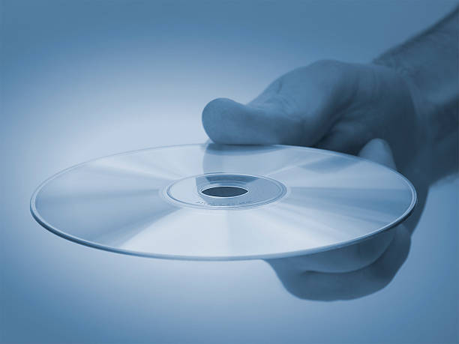

Slide 23
2 things to pray about in a word: 1.) The sins OTHERS have forgiven us of… 2.) The sins WE have forgiven others of.

