Slide 1
ACTS 13 ¹ Now in the church at Antioch there were prophets and teachers: Barnabas, Simeon called Niger, Lucius of Cyrene, Manaen (who had been brought up with Herod the tetrarch) and Saul. ² While they were worshiping the Lord and fasting, the Holy Spirit said, “Set apart for me Barnabas and Saul for the work to which I have called them.” ³ So after they had fasted and prayed, they placed their hands on them and sent them off.

Slide 2
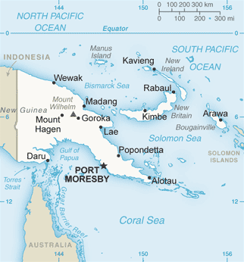
Papua New Guinea

Slide 3
CHRIST ENCOUNTERS

Slide 5
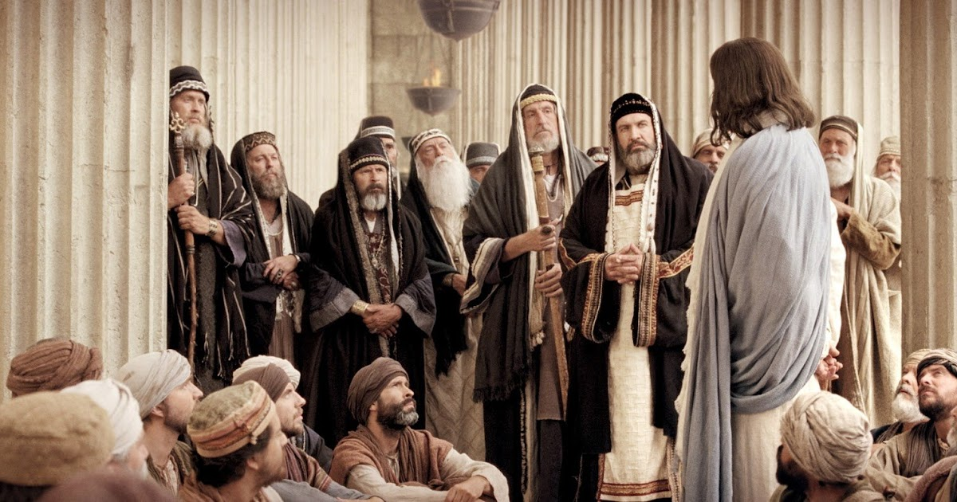

Slide 6
John 15:20 “‘A servant is not greater than his master.’ If they persecuted me, they will persecute you also. If they obeyed my teaching, they will obey yours also.”

Slide 7
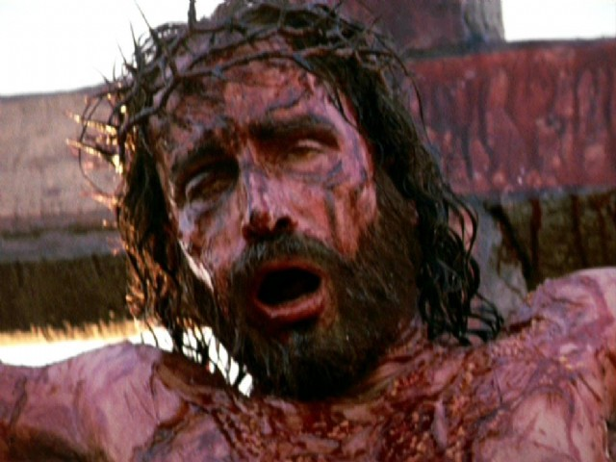
“Father, forgive them for they don’t know what they are doing.” (Luke 23:34)

Slide 8
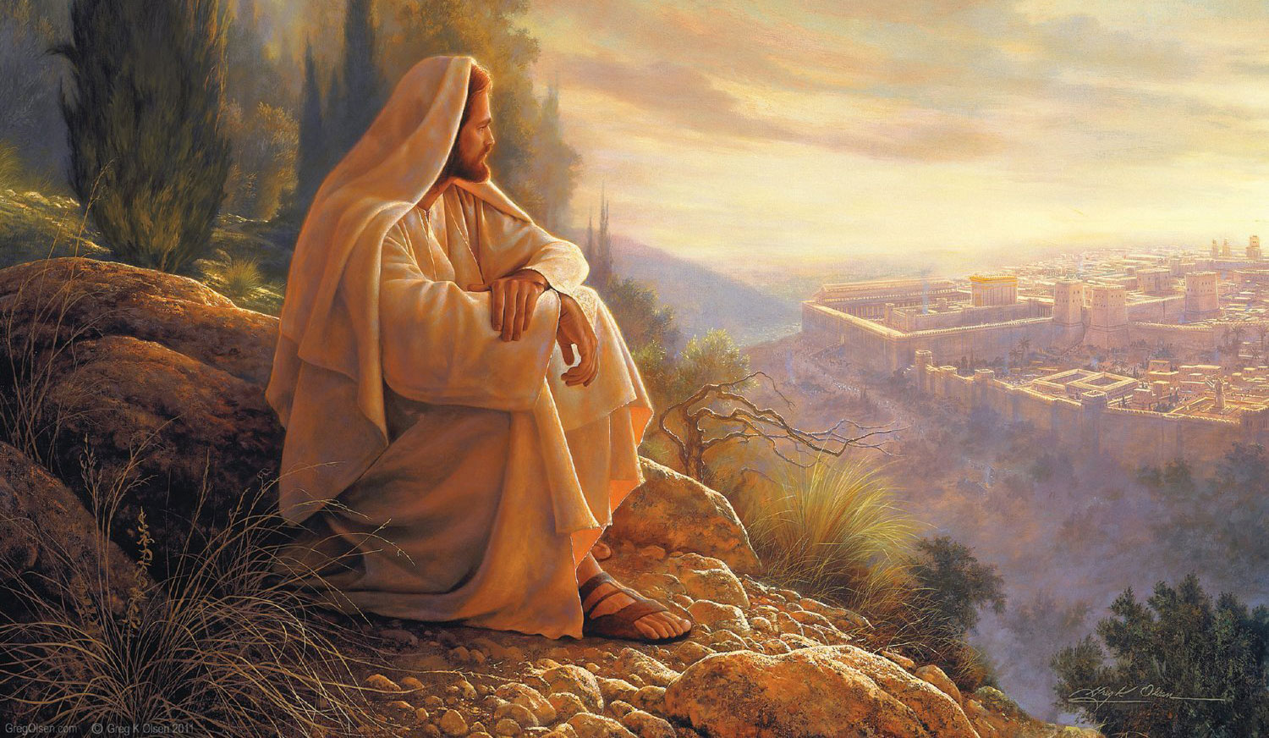

Slide 9
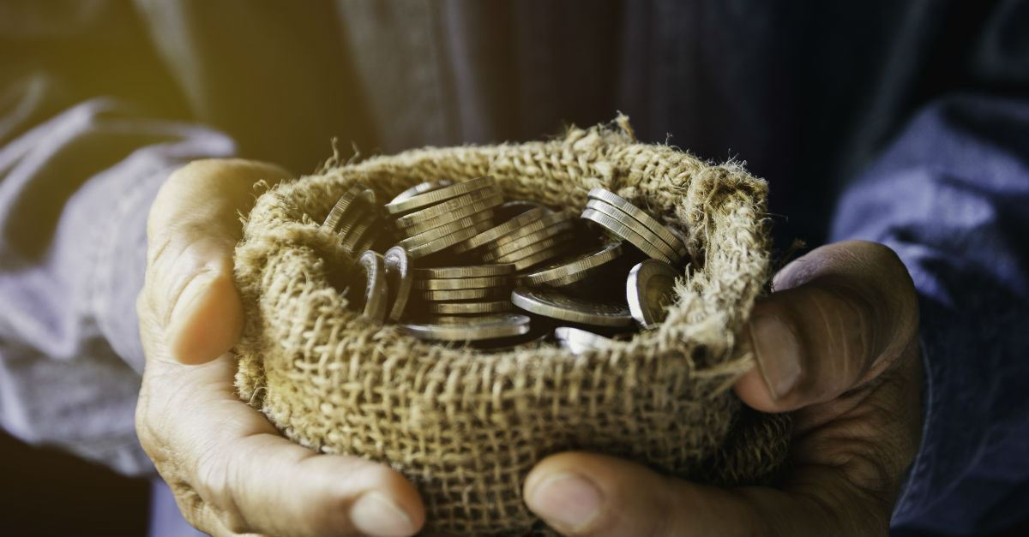

Slide 10
Luke 7 ²⁹ (All the people, even the tax collectors, when they heard Jesus’ words, acknowledged that God’s way was right, because they had been baptized by John. ³⁰ But the Pharisees and the experts in the law rejected God’s purpose for themselves, because they had not been baptized by John.)

Slide 11
John 8 ¹² When Jesus spoke again to the people, he said, “I am the light of the world. Whoever follows me will never walk in darkness, but will have the light of life.”

Slide 12
John 8:24 I told you that you would die in your sins; if you do not believe that I am he, you will indeed die in your sins.”
TRUTH #1: without embracing Jesus as the only possible Savior of their souls, people will spend eternity separated from God.

Slide 13
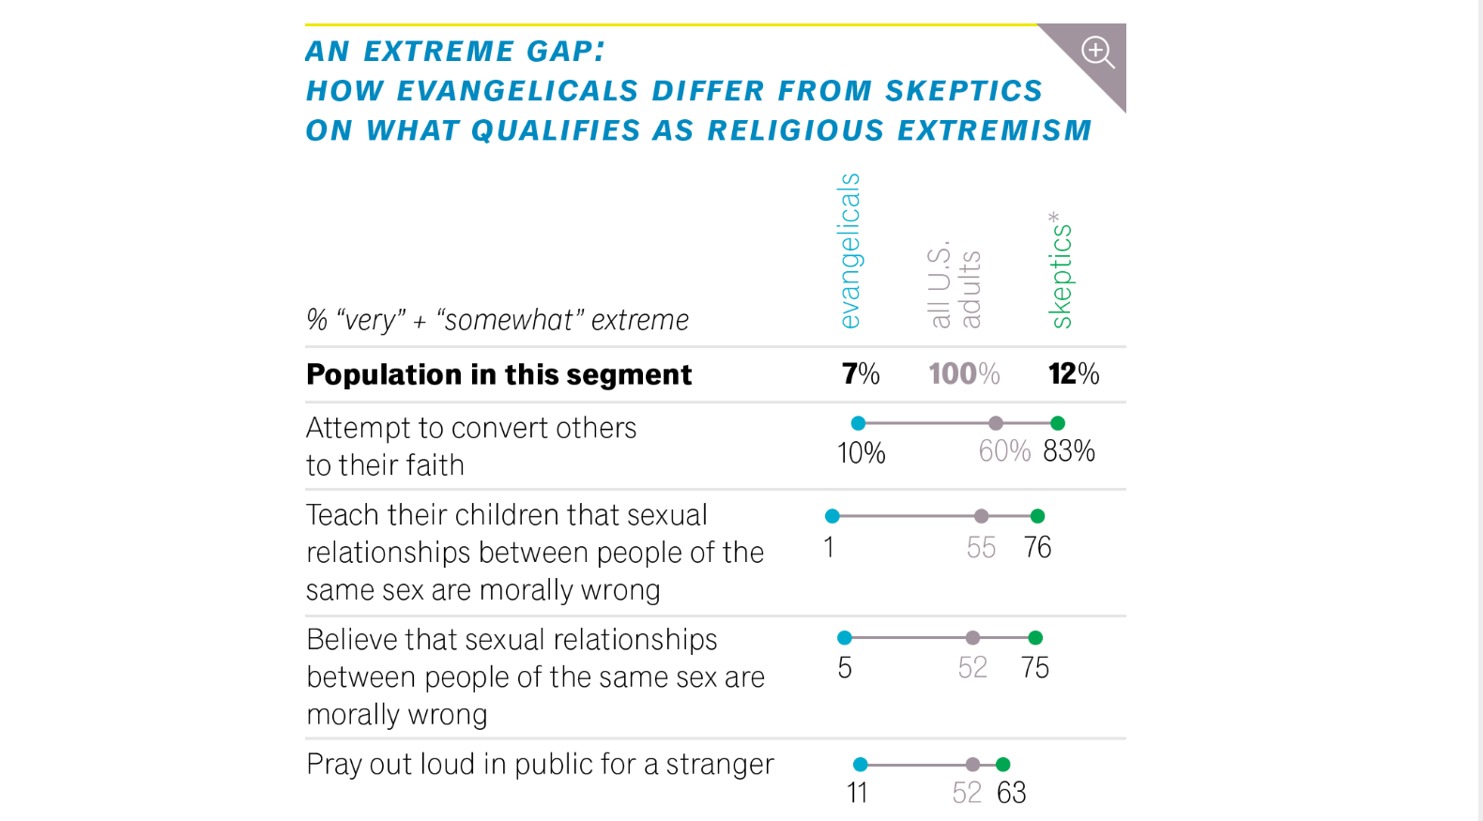

Slide 14
Things to help skeptics clarify:
The NATURE of GOD: “So you want a god like you, not one that is perfect in every way?”

Slide 15
Things to help skeptics clarify:
The NATURE of GOD: “So you want a god like you, not one that is perfect in every way?”
The NATURE of their ETERNAL DESTINY—Heaven or Hell

Slide 16
John 16:8 And when He [the Holy Spirit] has come, He will convict the world of sin, and of righteousness, and of judgment. [NKJV]

Slide 17
The cardinal rule of American culture:
NEVER say anything offensive to someone else…ESPECIALLY ABOUT THEIR SIN!

Slide 18
Apart from Jesus, we are slaves to sin.
John 8
³¹ To the Jews who had believed him, Jesus said, “If you hold to my teaching, you are really my disciples. ³² Then you will know the truth, and the truth will set you free.”
³³ They answered him, “We are Abraham’s descendants and have never been slaves of anyone. How can you say that we shall be set free?”

Slide 19
Apart from Jesus, we are slaves to sin.
John 8
³⁴ Jesus replied, “Very truly I tell you, everyone who sins is a slave to sin.”

Slide 20
Apart from Jesus, we are slaves to sin.
³⁴ Jesus replied, “Very truly I tell you, everyone who sins is a slave to sin.”
Romans 3:23—“All have sinned and fall short of God’s glorious standard.” [NLT]

Slide 21
John 8:44 You belong to your father, the devil, and you want to carry out your father’s desires.

Slide 23
NOT!

Slide 24
John 1:12-13 But as many as received Him, to them He gave the right to become children of God, to those who believe in His name: ¹³ who were born, not of blood, nor of the will of the flesh, nor of the will of man, but of God.

Slide 25
Jesus’ dealings with resistant people teach us to…
trust the Holy Spirit to convict of sin, righteousness and judgment.
be honest with people about what is at stake in rejecting Jesus.
communicate that a saving relationship with God is all about Jesus Christ.

Slide 26
A tool we have in sharing the Gospel:
…our sinfulness.

Slide 27
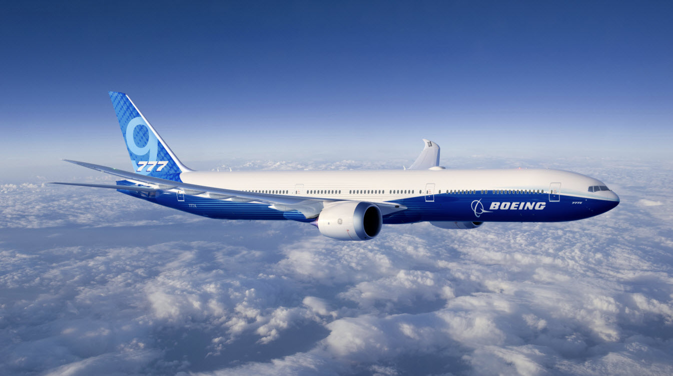
A tool we have in sharing the Gospel:
…our sinfulness.

Slide 28
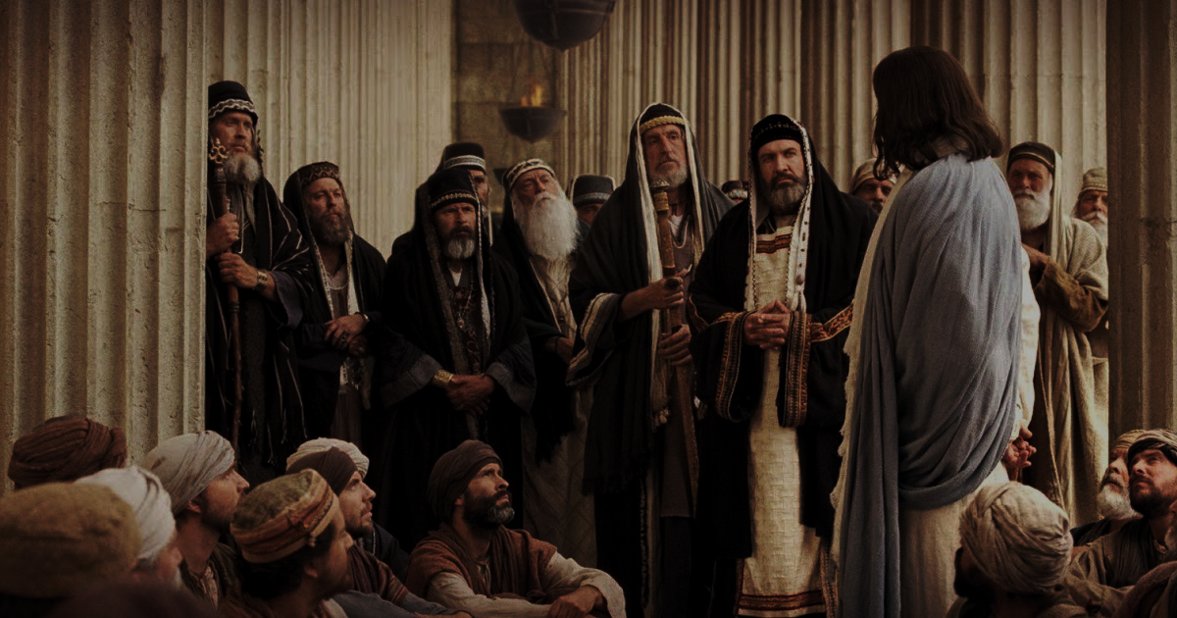
Have you put your faith in Jesus Christ alone?
Have you dedicated your life to sharing that reality with others?

