Slide 1
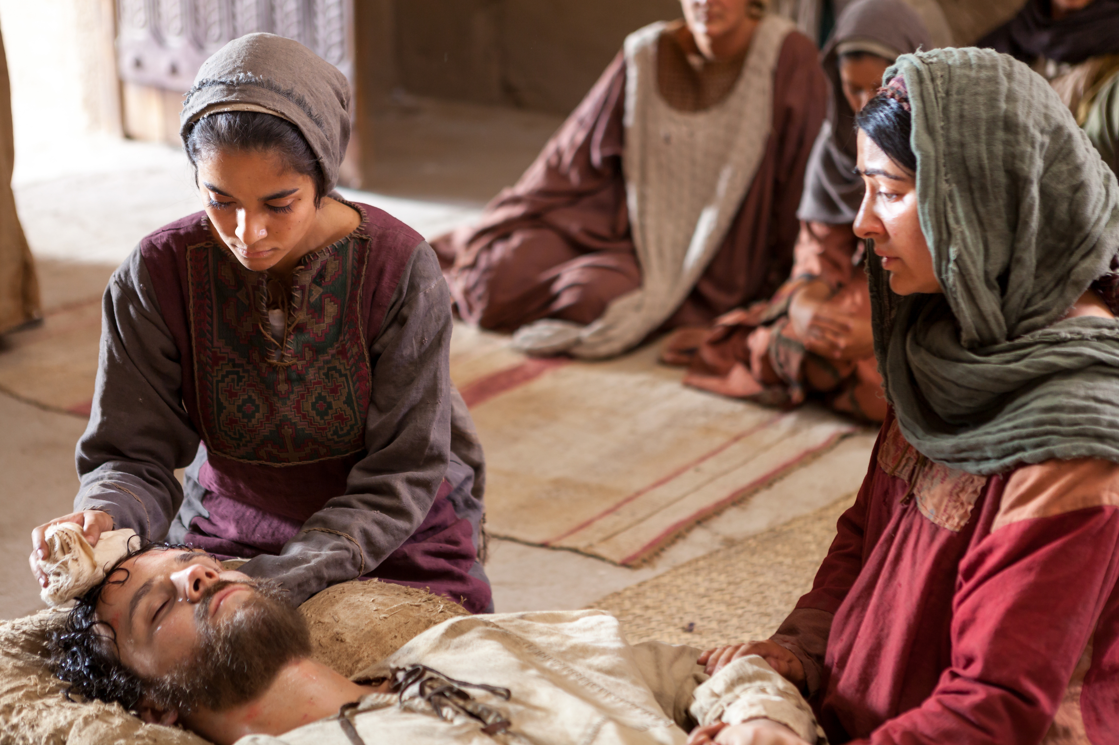
Series:
Christ Encounters
in the Gospels
John 11
“Crisis-Encounters with Christ”

Slide 2
JOHN 11 (NASV)
¹ Now a certain man was sick: Lazarus of Bethany, the village of Mary and her sister Martha. ² And it was the Mary who anointed the Lord with ointment, and wiped His feet with her hair, whose brother Lazarus was sick.

Slide 3
JOHN 11
³ So the sisters sent word to Him, saying, “Lord, behold, he whom You love is sick.” ⁴ But when Jesus heard this, He said, “This sickness is not meant for death, but is for the glory of God, so that the Son of God may be glorified by it.” ⁵ (Now Jesus loved Martha and her sister, and Lazarus.) ⁶ So when He heard that he was sick, He then stayed two days longer in the place where He was.

Slide 4
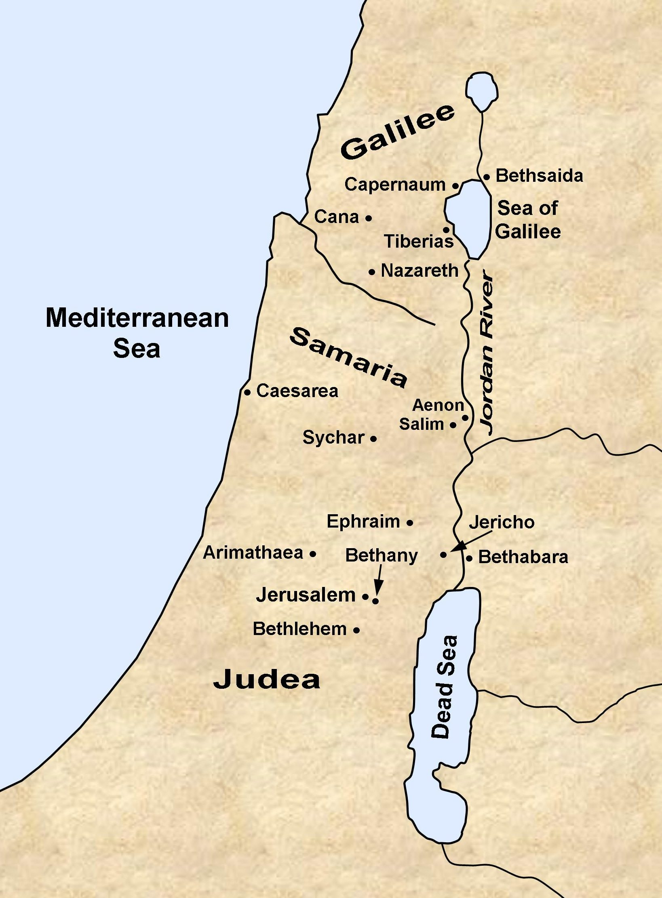

Slide 5
JOHN 11
³ So the sisters sent word to Him, saying, “Lord, behold, he whom You love is sick.” ⁴ But when Jesus heard this, He said, “This sickness is not meant for death, but is for the glory of God, so that the Son of God may be glorified by it.” ⁵ (Now Jesus loved Martha and her sister, and Lazarus.) ⁶ So when He heard that he was sick, He then stayed two days longer in the place where He was.

Slide 6
TRUTH #1
Our life crises are there ‘for the glory of God’…to make God’s greatness visible in our world.

Slide 7
Challenge
Sometime soon, write out your testimony that you want read at your funeral.

Slide 8
TRUTH #2
God’s delays are divine decisions, not divine disinterest.

Slide 9
TRUTH #3
Our crisis-produced Christ-encounters may have a much bigger audience than just us.

Slide 10
TRUTH #4
Crisis-encounters are meant by God to be fresh Christ-encounters.

Slide 11
Daniel Richie

Slide 12
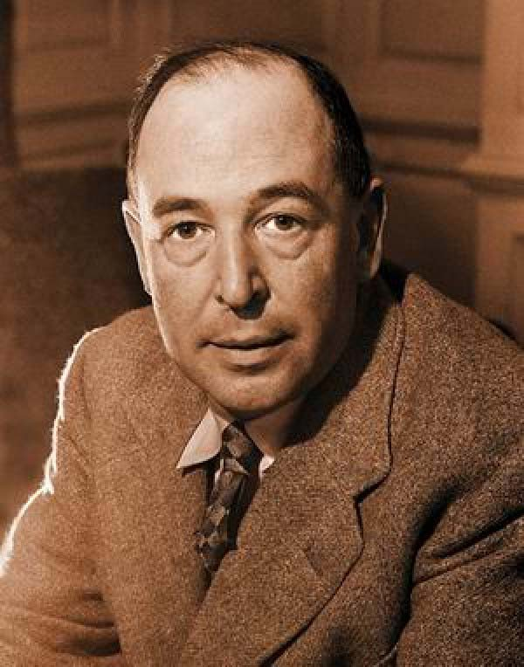
C.S. Lewis
“Pain insists upon being attended to. God whispers to us in our pleasures, speaks in our conscience, but shouts in our pain: it is His megaphone to rouse a deaf world.”

Slide 13
JOHN 11
¹⁷ So when Jesus came, He found that he had already been in the tomb four days. ¹⁸ Now Bethany was near Jerusalem, about fifteen stadia away; ¹⁹ and many of the Jews had come to Martha and Mary, to console them about their brother. ²⁰ So then Martha, when she heard that Jesus was coming, went to meet Him, but Mary stayed in the house.

Slide 14
TRUTH #5
Jesus wants to encounter us in our crises but He will not force his way into our pain.

Slide 15
Our response to God in any crisis is far more important than the crisis itself.

Slide 16
JOHN 11
²¹ Martha then said to Jesus, “Lord, if You had been here, my brother would not have died. ²² Even now I know that whatever You ask of God, God will give You.”

Slide 17
TRUTH #6
In the midst of crisis, look for the truths you can still affirm about Jesus.

Slide 18
JOHN 11
²³ Jesus said to her, “Your brother will rise from the dead.”

Slide 19
JOHN 11
²³ Jesus said to her, “Your brother will rise from the dead.” ²⁴ Martha said to Him, “I know that he will rise in the resurrection on the last day.”

Slide 20
TRUTH #7
Crisis encounters with Jesus will always call for FRESH FAITH.

Slide 21
JOHN 11
²⁵ Jesus said to her, “I am the resurrection and the life; the one who believes in Me will live, even if he dies, ²⁶ and everyone who lives and believes in Me will never die. Do you believe this?” ²⁷ She said to Him, “Yes, Lord; I have come to believe that You are the Christ, the Son of God, and He who comes into the world.”

Slide 22
JOHN 11
²⁸ When she had said this, she left and called Mary her sister, saying secretly, “The Teacher is here and is calling for you.” ²⁹ And when she heard this, she *got up quickly and came to Him.

Slide 23
TRUTH #7
Crisis encounters with Jesus will always call for FRESH FAITH.

Slide 24
TRUTH #8
Jesus wants to confirm His love for us during the worst times in life.

Slide 25
TRUTH #9
Don’t expect your encounter with Jesus in your crisis to follow an expected process.

Slide 27
TRUTH #10
Once you’ve experienced Jesus carrying you through your worst fears and crisis you will be able to let go of everything else you were counting on for security to worship Him as never before.

