Slide 1
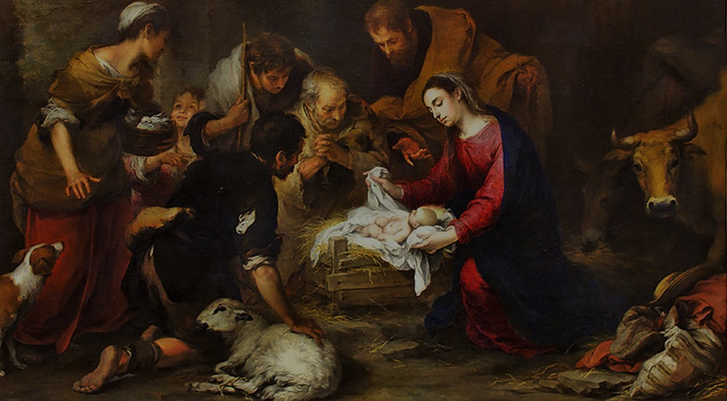
Christmas Through the Eyes of the Humble

Slide 2
Who were all the participants in the Advent of Jesus at His birth?

Slide 3
How many would you consider to be HUMBLE?

Slide 4
What’s your definition of

Slide 5
Webster’s Definition of Humility --freedom from pride or arrogance; --the quality or state of being humble.

Slide 6
Cambridge Dictionary: The quality of not being proud because you are aware of your bad qualities. The feeling or attitude that you have no special importance that makes you better than others. Lack of pride.

Slide 7
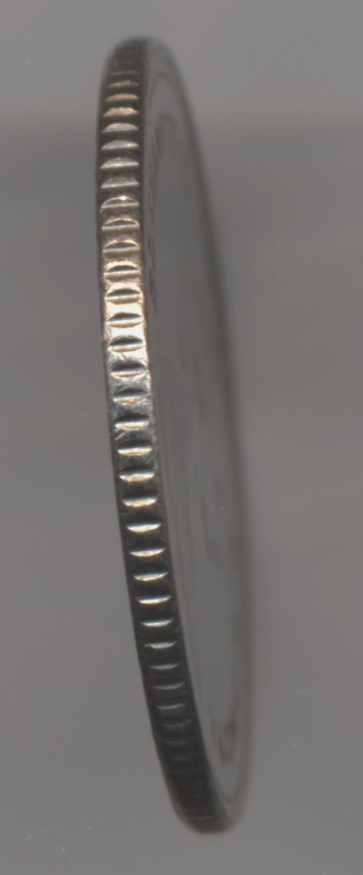
God’s side of the ‘coin’ of humility:
Humility is partially a work of God in the hearts of His people.
Deuteronomy 8:2 (also vs. 16)-- Remember how the Lord your God led you all the way in the wilderness these forty years, to humble and test you in order to know what was in your heart, whether or not you would keep his commands.

Slide 8
God’s side of the ‘coin’ of humility:
Humility is partially a work of God in the hearts of His people.
Matthew 11:29— Take my yoke upon you and learn from me, for I am gentle and humble in heart, and you will find rest for your souls.

Slide 9
2. Humility is something God sees and responds to in people with…
A. Salvation/deliverance:
2 Samuel 22:28-- You save the
humble, but your eyes are on the haughty to bring them low.

Slide 10
B. God responds with forgive-ness, justification & healing:
2 Chronicles 7:14-- If my people, who are called by my name, will humble
themselves and pray and seek my face and turn from their wicked ways, then I will hear from heaven, and I will forgive their sin and will heal their land.

Slide 11
B. God responds with forgiveness, justification & healing: Luke 18
¹³ “But the tax collector stood at a distance. He would not even look up to heaven, but beat his breast and said, ‘God, have mercy on me, a sinner.’ ¹⁴ “I tell you that this man, rather than the other, went home justified before God. For all those who exalt themselves will be humbled, and those who humble themselves will be exalted.”

Slide 12
C. God gives to the humble patience, love, compassion and unity.
I Peter 3:8-- Finally, all of you, be like-minded, be sympathetic, love one another, be compassionate and humble.
Ephesians 4:2-- Be completely humble
and gentle; be patient, bearing with one another in love.

Slide 13
D. God responds to humility with sustaining power & provision.
Psalm 147:6-- The Lord sustains the humble but casts the wicked to the ground.

Slide 14
E. God responds to the humble with Guidance:
Proverbs 25:9-- He guides the
humble in what is right and teaches them his way.

Slide 15
F. God responds to humility with favor/grace of God:
James 4:6-- But he gives us more grace. That is why Scripture says: “God opposes the proud but shows favor to the humble.”
Luke 1:48—For he [God] has been mindful of the humble state of his servant [Mary]. From now on all generations will call me blessed….”

Slide 16
From man’s side of the ‘coin’ of humility:
1. It is a choice we make:
Luke 14:11—“For all those who exalt themselves will be humbled, and those who humble themselves will be exalted.”

Slide 17
From man’s side of the ‘coin’ of humility:
It is a choice we make:
Luke 18:14—2 men—Temple praying
Ephesians 4:2 (& James 4:10)— Be completely humble and gentle; be patient, bearing with one another in love. It’s a command…and commands involve a choice of the will.

Slide 18
From man’s side of the ‘coin’ of humility:
2. Humility grows from a reverent fear of God:
Proverbs 22:4—Humility is the fear of the Lord; its wages are riches and honor and life.

Slide 19
From man’s side of the ‘coin’ of humility:
3. Humility respects God’s justice in judgment…and submits in hope
2 Chronicles 12:6—The leaders of Israel and the king humbled themselves and said, “The Lord is just.”

Slide 20
From man’s side of the ‘coin’ of humility:
4. Humility can be evidenced by acts of humiliation:
Fasting: Ezra 8:21-- There, by the Ahava Canal, I proclaimed a fast, so that we might humble ourselves before our God and ask him for a safe journey for us and our children, with all our possessions.

Slide 21
4. Humility can be evidenced by…
A. Fasting: Isaiah 58:5-7
“Is not this the kind of fasting I have chosen: to loose the chains of injustice and untie the cords of the yoke, to set the oppressed free and break every yoke? ⁷ Is it not to share your food with the hungry and to provide the poor wanderer with shelter—when you see the naked, to clothe them, and not to turn away from your own flesh and blood?”

Slide 22
4. Humility can be evidenced by…
B. Praying:
2 Chron. 7:14—If my people….
Dan. 10:12—3 weeks of praying!

Slide 23
4. Humility can be evidenced by…
C. Repentance:
2 Chronicles 34:27—“Because your heart was responsive and you humbled yourself before God when you heard what he spoke against this place and its people, and because you humbled yourself before me and tore your robes and wept in my presence, I have heard you,” declares the Lord.

Slide 24
4. Humility can be evidenced by…
D. Obedience:
Zephaniah 2:3—Seek the Lord, all you humble of the land, you who do what he commands. Seek righteousness, seek humility;
Deuteronomy 8:2—Remember how the Lord
your God led you all the way in the wilderness these forty years, to humble and test you in order to know what was in your heart, whether or not you would keep his commands.

Slide 25
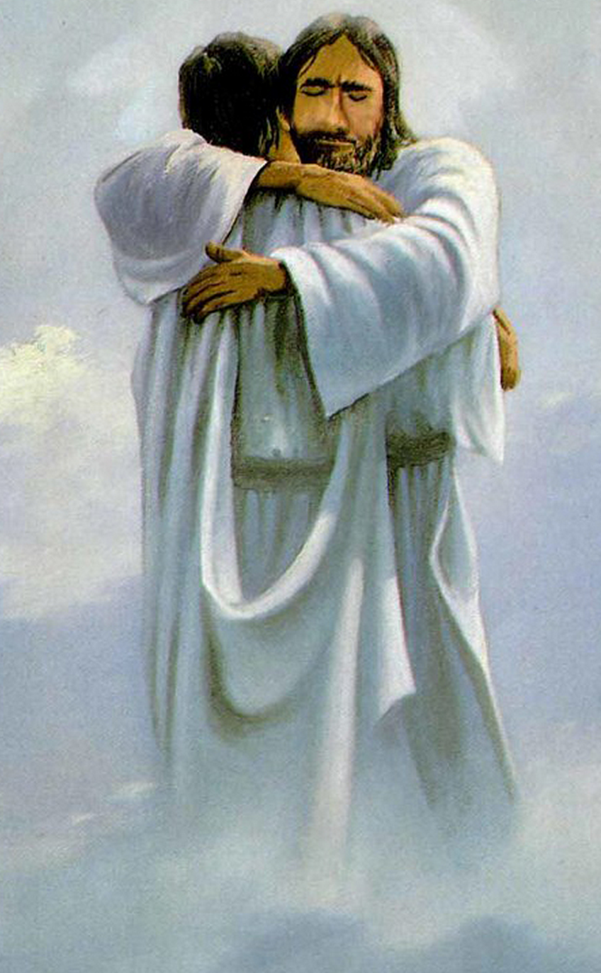
Humility is…
relating to God or sinners in a way that reflects God’s loving heart for holiness, justice and restored relationship.

Slide 26
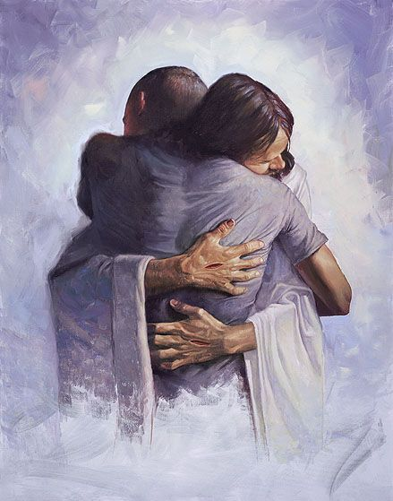
Humility will almost always cost us something.

Slide 27
What were their evidences of humility in these people that we could embrace ourselves?
1. Zechariah & Elizabeth: Luke 1:1-25, 39-45, 57-80
2. Mary: Luke 1:26-38, 46-56, 2:1-7, 19-21, 39
3. Joseph: Matthew 1:18-25; 2:13-15, 19-23
4. The Innkeeper: Luke 2:7, 12
5. Angels: Luke 1:11-20, 26-37; 2:8-14
6. Shepherds: Luke 2:8-20
7. Magi: Matthew 2:1-12
8. Simeon & Anna: Luke 2:22-38

Slide 28
Why does God choose to bless and use humble people?

Slide 29
Why does God choose to bless and use humble people?
Have you taken the first step into humility– reconciliation with God through Jesus Christ?

Slide 30
Why does God choose to bless and use humble people?
Have you taken the first step into humility– reconciliation with God through Jesus Christ?
What qualities of humility is God asking you to embrace more fully right now?
How can you do that this week? With whom?

