Slide 1
WHO KILLED GOD?

Slide 2
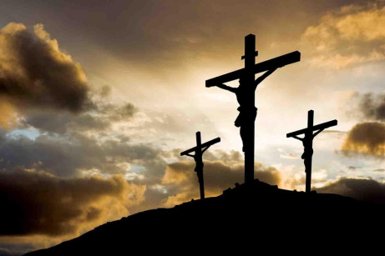
Colossians 1:15
Jesus is “the image of the invisible God”
Hebrews 1:3
Jesus “…is the radiance of God’s glory and the exact representation of his being.”

Slide 3
Romans 8:32
“He who did not spare
his own Son but gave
him up for us all, how will he not also with him graciously give us all things?”

Slide 4
Acts 2:23
“This Jesus [was]
delivered up according to the definite plan and foreknowledge of God.”

Slide 5
Isaiah 53:4 & 10
“…we considered him
punished by God,
stricken by him, and afflicted.”
“Yet it was the Lord’s will to crush him and cause him to suffer…the Lord
made his life an offering for sin….”

Slide 6
Acts 4:27, 28
“Indeed Herod and Pontius Pilate met together with the Gentiles and the people of Israel in this city to conspire against your holy servant Jesus, whom you anointed. ²⁸ They did what your power and will had decided beforehand should happen.”

Slide 7
John 10:17 & 18
“I lay down my life…¹⁸ No one takes it from me, but I lay it down of my own accord. I have authority to lay it down and authority to take it up again. This command I received from my Father.”

Slide 8
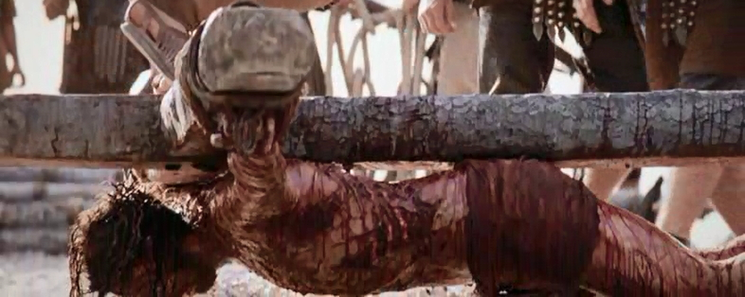

Slide 10
WHO KILLED GOD?

Slide 11
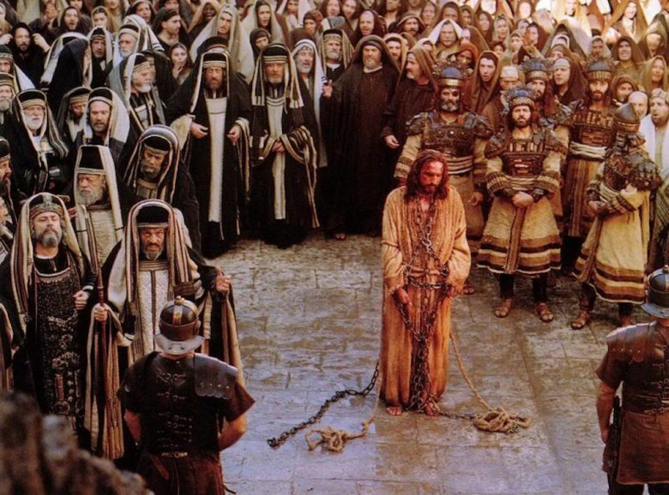
WHO KILLED GOD?

Slide 12
John 1:29
“Look, the Lamb of God, who takes away the sin of the world.”

Slide 13
Romans 3:23-25
“…for all have sinned and fall short of the glory of God, ²⁴ and all are justified freely by his grace through the redemption that came by Christ Jesus. ²⁵ God presented Christ as a sacrifice of atonement, through the shedding of his blood—to be received by faith.

Slide 14
Hebrews 9:27-28
“Just as people are destined to die once, and after that to face judgment, ²⁸ so Christ was sacrificed once to take away the sins of many; and he will appear a second time, not to bear sin, but to bring salvation to those who are waiting for him.

Slide 15
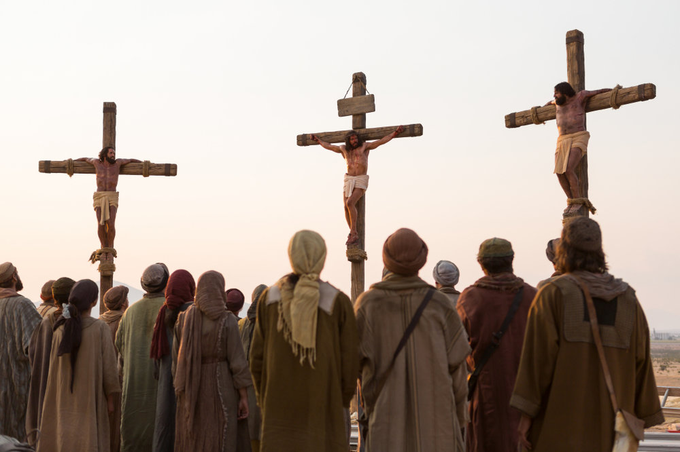
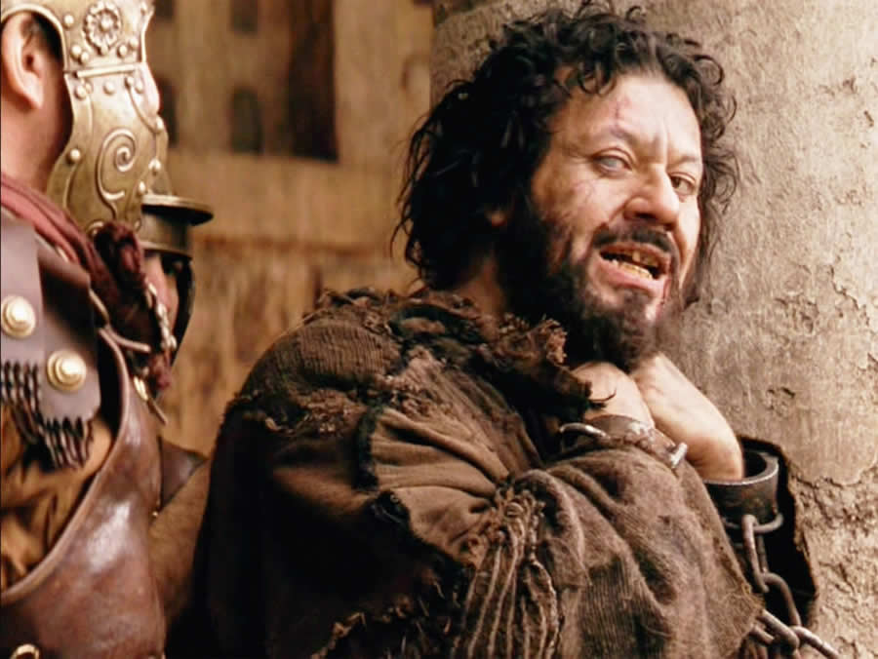
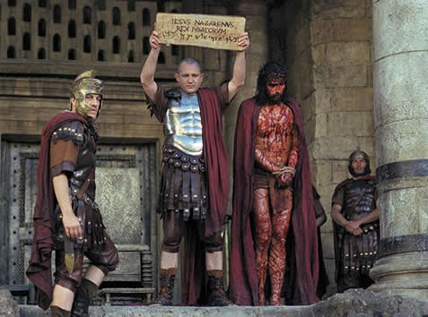

Slide 16
Matthew 27:27-31
Then he released Barabbas to them. But he had Jesus flogged, and handed him over to be crucified. ²⁷ Then the governor’s soldiers took Jesus into the Praetorium and gathered the whole company of soldiers around him. ²⁸ They stripped him and put a scarlet robe on him, ²⁹ and then twisted together a crown of thorns and set it on his head.

Slide 17
Matthew 27:27-37
They put a staff in his right hand. Then they knelt in front of him and mocked him. “Hail, king of the Jews!” they said. ³⁰ They spit on him, and took the staff and struck him on the head again and again. ³¹ After they had mocked him, they took off the robe and put his own clothes on him. Then they led him away to crucify him.”

Slide 18
They came to a place called Golgotha (which means “the place of the skull”). ³⁴ There they offered Jesus wine to drink, mixed with gall;
but after tasting it, he refused to drink it. ³⁵ When they had crucified him, they divided up his clothes by casting lots. ³⁶ And sitting down, they kept watch over him there. ³⁷ Above his head they placed the written charge against him: this is Jesus, the king of the Jews.

Slide 19
John 1:11
Jesus “came to that which was his own, but his own did not receive him.”

Slide 20
Matthew 26:59
“Those who had arrested Jesus took him to Caiaphas the high priest, where the teachers
of the law and the elders had assembled.”
“The chief priests and the whole Sanhedrin were looking for false evidence against Jesus so that they could put him to death. ⁶⁰ But they did not find any, though
many false witnesses came forward.

Slide 21
Matthew 26:65, 66
Then the high priest tore his clothes and said, “He has spoken blasphemy! Why do we need any more witnesses? Look, now you have heard the blasphemy. ⁶⁶ What do you think?”
“He is worthy of death,” they answered.

Slide 22
Matthew 26:67-68
⁶⁷ Then they spit in his face and struck him with their fists. Others slapped him ⁶⁸ and said, “Prophesy to us, Messiah. Who hit you?”

Slide 23
Matthew 27
²² “What shall I do, then, with Jesus who is called the Messiah?” Pilate asked. They all answered, “Crucify him!” ²³ “Why? What crime has he committed?” asked Pilate. But they shouted all the louder, “Crucify him!”

Slide 24
Matthew 27
²⁴ When Pilate saw that he was getting nowhere, but that instead an uproar was starting, he took water and washed his hands in front of the crowd. “I am innocent of this man’s blood,” he said. “It is your responsibility!” ²⁵ All the people answered, “His blood is on us and on our children!”

Slide 25
Acts 4:27
“For truly in this city there were gathered together against Your holy servant Jesus, whom You anointed, both Herod and Pontius Pilate, along with the Gentiles and the peoples of Israel”

Slide 26
1 Thessalonians 2:14-15
“…the Jews who killed the Lord Jesus and the prophets”

Slide 27
Isaiah 53:7-8
“He was oppressed and afflicted, yet he did not open his mouth; he was led like a lamb to the slaughter, and as a sheep before its shearers is silent, so he did not open his mouth.

Slide 28
Isaiah 53:7-8
⁸ By oppression and judgment he was taken away. Yet who of his generation protested? For he was cut off from the land of the living; for the transgression of my people he was punished.”

Slide 30
DID WE KILL GOD?

Slide 31
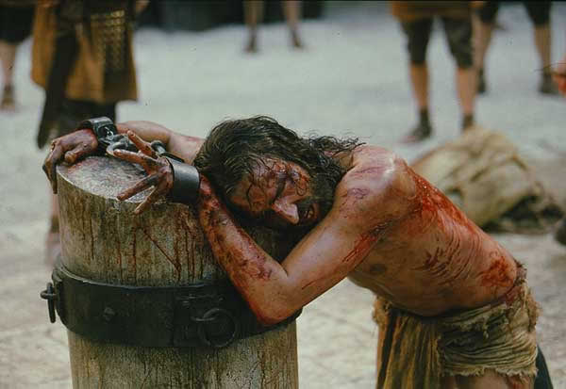

Slide 32
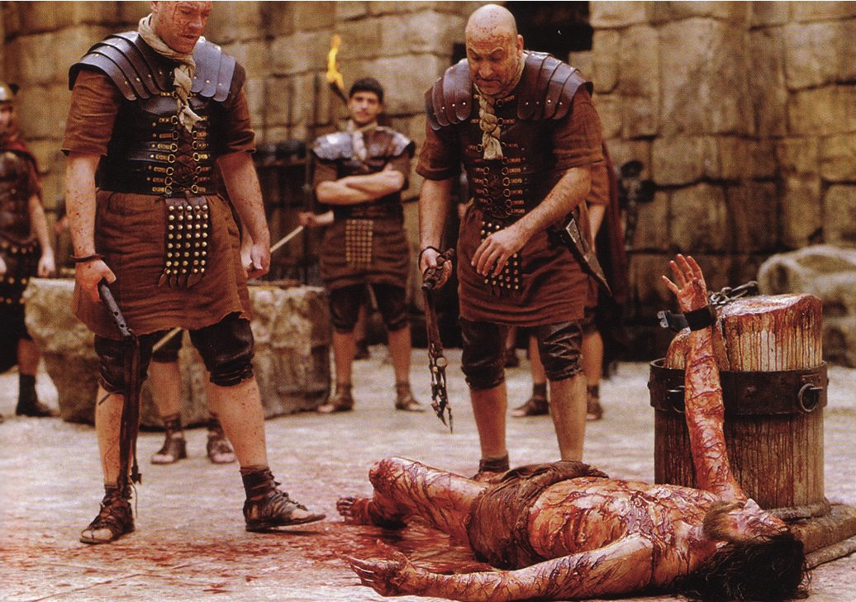

Slide 33
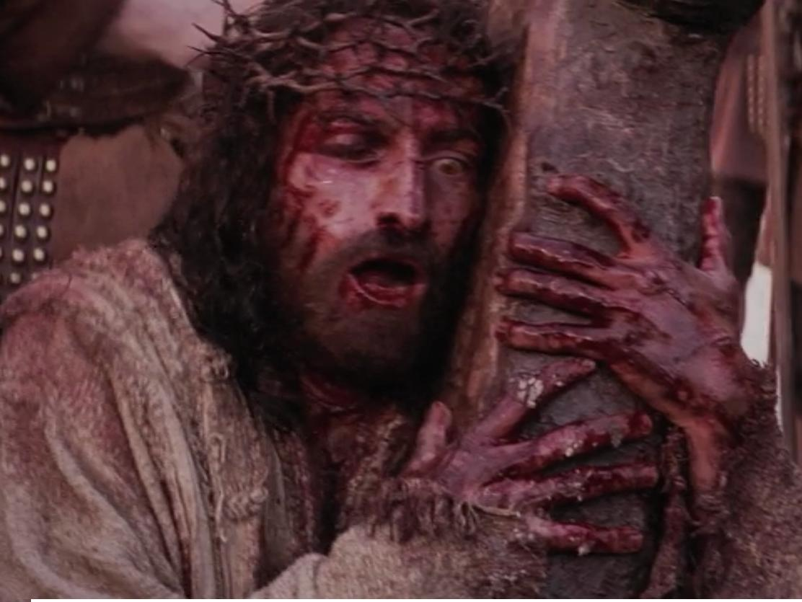

Slide 34
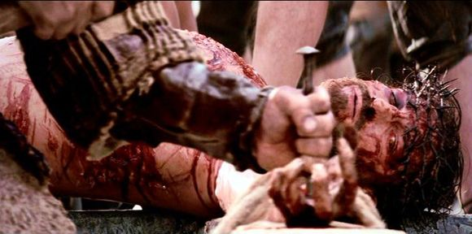

Slide 35
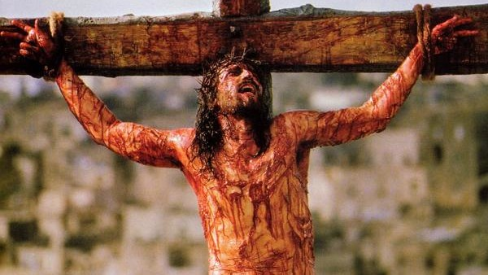

Slide 36
Romans 4:25 He was delivered over to death for OUR sins…. I Corinthians 15:3 For what I received I passed on to you as of first importance: that Christ died for OUR sins according to the Scriptures….

Slide 37
Galatians 1:3-4 Grace and peace to you from…the Lord Jesus Christ,⁴ who gave himself for OUR sins to rescue US from the present evil age….

Slide 38
Colossians 2:13-14 When you were dead in YOUR sins and in the uncircumcision of your flesh, God made you alive with Christ. He forgave us all OUR sins, ¹⁴ having canceled the charge of OUR legal indebtedness, which stood against US and condemned US; he has taken it away, nailing it to the cross.

Slide 39
1 Peter 2:23-24 “When they hurled their insults at him, he did not retaliate; when he suffered, he made no threats. Instead, he entrusted himself to him who judges justly. He himself bore OUR sins in his body on the cross….

Slide 40
1 Peter 3:18 For Christ also suffered once for sins, the righteous for the unrighteous, to bring YOU to God. 1 John 2:2 He is the atoning sacrifice for OUR sins, and not only for ours but also for the sins of the whole world.

Slide 41
1 John 4:10 This is love: not that we loved God, but that he loved us and sent his Son as an atoning sacrifice for OUR sins. Revelation 1:5 To him who loves US and has freed US from our sins by his blood…to him be glory and power for ever and ever! Amen.

Slide 42
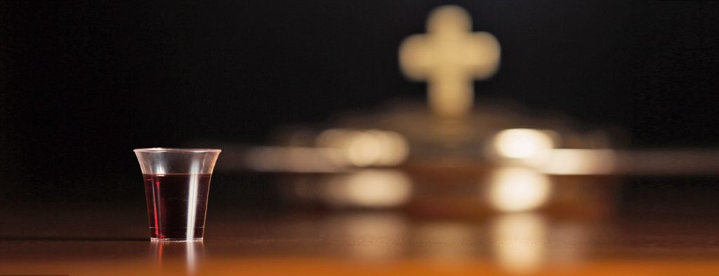
THE LORD’S SUPPER

