Slide 1
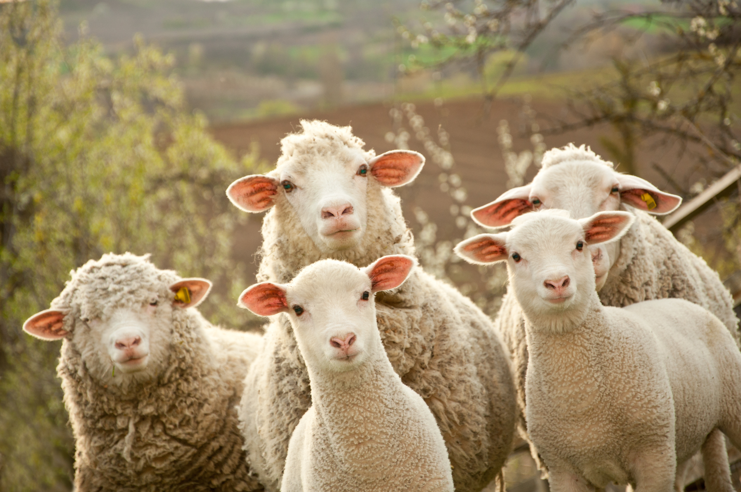
Fear Not, Little Flock
Luke 12:32

Slide 2
Fear not, little flock, for it is your Father’s good pleasure to give you the kingdom. Luke 12:32

Slide 3
Fear not, little flock, for it is your Father’s good pleasure to give you the kingdom. Luke 12:32
Command
Reason

Slide 4
Fear not, little flock, for it is your Father’s good pleasure to give you the kingdom. Luke 12:32
Command
Reason

Slide 5
The Command
Fear not, little flock,
for it is your Father’s good pleasure
to give you the kingdom.

Slide 6
The Reason
Fear not, little flock,
for it is your Father’s good pleasure
to give you the kingdom.

Slide 7
He came to his own,
and his own did not receive him.
but to all who did receive him,
who believed in his name,
he gave the right to become
the children of God.
John 1:11-12

Slide 8
Or which one of you, if his son asks him for bread, will give him a stone? Or if he asks for a fish, will give him a serpent?
If you then, who are evil, know how to give good gifts to your children, how much more will your Father who is in heaven give good things to those who ask him!
Matthew 7:9-11

Slide 9
The Kingdom of God
The Present Age
The Age to Come (KOG)
Oppressed by
Spiritual and
Political forces
All evil defeated
Death defeated
God reigns over all
Justice/righteousness
“Day of the Lord”
Son of Man comes
To judge and
establish KOG

Slide 10
And he said to them, “Truly, I say to you, there is no one who has left house or wife or brothers or parents or children, for the sake of the kingdom of God, who will not receive many times more in this time, and in the age to come eternal life.”
Luke 18:29-30

Slide 11
And do not seek what you are to eat and what you are to drink, nor be worried. For all the nations of the world seek after these things, and your Father knows that you need them. Instead, seek his kingdom, and these things will be added to you.
Luke 12:29-31

Slide 12
Fear not, little flock, for it is your Father’s good pleasure to give you the kingdom. Sell your possessions, and give to the needy. Provide yourselves with moneybags that do not grow old, with a treasure in the heavens that does not fail, where no thief approaches and no moth destroys. For where your treasure is, there will your heart be also.
Luke 12:32-34

Slide 13
For you had compassion on those in prison, and you joyfully accepted the plundering of your property, since you knew that you yourselves had a better possession and an abiding one.
Hebrews 10:34

Slide 14
You will be delivered up even by parents and brothers and relatives and friends, and some of you they will put to death. You will be hated by all for my name’s sake. But not a hair of your head will perish.
Luke 21:16-18

Slide 15
Questions for Reflection/Discussion
Of the two types of fears discussed in the sermon, which one - fears about physical needs or fears about security – are you most likely to have trouble with?
How does understanding what God has promised you in Luke 12:32 help you to fight that fear?
What might God be asking you to do for Him, that you’ve been prevented from doing by your fears? What’s one thing you can do this week to move forward in obedience?

