Slide 1
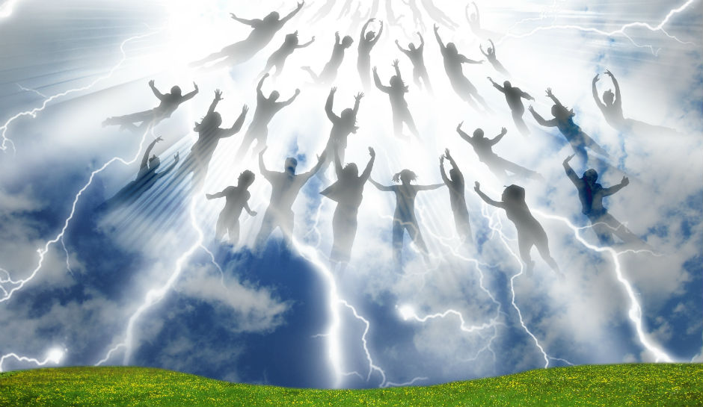
Killing God…
Resurrecting People

Slide 3
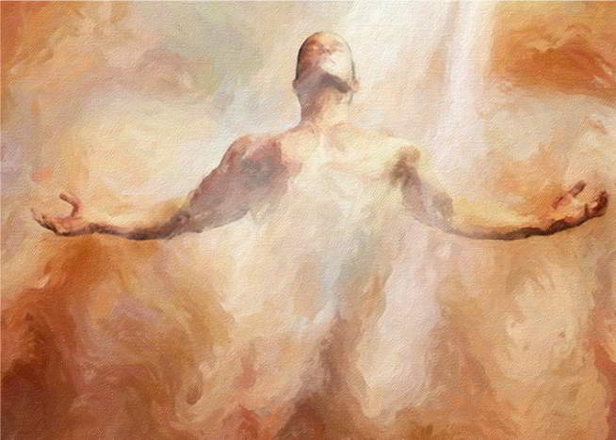

Slide 4
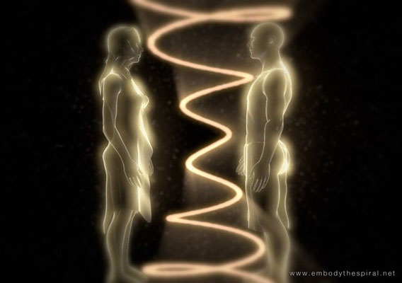

Slide 5
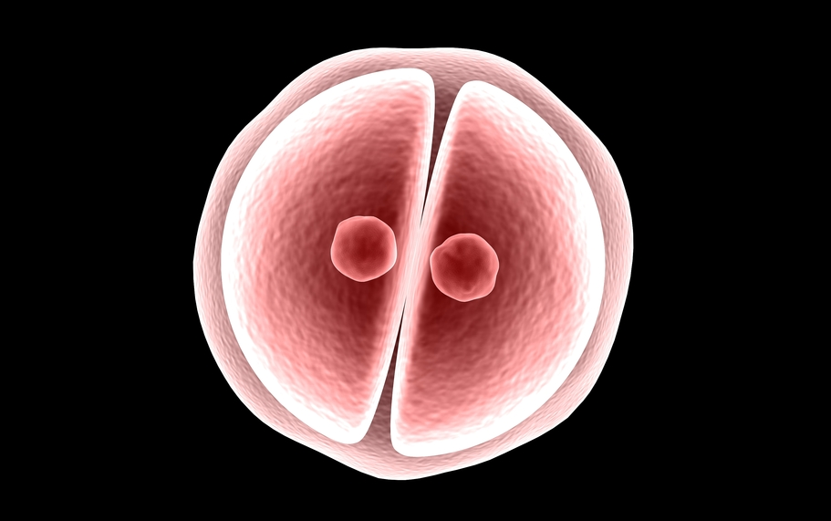

Slide 6
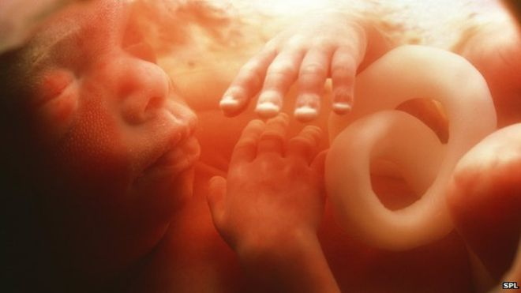

Slide 7
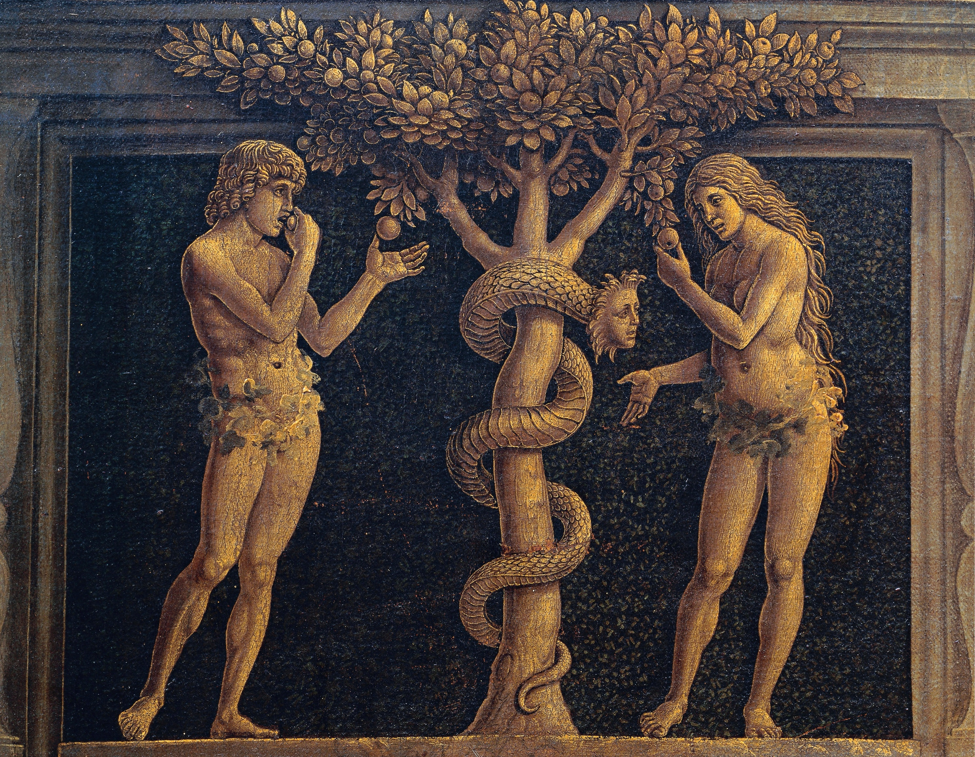

Slide 8
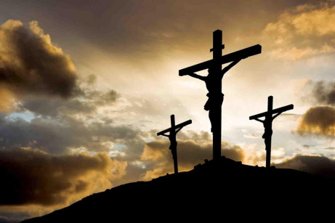
John 10:17-18
“The reason my Father
loves me is that I lay
down my life—only to take it up again. ¹⁸ No one takes it from me, but I lay it down of my own accord. I have authority to lay it down and authority to take it up again.”

Slide 9
Romans 6:23
“for the wages of sin
Is death….”

Slide 10
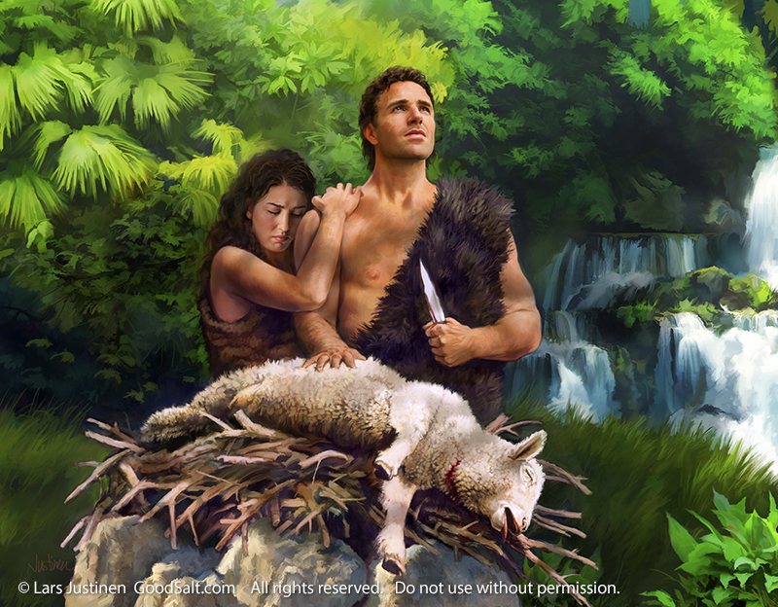

Slide 11
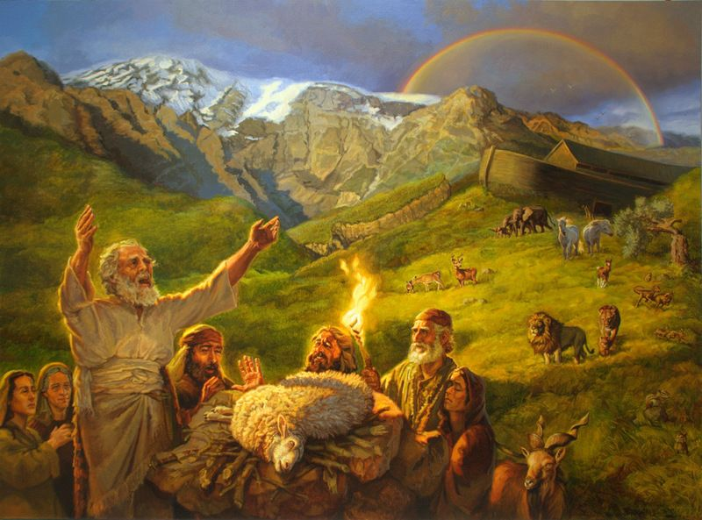
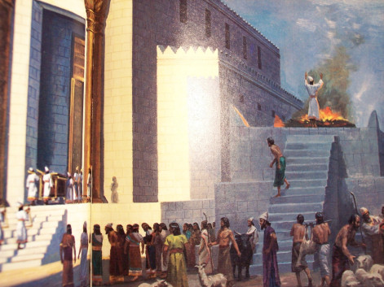
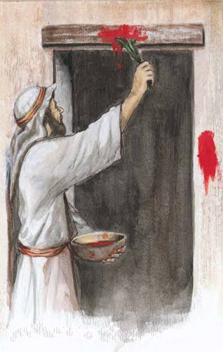

Slide 12
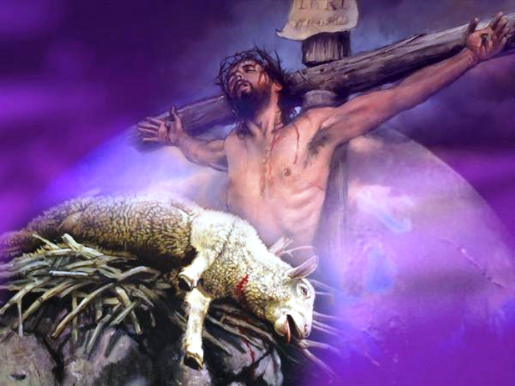

Slide 13
Romans 6:23
“The wages of sin is death….”
Ephesians 1:7
“In him we have redemption through his blood, the forgiveness of sins, in accordance with the riches of God’s grace….”

Slide 14
Hebrews 9:12
“He did not enter by means of the blood of goats and calves; but he entered the Most Holy Place once for all by his own blood, thus obtaining eternal redemption.”

Slide 15
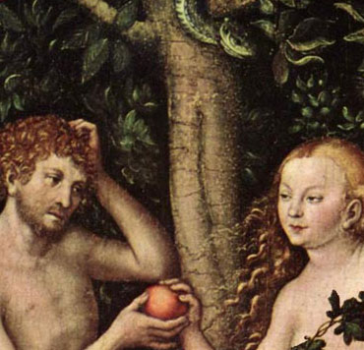

Slide 16
Hebrews 4:15
“For we do not have a high priest who is unable to empathize with our weaknesses, but we have one who has been tempted in every way, just as we are—yet he did not sin.”

Slide 17
What have YOU done with Jesus?

Slide 19
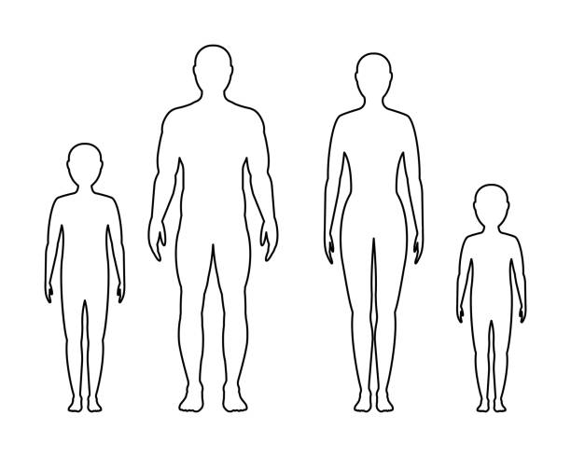
So WHY do we as humans
really need bodies?

Slide 20
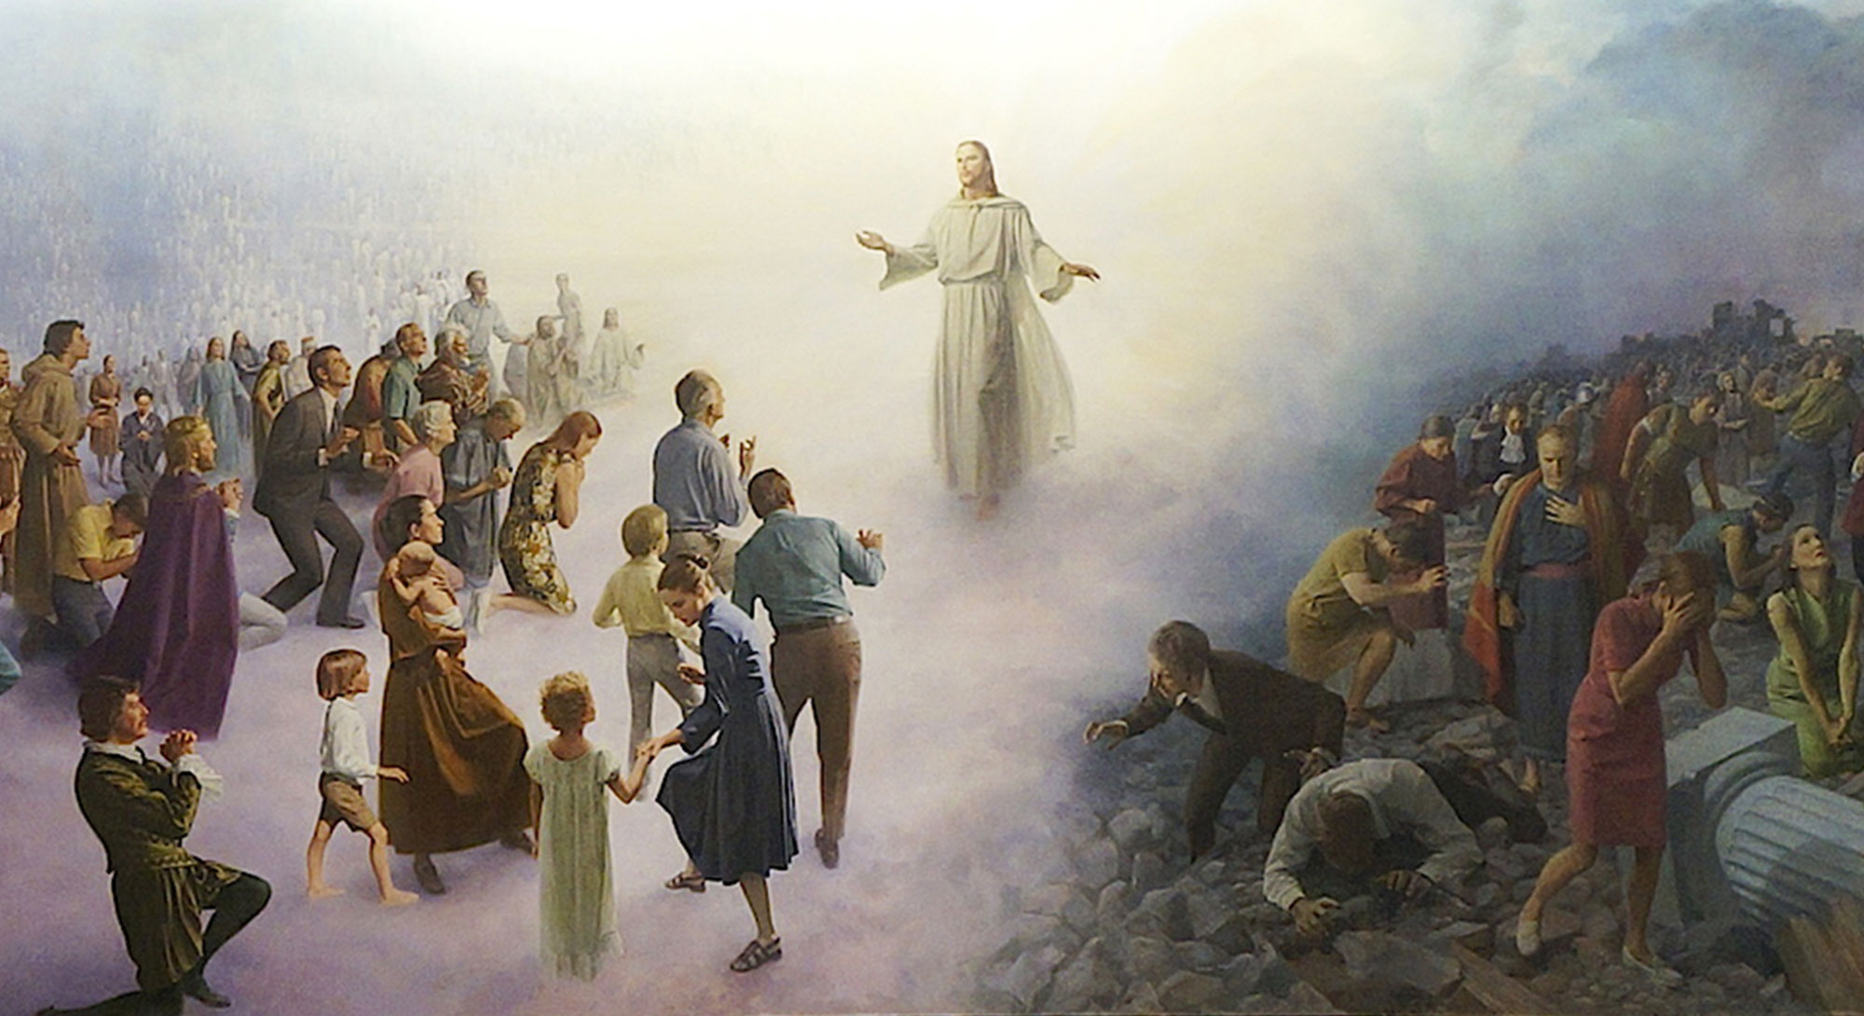

Slide 21
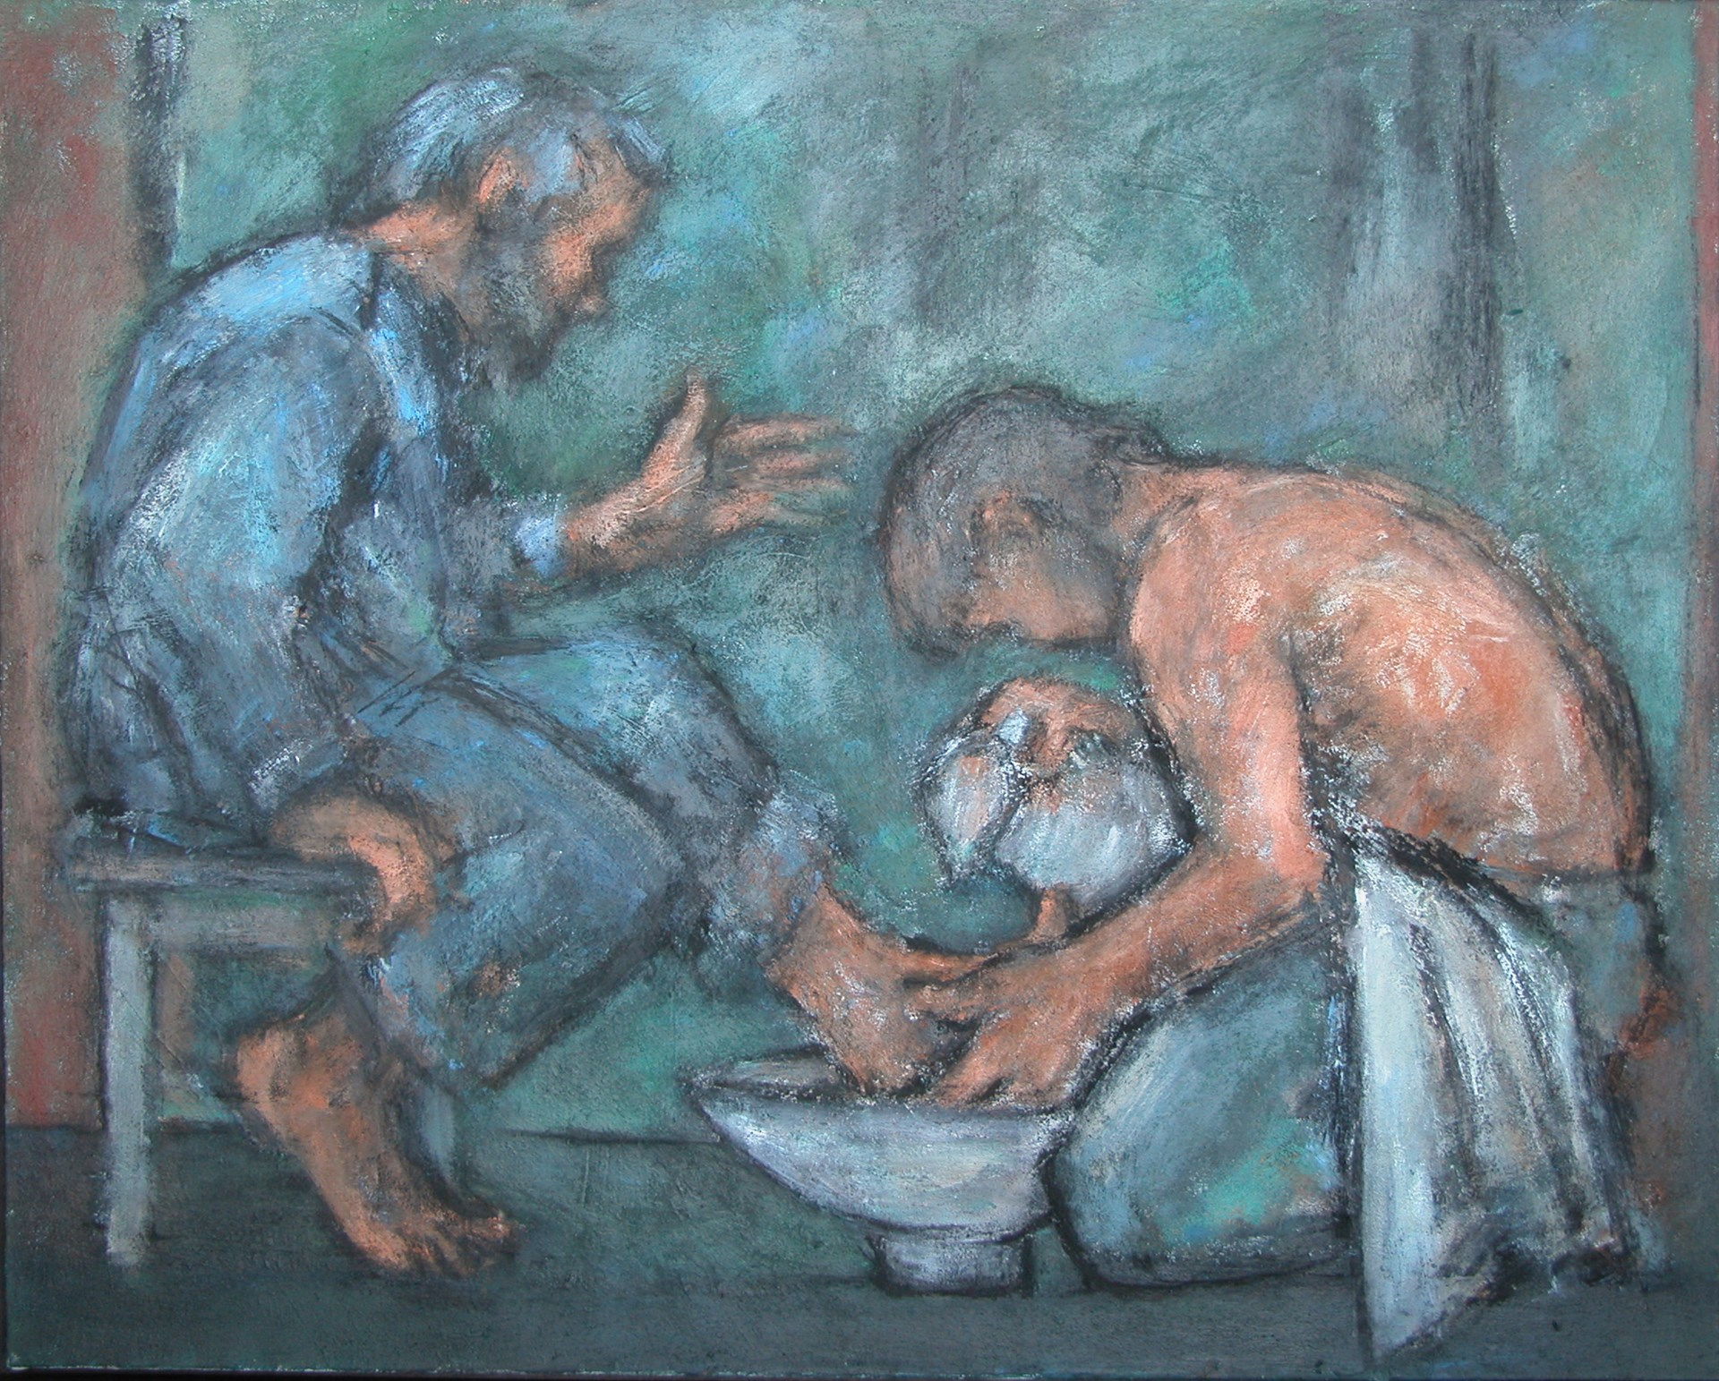
Glorify God with your body…
by showing off God through your body!

Slide 22
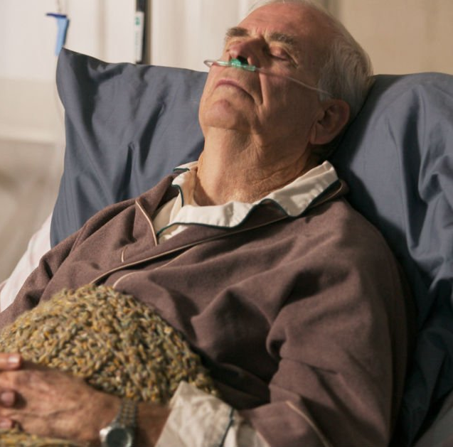
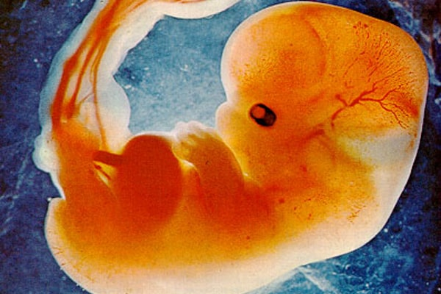
Who loves the human body more…
God OR people today?

Slide 23
Who loves the human body more…
God OR people today?

Slide 24
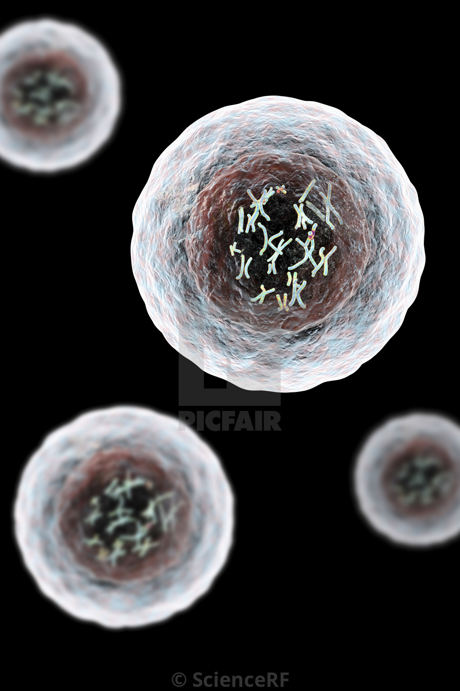
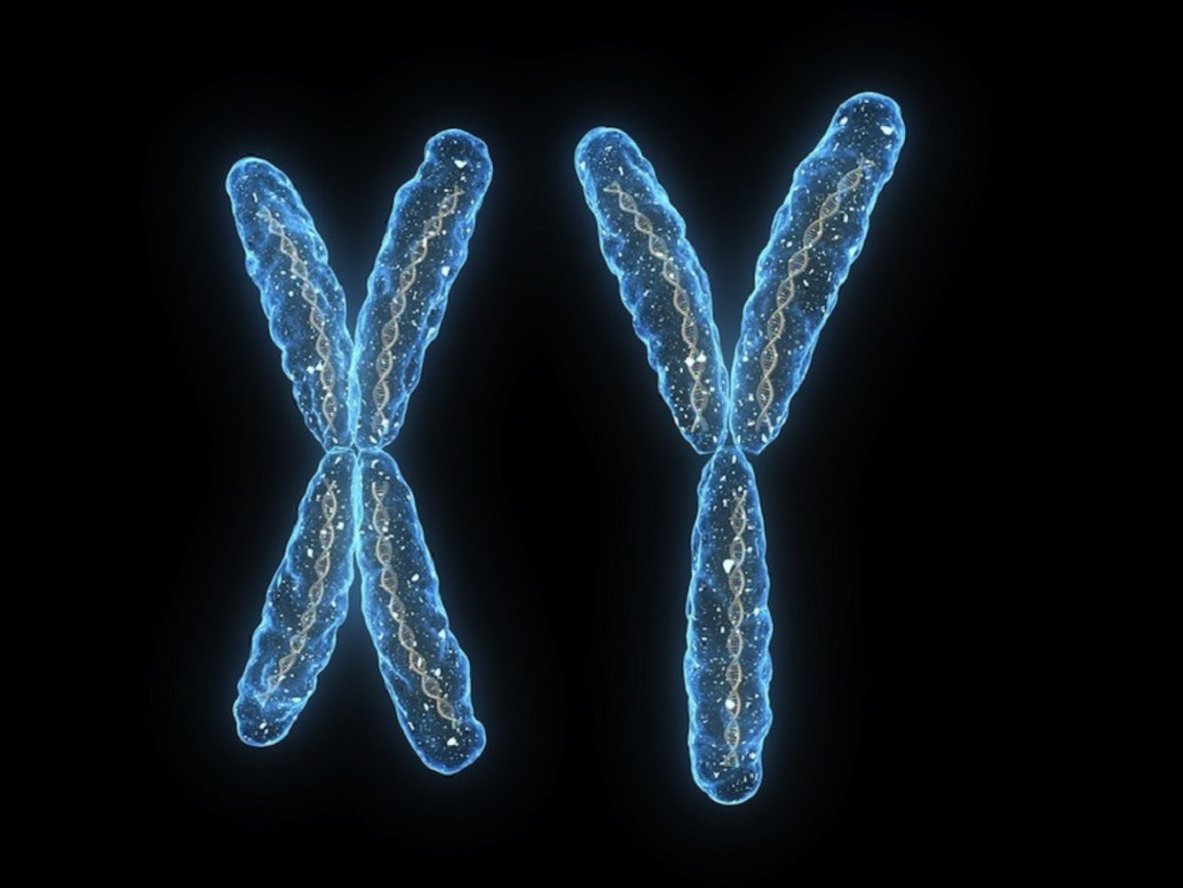

Slide 25
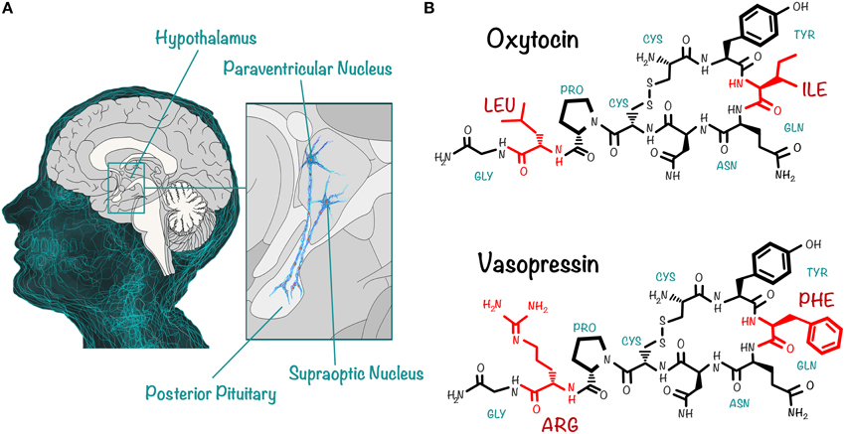
Who loves the human body more…
God OR people today?

Slide 26
1 Cor. 6:18-20
Flee from sexual immorality. All other sins a person commits are outside the body, but whoever sins sexually, sins against their own body.¹⁹ Do you not know that your bodies are temples of the Holy Spirit, who is in you, whom you have received from God? You are not your own;²⁰ you were bought at a price. Therefore honor God with your bodies.”.

Slide 27
Our bodies are
God’s temple.

Slide 29
Romans 6
What shall we say, then? Shall we go on sinning so that grace may increase? ² By no means! We are those who have died to sin; how can we live in it any longer? ³ Or don’t you know that all of us who were baptized into Christ Jesus were baptized into his death? ⁴ We were therefore buried with him through baptism into death in order that, just as Christ was raised from the dead through the glory of the Father, we too may live a new life.

Slide 30
Romans 7:4
So, my brothers and sisters, you also died to the law through the body of Christ, that you might belong to another, to him who was raised from the dead, in order that we might bear fruit for God.

Slide 31
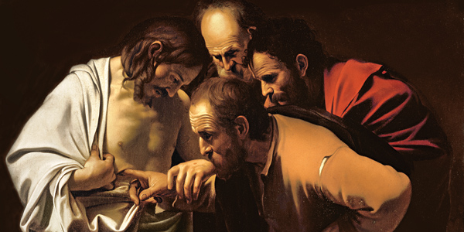

Slide 32
QUESTIONS about the relationship between the resurrection of Jesus Christ and its impact on our understanding, view & use of our human bodies?

