Slide 1
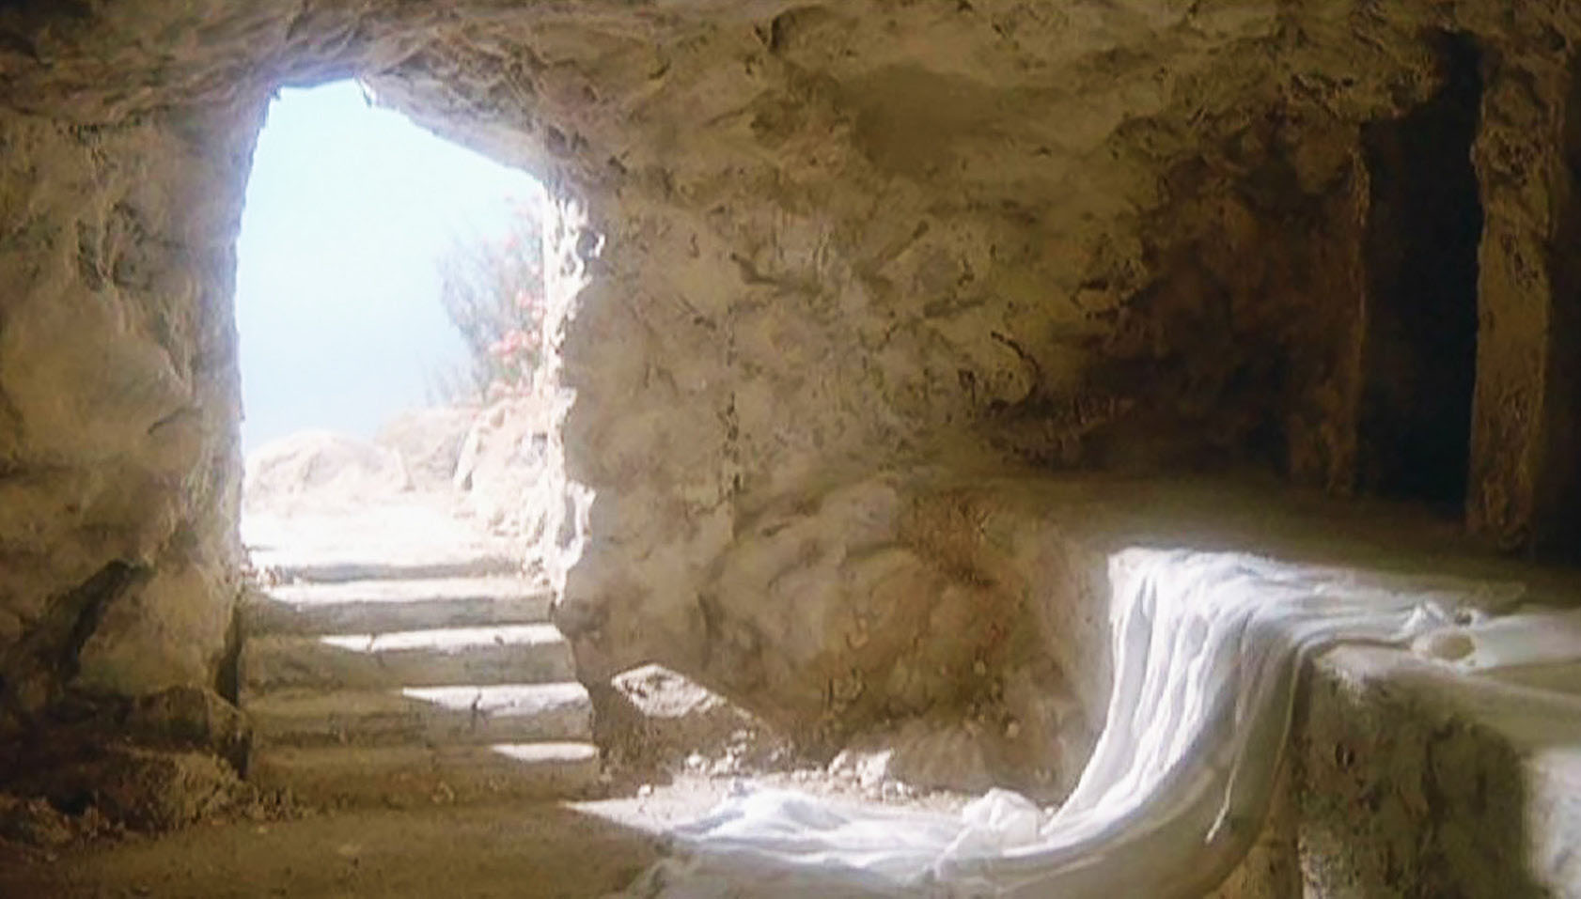
WHO REALLY NEEDS A RESURRECTION?

Slide 2
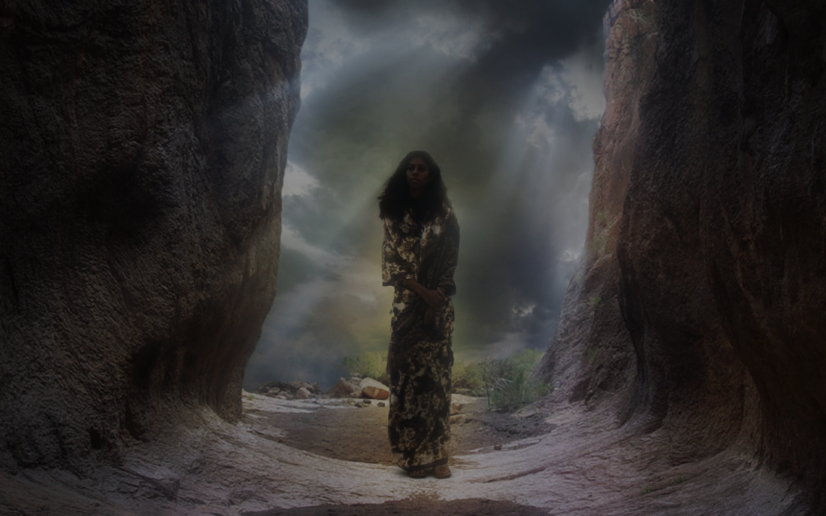

Slide 3
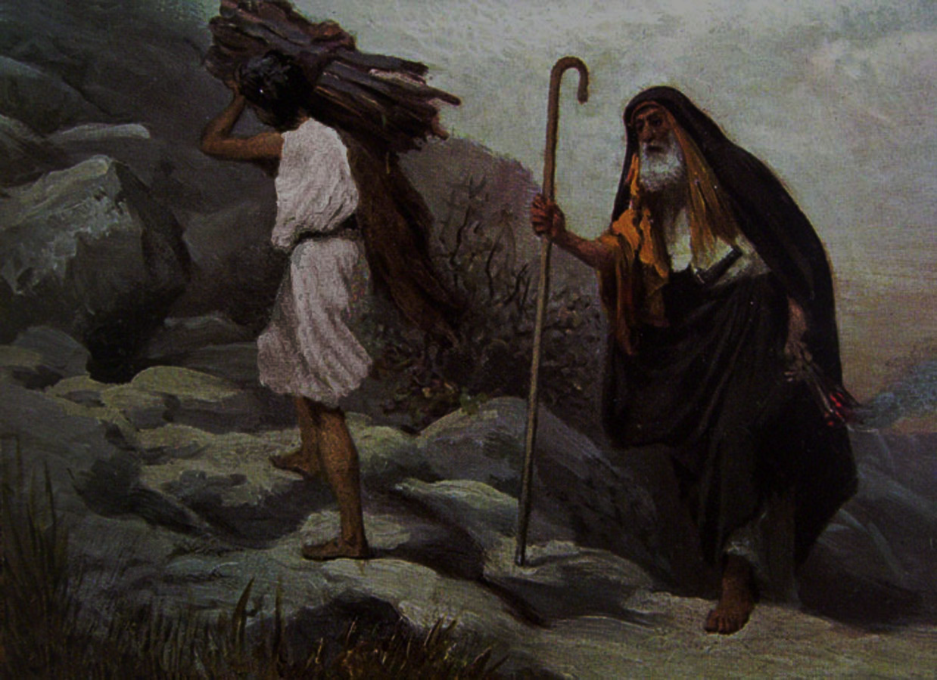
Hebrews 11
¹⁷ By faith Abraham, when God tested him, offered Isaac as a sacrifice. He who had embraced the promises was about to sacrifice his one and only son, ¹⁸ even though God had said to him, “It is through Isaac that your offspring will be reckoned.” ¹⁹ Abraham reasoned that God could even raise the dead, and so in a manner of speaking he did receive Isaac back from death.

Slide 4
Romans 8
¹⁰ But if Christ is in you, then even though your body is subject to death because of sin, the Spirit gives life because of righteousness. ¹¹ And if the Spirit of him who raised Jesus from the dead is living in you, he who raised Christ from the dead will also give life to your mortal bodies because of his Spirit who lives in you.

Slide 5
Philippians 3:10-11
I want to know Christ—yes, to know the power of his resurrection and participation in his sufferings, becoming like him in his death, ¹¹ and so, somehow, attaining to the resurrection from the dead.

Slide 6
How have you seen God bring new, resurrection life into a ‘death’ experience of your life?

Slide 7
How have you seen God bring new, resurrection life into a ‘death’ experience of your life?
Where would you love to see God bring his resurrection power to bear in your life or experience right now?

Slide 8
1 CORINTHIANS 15

Slide 9
1 CORINTHIANS 15
WHY is the reality of a resurrection SO important?

Slide 10
1 CORINTHIANS 15
WHY is the reality of a resurrection SO important? If it didn’t happen…
Jesus wasn’t resurrected either.
The Gospel is useless.
Every Christian’s faith is futile.
The Apostles were liars.

Slide 11
1 CORINTHIANS 15
WHY is the reality of a resurrection SO important?
If it didn’t happen…
We’re still stuck in sin.
Every Christian in history is lost.
We’re true losers.

Slide 12
1 CORINTHIANS 15
WHY is the resurrection SO important?
Positively, Jesus’ resurrection…
guarantees our resurrection.
reverses the curse of sin.
guarantees a certain order of future resurrections.

Slide 13
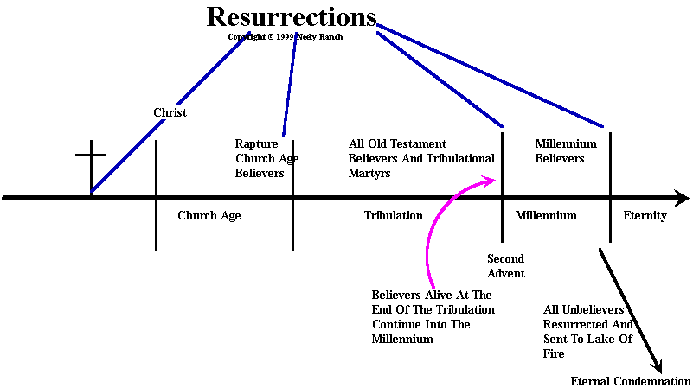

Slide 14
1 CORINTHIANS 15
WHY is the resurrection SO important?
Positively, Jesus’ resurrection…
assures the destruction of all other spiritual powers.
gives meaning to suffering.
shapes our philosophy about life.

Slide 15
1 CORINTHIANS 15
2. WHO saw Jesus’ resurrected?

Slide 17
1 CORINTHIANS 15
3. How are the dead actually going to be raised?
In a flash, in the twinkling of an eye, at the last trumpet. For the trumpet will sound,
the dead will be raised imperishable, and we will be changed. (1 Corinthians 15:52)

Slide 18
1 CORINTHIANS 15
4. What is this resurrection body going to be made of?

Slide 19
³⁵ But someone will ask, “How are the dead raised? With what kind of body will they come?” ³⁶ How foolish! What you sow does not come to life unless it dies. ³⁷ When you sow, you do not plant the body that will be, but just a seed, perhaps of wheat or of something else. ³⁸ But God gives it a body as he has determined, and to each kind of seed he gives its own body.
(1 Corinthians 15:35-38)

Slide 20
We do have a parallel experience in gardening. You plant a “dead” seed; soon there is a flourishing plant. There is no visual likeness between seed and plant. You could never guess what a tomato would look like by looking at a tomato seed. What we plant in the soil and what grows out of it don’t look anything alike. The dead body that we bury in the ground and the resurrection body that comes from it will be dramatically different.
(1 Corinthians 15:35-38—The Message)

Slide 21
1 CORINTHIANS 15
5. How will that resurrection body differ from our present ones?

Slide 22
PRESENT BODIES vs. our FUTURE BODIES
Perishable
Shabby/Dishonorable
Weak
Natural
Earthly (substance)
Incapable of the Kingdom
Mortal/dies
Imperishable (42)
Glorious (43)
Powerful (43)
Spiritual (44)
Heavenly (substance)49
Fit for the Kingdom (50)
Immortal/never fades (53)

Slide 23
1 CORINTHIANS 15
6. Who will experience this resurrection?
⁵¹ Listen, I tell you a mystery: We will not all sleep, but we will all be changed— ⁵² in a flash, in the twinkling of an eye, at the last trumpet. For the trumpet will sound, the dead will be raised imperishable, and we will be changed.

Slide 24
1 THESSALONIANS 4:14-18
¹⁴ For we believe that Jesus died and rose again, and so we believe that God will bring with Jesus those who have fallen asleep in him.
¹⁵ According to the Lord’s word, we tell you that we who are still alive, who are left until the coming of the Lord, will certainly not precede those who have fallen asleep.

Slide 25
1 THESSALONIANS 4:14-18
¹⁶ For the Lord himself will come down from heaven, with a loud command, with the voice of the archangel and with the trumpet call of God, and the dead in Christ will rise first. ¹⁷ After that, we who are still alive and are left will be caught up together with them in the clouds to meet the Lord in the air. And so we will be with the Lord forever. ¹⁸ Therefore encourage one another with these words.

Slide 26
1 CORINTHIANS 15
7. What should be some of the effects on us of Christ’s resurrection reality?
⁵⁸ Therefore, my dear brothers and sisters, stand firm. Let nothing move you. Always give your-selves fully to the work of the Lord, because you know that your labor in the Lord is not in vain.

Slide 27
1 CORINTHIANS 15
7. What should be some of the effects on us of Christ’s resurrection reality?
Stand firm in Christ.

Slide 28
1 CORINTHIANS 15
7. What should be some of the effects on us of Christ’s resurrection reality?
Stand firm in Christ.
Don’t let anything move you off of the resurrected Jesus Christ.

Slide 29
1 CORINTHIANS 15
7. What should be some of the effects on us of Christ’s resurrection reality?
Stand firm in Christ.
Don’t let anything move you off of the resurrected Jesus Christ.
Persistently give yourself to the work of the resurrected Lord Jesus.

Slide 30
WE REALLY NEED A RESURRECTION?

