Slide 2
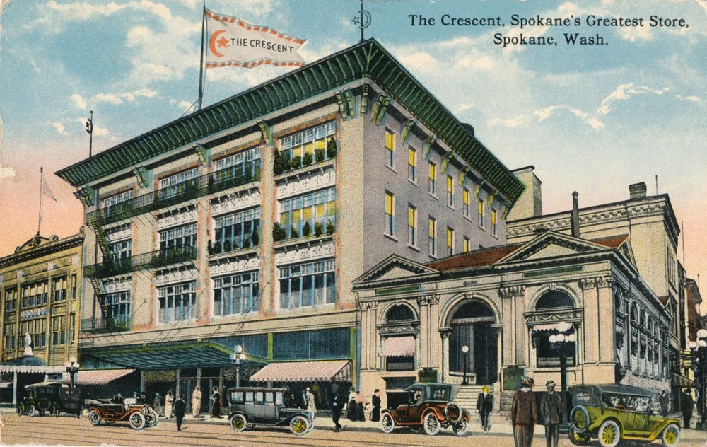

Slide 3
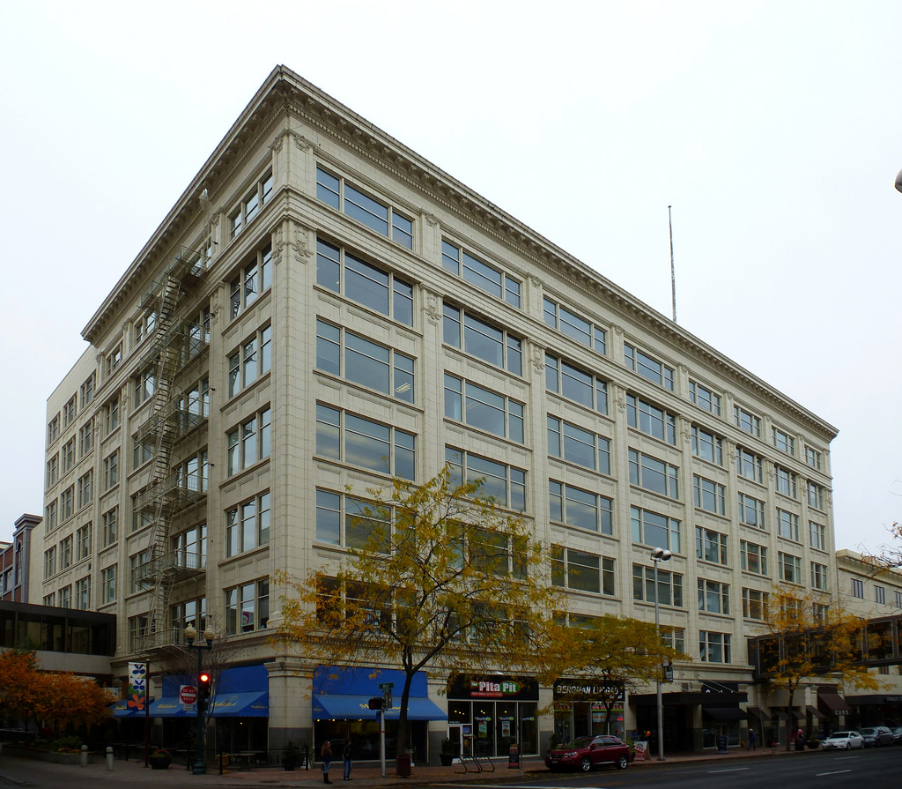
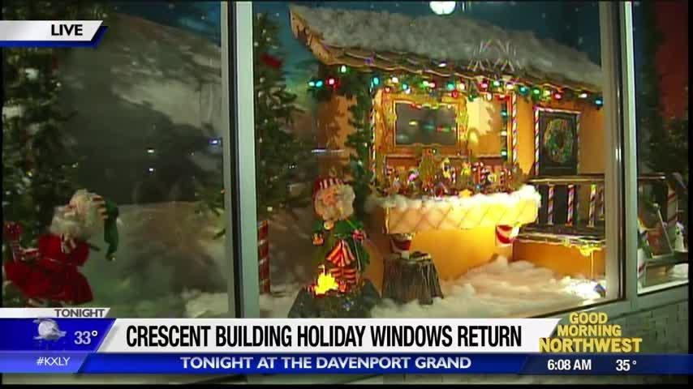

Slide 5
Romans 15:13
May the God of hope fill you with all joy and peace as you trust in him, so that you may overflow with hope by the power of the Holy Spirit.

Slide 7
Luke 2:14 “Glory to God in the highest heaven, and on earth peace to those on whom his favor rests.”

Slide 8
Acts 10:36 “You know the message God sent to the people of Israel, announcing the good news of peace through Jesus Christ, who is Lord of all.”

Slide 9
Ephesians 2:13-14 “But now in Christ Jesus you who once were far away have been brought near by the blood of Christ. ¹⁴ For he himself is our peace, who has made the two groups one and has destroyed the barrier, the dividing wall of hostility….”

Slide 11
Christmas Love

Slide 12
Romans 8 If God is for us, who can be against us? ³² He who did not spare his own Son, but gave him up for us all—how will he not also, along with him, graciously give us all things? ³³ Who will bring any charge against those whom God has chosen? It is God who justifies. ³⁴ Who then is the one who condemns? No one. Christ Jesus who died—more than that, who was raised to life—is at the right hand of God and is also interceding for us.

Slide 13
Romans 8 ³⁵ Who shall separate us from the love of Christ? Shall trouble or hardship or persecution or famine or nakedness or danger or sword? ³⁶ As it is written: “For your sake we face death all day long; we are considered as sheep to be slaughtered.”

Slide 14
Romans 8 ³⁷ No, in all these things we are more than conquerors through him who loved us. ³⁸ For I am convinced that neither death nor life, neither angels nor demons, neither the present nor the future, nor any powers, ³⁹ neither height nor depth, nor anything else in all creation, will be able to separate us from the love of God that is in Christ Jesus our Lord.

Slide 15
I Corinthians 13 ⁴ Love is patient, love is kind. It does not envy, it does not boast, it is not proud. ⁵ It does not dishonor others, it is not self-seeking, it is not easily angered, it keeps no record of wrongs. ⁶ Love does not delight in evil but rejoices with the truth. ⁷ It always protects, always trusts, always hopes, always perseveres. ⁸ Love never fails.”

Slide 16
Ephesians 1:3-6 3) Praise be to the God and Father of our Lord Jesus Christ, who has blessed us in the heavenly realms with every spiritual blessing in Christ. 4) =For he chose us in him before the creation of the world to be holy and blameless in his sight. In love 5) he predestined us for adoption to sonship through Jesus Christ, in accordance with his pleasure and will— 6) to the praise of his glorious grace, which he has freely given us in the One he loves.

Slide 17
Ephesians 3:17-19 And I pray that you, being rooted and established in love, may have power, together with all the Lord’s holy people, to grasp how wide and long and high and deep is the love of Christ, and to know this love that surpasses knowledge—that you may be filled to the measure of all the fullness of God.

Slide 19
Luke 2:8-10 ⁸ And there were shepherds living out in the fields nearby, keeping watch over their flocks at night. ⁹ An angel of the Lord appeared to them, and the glory of the Lord shone around them, and they were terrified. ¹⁰ But the angel said to them, “Do not be afraid. I bring you good news that will cause great joy for all the people.

Slide 20
Today in the town of David a Savior has been born to you; he is the Messiah, the Lord. ¹² This will be a sign to you: You will find a baby wrapped in cloths and lying in a manger.” ¹³ Suddenly a great company of the heavenly host appeared with the angel, praising God and saying, ¹⁴ “Glory to God in the highest heaven, and on earth peace to those on whom his favor rests.”

Slide 21
Matthew 2:9-11 “…They went on their way, and the star they had seen when it rose went ahead of them until it stopped over the place where the child was. ¹⁰ When they saw the star, they were overjoyed. ¹¹ On coming to the house, they saw the child with his mother Mary, and they bowed down and worshiped him. Then they opened their treasures and presented him with gifts of gold, frankincense and myrrh.”

