Slide 2
Judges 21:25 “In those days there was no king in Israel; everyone did what was right in his own eyes”

Slide 3
I Samuel 1 There was a certain man from Ramathaim, a Zuphite from the hill country of Ephraim, whose name was Elkanah son of Jeroham, the son of Elihu, the son of Tohu, the son of Zuph, an Ephraimite. ² He had two wives; one was called Hannah and the other Peninnah. Peninnah had children, but Hannah had none.

Slide 4
I Samuel 1 ³ Year after year this man went up from his town to worship and sacrifice to the Lord Almighty at Shiloh, where Hophni and Phinehas, the two sons of Eli, were priests of the Lord. ⁴ Whenever the day came for Elkanah to sacrifice, he would give portions of the meat to his wife Peninnah and to all her sons and daughters.

Slide 5
I Samuel 1 ⁵ But to Hannah he gave a double portion because he loved her, and the Lord had closed her womb. ⁶ Because the Lord had closed Hannah’s womb, her rival kept provoking her in order to irritate her. ⁷ This went on year after year. Whenever Hannah went up to the house of the Lord, her rival provoked her till she wept and would not eat.

Slide 6
I Samuel 1 ⁸ Her husband Elkanah would say to her, “Hannah, why are you weeping? Why don’t you eat? Why are you downhearted? Don’t I mean more to you than ten sons?”

Slide 7
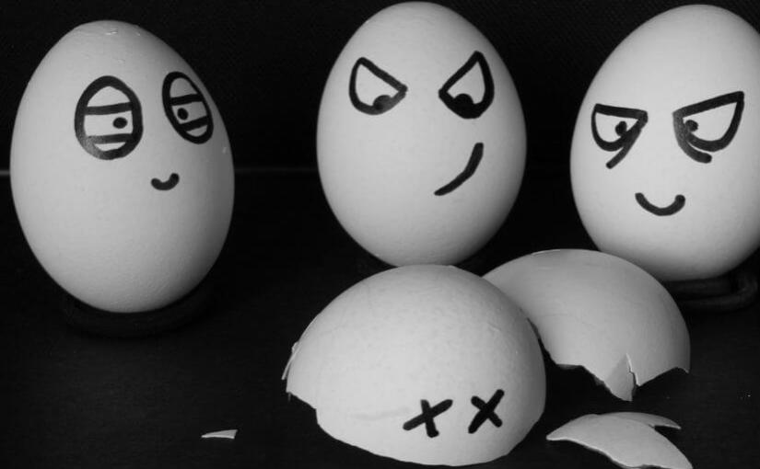
DYSFUNCTIONAL FAMILY…

Slide 8
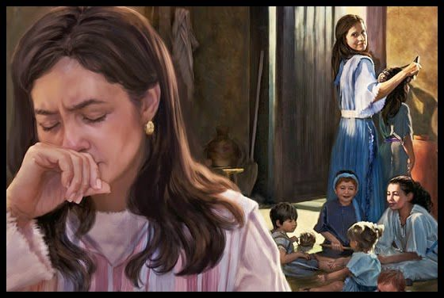

Slide 9
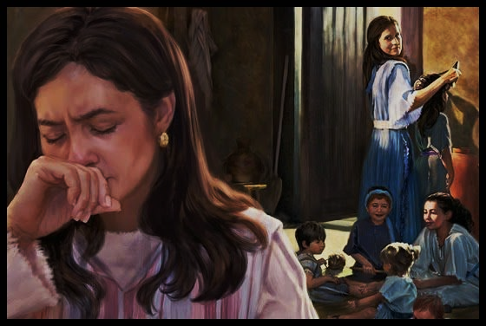
Exodus 23:25 –
“Worship the Lord your God, and his blessing will be on your food and water. I will take away sickness from among you, and none will miscarry or be barren in your land. I will give you a full life span.”

Slide 10
Delayed blessings have deep purposes.

Slide 11
1st Samuel 1 ⁹ Once when they had finished eating and drinking in Shiloh, Hannah stood up. Now Eli the priest was sitting on his chair by the doorpost of the Lord’s house. ¹⁰ In her deep anguish Hannah prayed to the Lord, weeping bitterly.

Slide 12
1st Samuel 1 ¹¹ And she made a vow, saying, “Lord Almighty, if you will only look on your servant’s misery and remember me, and not forget your servant but give her a son, then I will give him to the Lord for all the days of his life, and no razor will ever be used on his head.”

Slide 13
1st Samuel 1 ¹² As she kept on praying to the Lord, Eli observed her mouth. ¹³ Hannah was praying in her heart, and her lips were moving but her voice was not heard. Eli thought she was drunk ¹⁴ and said to her, “How long are you going to stay drunk? Put away your wine.”

Slide 14
1st Samuel 1 ¹⁵ “Not so, my lord,” Hannah replied, “I am a woman who is deeply troubled. I have not been drinking wine or beer; I was pouring out my soul to the Lord. ¹⁶ Do not take your servant for a wicked woman; I have been praying here out of my great anguish and grief.”

Slide 15
1st Samuel 1 ¹⁷ Eli answered, “Go in peace, and may the God of Israel grant you what you have asked of him.” ¹⁸ She said, “May your servant find favor in your eyes.” Then she went her way and ate something, and her face was no longer downcast.

Slide 16
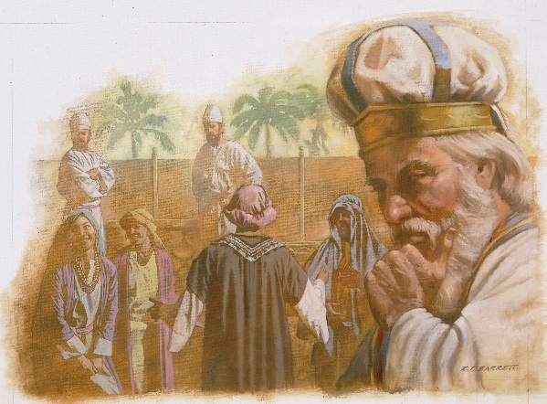

Slide 17
1st Samuel 2 Then Hannah prayed and said: “My heart rejoices in the Lord; in the Lord my horn is lifted high. My mouth boasts over my enemies, for I delight in your deliverance. ² “There is no one holy like the Lord; there is no one besides you; there is no Rock like our God.

Slide 18
1st Samuel 2 ³ “Do not keep talking so proudly or let your mouth speak such arrogance, for the Lord is a God who knows, and by him deeds are weighed. ⁴ “The bows of the warriors are broken, but those who stumbled are armed with strength.

Slide 19
1st Samuel 2 ⁵ Those who were full hire themselves out for food, but those who were hungry are hungry no more. She who was barren has borne seven children, but she who has had many sons pines away. ⁶ “The Lord brings death and makes alive; he brings down to the grave and raises up.

Slide 20
1st Samuel 2 ⁷ The Lord sends poverty and wealth; he humbles and he exalts. ⁸ He raises the poor from the dust and lifts the needy from the ash heap; he seats them with princes and has them inherit a throne of honor. “For the foundations of the earth are the Lord’s; on them he has set the world.

Slide 21
⁹ He will guard the feet of his faithful se rvants,but the wicked will be silenced in the place of darkness. “It is not by strength that one prevails; ¹⁰those who oppose the Lord will be broken. The Most High will thunder from heaven; the Lord will judge the ends of the earth. “He will give strength to his king and exalt the horn of his anointed.”

Slide 22
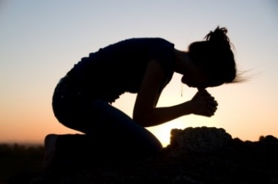
Never underestimate the power of a praying parent…

Slide 23
Unanswered prayers can lead to unparalleled spiritual longings.

Slide 24
Imperfect leadership has never stopped godly progress.

Slide 25
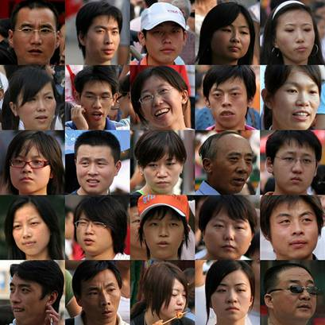
CHINA

Slide 26
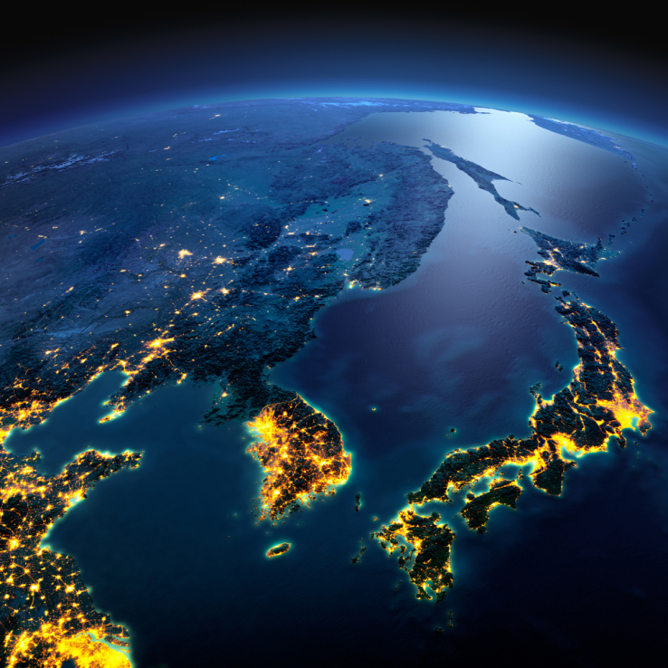
South Korea

Slide 28
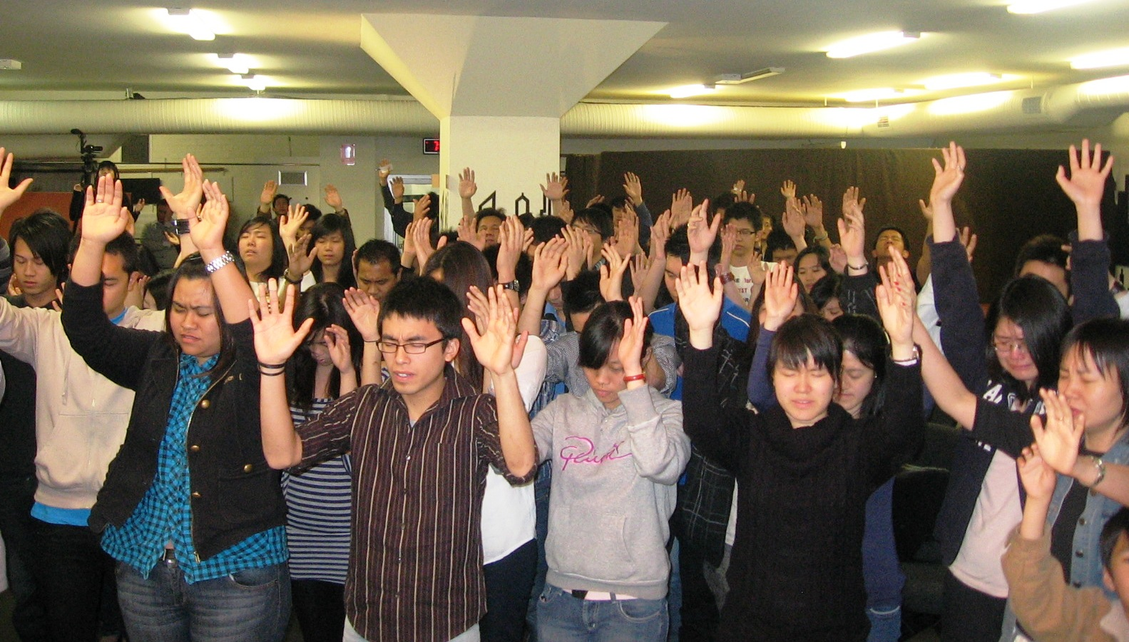
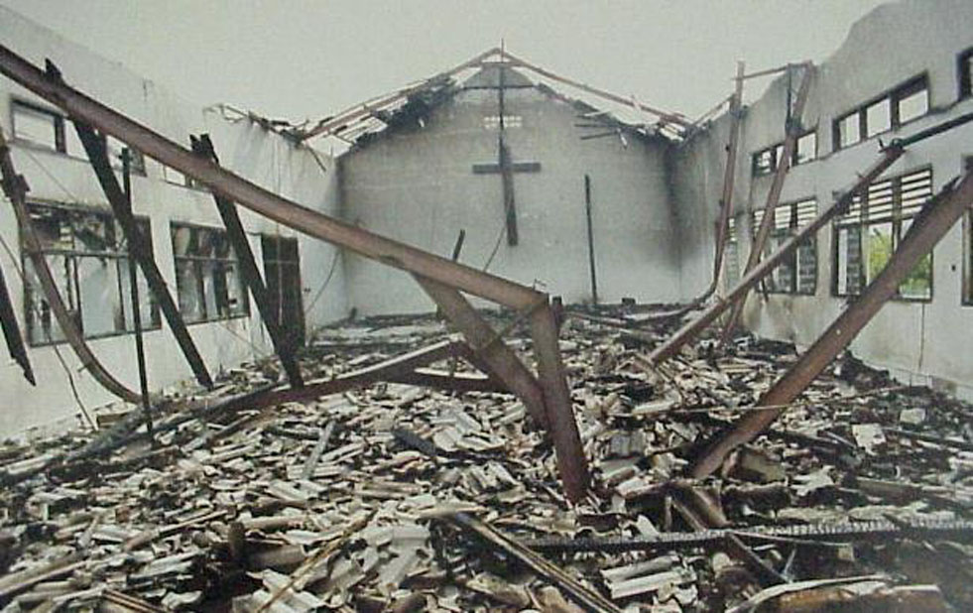
Indonesia

Slide 29
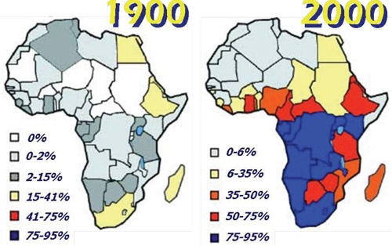

Slide 30
Imperfect leadership has never stopped godly progress.

