Slide 1
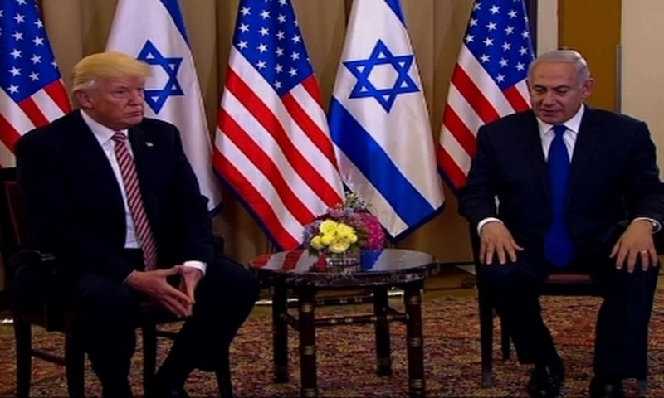
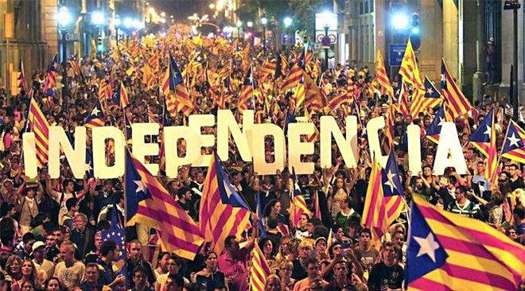
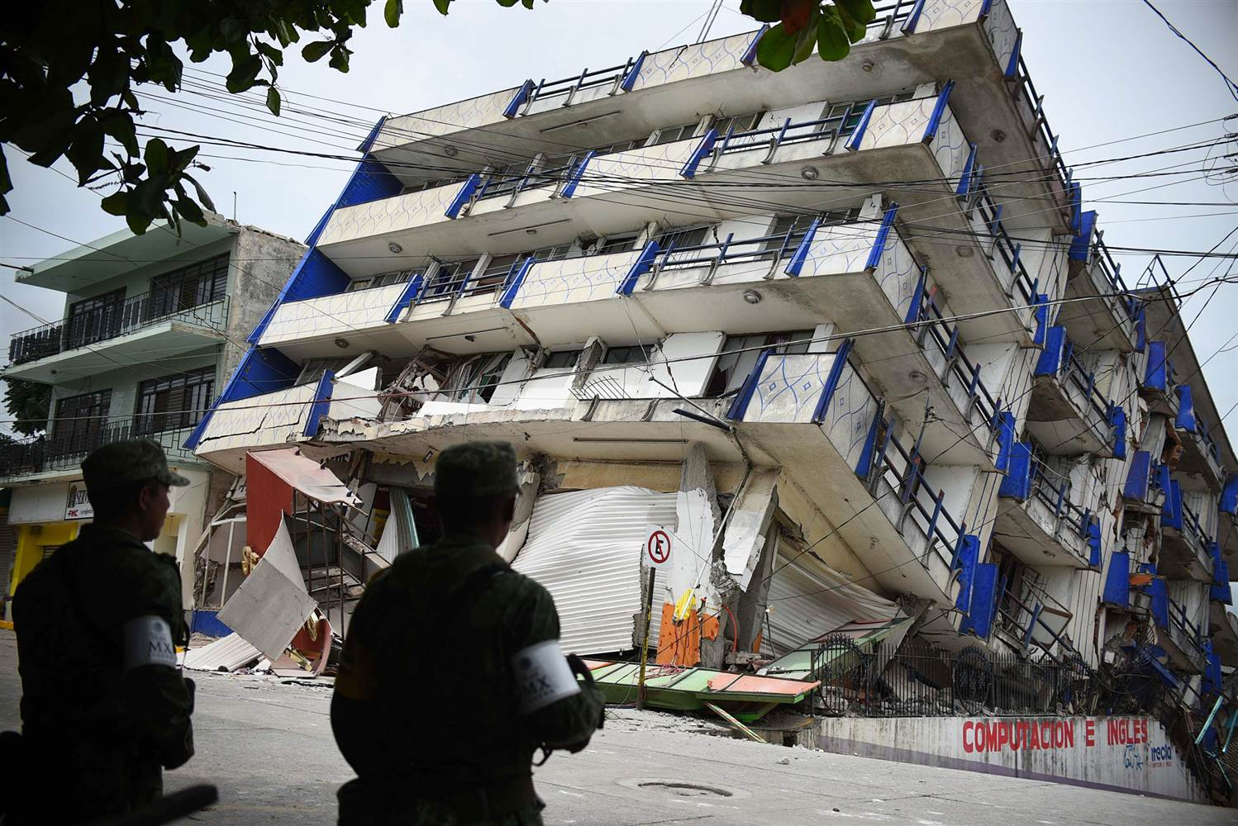
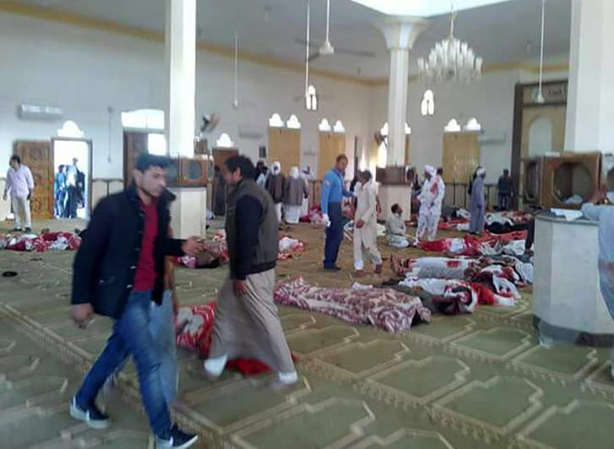
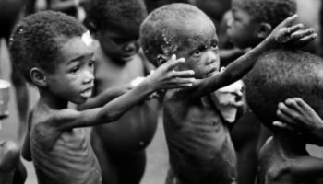
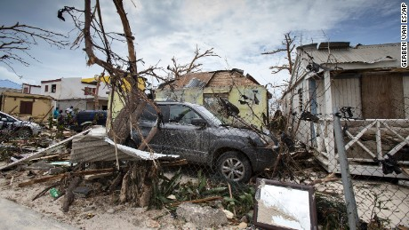
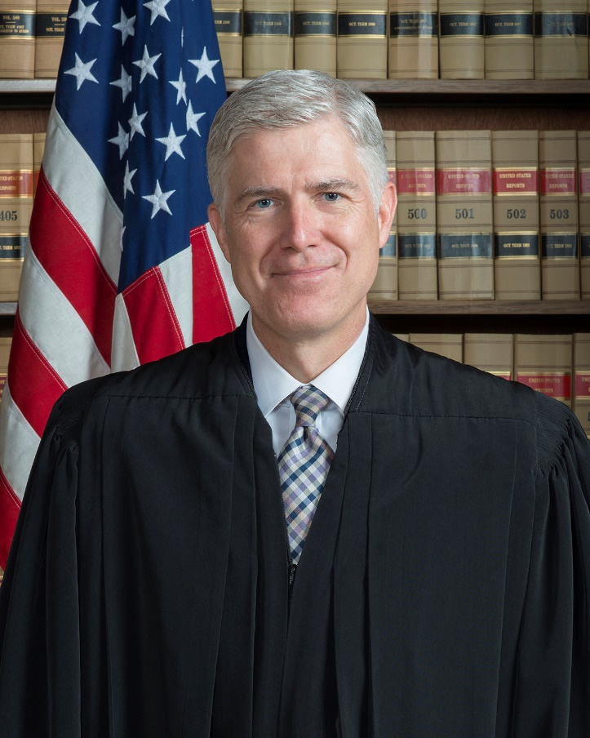
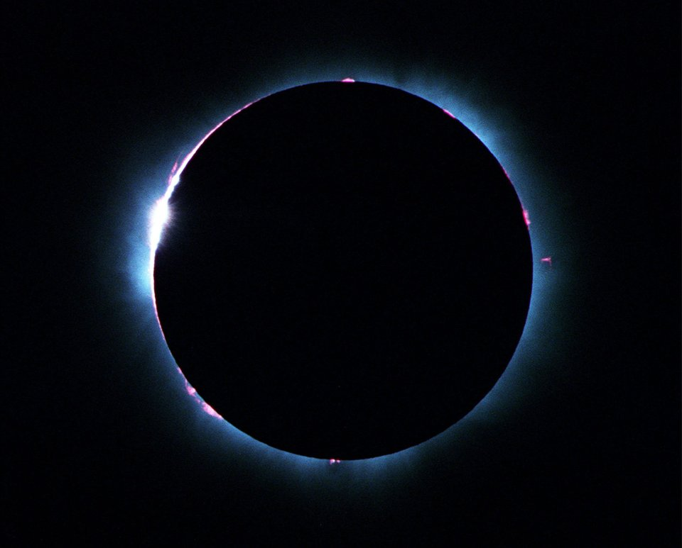
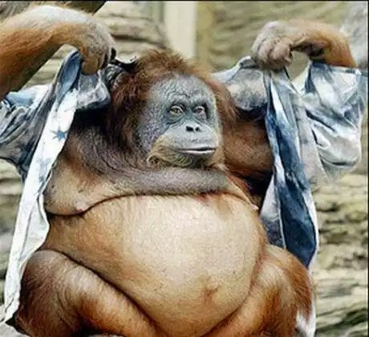
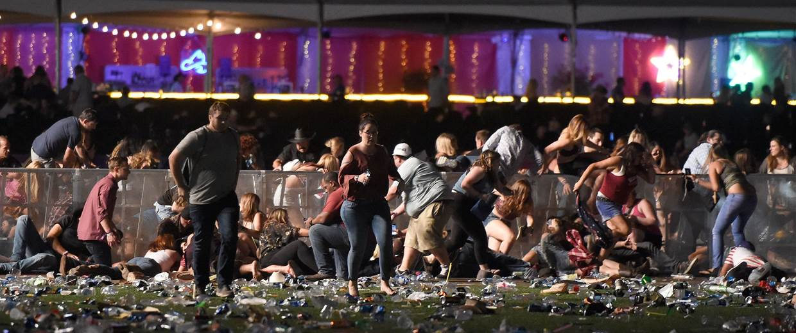
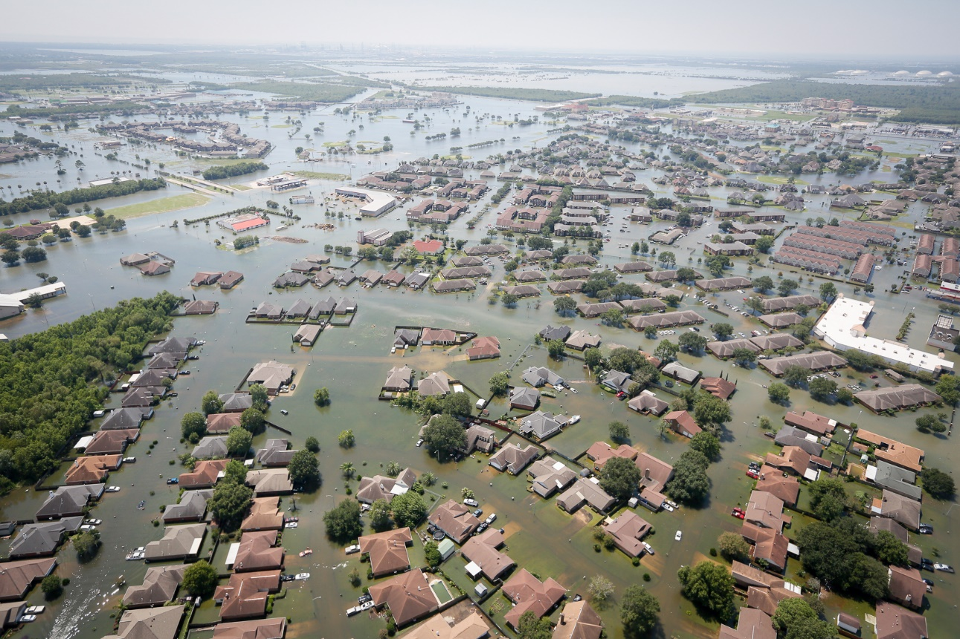
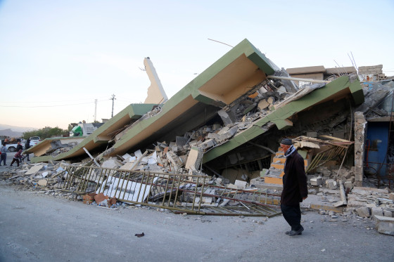
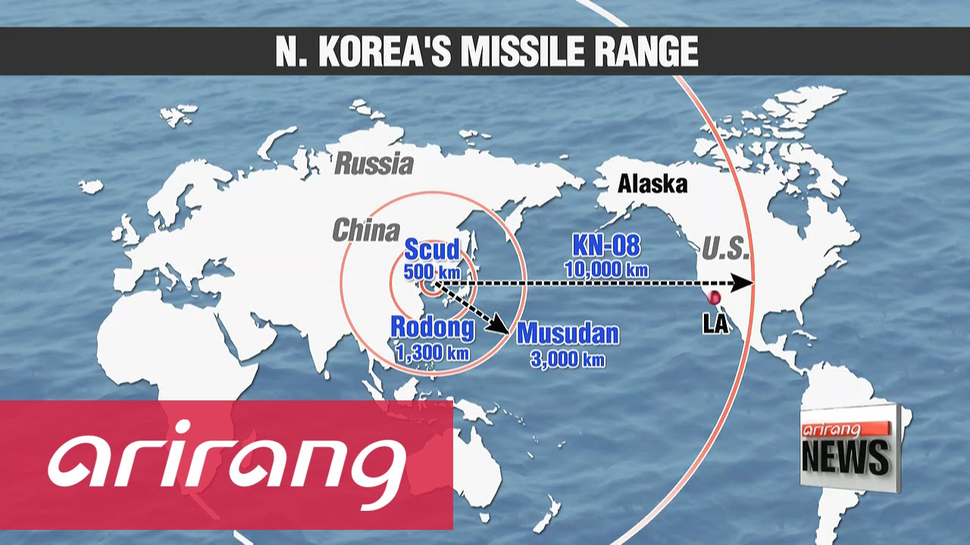
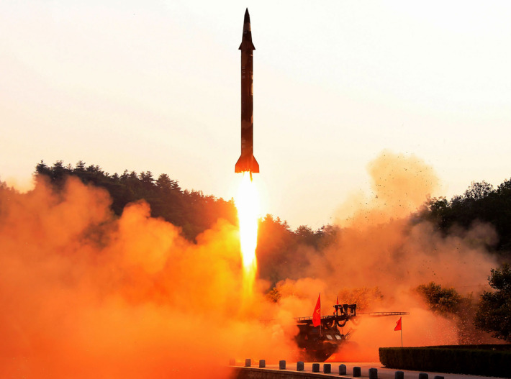

Slide 2
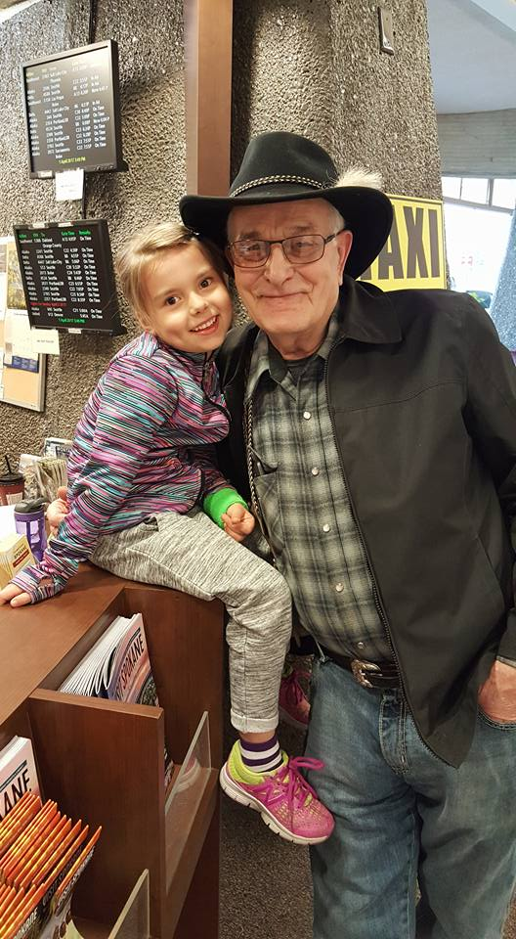
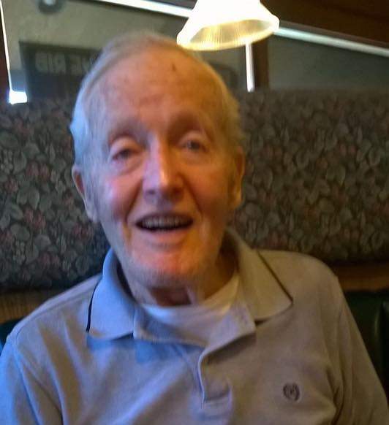
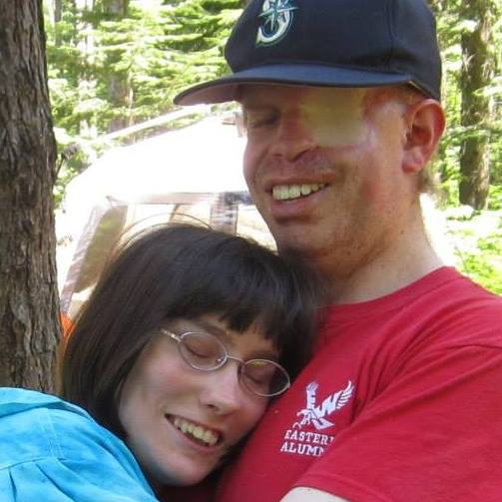

Slide 3
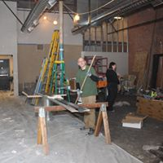
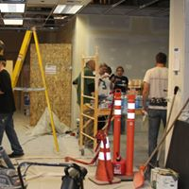

Slide 4
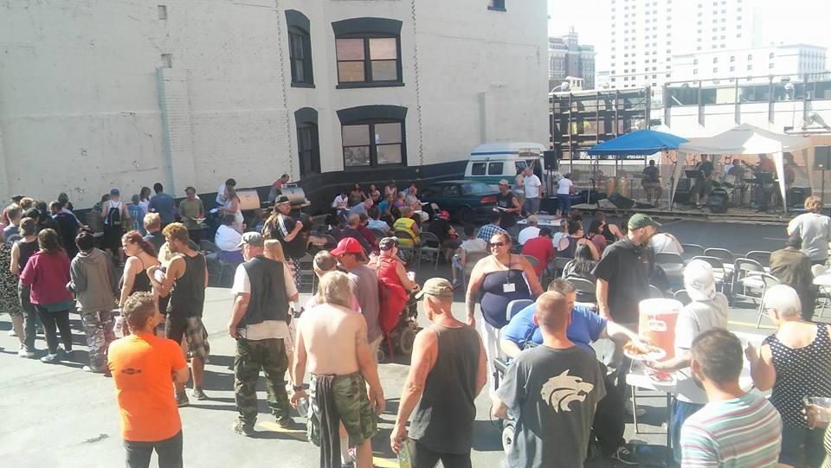

Slide 6
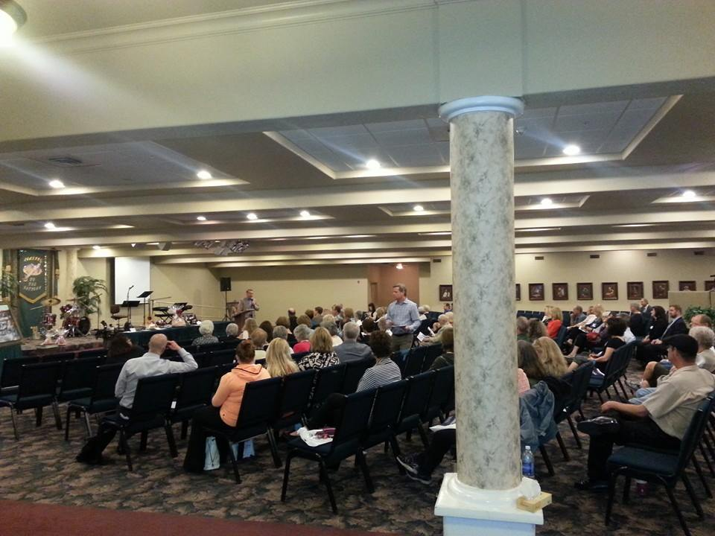

Slide 8
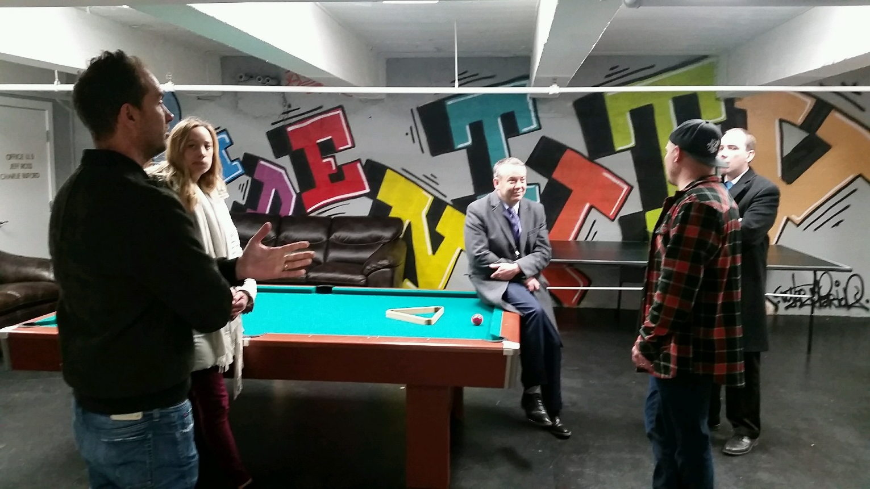
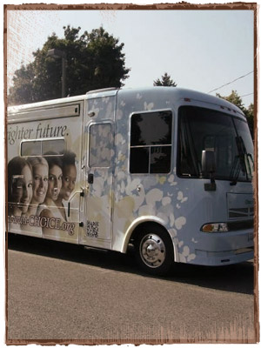
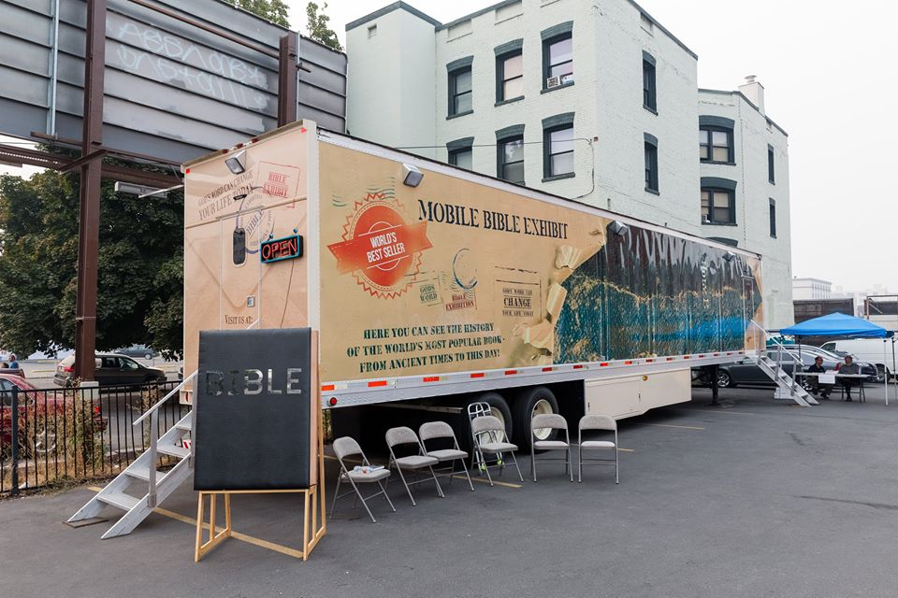

Slide 10
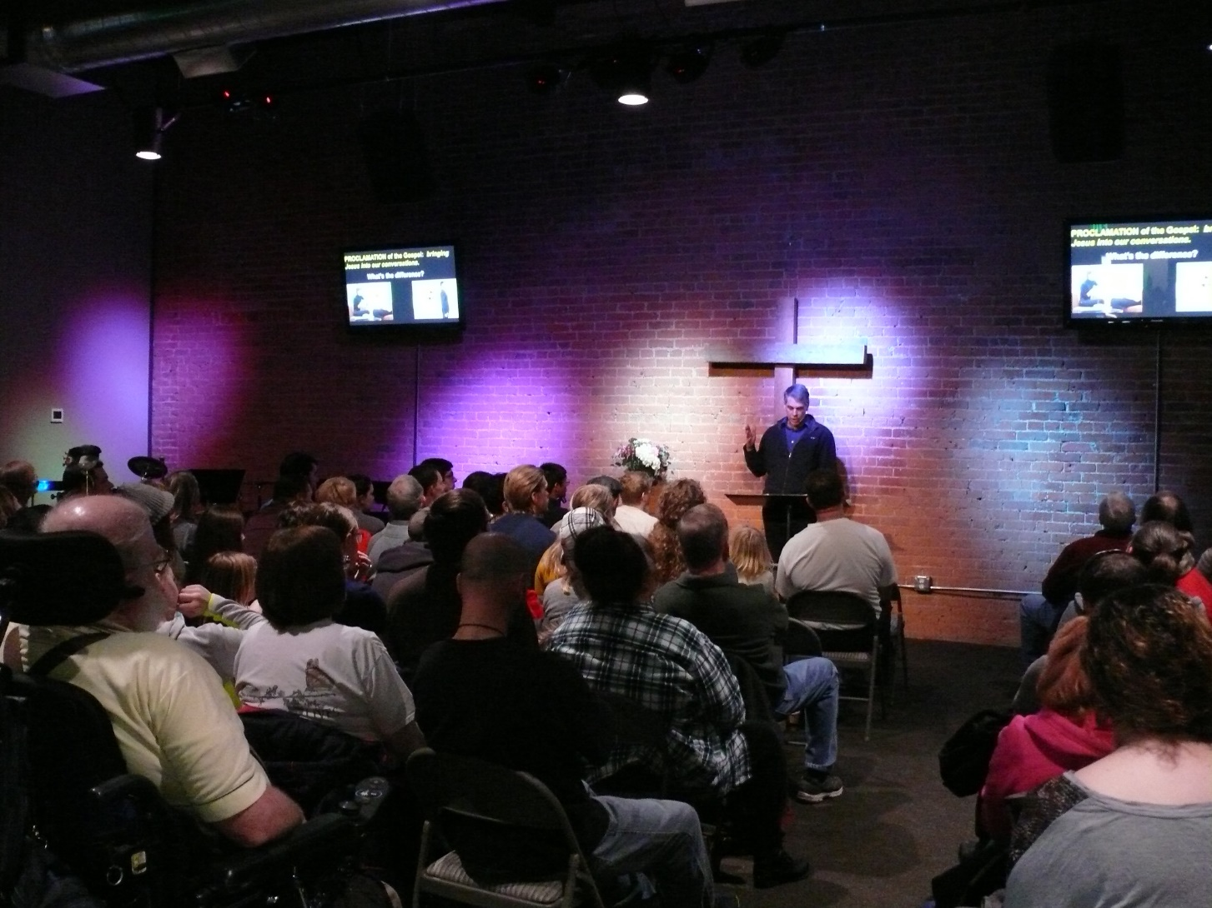

Slide 11
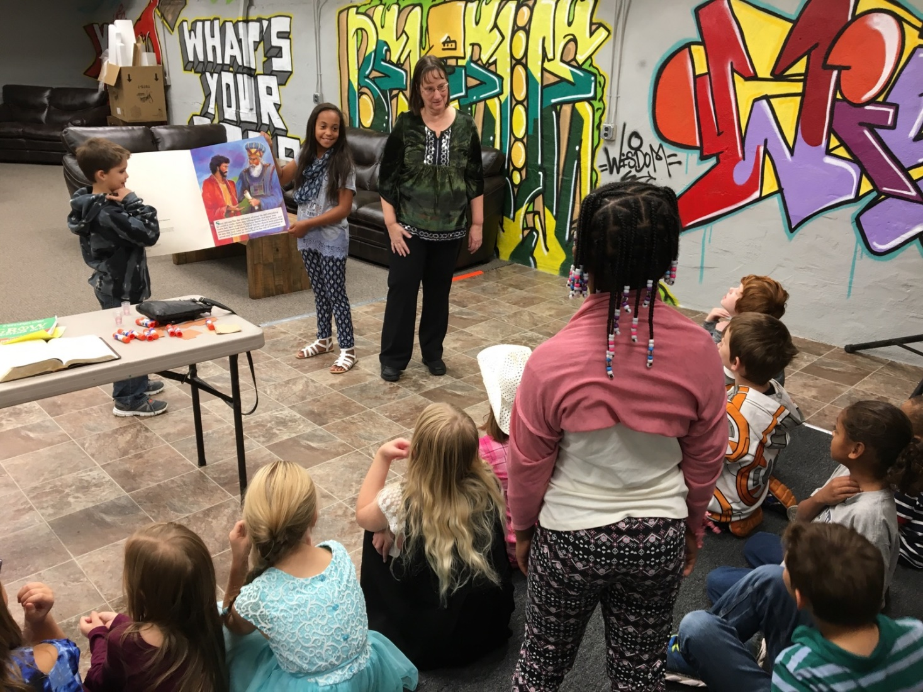

Slide 12
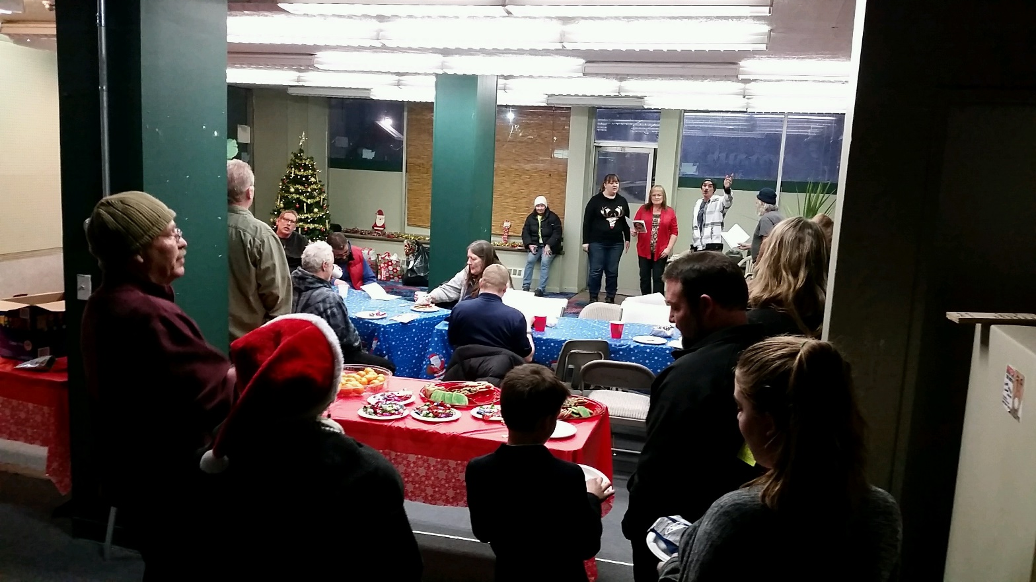

Slide 13
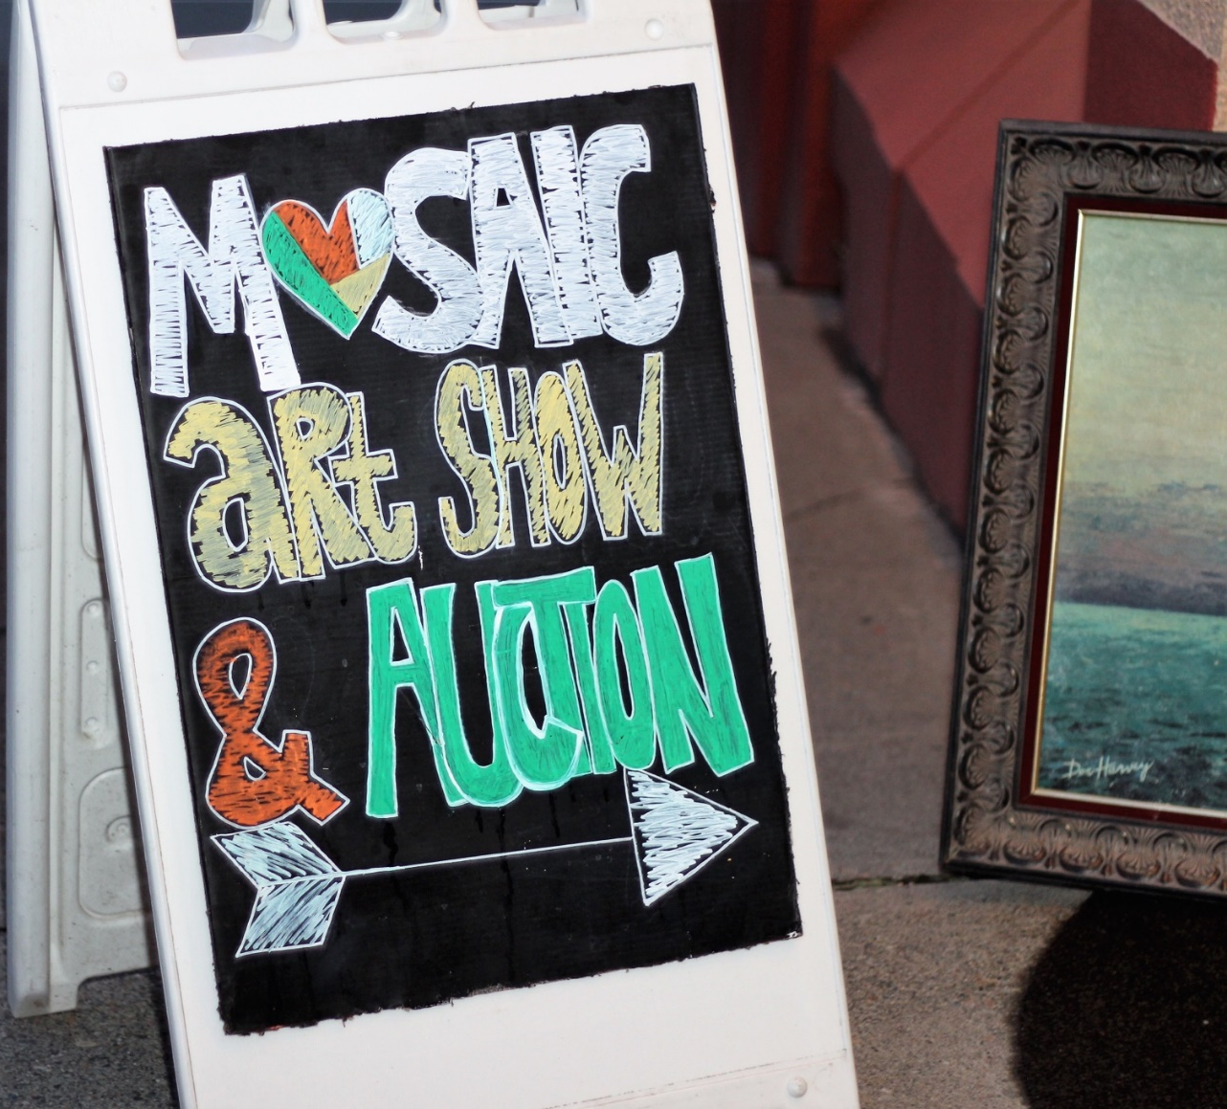
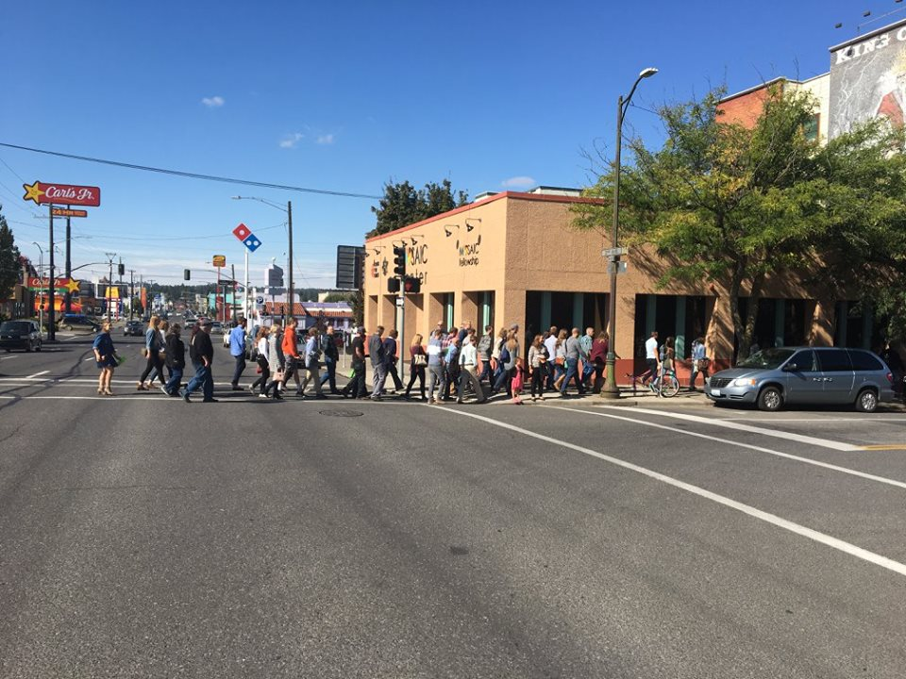

Slide 14
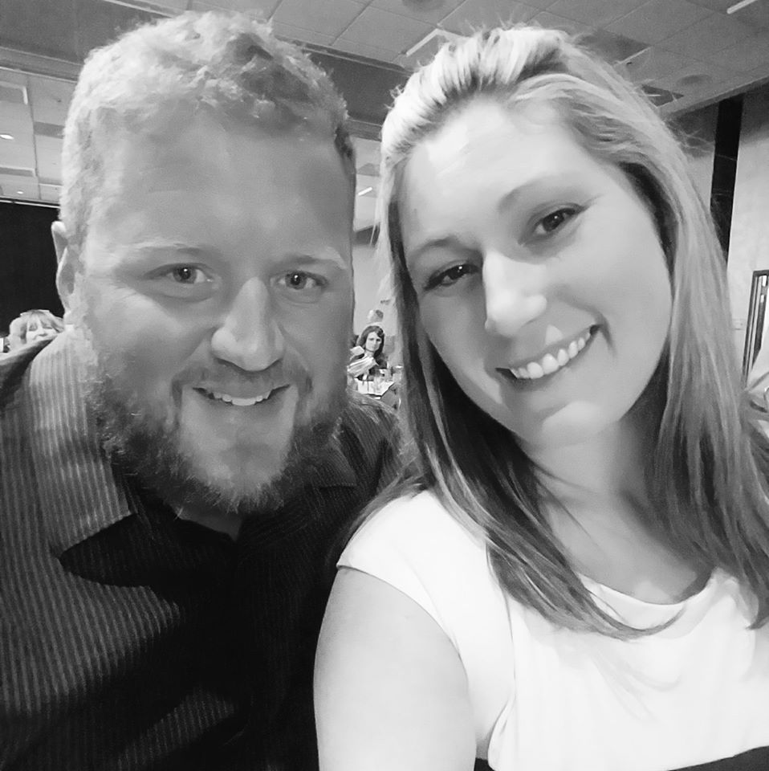
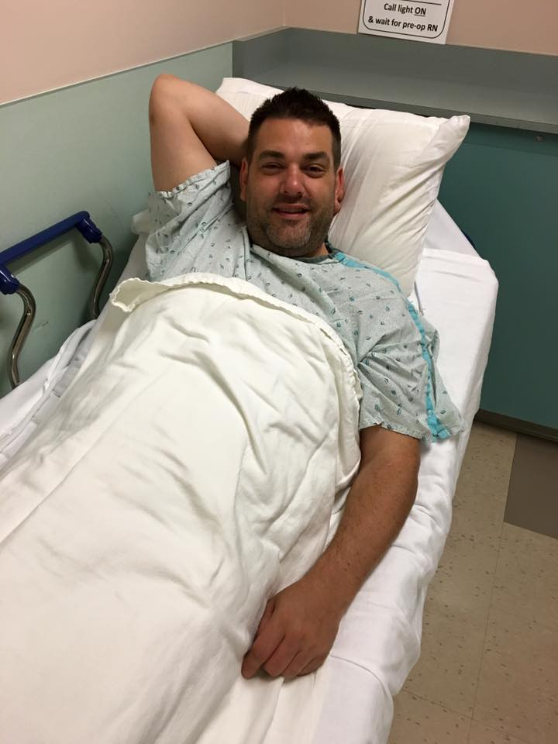
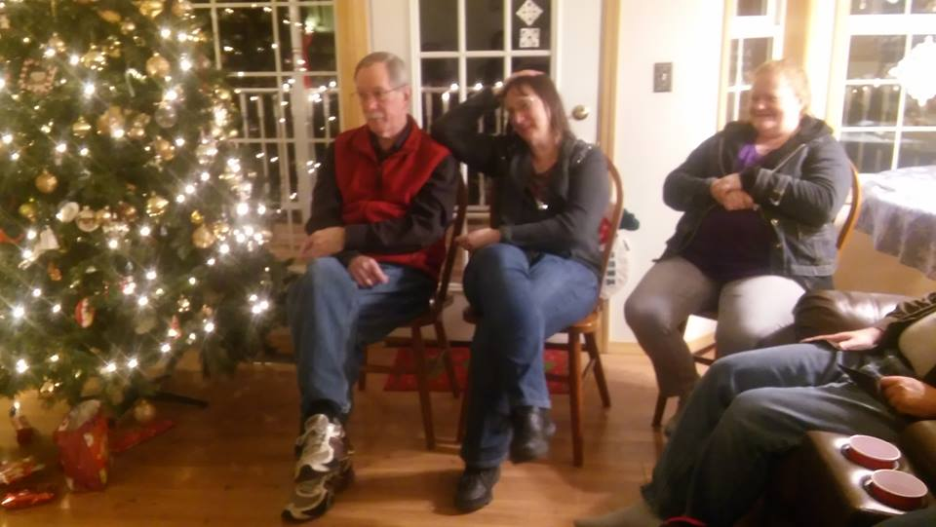

Slide 16
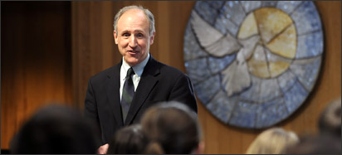
Academy of Christian Discipleship

Slide 17
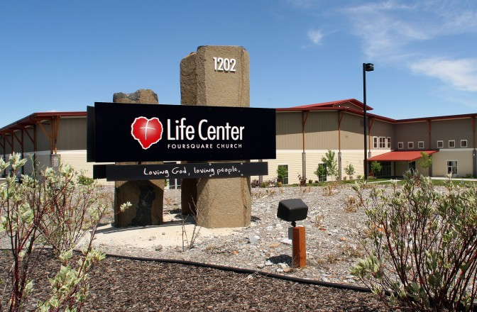
$70,000 No-Interest Loans from Mosaic Members
$25,000 Gift from Life center
$42,000 Total Building Fund Gifts

Slide 18
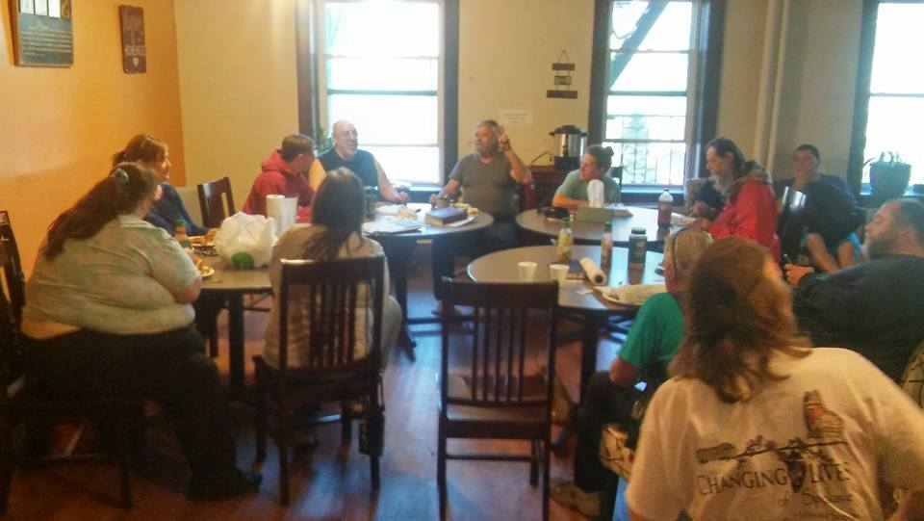

Slide 19
Deuteronomy 5:15—“Remember that you were slaves in Egypt and that the Lord your God brought you out of there with a mighty hand and an outstretched arm.” Ephesians 2:12, 13—“Remember that at that time you were separate from Christ, excluded from citizenship in Israel and foreigners to the covenants of the promise, without hope and without God in the world. ¹³ But now in Christ Jesus you who once were far away have been brought near by the blood of Christ.”

Slide 20
Psalm 77:11 “I will remember the deeds of the Lord; yes, I will remember your miracles of long ago.” Psalm 105:5 “Remember the wonders he has done, his miracles, and the judgments he pronounced….”

Slide 21
Psalm 103:1-5— Praise the Lord, my soul; all my inmost being, praise his holy name. ² Praise the Lord, my soul, and forget not all his benefits— ³ who forgives all your sins and heals all your diseases, ⁴ who redeems your life from the pit and crowns you with love and compassion, ⁵ who satisfies your desires with good things so that your youth is renewed like the eagle’s.

Slide 22
John 15:20—“Remember what I told you: ‘A servant is not greater than his master.’ If they persecuted me, they will persecute you also. If they obeyed my teaching, they will obey yours also.” 2 Timothy 2:8—Remember Jesus Christ, raised from the dead, descended from David. This is my gospel….”

Slide 23
Things I am thankful and grateful to God for in 2017 are…

Slide 24
Letting Go….

Slide 25
Ephesians 4:31, 32—Get rid of all bitterness, rage and anger, brawling and slander, along with every form of malice. ³² Be kind and compassionate to one another, forgiving each other, just as in Christ God forgave you. Mark 11:25—And when you stand praying, if you hold anything against anyone, forgive them, so that your Father in heaven may forgive you your sins.”

Slide 26
Colossians 3:13 Bear with each other and forgive one another if any of you has a grievance against someone. Forgive as the Lord forgave you.

Slide 27
The names (or an initial) and a descriptive word about an incident that you want to let go of…or forgive.

Slide 28
I Peter 3:10-12 “Whoever would love life and see good days must keep their tongue from evil and their lips from deceitful speech. ¹¹ They must turn from evil and do good; they must seek peace and pursue it. ¹² For the eyes of the Lord are on the righteous and his ears are attentive to their prayer, but the face of the Lord is against those who do evil.”

Slide 29
I Peter 3:10-12 “Whoever would love life and see good days Zoe (Gk.) = shared life with God Agape (Gk.) = self-sacrificing love

Slide 30
“Whoever wants to do what is in the best interest of this shared life with God…whoever wants to steward well this life we have both now and forever with Jesus….”

Slide 31
I Peter 3:10-12 “Whoever would love life and see good days….
MEANS…living out the goodness of God in our world.

Slide 32
Adult Education (Sun. a.m.): --Experiencing the Spiritual Practices --Theology of Christ & Salvation
Academy of Christian Discipleship:
--Tuesday & Wednesday cohorts
Changing Lives:
--Thursday evening: 12-Step Studies
Mentoring & Small Groups

Slide 33
I Peter 3:10-12 “Whoever would love life and see good days must keep their tongue from evil and their lips from deceitful speech. ¹¹ They must turn from evil and do good; they must seek peace and pursue it. ¹² For the eyes of the Lord are on the righteous and his ears are attentive to their prayer, but the face of the Lord is against those who do evil.”

Slide 34
I Peter 3:8, 9 All of you, be like-minded, be sympathetic, love one another, be compassionate and humble. ⁹ Do not repay evil with evil or insult with insult. On the contrary, repay evil with blessing, because to this you were called so that you may inherit a blessing.

Slide 35
I Peter 3:10-12 “Whoever would love life and see good days must keep their tongue from evil and their lips from deceitful speech. ¹¹ They must turn from evil and do good; they must seek peace and pursue it. ¹² For the eyes of the Lord are on the righteous and his ears are attentive to their prayer, but the face of the Lord is against those who do evil.”

Slide 36
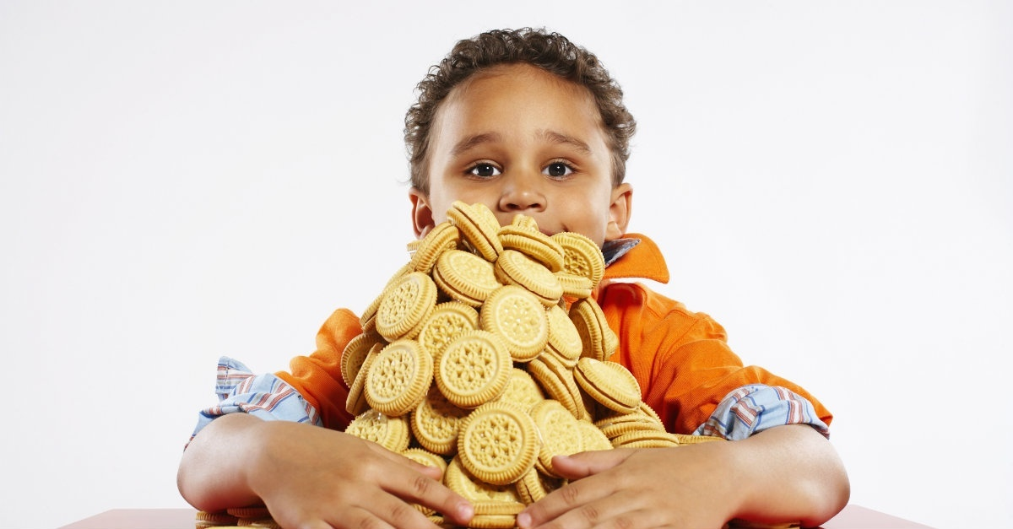
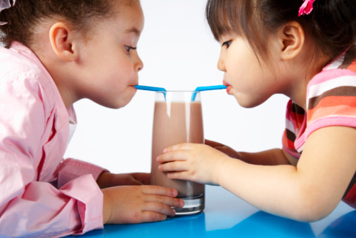
Greed
verses...
giving

Slide 37
I would love to have God’s favor as I do the following good this coming year: >YFC dinners >Neighborhood Outreach Teams >Changing Lives Min. >Mosaic Ministries >???

