Slide 1
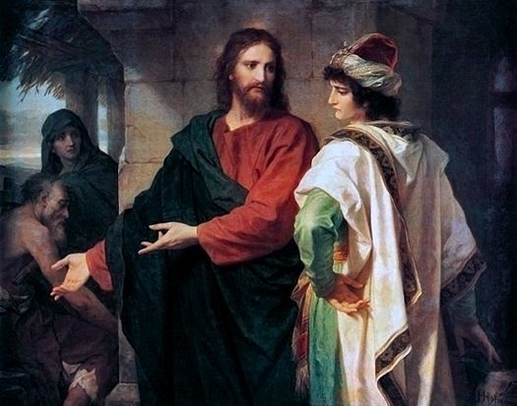
Series:
Christ Encounters
in the Gospels
Mark 10:17-27
“The Rich
Young Man”
Painting by Heinrich Hoffmann, 1889

Slide 2
Mark 10:17-27

Slide 3
Observations about this young man:
¹⁷ And as he was setting out on his journey, a man ran up and knelt before him and asked him, “Good Teacher, what must I do to inherit eternal life?”

Slide 4
Observations about this young man:
^{i. He is eagerly seeking,}
^{ii. respectful/reverent,}
iii. acknowledges Jesus as wise,
iv. spiritually oriented/seeking

Slide 5
Truth #1:
Some people who appear to earnestly be seeking truth and God, are not ACTUALLY seeking with their whole heart.

Slide 6
Jeremiah 29:13
(God through Jeremiah to the Israelites after 70 year exile)
¹³ You will seek me and find me when you seek me with all your heart.
Matthew 7:7-8
^{(Jesus speaking)}
⁷ “Ask and it will be given to you;
seek and you will find;
knock and the door will be opened to you.

Slide 7
¹⁷ And as he was setting out on his journey, a man ran up and knelt before him and asked him, “Good Teacher, what must I do to inherit eternal life?”
¹⁸ And Jesus said to him,
“Why do you call me good?
No one is good except God alone.

Slide 8
What is Jesus doing here?
Option 1: Jesus is trying to tell the rich man something about himself. Namely, that Jesus is not good and not God.
Option 2: Jesus is trying to get the rich man to think about what he means by “good” so that the man realizes he (the rich man) is not good compared to God.

Slide 9
¹⁹ You know the commandments:
VI: Do not murder,
VII: Do not commit adultery,
VIII: Do not steal,
IX: Do not bear false witness,
: Do not defraud,
V: Honor your father and mother.’”
²⁰ And he said to him,
“Teacher, all these I have kept from my youth.”

Slide 10
Truth #2:
Most people view themselves as “pretty good”, but they are not.

Slide 11
²¹ And Jesus, looking at him, loved him, and said to him, “You lack one thing: go, sell all that you have and give to the poor, and you will have treasure in heaven; and come, follow me.”
²² Disheartened by the saying, he went away sorrowful, for he had great possessions.

Slide 12
Truth #3:
Jesus points out your sin to you because he LOVES you.

Slide 13
Truth #4:
God demands we love him with our entire heart.

Slide 14
Truth #4:
Jesus demands we love him with our entire heart.
Q. What idol(s) tempts your heart away from the lordship of Jesus?

Slide 15
Truth #5:
“he went away sorrowful” (v. 22)
Following Jesus will result in sadness/pain to our flesh.

Slide 16
Matthew 16:24-26
²⁴ Then Jesus told his disciples, “If anyone would come after me, let him deny himself and
take up his cross and follow me.

Slide 17
1 Peter 2:24
²⁴ “He himself bore our sins” in his body on the cross,
so that we might die to sins and live for righteousness;
“by his wounds you have been healed.”

Slide 18
Romans 8:12-17
¹² Therefore, brothers and sisters, we have an obligation—but it is not to the flesh, to live according to it. ¹³ For if you live according to the flesh, you will die; but if by the Spirit you put to death the misdeeds of the body, you will live.

Slide 19
Romans 8:12-17
¹⁴ For those who are led by the Spirit of God are the children of God. ¹⁵ The Spirit you received does not make you slaves, so that you live in fear again; rather, the Spirit you received brought about your adoption to sonship. And by him we cry, “Abba, Father.” ¹⁶ The Spirit himself testifies with our spirit that we are God’s children. ¹⁷ Now if we are children, then we are heirs—heirs of God and co-heirs with Christ, if indeed we share in his sufferings in order that we may also share in his glory.

Slide 20
Psalm 4:5
Offer the sacrifices of righteousness,
and put your trust in the LORD.

Slide 21
^{(Our Text)}
^{Mark 10:23-27}
…“With man it is impossible, but not with God.
For all things are possible with God.”

Slide 22
Truth #6:
God’s Spirit is needed to crucify the flesh.

Slide 23
Matthew 19 adds...
²⁷ Peter answered him, “We have left everything to follow you! What then will there be for us?”
²⁸ Jesus said to them, “Truly I tell you, at the renewal of all things, when the Son of Man sits on his glorious throne, you who have followed me will also sit on twelve thrones, judging the twelve tribes of Israel. ²⁹ And everyone who has left houses or brothers or sisters or father or mother or wife or children or fields for my sake will receive a hundred times as much and will inherit eternal life. ³⁰ But many who are first will be last, and many who are last will be first.

Slide 24
Truth #7:
The reward of God from righteous living FAR EXCEEDS any satisfaction our flesh gets from sinning.

Slide 25
7 truths from this passage
1. Some people who appear to earnestly be seeking truth and God, are not ACTUALLY seeking with their whole heart.
2. Most people view themselves as “pretty good”, but they are not.
3. Jesus points out your sin to you (convicts) because he LOVES you.
4. God demands we love him with our entire heart.
5. Following Jesus will result in sadness/pain for our flesh.
6. God’s Spirit is needed to crucify the flesh.
7. The reward of God from righteous living FAR EXCEEDS any satisfaction our flesh gets from sinning.

Slide 26
Matthew 6:19-21
Lay Up Treasures in Heaven
¹⁹ “Do not lay up for yourselves treasures on earth, where moth and rust destroy and where thieves break in and steal, ²⁰ but lay up for yourselves treasures in heaven, where neither moth nor rust destroys and where thieves do not break in and steal. ²¹ For where your treasure is, there your heart will be also.

Slide 27
Painting by Heinrich Hoffmann, 1889

