Slide 1
(Part 2) Romans 9:19-29

Slide 2
Romans 9
I speak the truth in Christ—I am not lying, my conscience confirms it through the Holy Spirit— ² I have great sorrow and unceasing anguish in my heart. ³ For I could wish that I myself were cursed and cut off from Christ for the sake of my people, those of my own race, ⁴ the people of Israel.

Slide 3
Romans 9
Theirs is the adoption to sonship; theirs the divine glory, the covenants, the receiving of the law, the temple worship and the promises. ⁵ Theirs are the patriarchs, and from them is traced the human ancestry of the Messiah, who is God over all, forever praised! Amen.

Slide 4
Romans 9
⁶ But it is not as though the word of God has failed. For not all who are descended from Israel belong to Israel, ⁷ and not all are children of Abraham because they are his offspring, but “Through Isaac shall your offspring be named.”

Slide 5
Romans 9
⁸ This means that it is not the children of the flesh who are the children of God, but the children of the promise are counted as offspring. ⁹ For this is what the promise said: “About this time next year I will return, and Sarah shall have a son.” ¹⁰ And not only so, but also when Rebekah had conceived children by one man, our forefather Isaac,

Slide 6
Romans 9
¹¹ though they were not yet born and had done nothing either good or bad—in order that God's purpose of election might continue, not because of works but because of him who calls— ¹² she was told, “The older will serve the younger.” ¹³ As it is written,
“Jacob I loved, but Esau I hated.”

Slide 7
Romans 9
¹⁴ What shall we say then? Is there injustice on God's part? By no means!
¹⁵ For he says to Moses, “I will have mercy on whom I have mercy, and I will have compassion on whom I have compassion.”

Slide 8
Romans 9
¹⁶ So then it depends not on human will or exertion, but on God, who has mercy. ¹⁷ For the Scripture says to Pharaoh, “For this very purpose I have raised you up, that I might show my power in you, and that my name might be proclaimed in all the earth.” ¹⁸ So then he has mercy on whomever he wills, and he hardens whomever he wills.

Slide 9
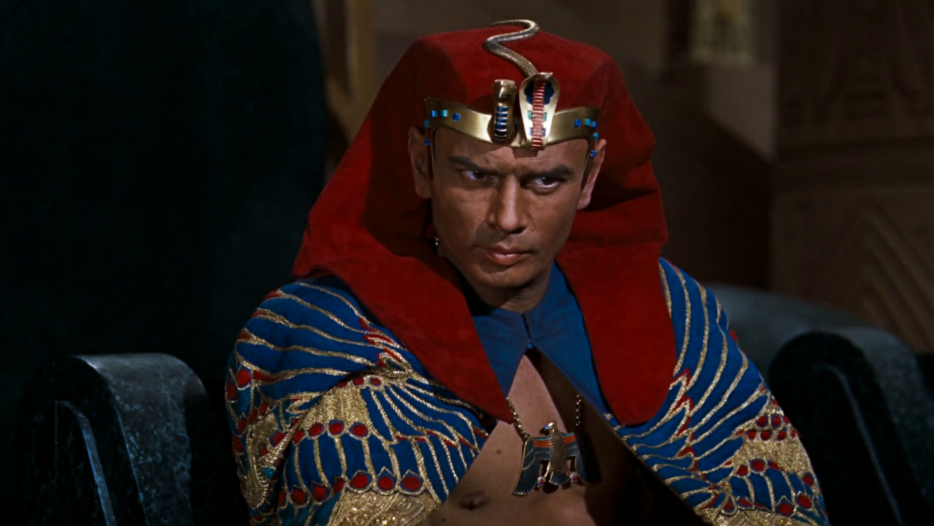
Pharaoh

Slide 10
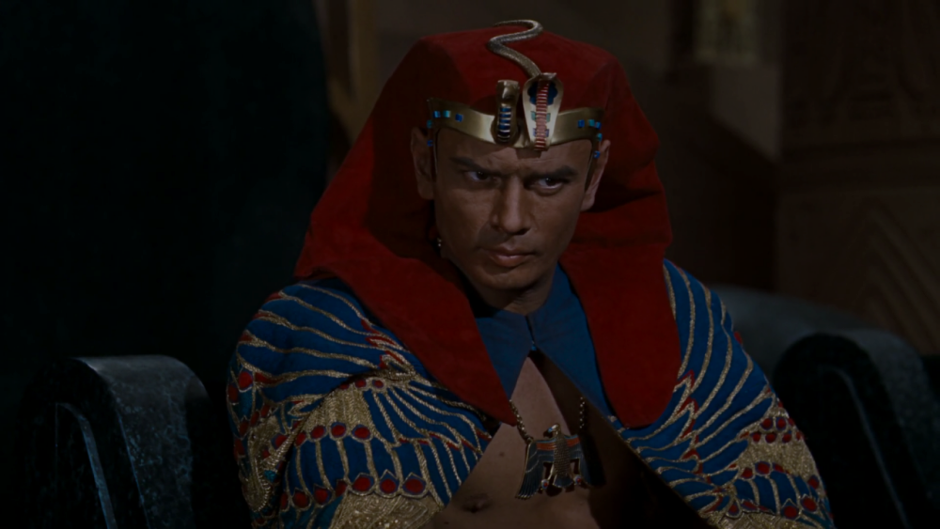
Exodus 7:13
Yet Pharaoh’s heart became hard
and he would not listen to them,
just as the Lord had said.

Slide 11
Exodus 9:12
But the Lord hardened Pharaoh’s heart and he would not listen to Moses and Aaron, just as the Lord had said to Moses.

Slide 12
Exodus 9:34
When Pharaoh saw that the rain and hail and thunder had stopped, he sinned again: He and his officials hardened their hearts.

Slide 13
Exodus
10:1
10:20
10:27
11:10
14:8

Slide 14
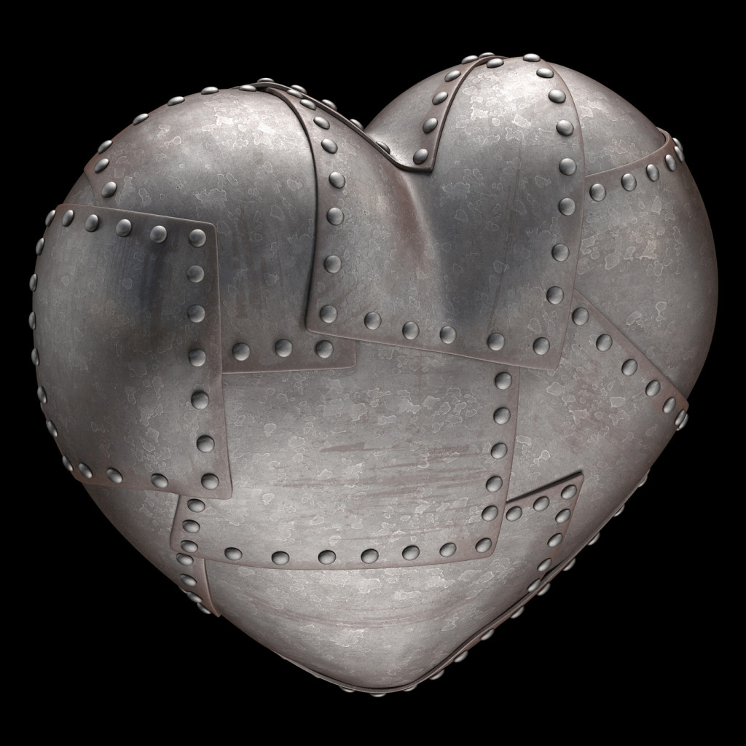
I Samuel 6:6
“Why do you harden your hearts as the Egyptians and Pharaoh did?”

Slide 15
2 Chronicles 36
He became stiff-necked and hardened his heart and would not turn to the Lord, the God of Israel. ¹⁴ Furthermore, all the leaders of the priests and the people became more and more unfaithful, following all the detestable practices of the nations and defiling the temple of the Lord, which he had consecrated in Jerusalem.

Slide 16
Ezekiel 3:7
“But the people of Israel are not willing to listen to you because they are not willing to listen to me, for all the Israelites are hardened and obstinate.”

Slide 17
Daniel 5:21, 22
“His heart became arrogant and hardened with pride… until he acknowledged that the Most High God is sovereign over all kingdoms on earth and sets over them anyone he wishes.”

Slide 18
Mark 6:51, 52
Then he climbed into the boat with them, and the wind died down. They were completely amazed, ⁵² for they had not understood about the loaves; their hearts were hardened.

Slide 19
Mark 8
Jesus asked them: “Why are you talking about having no bread? Do you still not see or understand? Are your hearts hardened?
¹⁸ Do you have eyes but fail to see, and ears but fail to hear? And don’t you remember? ¹⁹ When I broke the five loaves for the five thousand, how many basketfuls of pieces did you pick up?”

Slide 20
Mark 8
“Twelve,” they replied.
²⁰ “And when I broke the seven loaves for the four thousand, how many basketfuls of pieces did you pick up?”
They answered, “Seven.”
²¹ He said to them, “Do you
still not understand?”

Slide 21
John 12
³⁷ Even after Jesus had performed so many signs in their presence, they still would not believe in him. ³⁸ This was to fulfill the word of Isaiah the prophet:
“Lord, who has believed our message and to whom has the arm of the Lord been revealed?”

Slide 22
John 12
³⁹ For this reason they could not believe, because, as Isaiah says elsewhere: [Is. 6:10]
⁴⁰ “He has blinded their eyes and hardened their hearts, so they can neither see with their eyes, nor understand with their hearts, nor turn—and I would heal them.”

Slide 23
John 12
⁴¹ Isaiah said this because he saw Jesus’ glory and spoke about him. ⁴² Yet at the same time many even among the leaders believed in him. But because of the Pharisees they would not openly acknowledge their faith for fear they would be put out of the synagogue; ⁴³ for they loved human praise more than praise from God.

Slide 24
WHY God hardened the Jewish people:
1.) In response to their continued hardening of their hearts to Christ.

Slide 25
WHY God hardened the Jewish people:
1.) In response to their continued hardening of their hearts to Christ.
2.) To ensure a better plan—the crucifixion and resurrection of Jesus.

Slide 26
Romans 11:25, 26
“I do not want you to be ignorant of this mystery, brothers and sisters, so that you may not be conceited: Israel has experienced a hardening in part until the full number of the Gentiles has come in, ²⁶ and in this way all Israel will be saved.”

Slide 27
Hebrews 3
6) But Christ is faithful as the Son over God’s house. And we are his house, if indeed we hold firmly to our confidence and the hope in which we glory.
7) So, as the Holy Spirit says:
“Today, if you hear his voice, 8) do not harden your hearts as you did in the rebellion, during the time of testing in the wilderness, 9) where your ancestors tested and tried me, though for forty years they saw what I did.

Slide 28
Hebrews 3
¹² See to it, brothers and sisters, that none of you has a sinful, unbelieving heart that turns away from the living God. ¹³ But encourage one another daily, as long as it is called “Today,” so that none of you may be hardened by sin’s deceitfulness. ¹⁴ We have come to share in Christ, if indeed we hold our original conviction firmly to the very end. ¹⁵ As has just been said: “Today, if you hear his voice, do not harden your hearts as you did in the rebellion.” [Psalm 95:8]

Slide 29
HOW DOES HARDENING OF THE HEART HAPPEN?

Slide 30
Romans 9:17-18
¹⁷ For Scripture says to Pharaoh: “I raised you up for this very purpose, that I might display my power in you and that my name might be proclaimed in all the earth.”

Slide 31
Romans 9:17-18
¹⁸ Therefore God has mercy on whom he wants to have mercy, and he hardens whom he wants to harden.

Slide 32
Romans 9:19-21
¹⁹ One of you will say to me: “Then why does God still blame us? For who is able to resist his will?” ²⁰ But who are you, a human being, to talk back to God? “Shall what is formed say to the one who formed it, ‘Why did you make me like this?’” ²¹ Does not the potter have the right to make out of the same lump of clay some pottery for special purposes and some for common use?

Slide 33
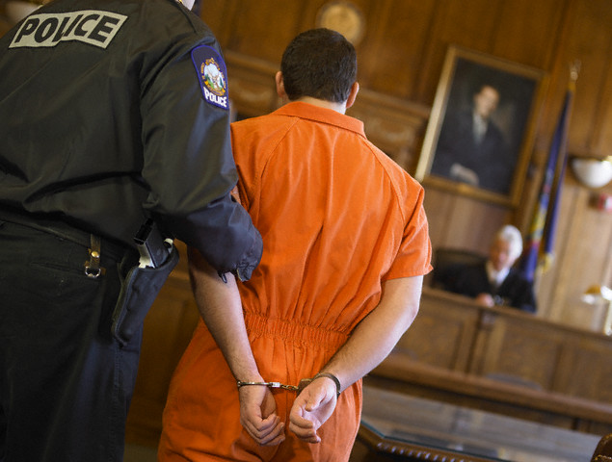
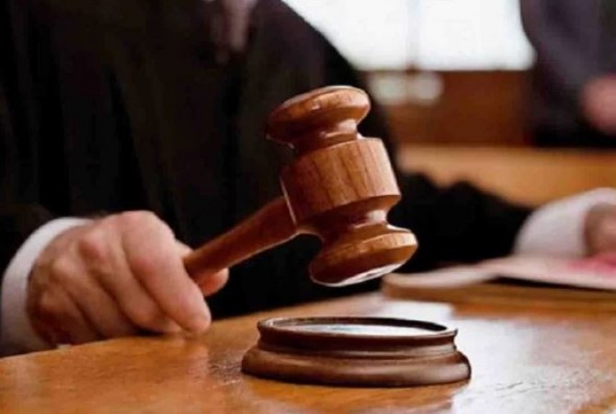

Slide 34
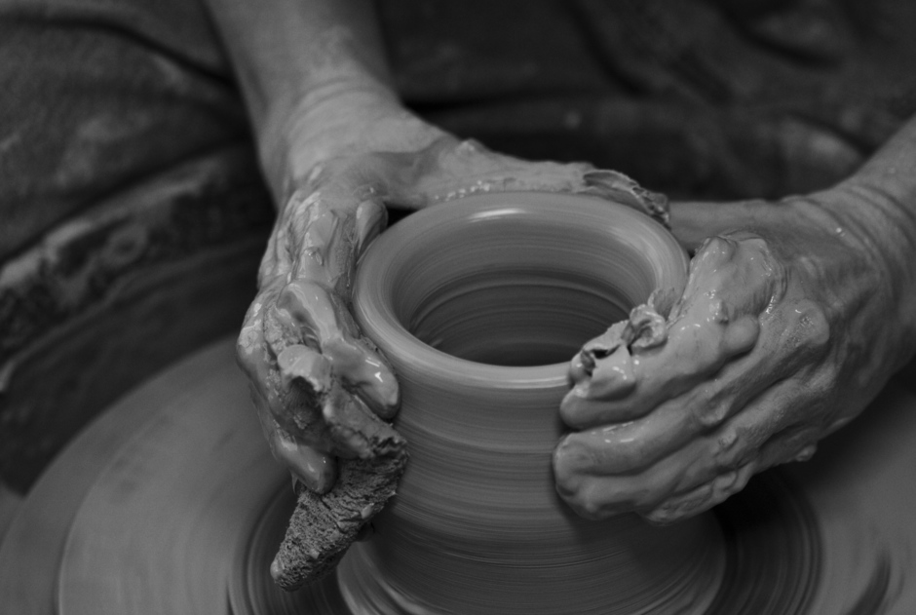

Slide 35
Romans 9:22-24
What if God, although choosing to show his wrath and make his power known, bore with great patience the objects of his wrath—prepared for destruction? ²³ What if he did this to make the riches of his glory known to the objects of his mercy, whom he prepared in advance for glory— ²⁴ even us, whom he also called, not only from the Jews but also from the Gentiles?

Slide 36
Romans 11
³³ Oh, the depth of the riches of the wisdom and knowledge of God! How unsearchable his judgments, and his paths beyond tracing out! ³⁴ “Who has known the mind of the Lord? Or who has been his counselor?”
³⁵ “Who has ever given to God, that God should repay them?”

Slide 37
Romans 11
³⁶ For from him and through him and for him are all things. To him be the glory forever! Amen.

