Slide 1
Romans 9:14-18

Slide 2
Foreknowledge
Predestination
Election Free will Justice

Slide 3
Abraham & Sarah
Ishmael
Isaac & Rebecca
Esau
Jacob
Israel
& the Messiah

Slide 4
Romans 9:14-18
¹⁴ What shall we say then? Is there injustice on God's part? By no means!
¹⁵ For he says to Moses, “I will have mercy on whom I have mercy, and I will have compassion on whom I have compassion.”

Slide 5
Romans 9:14-18
¹⁶ So then it depends not on human will or exertion, but on God, who has mercy. ¹⁷ For the Scripture says to Pharaoh, “For this very purpose I have raised you up, that I might show my power in you, and that my name might be proclaimed in all the earth.” ¹⁸ So then he has mercy on whomever he wills, and he hardens whomever he wills.

Slide 6
Romans 9
¹⁴ What shall we say then? Is there injustice on God's part? By no means!

Slide 8
Two Different Questions:
Vs. 14— “What shall we say then? Is there injustice on God’s part?”
Vs. 19– “One of you will say to me: ‘Then why does God still blame us?’”

Slide 9
Some…
…everyone

Slide 13
Romans 9
¹⁴ What shall we say then? Is there injustice on God's part? By no means!

Slide 14
Romans 9
¹⁵ For he says to Moses, “I will have mercy on whom I have mercy, and I will have compassion on whom I have compassion.” ¹⁶ So then it depends not on human will or exertion, but on God, who has mercy.

Slide 15
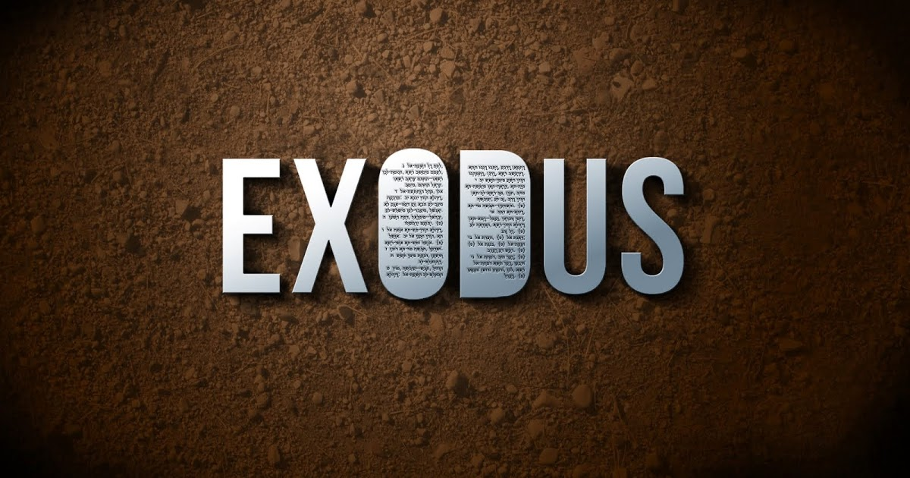
32-33

Slide 16
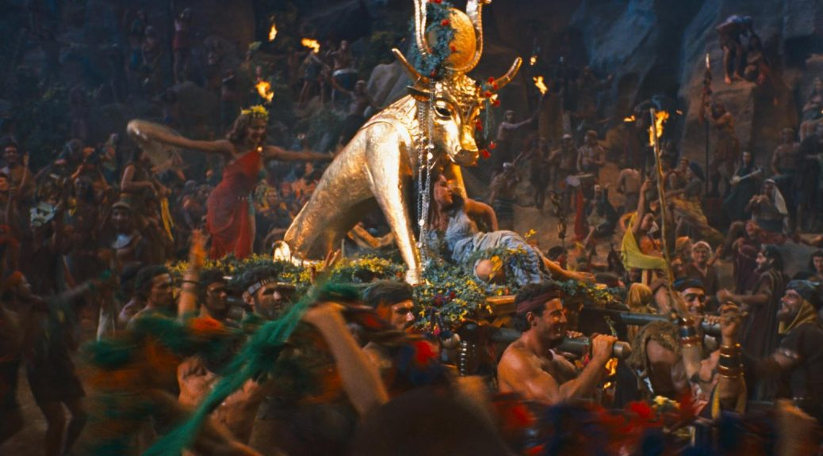

Slide 17
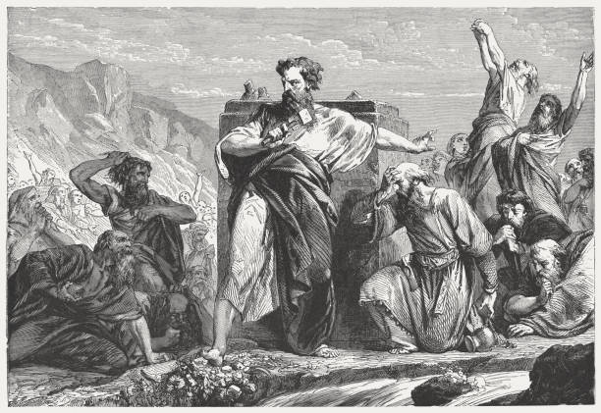

Slide 18
Exodus 32
³⁰ The next day Moses said to the people, “You have sinned a great sin. And now I will go up to the Lord; perhaps I can make atonement for your sin.” ³¹ So Moses returned to the Lord and said, “Alas, this people has sinned a great sin. They have made for themselves gods of gold. ³² But now, if you will forgive their sin—but if not, please blot me out of your book that you have written.”

Slide 19
Exodus 32
³³ But the Lord said to Moses, “Whoever has sinned against me, I will blot out of my book.
³⁴ But now go, lead the people to the place about which I have spoken to you; behold, my angel shall go before you. Nevertheless, in the day when I visit, I will visit their sin upon them.”

Slide 20
Exodus 33
When the people heard this disastrous word, they mourned, and no one put on his ornaments.
⁵ For the Lord had said to Moses, “Say to the people of Israel, ‘You are a stiff-necked people; if for a single moment I should go up among you, I would consume you. So now take off your ornaments, that I may know what to do with you.’” ⁶ Therefore the people of Israel stripped themselves of their ornaments, from Mount Horeb onward.

Slide 21
Exodus 33
¹⁵ And he said to him, “If your presence will not go with me, do not bring us up from here. ¹⁶ For how shall it be known that I have found favor in your sight, I and your people? Is it not in your going with us, so that we are distinct, I and your people, from every other people on the face of the earth?”

Slide 22
Exodus 33
¹⁷ And the Lord said to Moses, “This very thing that you have spoken I will do, for you have found favor in my sight, and I know you by name.” ¹⁸ Moses said, “Please show me your glory.” ¹⁹ And he said, “I will make all my goodness pass before you and will proclaim before you my name ‘The Lord.’ And I will be gracious to whom I will be gracious, and will show mercy on whom I will show mercy.

Slide 23
Romans 9:16
So then it depends not on human will or exertion, but on God, who has mercy.

Slide 24
John 1
¹² But to all who did receive him, who believed in his name, he gave the right to become children of God, ¹³ who were born, not of blood nor of the will of the flesh nor of the will of man, but of God.

Slide 25
Romans 9
¹⁷ For the Scripture says to Pharaoh, “For this very purpose I have raised you up, that I might show my power in you, and that my name might be proclaimed in all the earth.” ¹⁸ So then he has mercy on whomever he wills, and he hardens whomever he wills.

Slide 26
Romans 9
For the Scripture says to Pharaoh, “For this very purpose I have raised you up, that I might show my power in you, and that my name might be proclaimed in all the earth.”

Slide 27
Exodus 9:15
For by now I could have stretched out my hand and struck you and your people with a plague that would have wiped you off the earth. But I have raised you up for this very purpose, that I might show you my power and that my name might be proclaimed in all the earth.”

Slide 28
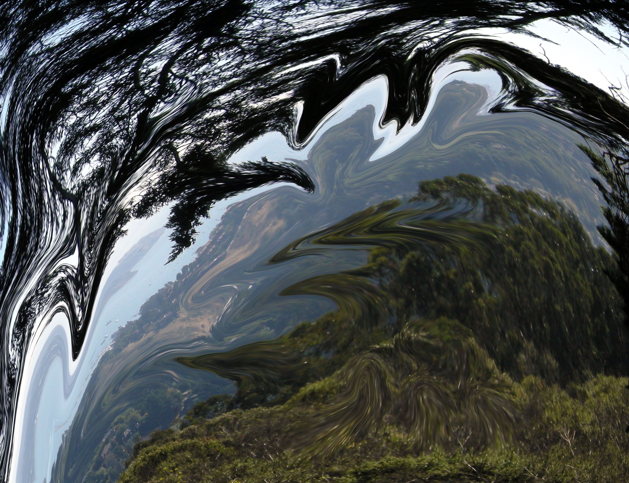
Warped view of God???

