Slide 1
Chosen…& Choosing Romans 9

Slide 2
Romans 9:6ff
⁶ But it is not as though the word of God has failed. For not all who are descended from Israel belong to Israel, ⁷ and not all are children of Abraham because they are his offspring, but “Through Isaac shall your offspring be named.”

Slide 3
Romans 9:6ff
⁸ This means that it is not the children of the flesh who are the children of God, but the children of the promise are counted as offspring. ⁹ For this is what the promise said: “About this time next year I will return, and Sarah shall have a son.” ¹⁰ And not only so, but also when Rebekah had conceived children by one man, our forefather Isaac,

Slide 4
Romans 9:6ff
¹¹ though they were not yet born and had done nothing either good or bad—in order that God's purpose of election might continue, not because of works but because of him who calls— ¹² she was told, “The older will serve the younger.” ¹³ As it is written, “Jacob I loved, but Esau I hated.”

Slide 5
Romans 9:6
But it is not as though the word of God has failed.

Slide 6
Romans 9:6
But it is not as though the word of God has failed.
THE INTEGRITY OF
GOD’S PROMISES

Slide 7
Romans 9:6-7
For not all who are descended from Israel belong to Israel, ⁷ and not all are children of Abraham because they are his offspring.
NOT EVERY DESCENDANT OF JACOB IS AN ISRAELITE

Slide 8
Romans 9:7-8
⁷ and not all are children of Abraham because they are his offspring, but “Through Isaac shall your offspring be named.”
⁸ This means that it is not the children of the flesh who are the children of God, but the children of the promise are counted as offspring.

Slide 9
A CHILD OF THE FLESH
verses
A CHILD OF PROMISE
Romans 9:8—This means that it is not the children of the flesh who are the children of God, but the children of the promise are counted as offspring.

Slide 10
Romans 9:8
⁸ This means that it is not the children of the flesh who are the children of God, but the children of the promise are counted as offspring. ⁹ For this is what the promise said: “About this time next year I will return, and Sarah shall have a son.”

Slide 11
Romans 9:10-12
¹⁰ And not only so, but also when Rebekah had conceived children by one man, our forefather Isaac, ¹¹ though they were not yet born and had done nothing either good or bad—in order that God's purpose of election might continue, not because of works but because of him who calls— ¹² she was told, “The older will serve the younger.”

Slide 12
Romans 9:10-12
¹⁰ And not only so, but also when Rebekah had conceived children by one man, our forefather Isaac, ¹¹ though they were not yet born and had done nothing either good or bad—in order that God's purpose of election might continue, not because of works but because of him who calls— ¹² she was told, “The older will serve the younger.”

Slide 13
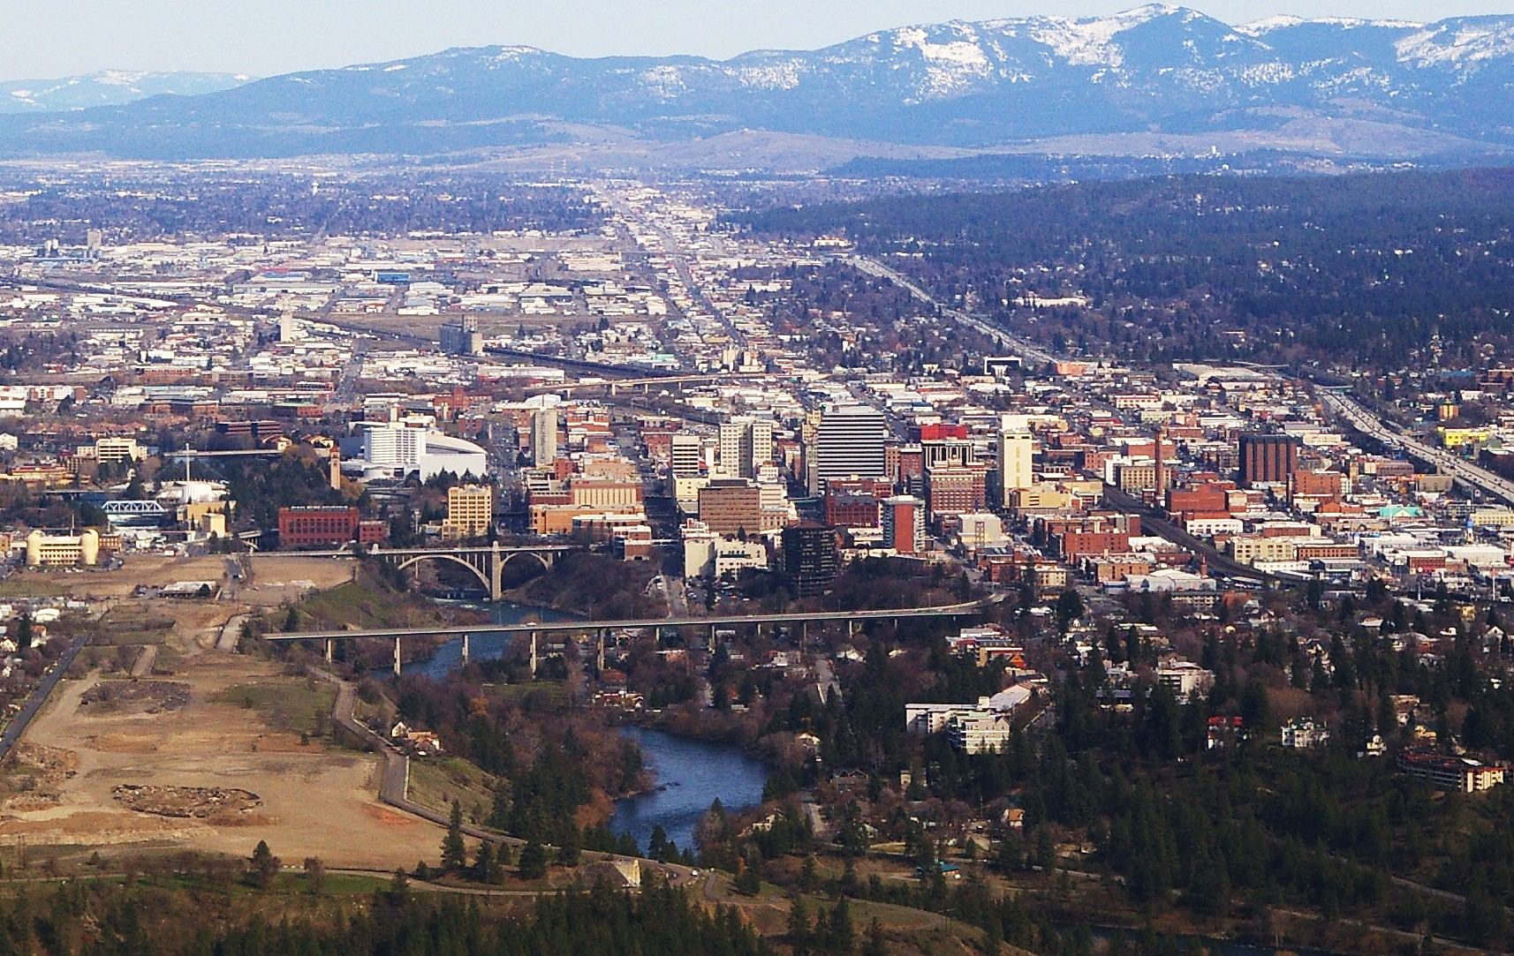

Slide 14
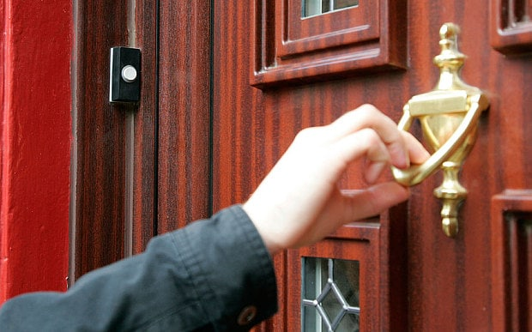

Slide 15
When it comes to things we have difficulty understanding about God,
we must never sacrifice the things
we clearly understand about God.

Slide 16
God’s word/covenant/promise never fails.

Slide 17
Being part of the people of God is not a matter of ethnicity, history or of birth; it is a matter of God’s purposes, election, call and promises and your response to that.

Slide 18
It’s a matter of grace, not race!

Slide 19
God’s purposes in our lives stand forever and always!

Slide 20
Romans 9:13
As it is written, “Jacob I loved, but Esau I hated.”
(Malachi 1:2-3)

Slide 21
Luke 14:26
“If anyone comes to me and does not hate father and mother, wife and
children, brothers and sisters—yes, even their own life—such a person cannot be my disciple.”

Slide 22
CALVINISM ARMINIANISM
Predestination
Foreknowledge

Slide 23
CALVINISM ARMINIANISM
Predestination
God’s work towards sinners to destine the elect to salvation while consigning the non-elect to perdition.
God’s work toward sinners to save those (the church) who, of their free will, choose Christ.

Slide 24
CALVINISM ARMINIANISM
Predestination
Foreknowledge
The relationship God chooses to enter into with certain people, before the beginning of time, that He knows will result in their salvation. It is limited to the elect.
God’s knowledge in eternity of who will respond to His saving grace in time.

Slide 25
CALVINISM ARMINIANISM
Predestination
Foreknowledge
The basis of foreknowledge
God’s sovereign love, mercy and grace in choosing the elect.
His omniscience of that aspect of the future

Slide 26
QUESTIONS?

