Slide 1
Living Whole in a broken world
Romans 8:18-25

Slide 4
Learning to live well in this broken world means
learning to live for more
than this broken world.

Slide 5
Romans 8:16-17
¹⁶ The Spirit himself bears witness with our spirit that we are children of God,
¹⁷ and if children, then heirs—heirs of God and fellow heirs with Christ, provided we suffer with him in order that we may also be glorified with him.

Slide 6
Romans 8:16-17
¹⁶ The Spirit himself bears witness with our spirit that we are children of God,
¹⁷ and if children, then heirs—heirs of God and fellow heirs with Christ, provided we suffer with him in order that we may also be glorified with him.

Slide 7
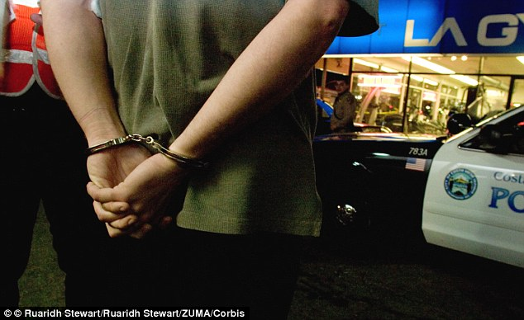

Slide 8
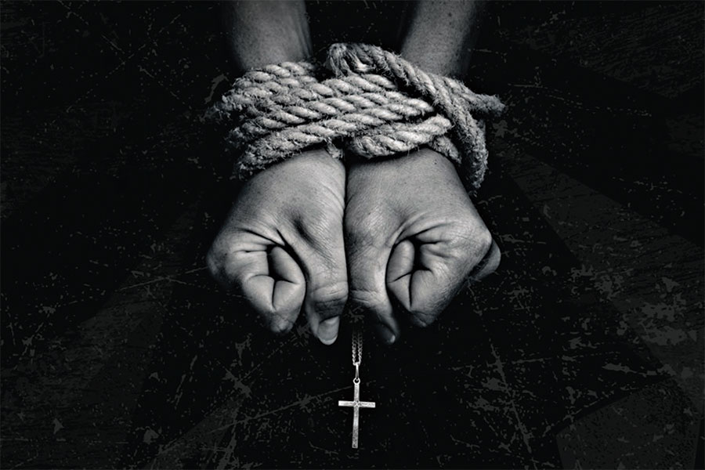

Slide 9
In a world filled with evil,
godly people will suffer
for being good.

Slide 10
Romans 8:18
¹⁸ For I consider that the sufferings of this present time are not worth comparing with the glory that is to be revealed to us.

Slide 11
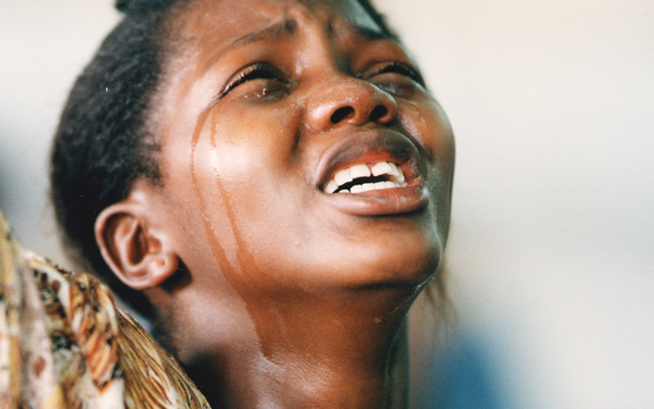
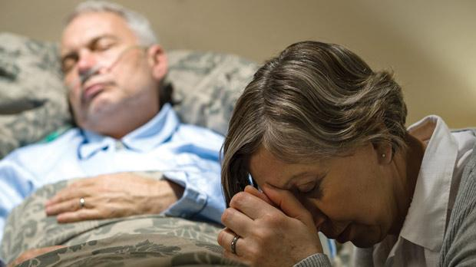
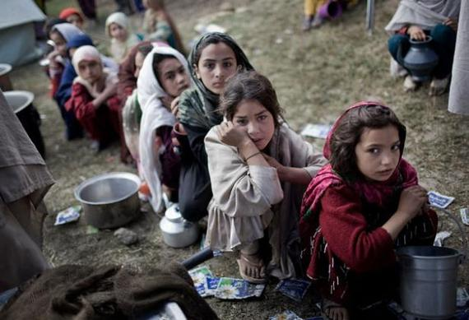
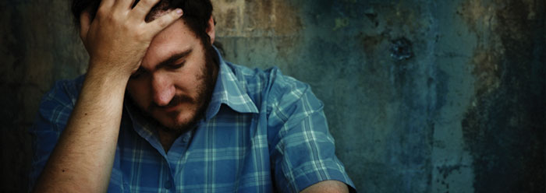

Slide 12
Romans 8:18
¹⁸ For I consider that the sufferings of this present time are not worth comparing with the glory that is to be revealed to us.

Slide 13
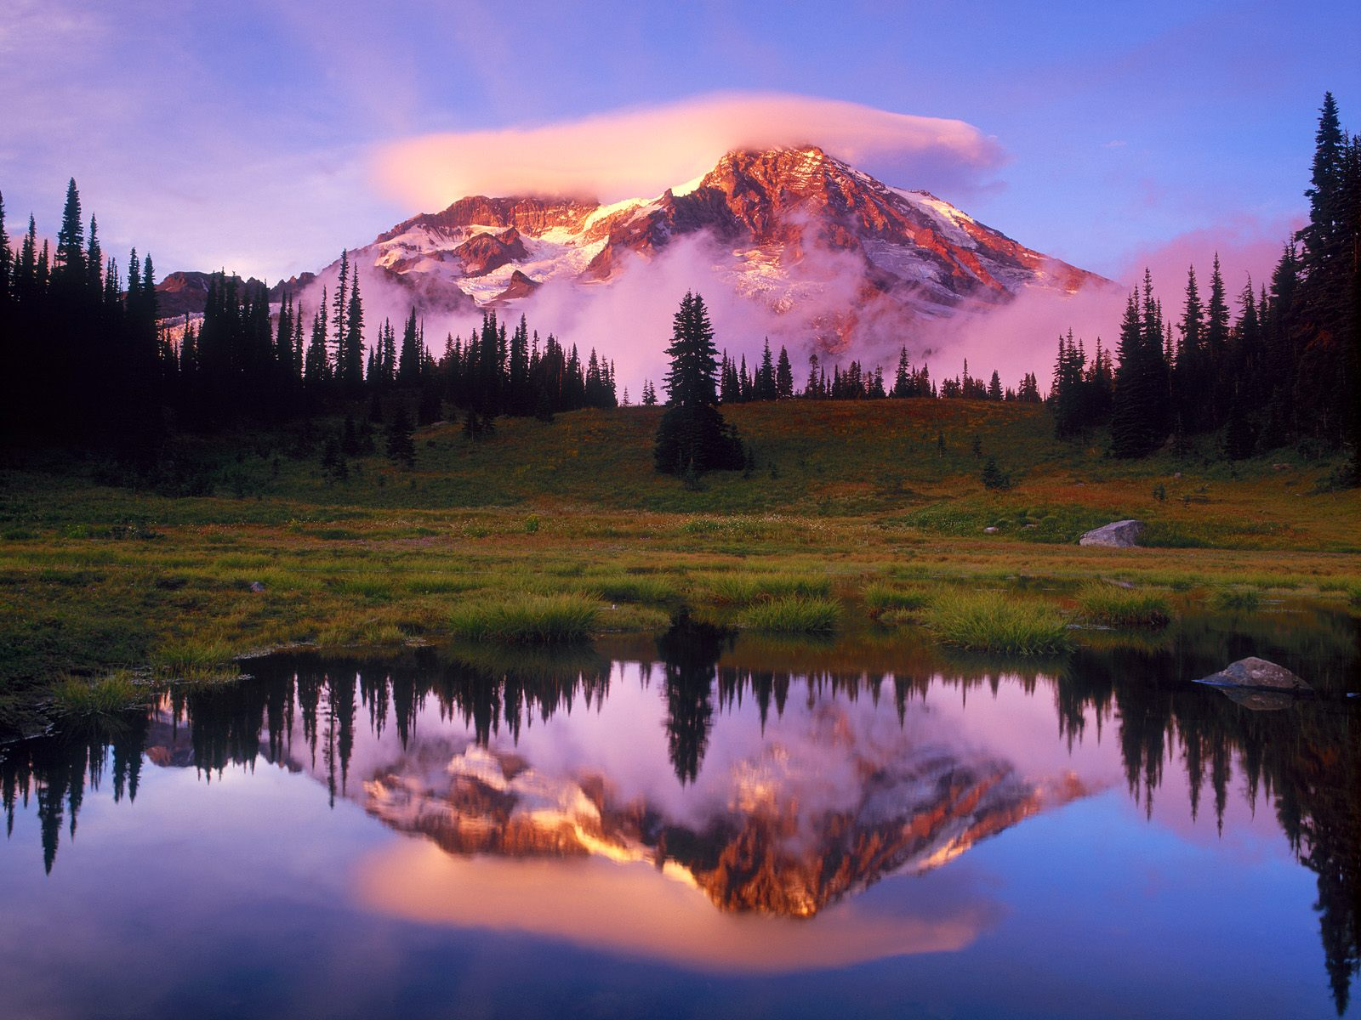

Slide 14
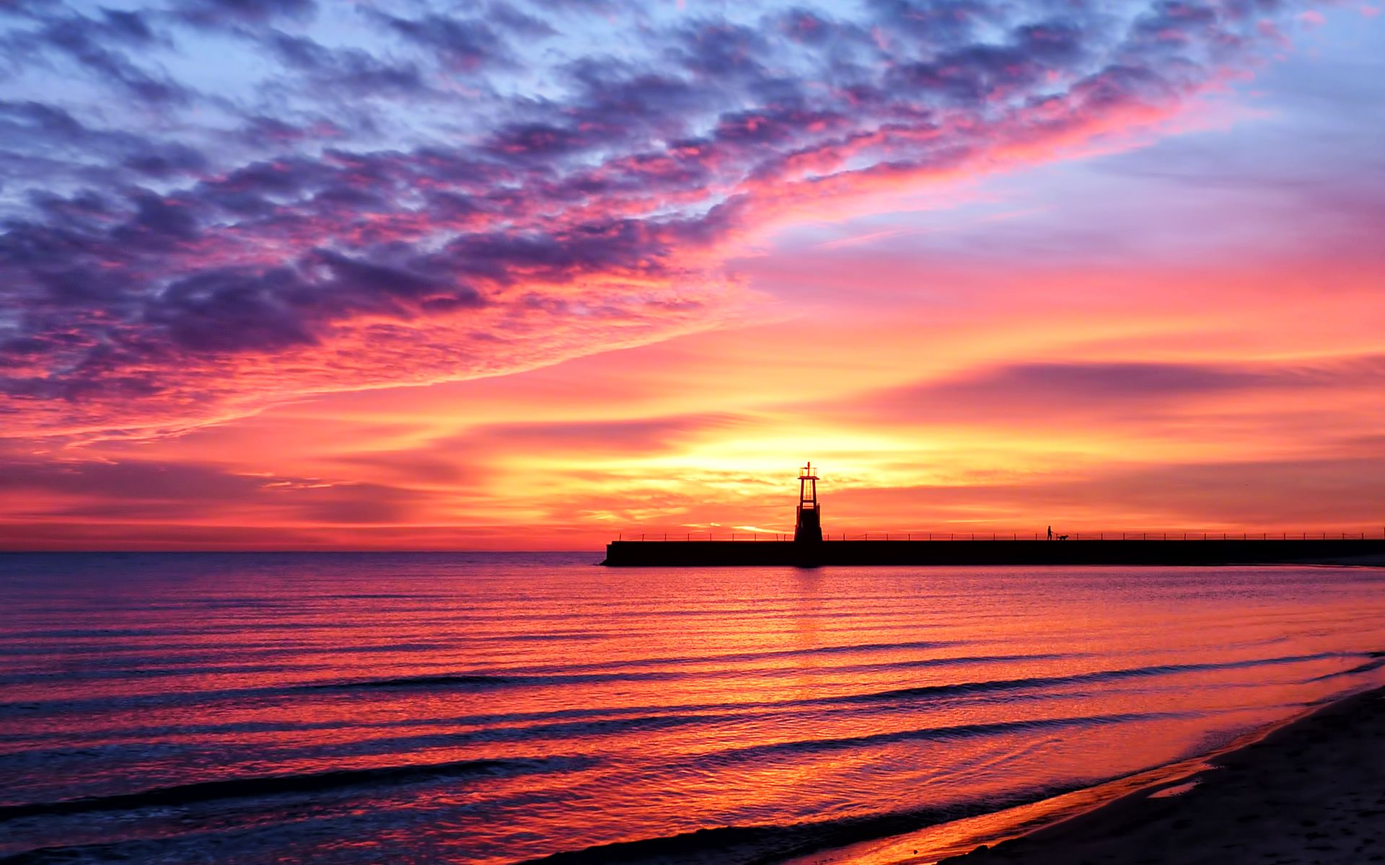

Slide 15
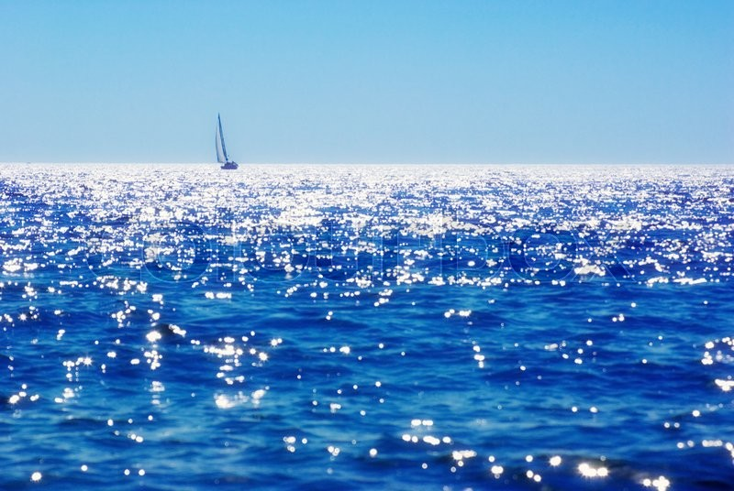

Slide 16
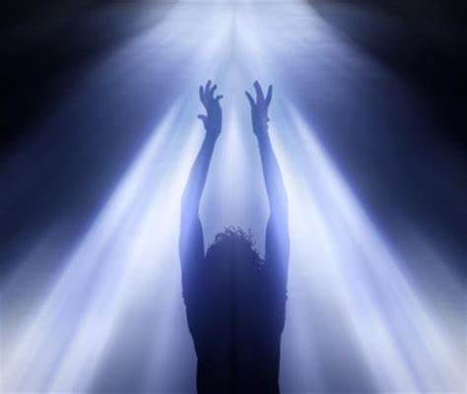
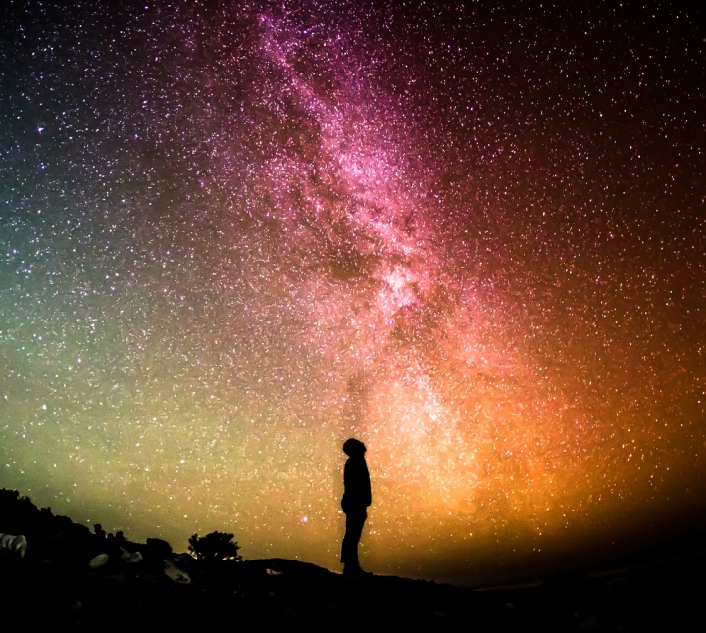

Slide 17
www.Biblegateway.com
Search “glory”

Slide 18
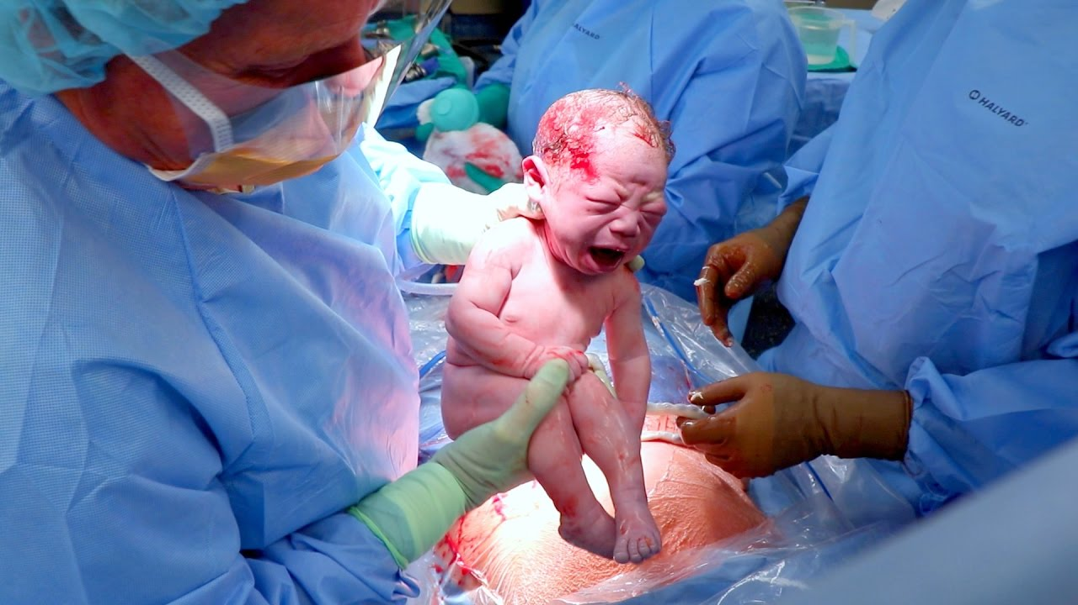

Slide 19
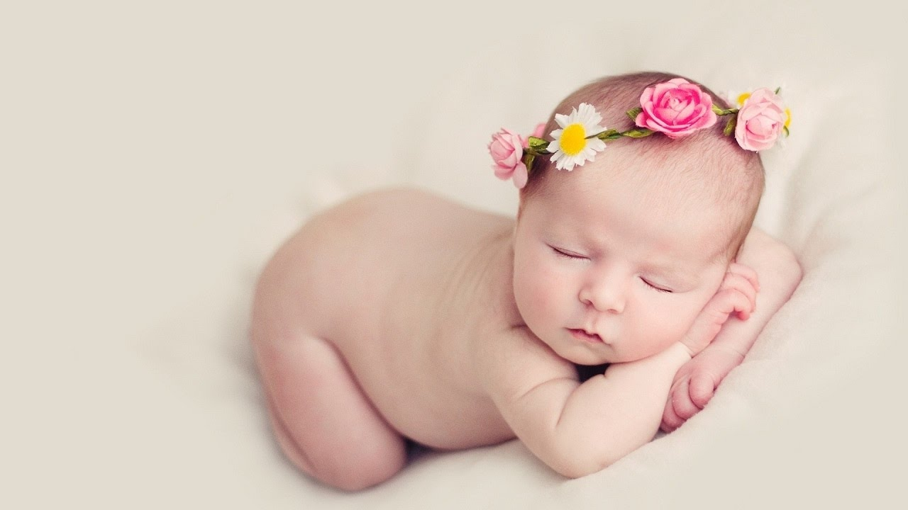

Slide 20
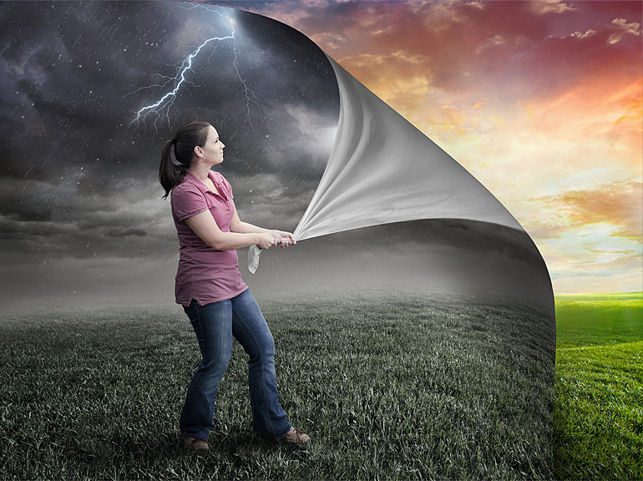

Slide 21
Romans 8:19-23
¹⁹ For the creation waits with eager longing for the revealing of the sons of God. ²⁰ For the creation was subjected to futility, not willingly, but because of him who subjected it, in hope ²¹ that the creation itself will be set free from its bondage to corruption and obtain the freedom of the glory of the children of God.

Slide 22
Romans 8:19-23
²² For we know that the whole creation has been groaning together in the pains of childbirth until now. ²³ And not only the creation, but we ourselves, who have the firstfruits of the Spirit, groan inwardly as we wait eagerly for adoption as sons, the redemption of our bodies.

Slide 23
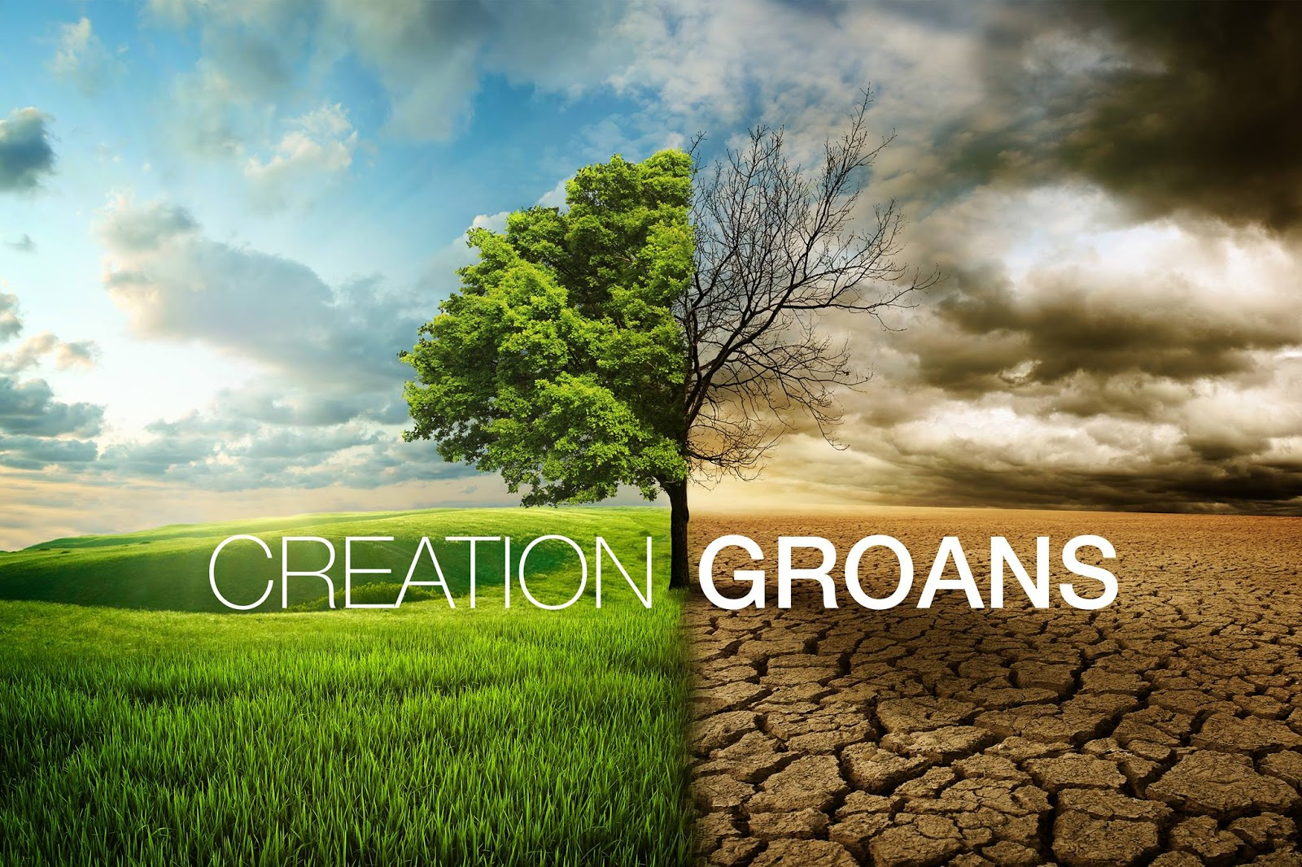

Slide 24
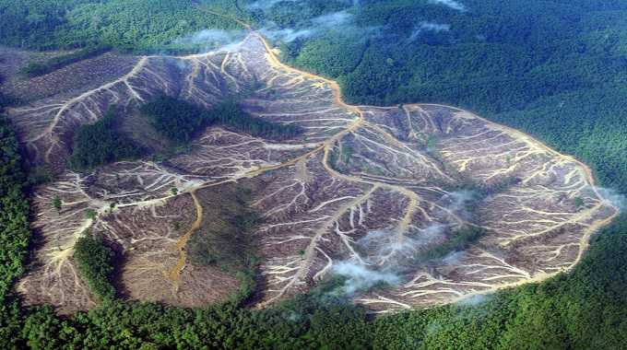

Slide 25
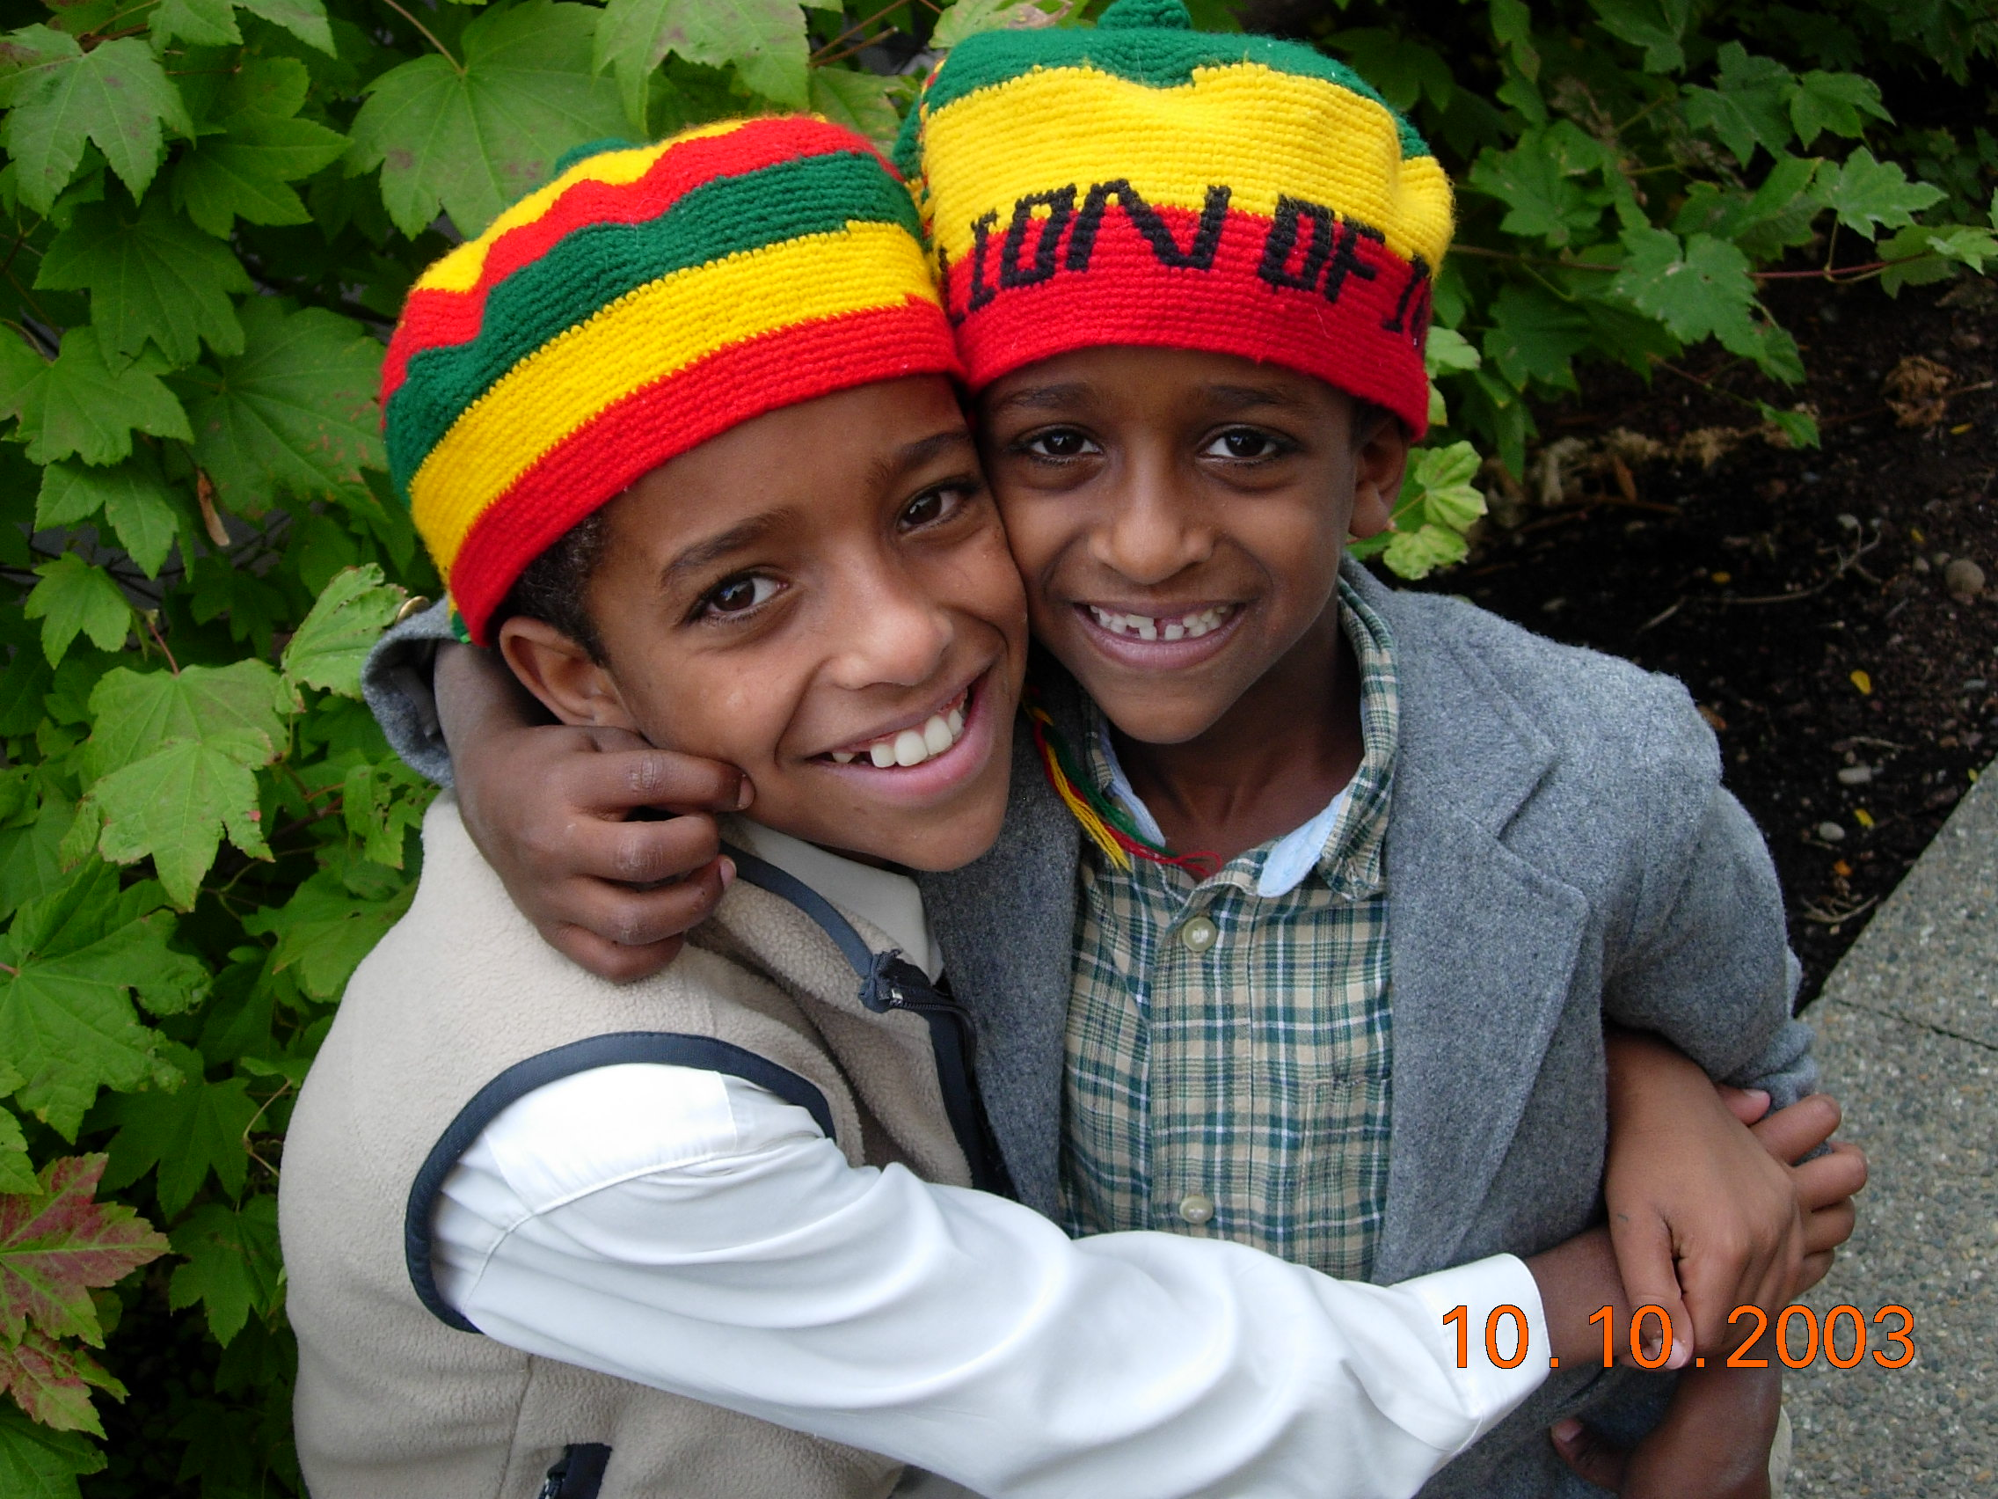

Slide 26
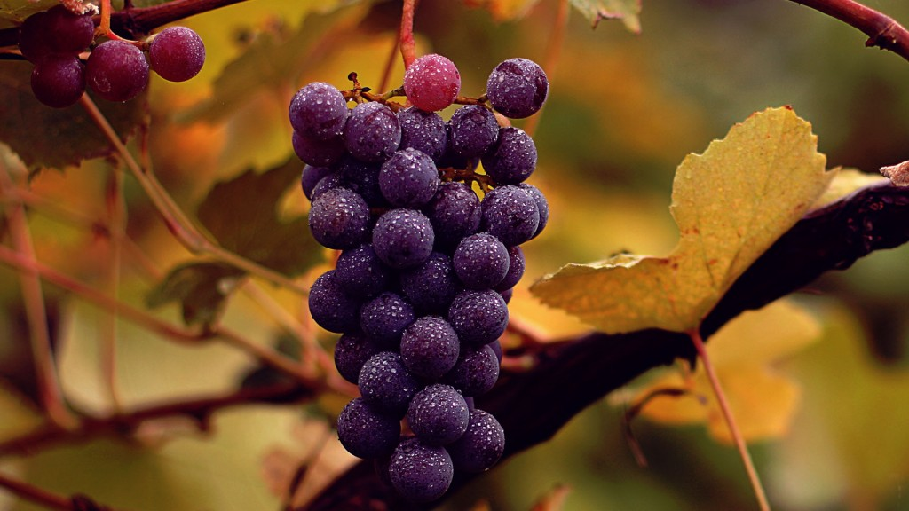
Firstfruits

Slide 27
Romans 8:24
For in this hope we were saved. Now
hope that is seen is not hope. For who hopes for what he sees? ²⁵ But if we hope for what we do not see, we wait for it with patience.

Slide 28
Learning to live well in this broken world means
learning to live for more
than this broken world.

Slide 29
I Corinthians 2:9-10
As it is written,
“What no eye has seen, nor ear heard, nor the heart of man imagined, what God has prepared for those who love him”—
¹⁰ these things God has revealed to us through the Spirit. For the Spirit searches everything, even the depths of God.

