Slide 1
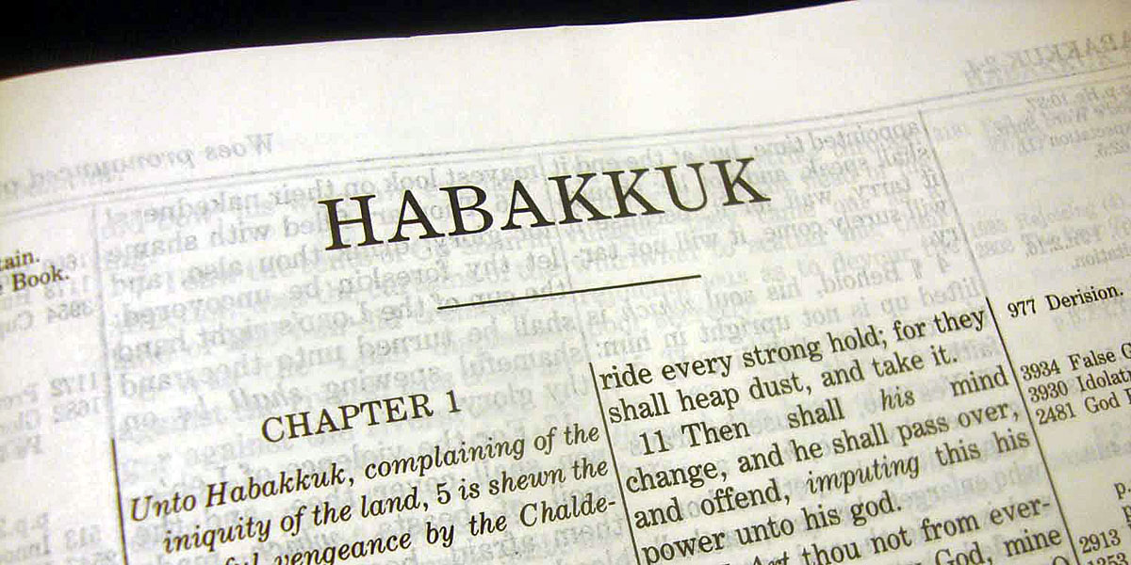
Finding the Best…
…in the Worst

Slide 2
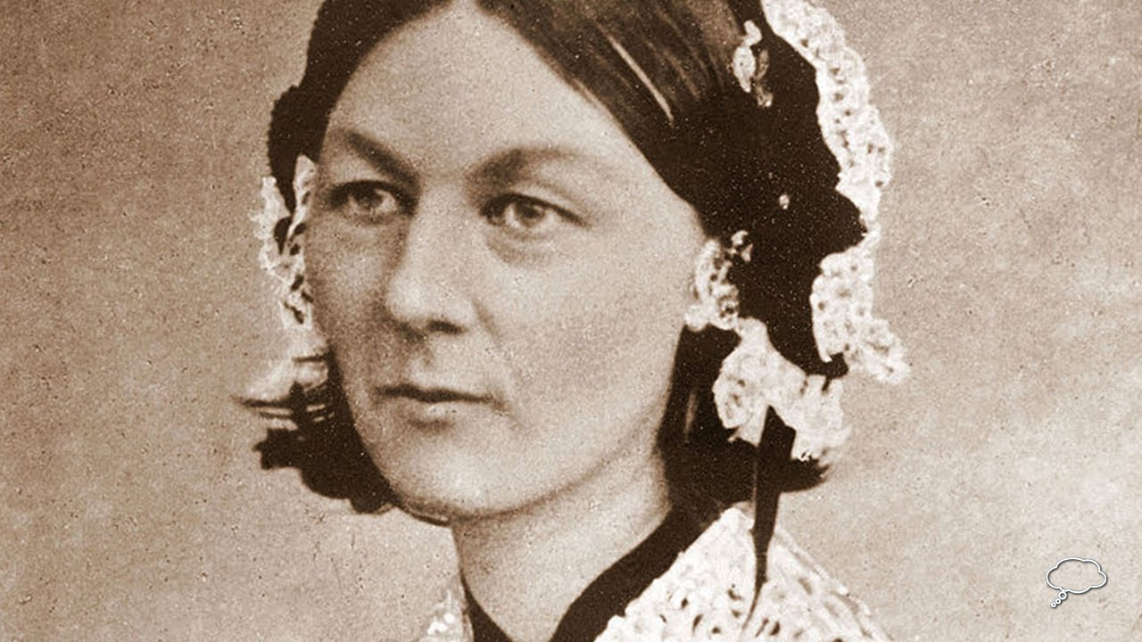
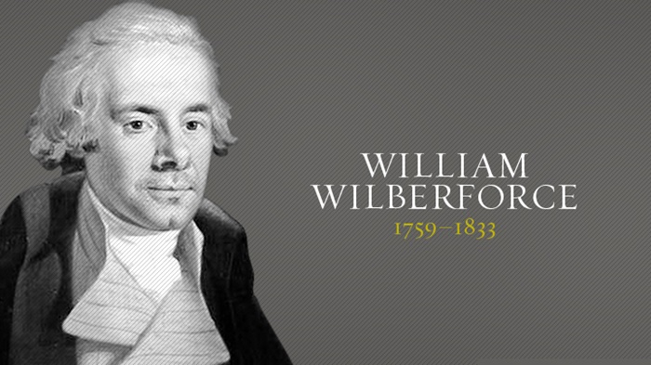
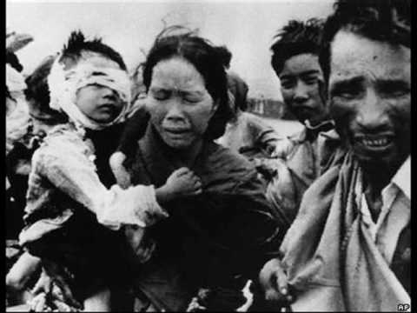
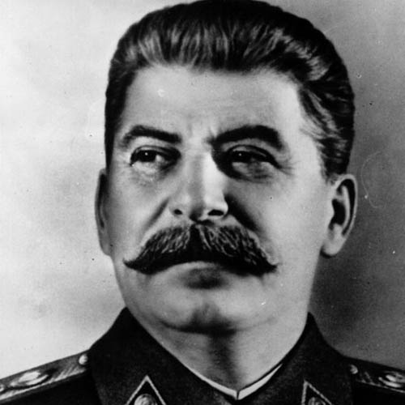
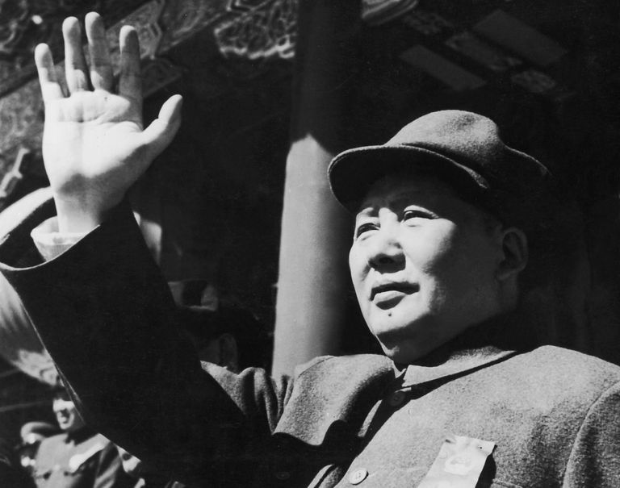
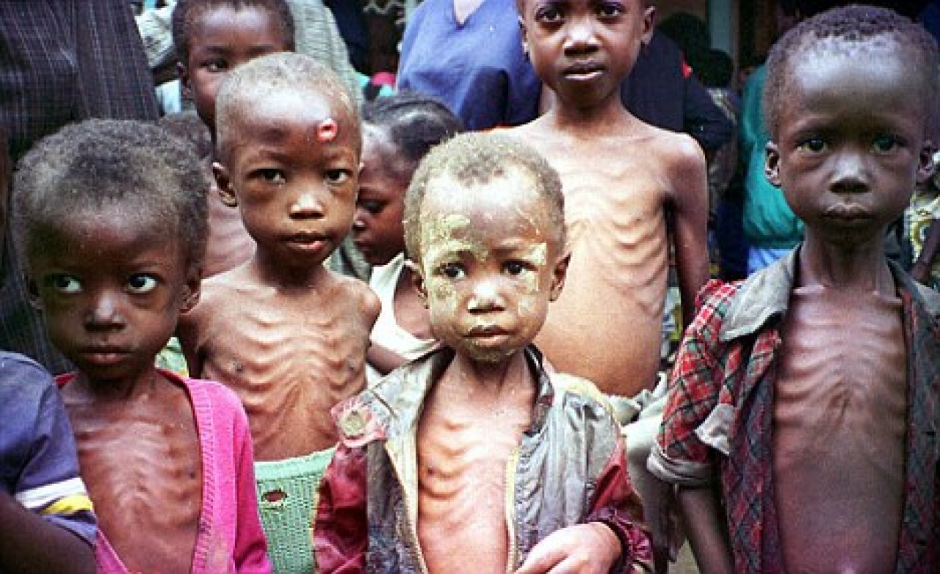
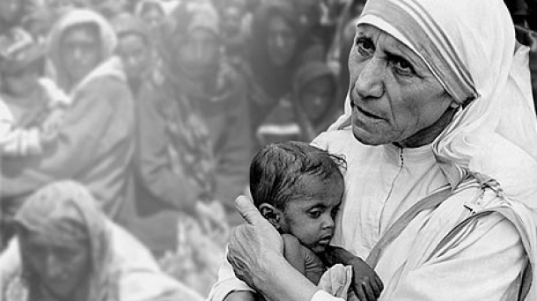
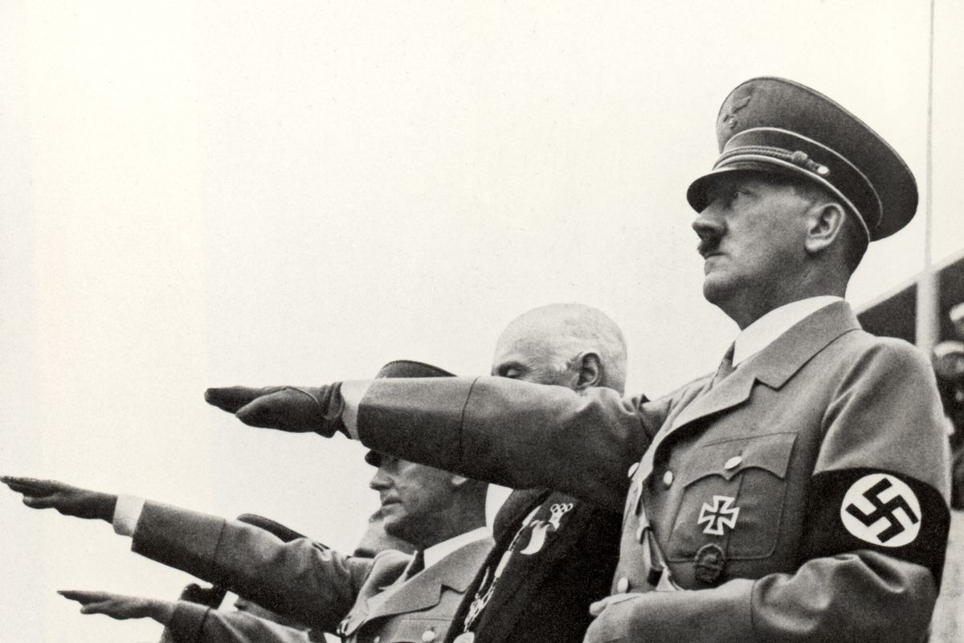
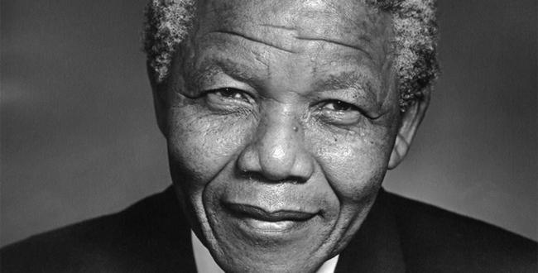

Slide 4
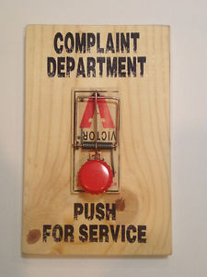

Slide 5
^{HABAKKUK 1}
2 How long, Lord, must I call for help, ^{but you do not listen?} ^{Or cry out to you, “Violence!”} ^{but you do not save?} 3 Why do you make me look at injustice? Why do you tolerate wrongdoing?

Slide 6
^{HABAKKUK 1}
Destruction and violence are before me; there is strife, and conflict abounds. ⁴ Therefore the law is paralyzed, and justice never prevails. The wicked hem in the righteous, so that justice is perverted.

Slide 7
^{HABAKKUK 1}
2 How long, Lord, must I call for help, ^{but you do not listen?} ^{Or cry out to you, “Violence!”} ^{but you do not save?} 3 Why do you make me look at injustice? Why do you tolerate wrongdoing?

Slide 8
^{HABAKKUK 1}
Destruction and violence are before me; there is strife, and conflict abounds. ⁴ Therefore the law is paralyzed, and justice never prevails. The wicked hem in the righteous, so that justice is perverted.

Slide 9
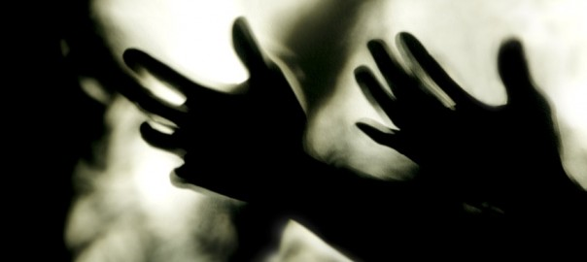

Slide 10
Habakkuk 1
5) “Look at the nations and watch— and be utterly amazed. For I am going to do something in your days that you would not believe, even if you were told.

Slide 11
Habakkuk 1
6) I am raising up the Babylonians, that ruthless and impetuous people, who sweep across the whole earth to seize dwellings not their own.

Slide 12
Habakkuk 1
¹⁶ Therefore he sacrifices to his net and burns incense to his dragnet, for by his net he lives in luxury and enjoys the choicest food. ¹⁷ Is he to keep on emptying his net, destroying nations without mercy?

Slide 13
Habakkuk 2
⁴ “See, the enemy is puffed up; his desires are not upright— but the righteous person will live by his faithfulness—

Slide 14
Romans 1:17
For in the gospel the righteousness of God is revealed—a righteousness that is by faith from first to last, just as it is written: “The righteous will live by faith.”

Slide 15
Habakkuk 2
Woe to the Proud—2:4-5
Woe to the Greedy—2:6-8
Woe to the Dishonest—2:9-11
Woe to the Violent—2:12-14
Woe to the Sensual—2:15-17
Woe to the Idolater—2:18-20

Slide 16
Habakkuk 2
²⁰ The Lord is in his holy temple; let all the earth be silent before him.

Slide 17
Habakkuk 3
A prayer of Habakkuk the prophet.
² Lord, I have heard of your fame; I stand in awe of your deeds, Lord. Repeat them in our day, in our time make them known; in wrath remember mercy.

Slide 18
Habakkuk 3
² Lord, I have heard of your fame; I stand in awe of your deeds, Lord. Repeat them in our day, in our time make them known; in wrath remember mercy.

Slide 19
Habakkuk 3
³ God came from Teman, the Holy One from Mount Paran. His glory covered the heavens and his praise filled the earth. ⁴ His splendor was like the sunrise; rays flashed from his hand, where his power was hidden.

Slide 20
Habakkuk 3
⁵ Plague went before him; pestilence followed his steps. ⁶ He stood, and shook the earth; he looked, and made the nations tremble. The ancient mountains crumbled and the age-old hills collapsed— but he marches on forever.

Slide 21
Habakkuk 3
¹¹ Sun and moon stood still in the heavens at the glint of your flying arrows, at the lightning of your flashing spear. ¹² In wrath you strode through the earth and in anger you threshed the nations.

Slide 22
Habakkuk 3
¹³ You came out to deliver your people, to save your anointed one. You crushed the leader of the land of wickedness, you stripped him from head to foot.

Slide 23
Revelation 19
¹¹ I saw heaven standing open and there before me was a white horse, whose rider is called Faithful and True. With justice he judges and wages war. ¹² His eyes are like blazing fire, and on his head are many crowns. He has a name written on him that no one knows but he himself. ¹³ He is dressed in a robe dipped in blood, and his name is the Word of God.

Slide 24
Revelation 19
¹⁴ The armies of heaven were following him, riding on white horses and dressed in fine linen, white and clean. ¹⁵ Coming out of his mouth is a sharp sword with which to strike down the nations. “He will rule them with an iron scepter.” He treads the winepress of the fury of the wrath of God Almighty.

Slide 25
Revelation 19
¹⁶ On his robe and on his thigh he has this name written: king of kings and lord of lords.
¹⁷ And I saw an angel standing in the sun, who cried in a loud voice to all the birds flying in midair, “Come, gather together for the great supper of God, ¹⁸ so that you may eat the flesh of kings, generals, and the mighty, of horses and their riders, and the flesh of all people, free and slave,great and small.”

Slide 26
Revelation 19
¹⁹ Then I saw the beast and the kings of the earth and their armies gathered together to wage war against the rider on the horse and his army. ²⁰ But the beast was captured, and with it the false prophet who had performed the signs on its behalf.

Slide 27
Revelation 19
With these signs he had deluded those who had received the mark of the beast and worshiped its image. The two of them were thrown alive into the fiery lake of burning sulfur.²¹ The rest were killed with the sword coming out of the mouth of the rider on the horse, and all the birds gorged themselves on their flesh.

Slide 28
Habakkuk 3
¹⁶ I heard and my heart pounded, my lips quivered at the sound; decay crept into my bones, and my legs trembled.

Slide 29
Habakkuk 3
Yet I will wait patiently for the day of calamity to come on the nation invading us. ¹⁷ Though the fig tree does not bud and there are no grapes on the vines, though the olive crop fails and the fields produce no food, though there are no sheep in the pen and no cattle in the stalls,

Slide 30
Habakkuk 3
…yet I will rejoice in the Lord, I will be joyful in God my Savior.
¹⁹ The Sovereign Lord is my strength; he makes my feet like the feet of a deer, he enables me to tread on the heights.

Slide 31
We won’t truly know that
God is all we need
in life and death
until we experience that
God is all we have.

