Slide 1
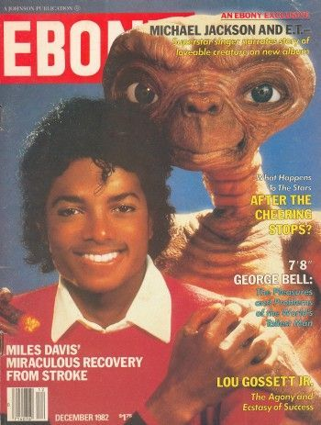
1982

Slide 2
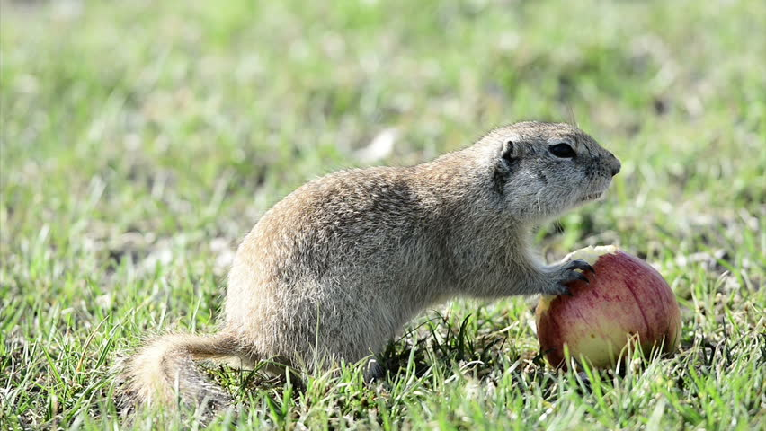

Slide 3
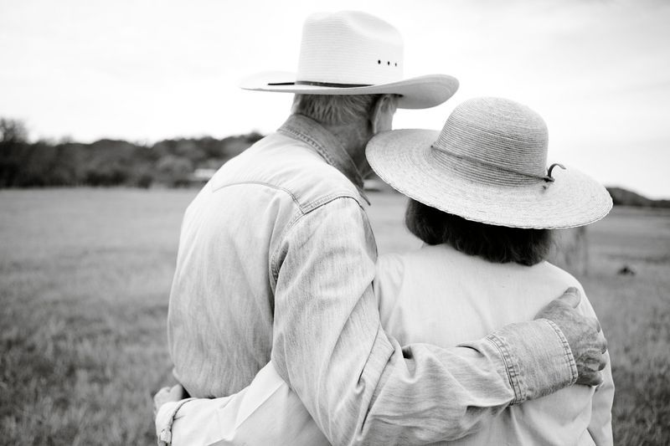

Slide 4
COLOSSIANS 2:2-3 “My goal is that they may be encouraged in heart and united in love, so that they may have the full riches of complete understanding, in order that they may know the mystery of God, namely, Christ, in whom are hidden all the treasures of wisdom and knowledge.”

Slide 5
COLOSSIANS 2:2-3 “My goal is that they may be encouraged in heart and united in love, so that they may have the full riches of complete understanding, in order that they may know the mystery of God, namely, Christ, in whom are hidden all the treasures of wisdom and knowledge.”

Slide 6
“What do you think should be the goal of doing church on Sundays?”
[Groups of 5-6]

Slide 7
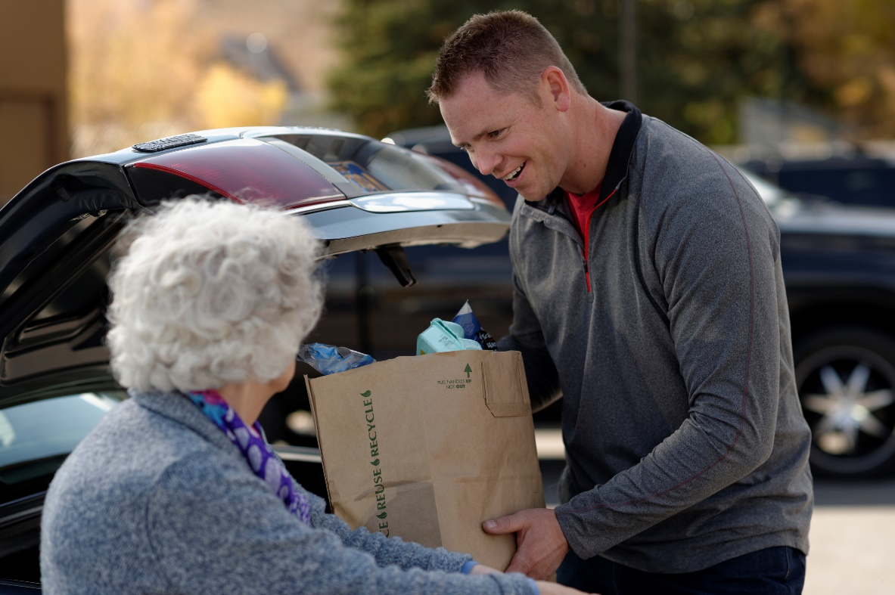
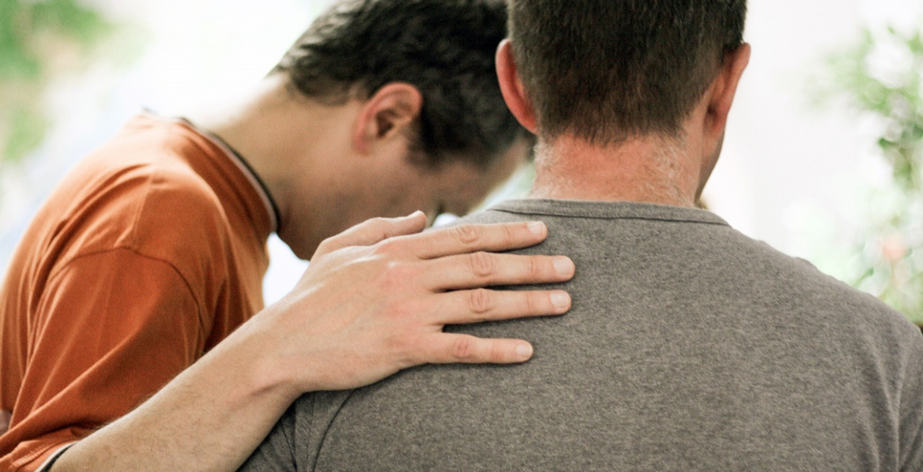

Slide 8
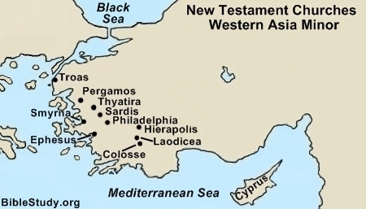

Slide 9
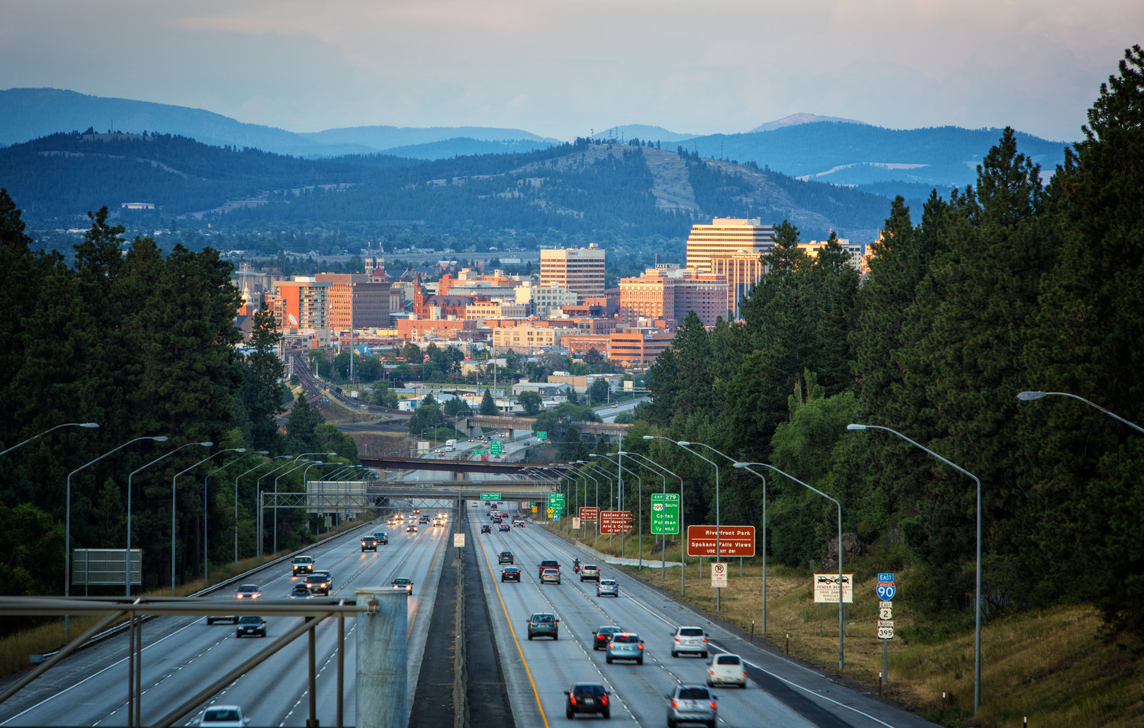
What are two goals do you have for God’s people in Spokane?

Slide 10
2 Questions to Discuss 1.) WHAT are Paul’s goals for fellow believers in Colossi? 2.) HOW does he say they can achieve those goals?

Slide 11
COLOSSIANS 2:2-4 ² My goal is that they may be encouraged in heart and united in love, so that they may have the full riches of complete understanding, in order that they may know the mystery of God, namely, Christ, ³ in whom are hidden all the treasures of wisdom and knowledge. ⁴ I tell you this so that no one may deceive you by fine-sounding arguments.

Slide 12
2 Questions to Discuss 1.) WHAT are Paul’s goals for fellow believers in Colossi? 2.) HOW does he say they can achieve those goals?

Slide 13
1.) Vs. 2—“My goal is that they may be encouraged in heart….” 2.) Vs. 2— ”My goal is that they may be…united in love….” 3.) Vs. 2—“…in order that they might know… Christ, in whom are hidden all the treasures of wisdom and knowledge.” 4.) Vs. 4—“I tell you this so that no one may deceive you by fine-sounding arguments.”

Slide 14
GOAL #1:
Vs. 2—“My goal is that they may be encouraged in heart….”
ENCOURAGE = “to comfort, give encouragement or strengthen.”

Slide 15
2 Corinthians 1:3-5
“…the Father of compassion and the God of all comfort, ⁴ who comforts us in all our troubles, so that we can comfort those in any trouble with the comfort we ourselves receive from God. ⁵ For just as we share abundantly in the sufferings of Christ, so also our comfort abounds through Christ.”

Slide 16
According to the Bible,
where does comfort come from?
A.) The Word of God—Romans 15:4
“For everything that was written in the past was written to teach us, so that through the endurance taught in the Scriptures and the encouragement they provide we might have hope.”

Slide 17
According to the Bible,
where does comfort come from?
B.) Teachings/exhortations/prophecies that correspond to the Word of God
I Corinthians 14:31– “For you can all prophesy in turn so that everyone may be instructed and encouraged.”

Slide 18
According to the Bible,
where does comfort come from?
C.) The FAITH of others—
1 Thessalonians 3:7-- Therefore, brothers and sisters, in all our distress and persecution we were encouraged about you because of your faith.

Slide 20
According to the Bible,
where does comfort come from?
D.) Expressions of Love from Believers, 2nd Cor. 7:6
“But God, who comforts the downcast, comforted us by the coming of Titus, ⁷ and not only by his coming but also by the comfort you had given him. He told us about your longing for me, your deep sorrow, your ardent concern for me, so that my joy was greater than ever.”

Slide 21
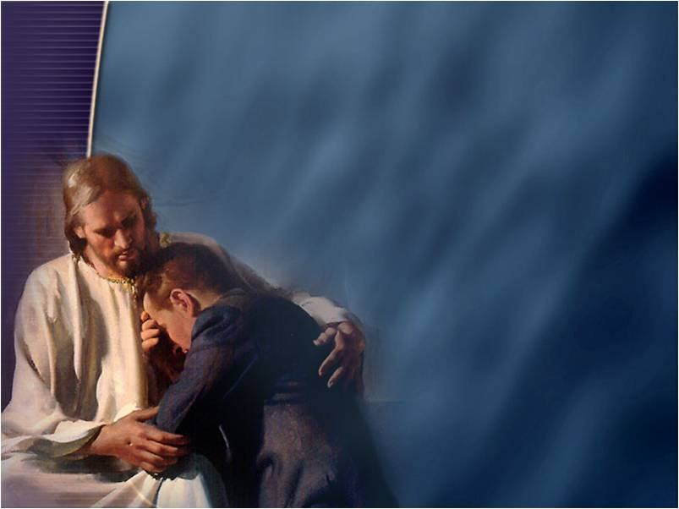
How has God comforted you in suffering (of any kind)?

Slide 22
Share your name.
Share about some area/issue/incident of your life where you could use more strength, some encouragement or some comfort.
Share prayer or some other gift of strength, encouragement or comfort.

Slide 23
GOAL #2:
Vs. 2--“My goal is that they may be encouraged in heart and united in love….”
2:29--“They have lost connection with the head, from whom the whole body, supported and held together by its ligaments and sinews, grows as God causes it to grow.”

Slide 24
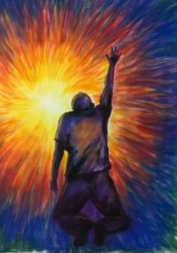
“Our Father, which art in heaven…
Forgive us our trespasses as we forgive those who have trespassed against us.”

Slide 25
What makes it hard to “be knit together in love” just on a Sunday-only basis?
How CAN we love each other in just a Sunday worship setting?

Slide 26
