Slide 1
Our Second Marriage Romans 7:1-6 August 23, 2020

Slide 2
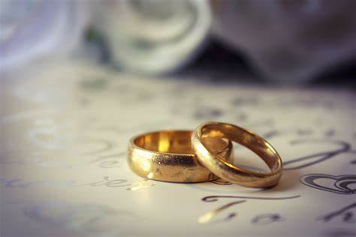
Is Marriage… >binding or liberating? >limiting or freeing? >confining or expansive?

Slide 3
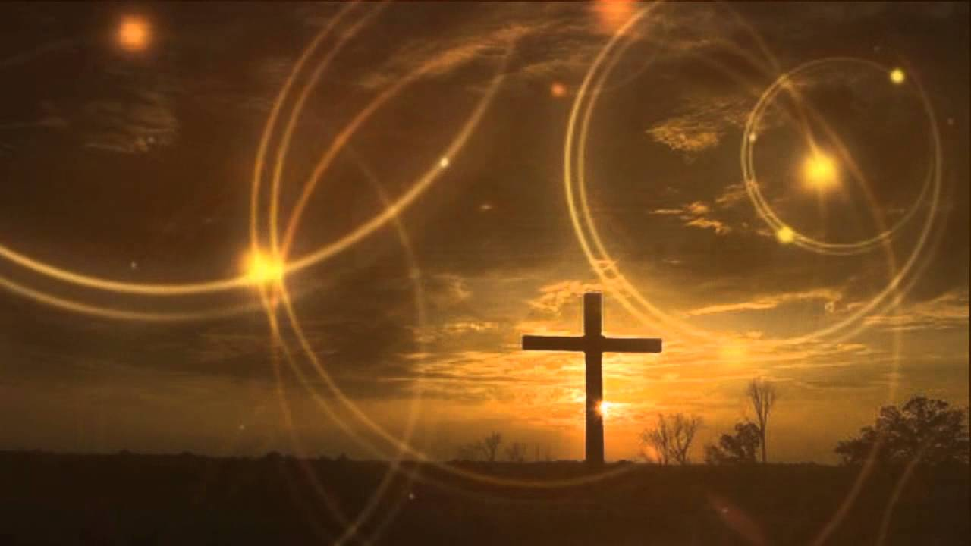
Is your spiritual experience… >binding or liberating? >limiting or freeing? >confining or expansive?

Slide 4
Our relationship to sin…

Slide 5
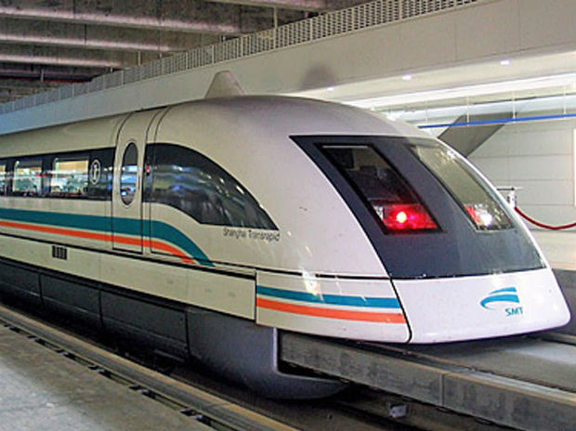

Slide 6
Our relationship to LAW
X
7

Slide 8
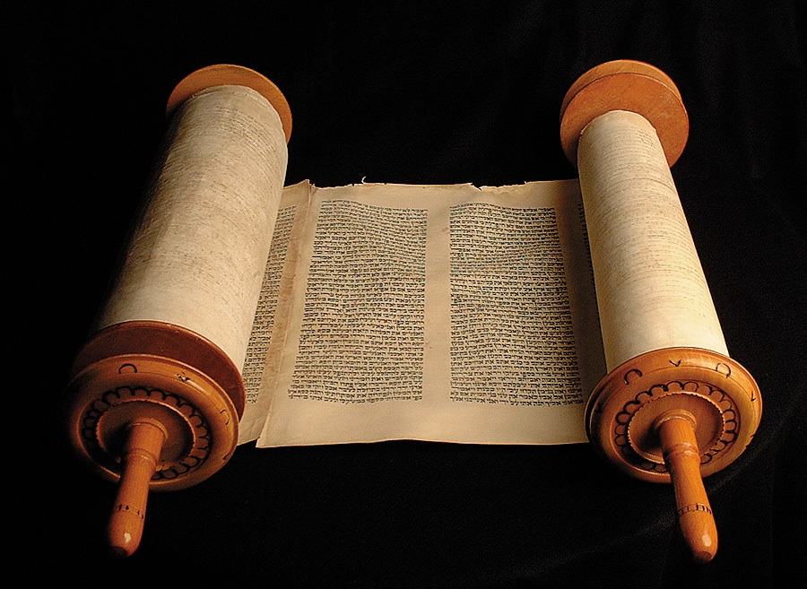

Slide 9
<Dietary <Religious <Civil

Slide 10
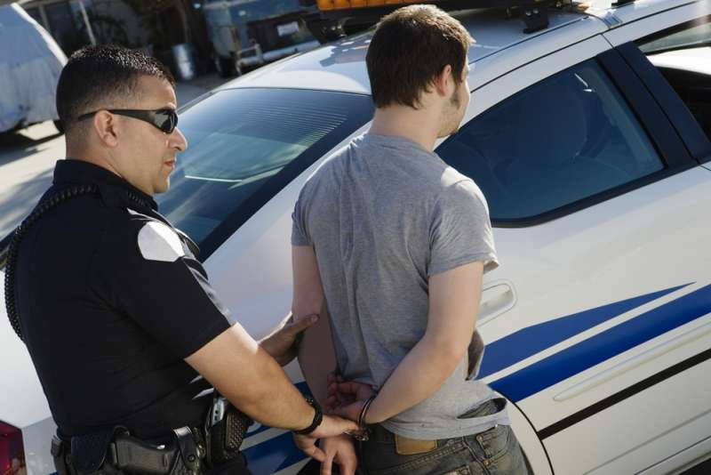

Slide 11
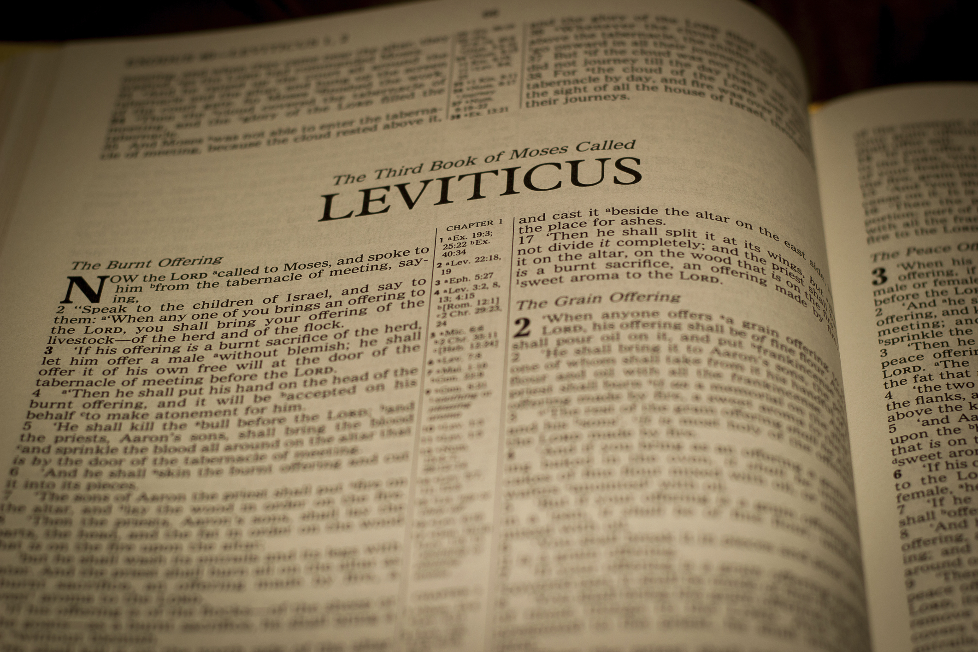

Slide 13
ROMANS 7:1 Or do you not know, brothers—for I am speaking to those who know the law—that the law is binding on a person only as long as he lives?

Slide 14
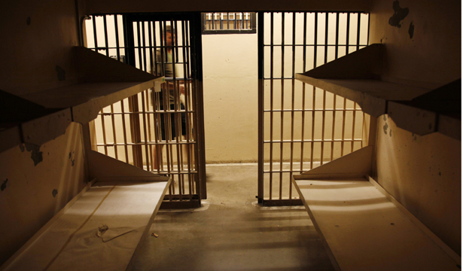

Slide 15
ROMANS 7:2-3 ² For a married woman is bound by law to her husband while he lives, but if her husband dies she is released from the law of marriage. ³ Accordingly, she will be called an adulteress if she lives with another man while her husband is alive. But if her husband dies, she is free from that law, and if she marries another man she is not an adulteress.

Slide 16
ROMANS 7:4 ⁴ Likewise, my brothers, you also have died to the law through the body of Christ, so that you may belong to another, to him who has been raised from the dead, in order that we may bear fruit for God.

Slide 17
ROMANS 7:4 ⁴ Likewise, my brothers, you also have died to the law through the body of Christ, so that you may belong to another, to him who has been raised from the dead, in order that we may bear fruit for God.

Slide 19
ROMANS 7:4 ⁴ Likewise, my brothers, you also have died to the law through the body of Christ, so that you may belong to another, to him who has been raised from the dead, in order that we may bear fruit for God.

Slide 20
What part of the O.T. Law are Christians obliged to keep?

Slide 23
John 13:34-35

Slide 24
Ephesians 3 ¹⁷ …that Christ may dwell in your hearts through faith—that you, being rooted and grounded in love, ¹⁸ may have strength to comprehend with all the saints what is the breadth and length and height and depth, ¹⁹ and to know the love of Christ that surpasses knowledge, that you may be filled with all the fullness of God.

Slide 25
Romans 7 ⁵ For while we were living in the flesh, our sinful passions, aroused by the law, were at work in our members to bear fruit for death.

Slide 26
Romans 7 ⁶ But now we are released from the law, having died to that which held us captive, so that we serve in the new way of the Spirit and not in the old way of the written code.

