Slide 1
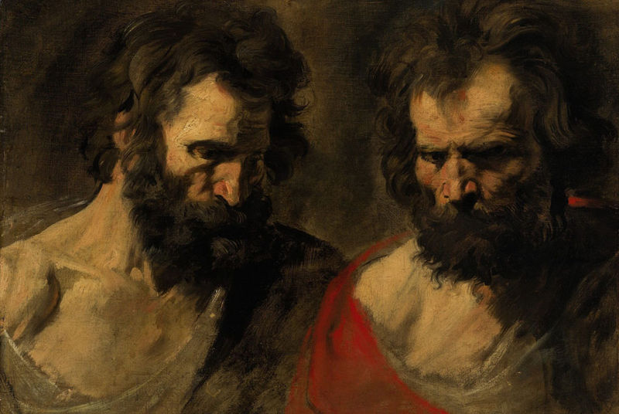
Two Prophets & A City

Slide 2
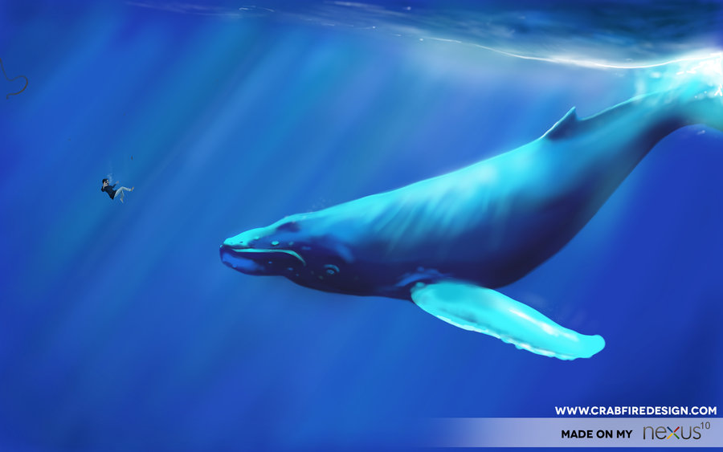
JONAH

Slide 3
MATTHEW 12
³⁸ Then some of the Pharisees and teachers of the law said to him, “Teacher, we want to see a sign from you.”
³⁹ He answered, “A wicked and adulterous generation asks for a sign! But none will be given it except the sign of the prophet Jonah. ⁴⁰ For as Jonah was three days and three nights in the belly of a huge fish, so the Son of Man will be three days and three nights in the heart of the earth.⁴¹ The men of Nineveh will stand up at the judgment with this generation and condemn it; for they repented at the preaching of Jonah, and now something greater than Jonah is here.”

Slide 4
What’s the theme of
JONAH?
Grace embraced transforms;
Grace rejected embitters.

Slide 6
Jonah prophecies Israel falls to the Assyrians Nahum prophecies Nineveh falls to the Babylonians
792-753 B.C.
722 B.C.
around 620 B.C.
612 B.C.

Slide 7
JONAH--
The only prophet with
no fulfilled prophecy.
The only outright rebellious
prophet.

Slide 8
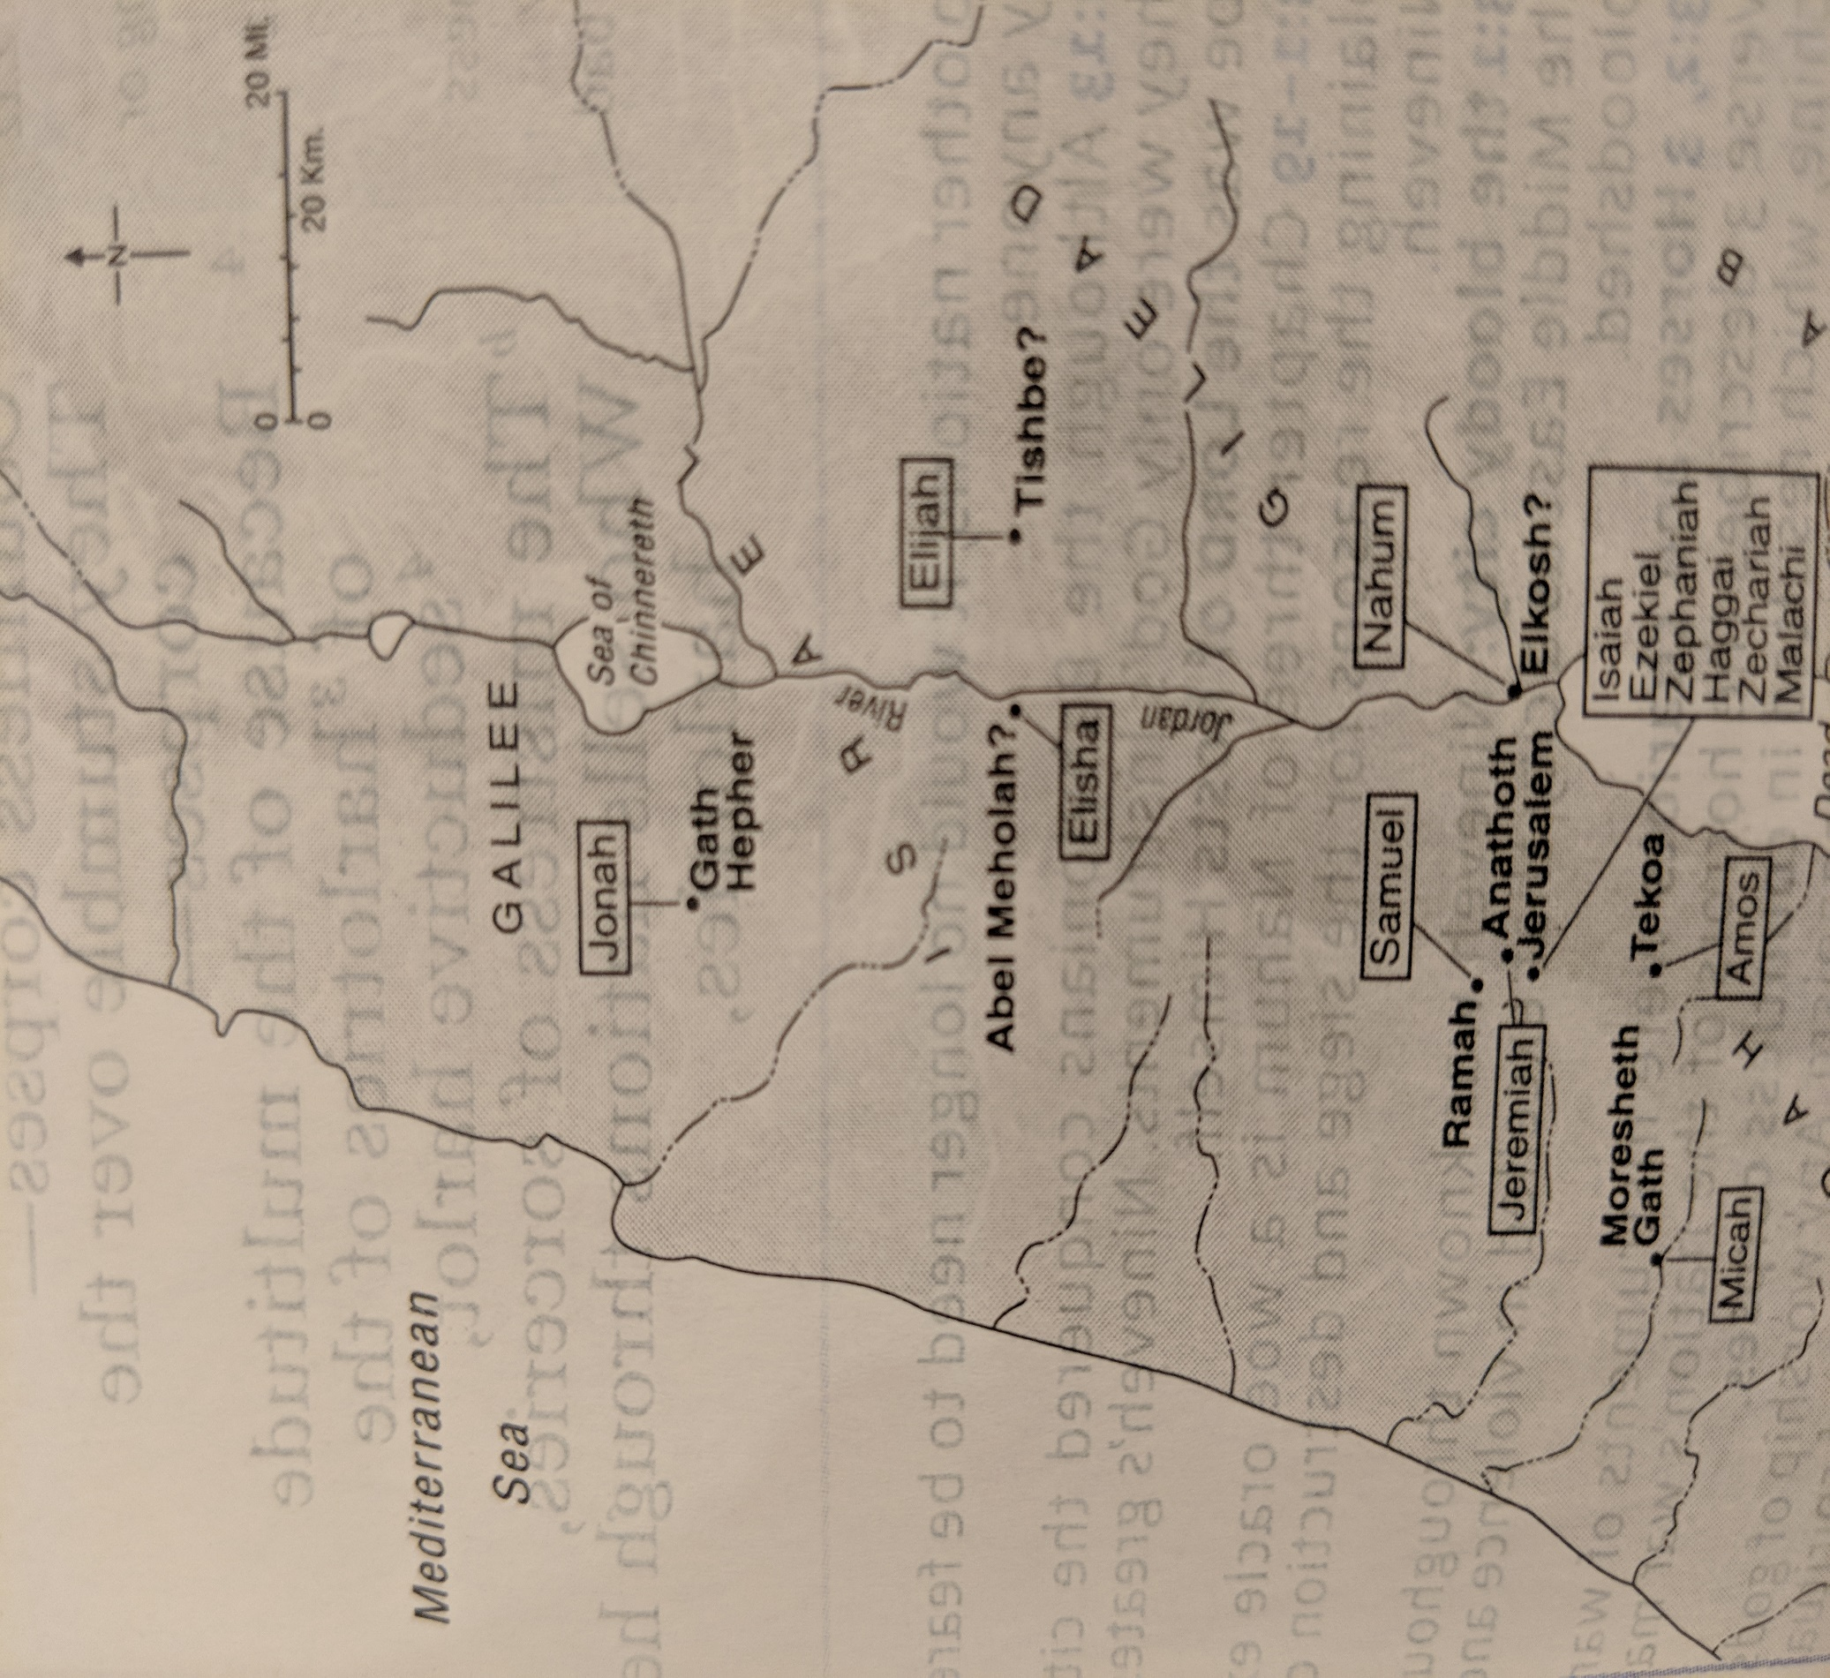
Jonah 1:2 “Go to the great city of Nineveh and preach against it, because its wickedness has come up before me.”

Slide 9
JONAH 1
³ But Jonah ran away from the Lord and headed for Tarshish. He went down to Joppa, where he found a ship bound for that port. After paying the fare, he went aboard and sailed for Tarshish to flee from the Lord.

Slide 10
CONTRASTS?
JONAH 1
⁴ Then the Lord sent a great wind on the sea, and such a violent storm arose that the ship threatened to break up. ⁵ All the sailors were afraid and each cried out to his own god. And they threw the cargo into the sea to lighten the ship.

Slide 11
CONTRASTS?
JONAH 1
But Jonah had gone below deck, where he lay down and fell into a deep sleep. ⁶ The captain went to him and said, “How can you sleep? Get up and call on your god! Maybe he will take notice of us so that we will not perish.”

Slide 12
CONTRASTS?
⁷ Then the sailors said to each other, “Come, let us cast lots to find out who is responsible for this calamity.” They cast lots and the lot fell on Jonah. ⁸ So they asked him, “Tell us, who is responsible for making all this trouble for us? What kind of work do you do? Where do you come from? What is your country? From what people are you?”

Slide 13
CONTRASTS?
⁹ He answered, “I am a Hebrew and I worship the Lord, the God of heaven, who made the sea and the dry land.”
¹⁰ This terrified them and they asked, “What have you done?” (They knew he was running away from the Lord, because he had already told them so.)

Slide 14
CONTRASTS?
¹¹ The sea was getting rougher and rougher. So they asked him, “What should we do to you to make the sea calm down for us?”
¹² “Pick me up and throw me into the sea,” he replied, “and it will become calm. I know that it is my fault that this great storm has come upon you.”

Slide 15
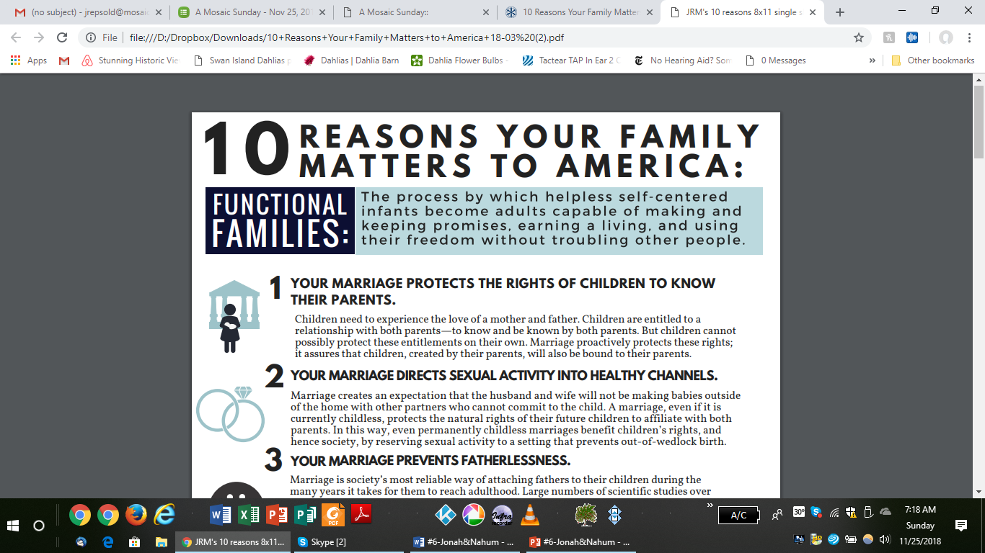

Slide 16
CONTRASTS?
¹³ Instead, the men did their best to row back to land. But they could not, for the sea grew even wilder than before. ¹⁴ Then they cried out to the Lord, “Please, Lord, do not let us die for taking this man’s life. Do not hold us accountable for killing an innocent man, for you, Lord, have done as you pleased.”

Slide 17
CONTRASTS?
¹⁵ Then they took Jonah and threw him overboard, and the raging sea grew calm.
¹⁶ At this the men greatly feared the Lord, and they offered a sacrifice to the Lord and made vows to him. ¹⁷ Now the Lord provided a huge fish to swallow Jonah, and Jonah was in the belly of the fish three days and three nights.

Slide 18
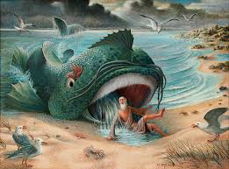
JONAH 2
¹⁰ And the Lord commanded the fish, and it vomited Jonah onto dry land.

Slide 19
JONAH 3
Then the word of the Lord came to Jonah a second time: ² “Go to the great city of Nineveh and proclaim to it the message I give you.”
³ Jonah obeyed the word of the Lord and went to Nineveh.

Slide 20
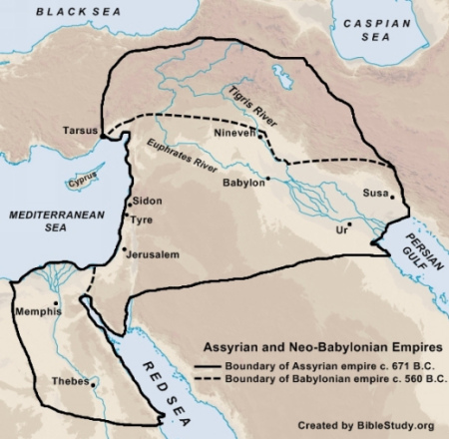

Slide 21
JONAH 3
Now Nineveh was a very large city; it took three days to go through it. ⁴ Jonah began by going a day’s journey into the city, proclaiming, “Forty more days and Nineveh will be overthrown.” ⁵ The Ninevites believed God. A fast was proclaimed, and all of them, from the greatest to the least, put on sackcloth.

Slide 22
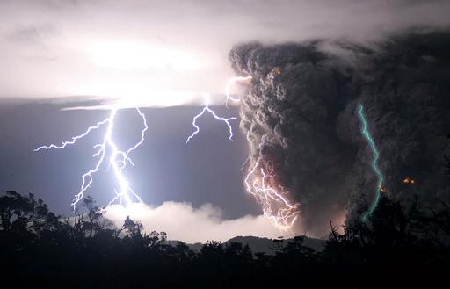
Signs of Divine Anger?

Slide 23
JONAH 3
⁶ When Jonah’s warning reached the king of Nineveh, he rose from his throne, took off his royal robes, covered himself with sackcloth and sat down in the dust.

Slide 24
JONAH 3
⁷ This is the proclamation he issued in Nineveh:
“By the decree of the king and his nobles:
Do not let people or animals, herds or flocks, taste anything; do not let them eat or drink. ⁸ But let people and animals be covered with sackcloth.

Slide 25
JONAH 3
Let everyone call urgently on God. Let them give up their evil ways and their violence.
⁹ Who knows? God may yet relent and with compassion turn from his fierce anger so that we will not perish.”

Slide 26
JONAH 3
¹⁰ When God saw what they did and how they turned from their evil ways, he relented and did not bring on them the destruction he had threatened.

Slide 27
JONAH 4 (Contrasts between God & Jonah)
But to Jonah this seemed very wrong, and he became angry. ² He prayed to the Lord, “Isn’t this what I said, Lord, when I was still at home? That is what I tried to forestall by fleeing to Tarshish. I knew that you are a gracious and compassionate God, slow to anger and abounding in love, a God who relents from sending calamity.

Slide 28
JONAH 4
But to Jonah this seemed very wrong, and he became angry. ² He prayed to the Lord, “Isn’t this what I said, Lord, when I was still at home? That is what I tried to forestall by fleeing to Tarshish. I knew that you are a gracious and compassionate God, slow to anger and abounding in love, a God who relents from sending calamity.

Slide 29
JONAH 4
³ Now, Lord, take away my life, for it is better for me to die than to live.”
⁴ But the Lord replied, “Is it right for you to be angry?”

Slide 30
JONAH 4
⁵ Jonah had gone out and sat down at a place east of the city. There he made himself a shelter, sat in its shade and waited to see what would happen to the city. ⁶ Then the Lord God provided a leafy plant and made it grow up over Jonah to give shade for his head to ease his discomfort, and Jonah was very happy about the plant.

Slide 31
JONAH 4
⁷ But at dawn the next day God provided a worm, which chewed the plant so that it withered.⁸ When the sun rose, God provided a scorching east wind, and the sun blazed on Jonah’s head so that he grew faint. He wanted to die, and said, “It would be better for me to die than to live.”

Slide 32
JONAH 4
⁹ But God said to Jonah, “Is it right for you to be angry about the plant?”
“It is,” he said. “And I’m so angry I wish I were dead.”

Slide 33
JONAH 4
¹⁰ But the Lord said, “You have been concerned about this plant, though you did not tend it or make it grow. It sprang up overnight and died overnight. ¹¹ And should I not have concern for the great city of Nineveh, in which there are more than a hundred and twenty thousand people who cannot tell their right hand from their left—and also many animals?”

