Slide 1
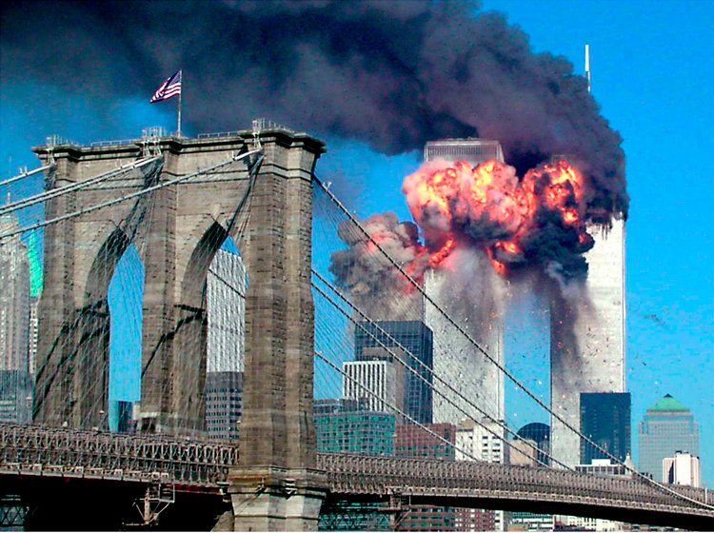
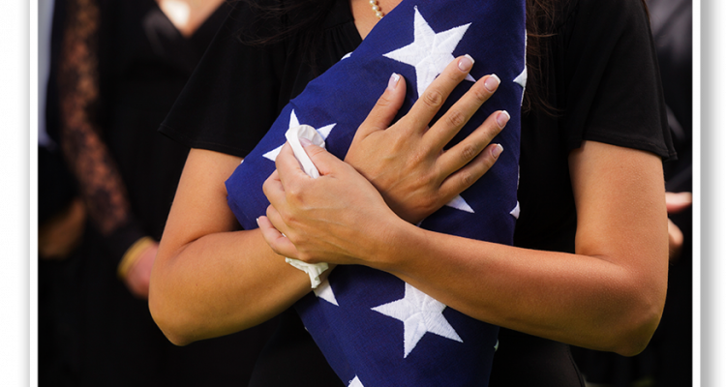
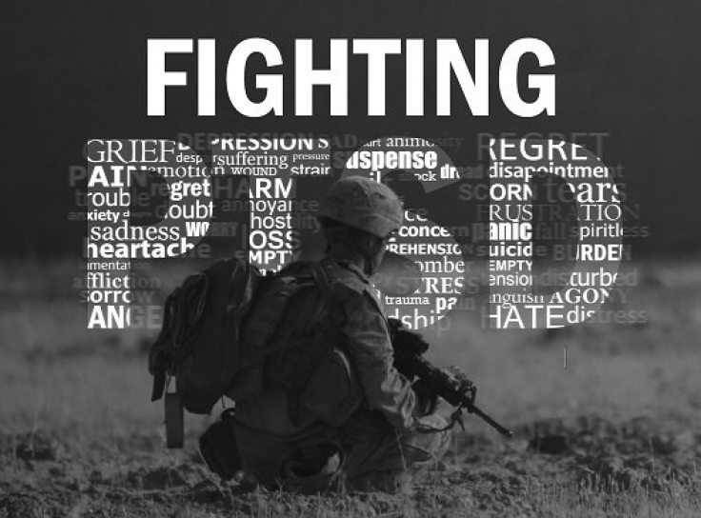
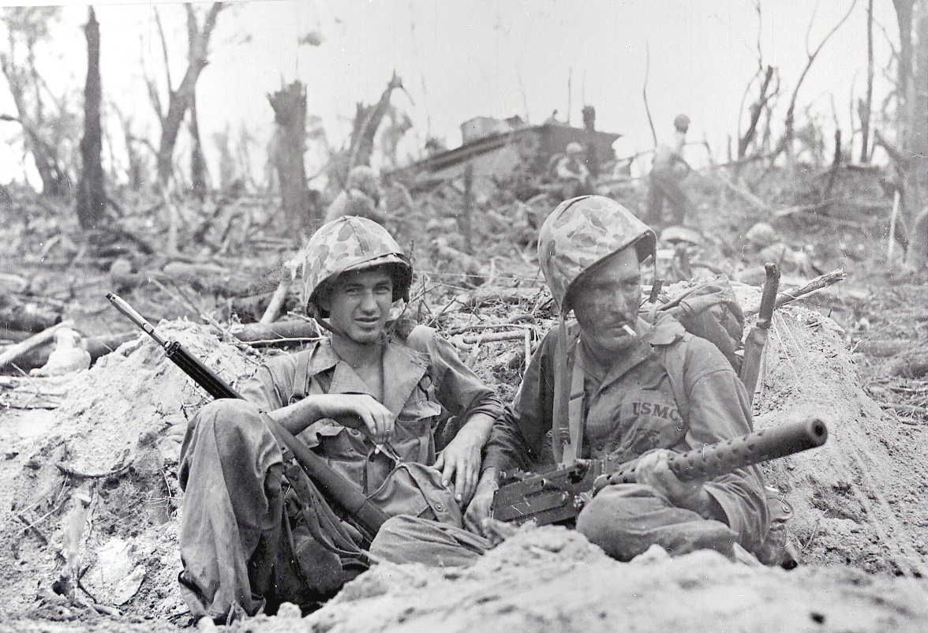

Slide 2
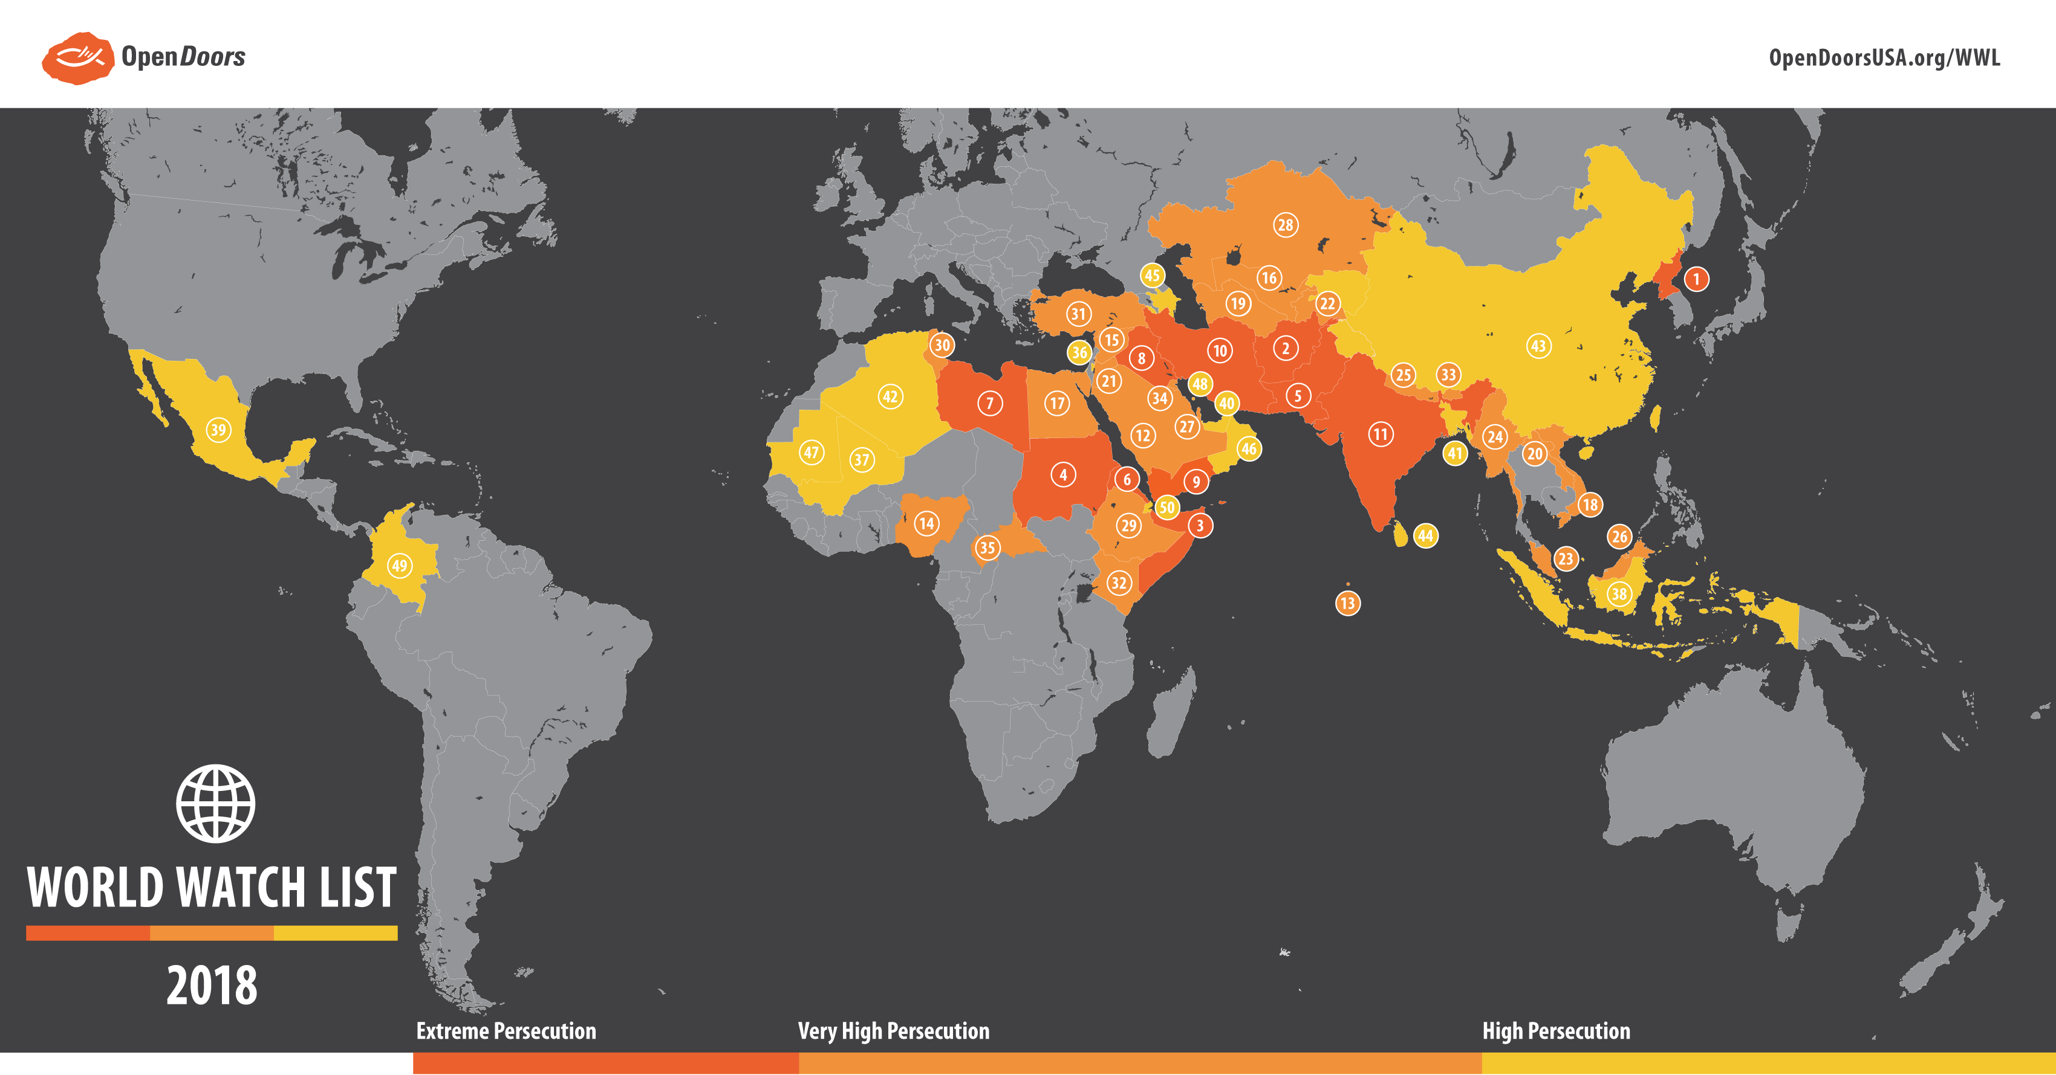

Slide 3
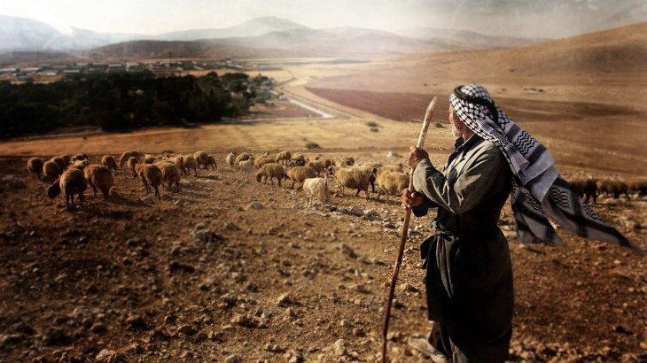
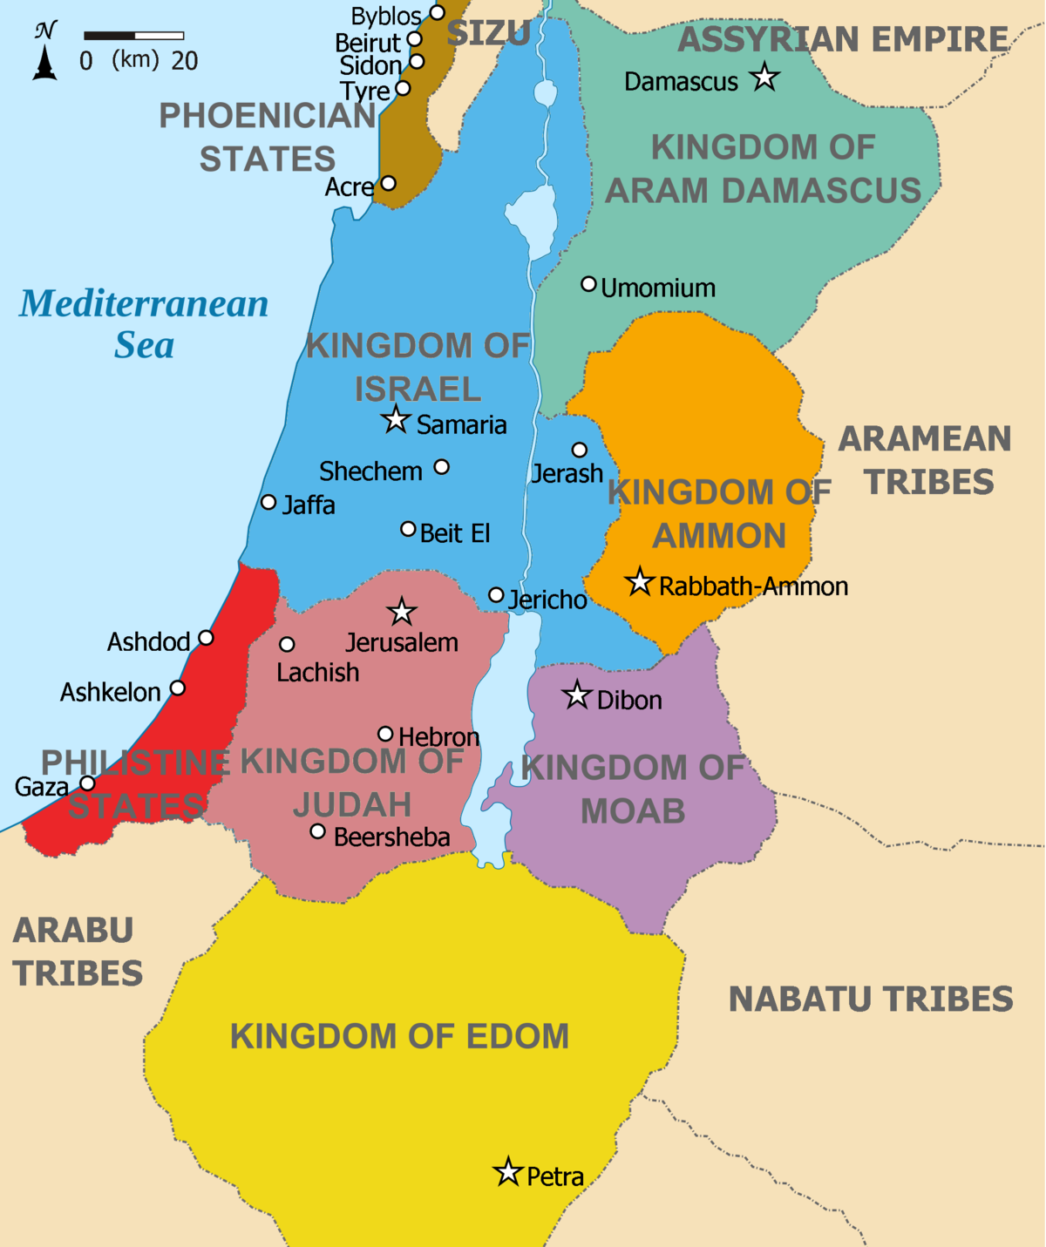

Slide 4
1:1-2:3
Prophecies against Israel’s enemies
2:4-9:15
Prophecies against Israel

Slide 5
Prophecies against other nations:
Damascus/Aram
2. Gaza/Philistia
3. Edom
4. Ammon
5. Moab

Slide 6
Amos 2:4-5
⁴ This is what the Lord says:
“For three sins of Judah, even for four, I will not relent. Because they have rejected the law of the Lord and have not kept his decrees, because they have been led astray by false gods, the gods their ancestors followed, ⁵ I will send fire on Judah that will consume the fortresses of Jerusalem.”

Slide 7
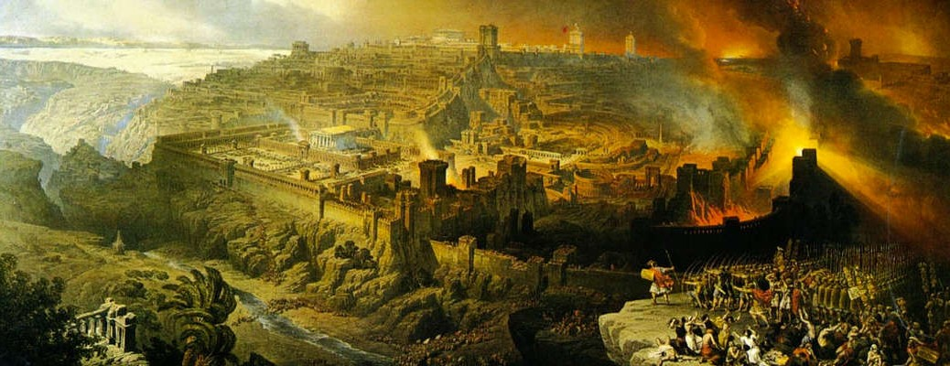
Siege of Jerusalem—586 B.C.

Slide 8
I Peter 4
¹⁷ For it is time for judgment to begin with God’s household; and if it begins with us, what will the outcome be for those who do not obey the gospel of God?
¹⁸ And, “If it is hard for the righteous to be saved, what will become of the ungodly and the sinner?”
¹⁹ So then, those who suffer according to God’s will should commit themselves to their faithful Creator and continue to do good.

Slide 9
Amos 2:4
Because they have rejected the law of the Lord and have not kept his decrees….

Slide 11
Amos 2:4
(NIV) Because they have rejected the law of the Lord and have not kept his decrees….
(NKJV) “Because they have despised the law of the Lord, and have not kept His commandments….”

Slide 12
Amos 8:11-14
“The days are coming,” declares the Sovereign Lord, “when I will send a famine through the land— not a famine of food or a thirst for water, but a famine of hearing the words of the Lord. ¹² People will stagger from sea to sea and wander from north to east, searching for the word of the Lord, but they will not find it.

Slide 13
Amos 8:11-14
¹³ “In that day “the lovely young women and strong young men will faint because of thirst. ¹⁴ Those who swear by the sin of Samaria— who say, ‘As surely as your god lives, Dan,’ or, ‘As surely as the god of Beersheba lives’— they will fall, never to rise again.”

Slide 14
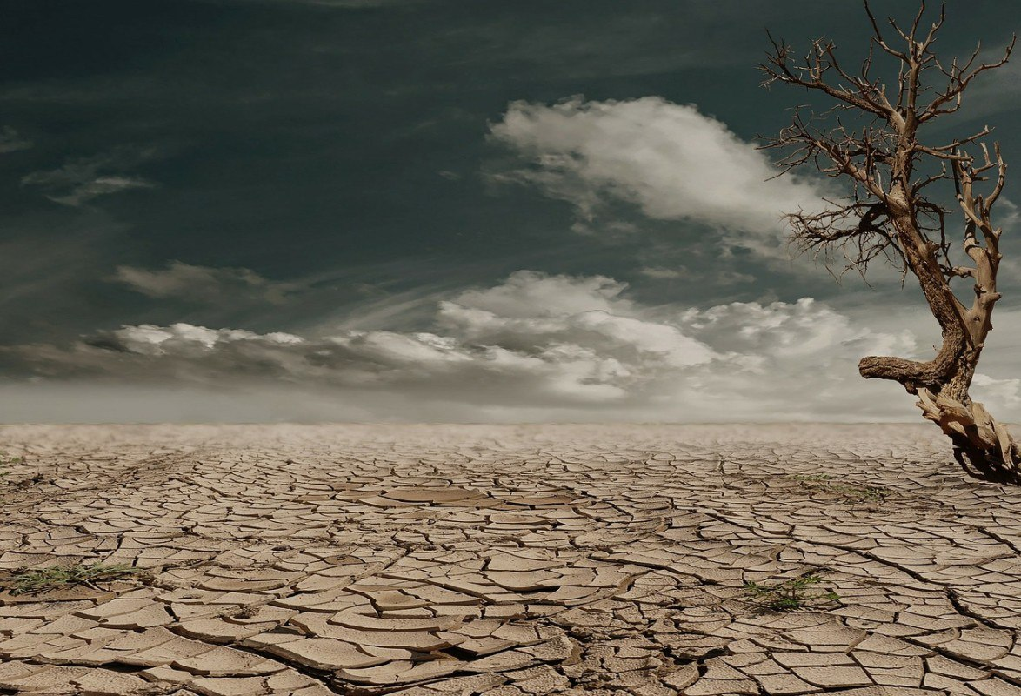
a famine of hearing the words of the Lord

Slide 15
What’s my heart towards
the Word of God?
Indifferent?
Irritated?
Dismissive?

Slide 16
Amos 5--This is what the Lord says to Israel: “Seek me and live; ⁵ do not seek Bethel, do not go to Gilgal, do not journey to Beersheba. For Gilgal will surely go into exile, and Bethel will be reduced to nothing.” ⁶ Seek the Lord and live, or he will sweep through the tribes of Joseph like a fire; it will devour them, and Bethel will have no one to quench it.

Slide 17
Amos 5
²¹ “I hate, I despise your religious festivals; your assemblies are a stench to me. ²² Even though you bring me burnt offerings and grain offerings, I will not accept them. Though you bring choice fellowship offerings, I will have no regard for them. ²³ Away with the noise of your songs! I will not listen to the music of your harps.

Slide 18
Amos 5
²⁴ But let justice roll on like a river, righteousness like a never-failing stream!
²⁵ “Did you bring me sacrifices and offerings forty years in the wilderness, people of Israel? ²⁶ You have lifted up the shrine of your king, the pedestal of your idols, the star of your god— which you made for yourselves. ²⁷ Therefore I will send you into exile beyond Damascus,” says the Lord, whose name is God Almighty.

Slide 20
Fresh Repentance…

Slide 21
Amos 5--This is what the Lord says to Israel: “Seek me and live; ⁵ do not seek Bethel, do not go to Gilgal, do not journey to Beersheba. For Gilgal will surely go into exile, and Bethel will be reduced to nothing.” ⁶ Seek the Lord and live, or he will sweep through the tribes of Joseph like a fire; it will devour them, and Bethel will have no one to quench it.

Slide 22
Amos 5
⁷ There are those who turn justice into bitterness and cast righteousness to the ground.
¹⁰ There are those who hate the one who upholds justice in court and detest the one who tells the truth.
¹¹ You levy a straw tax on the poor and impose a tax on their grain. Therefore, though you have built stone mansions, you will not live in them; though you have planted lush vineyards, you will not drink their wine.

Slide 23
Amos 5
¹² For I know how many are your offenses and how great your sins.
There are those who oppress the innocent and take bribes and deprive the poor of justice in the courts. ¹³ Therefore the prudent keep quiet in such times, for the times are evil.
¹⁴ Seek good, not evil, that you may live. Then the Lord God Almighty will be with you, just as you say he is.

Slide 24
Amos 5
¹⁵ Hate evil, love good; maintain justice in the courts. Perhaps the Lord God Almighty will have mercy on the remnant of Joseph.
²⁴ But let justice roll on like a river, righteousness like a never-failing stream!

Slide 25
How I treat people
displays
what I actually think
of God.

Slide 26
Acts 4:33-35
“And God’s grace was so powerfully at work in them all that there were no needy persons among them. For from time to time those who owned land or houses sold them, brought the money from the sales and put it at the apostles’ feet, and it was distributed to anyone who had need.”

Slide 27
