Slide 2
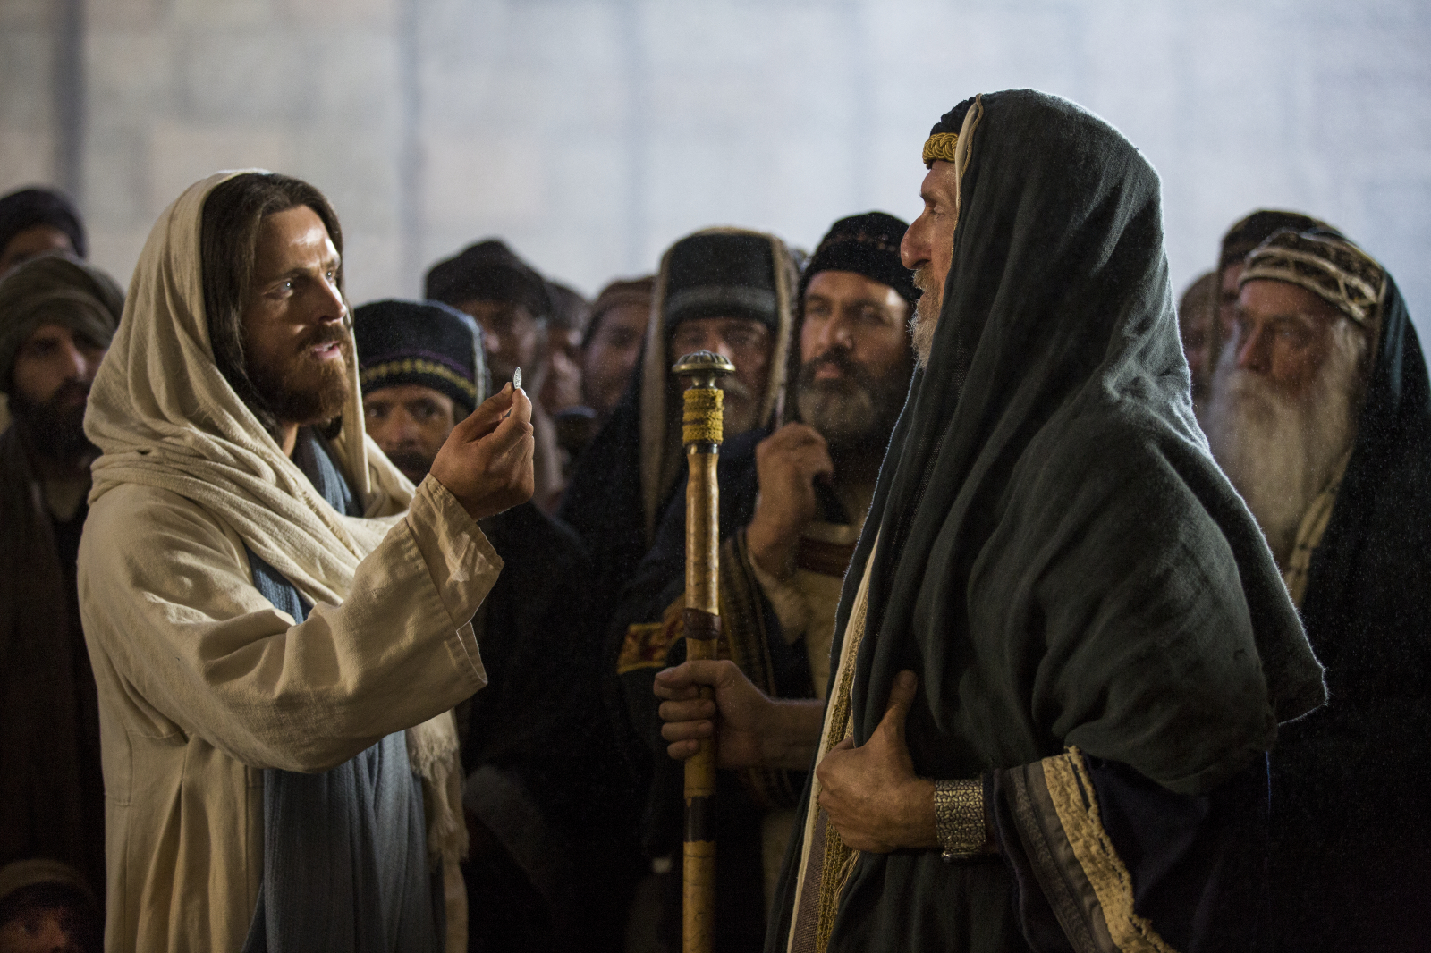

Slide 3
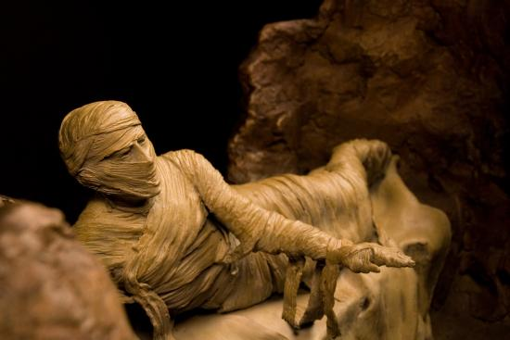

Slide 4
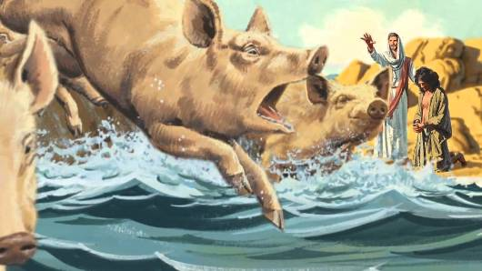

Slide 5
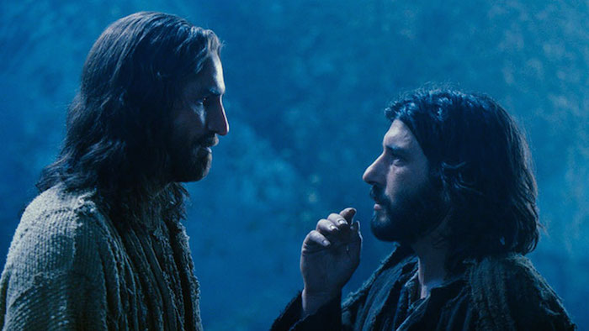

Slide 7
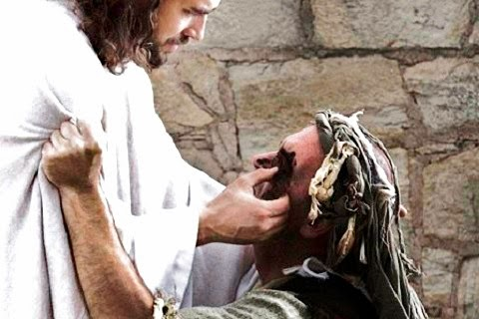

Slide 8
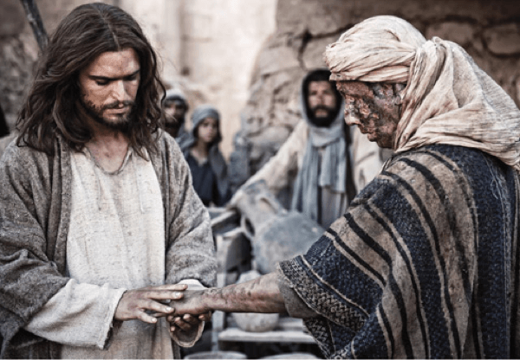

Slide 9
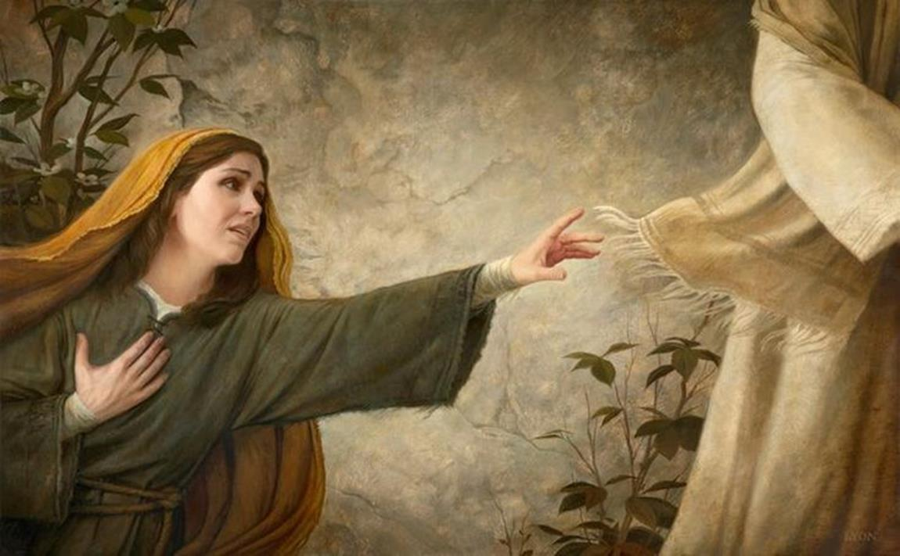

Slide 10
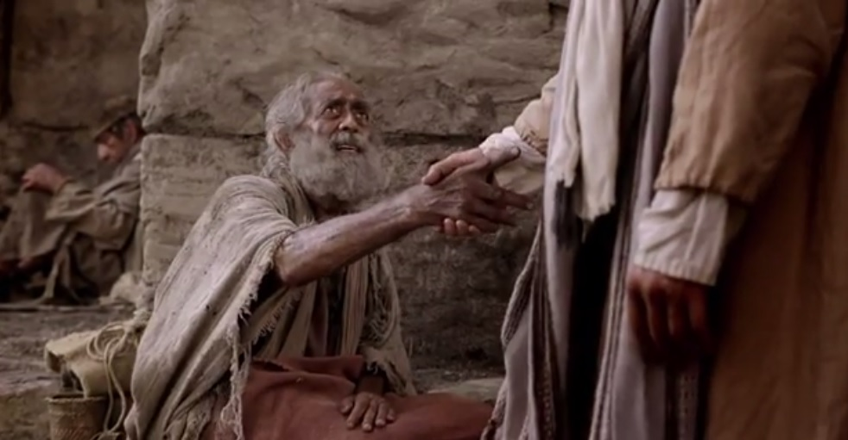

Slide 12
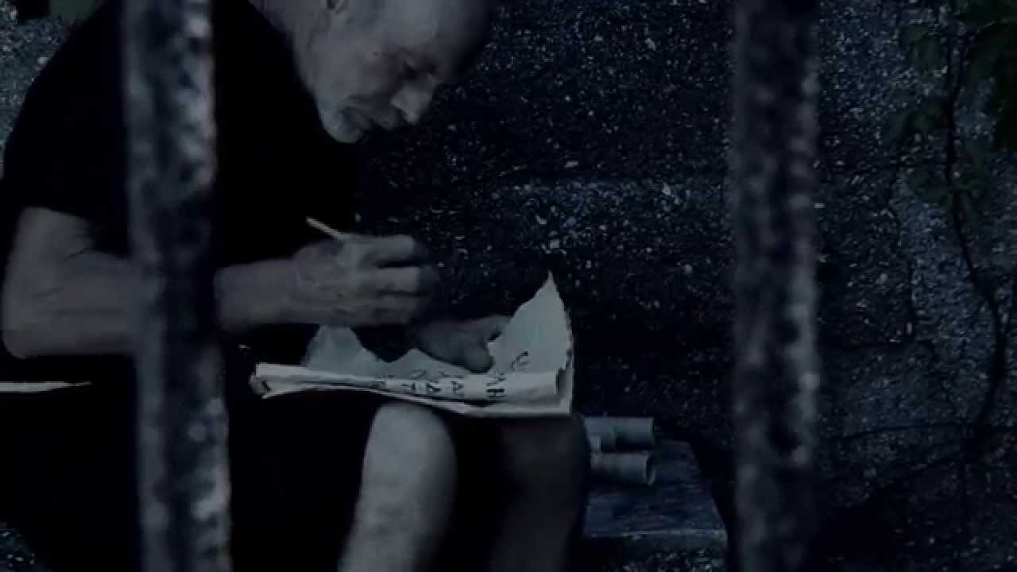

Slide 13
COLOSSIANS 1 ²⁴ Now I rejoice in what I am suffering for you, and I fill up in my flesh what is still lacking in regard to Christ’s afflictions, for the sake of his body, which is the church. ²⁵ I have become its servant by the commission God gave me to present to you the word of God in its fullness— ²⁶ the mystery that has been kept hidden for ages and generations, but is now disclosed to the Lord’s people.

Slide 14
COLOSSIANS 1 ²⁷ To them God has chosen to make known among the Gentiles the glorious riches of this mystery, which is Christ in you, the hope of glory. ²⁸ He is the one we proclaim, admonishing and teaching everyone with all wisdom, so that we may present everyone fully mature in Christ. ²⁹ To this end I strenuously contend with all the energy Christ so powerfully works in me.

Slide 15
COLOSSIANS 1:24 Now I rejoice in what I am suffering for you, and I fill up in my flesh what is still lacking in regard to Christ’s afflictions, for the sake of his body, which is the church.

Slide 16
How have you experienced suffering?

Slide 17
There are things we will experience with Christ in suffering that simply cannot be experienced with Him when life is good.

Slide 18
“I rejoice in what I am suffering for you…”

Slide 19
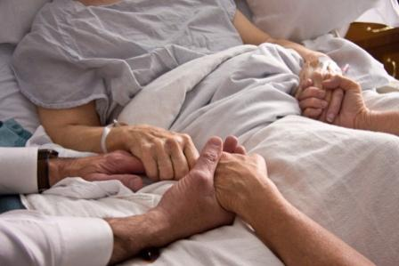
Suffering isn’t all about us; it’s also about what God is doing in those watching and suffering with us.

Slide 20
How has suffering enabled us to know Jesus more, differently and deeply?

Slide 21
Colossians 1:24
“…I fill up in my flesh what is still lacking in regard to Christ’s afflictions, for the sake of his body, which is the church.”

Slide 22
Philippians 3:10
“…that I may know Him and the power of His resurrection, and the fellowship of His sufferings, being conformed to His death….”

Slide 23
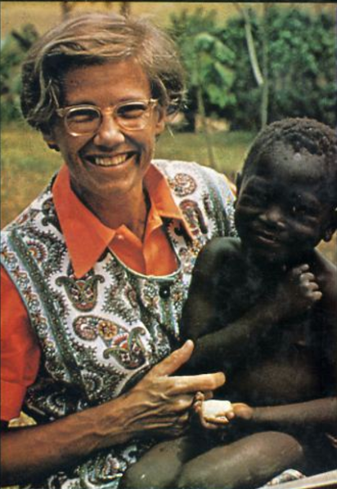
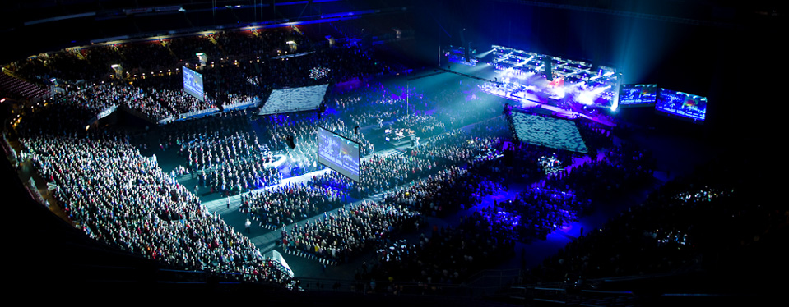
Dr. Helen Roseveare

Slide 25
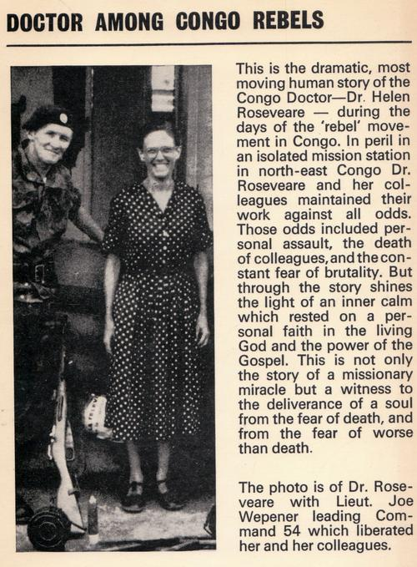
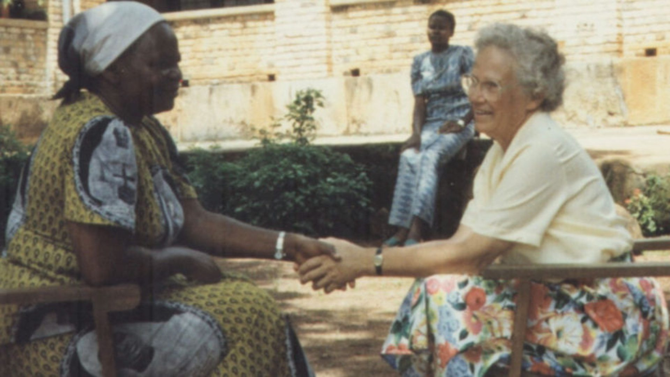
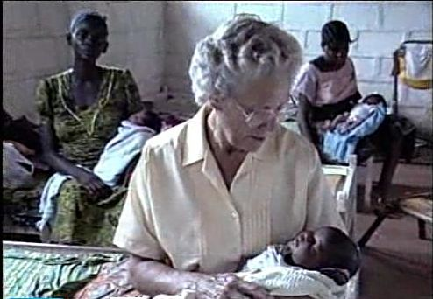

Slide 26
Father, how we thank You that Jesus is our good Shepherd and is there to comfort and strengthen in times of suffering, sadness, pain and loss.
Thank You that Your rod and staff sustain and keep me, no matter what season of life I am passing through and no matter how difficult the times become.

Slide 27
We praise You Lord, for You are our strong tower, into whose everlasting arm we flee for protection and safety, for You have pledged to uphold us with the right hand of Your righteousness. Thank You that in the midst of suffering and distress You have undertaken never to leave me nor forsake me - and when I face times of loneliness and isolation, Your promised grace is sufficient to carry me through.

Slide 28
Lord we know that as Your children we are indeed blessed and able to rest in You as our daily companion, our faithful Comforter and our wise Counsellor.
Thank You for bringing me to this point in my life and for so patiently teaching me the lesson of Your never-failing faithfulness.

Slide 29
Use us, we pray, to give like-comfort, companionship and counsel to other lonely and lost souls, who also need the strength of their good and faithful Shepherd.
And continue, we pray, to uphold and teach us more of Your comfort, strength, grace and love even in future suffering.
In Jesus name we pray this, Amen

