Slide 2
Colossians 4
⁶ Let your conversation be always full of grace, seasoned with salt, so that you may know how to answer everyone.

Slide 3
Spiritual Opportunity Questions
So, do you have any kind of spiritual belief?
What’s been your personal experience when it comes to faith and God?
What conclusions have you come to about who Jesus Christ is and your relationship to Him?

Slide 4
Suggestions for Conversations
Learn to listen by asking questions. Ask clarifying questions of their questions and objections.
People don’t care how much we know until they know how much we care.
Find out WHY people have the objections they do.

Slide 5
Suggestions for Conversations
Don’t be afraid to say, “That’s a good point,” or “I don’t have an answer for that right now.”
Keep your answers and questions SHORT!

Slide 6
What are the common questions or objections most people have
to belief in God and faith in Jesus Christ?

Slide 7
Mark 12
²⁹ “The most important one [commandment],” answered Jesus, “is this: ‘Hear, O Israel: The Lord our God, the Lord is one. ³⁰ Love the Lord your God with all your heart and with all your soul and with all your mind and with all your strength.’ ³¹ The second is this: ‘Love your neighbor as yourself.’ There is no commandment greater than these.”

Slide 8
2 Corinthians 10:5
“We demolish arguments
and every pretension that sets itself up against the knowledge of God,
and we take captive every thought
to make it obedient to Christ.

Slide 9
Mark 10
¹⁷ As Jesus started on his way, a man ran up to him and fell on his knees before him. “Good teacher,” he asked, “what must I do to inherit eternal life?”

Slide 10
Mark 10
¹⁷ As Jesus started on his way, a man ran up to him and fell on his knees before him. “Good teacher,” he asked, “what must I do to inherit eternal life?”
¹⁸ “Why do you call me good?” Jesus answered. “No one is good—except God alone.

Slide 11
Mark 10
¹⁹ You know the commandments: ‘You shall not murder, you shall not commit adultery, you shall not steal, you shall not give false testimony, you shall not defraud, honor your father and mother.’”

Slide 12
Mark 10
¹⁹ You know the commandments: ‘You shall not murder, you shall not commit adultery, you shall not steal, you shall not give false testimony, you shall not defraud, honor your father and mother.’”
²⁰ “Teacher,” he declared, “all these I have kept since I was a boy.”

Slide 13
Ask most people today…
“If you died tonight, and stood before God at heaven’s gate and He asked, “Why should I let you into heaven forever with me,” what would you say?”
…and what will they say?

Slide 14
Mark 10
²¹ Jesus looked at him and loved him. “One thing you lack,” he said. “Go, sell everything you have and give to the poor, and you will have treasure in heaven. Then come, follow me.”
²² At this the man’s face fell. He went away sad, because he had great wealth.

Slide 15
Statements People Make
1. I’m not religious.
Questions to ask:
Why is that?
What do you mean by religious?
Would you still consider yourself a spiritual person?

Slide 16
Statements People Make
1. I’m not religious.
Comments to give:
I’m not religious either. But I sure enjoy knowing God personally.

Slide 17
Statements People Make
I think religion is a crutch.
Questions to ask:
Doesn’t everyone have a limp?
So you’d say you are perfect and never need God?

Slide 18
Statements People Make
I think religion is a crutch.
Comments to give:
I’ll be praying God will show you how much you need Him. ☺
I think it’s worse than a crutch. It’s deceptive!
[The difference: DO (religion) vs. DONE (relationship with Jesus).]

Slide 19
Statements People Make
3.) “I have a hard time believing in a God I can’t see, hear, feel, touch or measure.”
QUESTIONS:
But don’t you believe in things you can’t measure scientifically like love, joy, beauty and kindness, good and evil?

Slide 20
Statements People Make
3.) “I have a hard time believing in a God I can’t see, hear, feel, touch or measure.”
COMMENTS:
Your own personal experiences with God—Him speaking, guiding, convicting, forgiving you, etc.

Slide 21
Statements People Make
3.) “I have a hard time believing in a God I can’t see, hear, feel, touch or measure.”
COMMENTS:
Things I can see lead me to believe in a God I can’t see.
Evidence #1: Everything in science tells us that our universe had a beginning.

Slide 22
Questions People Ask
“So who made God?”
COMMENTS:
Only things that have a beginning need a cause.
God is the uncaused, immaterial, eternal cause of everything in the universe.

Slide 23
Statements People Make
“I have a hard time believing in a God I can’t see, hear, feel, touch or measure.”
Evidence #2: Our universe is fine-tuned with astounding precision in ways that make it a place that can support life. The odds of this happening on its own, by sheer chance, are vanishingly small and thus point powerfully to an intelligent designer…precisely the kind of God the Bible presents.

Slide 24
The Force of Gravity
Gravity can’t change by even 1 part in 10 thousand billion billion billion (10³¹ or roughly a “nonillion”) or life as we know it anywhere in the universe would be impossible.

Slide 25
The Mass of a Neutron
If the neutron were not exactly as it is, about 1.001 times the mass of the proton, then all protons would have decayed into neutrons or all neutrons would have decayed into protons, and life would not be possible.

Slide 26
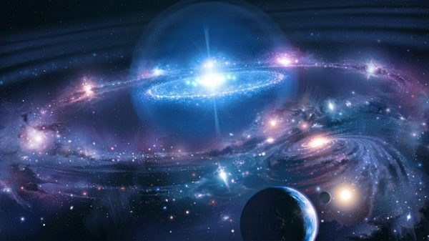
The Big Bang
Explosion of the Big Bang—
If it had differed in strength by as little as one part in 10⁶⁰ , the universe would have either quickly collapsed back on itself or expanded too swiftly for stars to form.

Slide 27
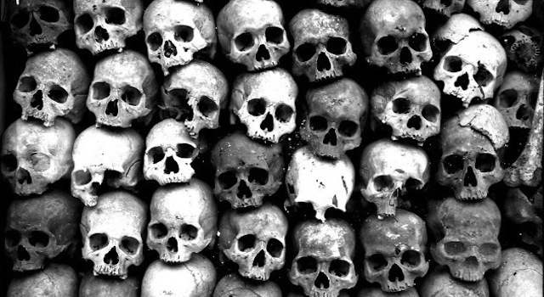
Statements People Make
“I have a hard time believing in a God I can’t see, hear, feel, touch or measure.”
Evidence #3: Objective Moral Standards in Human Nature

Slide 28
How well prepared are you to answer these kinds of questions?
Not at all
Some-what
Totally

Slide 29
Decide to pray every week for divine encounter opportunities.

