Slide 1
On a regular prescription?

Slide 2
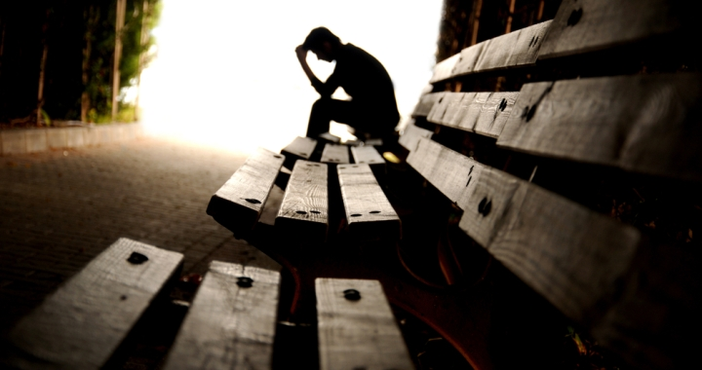

Slide 3
James 5:13-18 (ESV)
¹³ Is anyone among you suffering? Let him pray. Is anyone cheerful? Let him sing praise. ¹⁴ Is anyone among you sick? Let him call for the elders of the church, and let them pray over him, anointing him with oil in the name of the Lord.¹⁵ And the prayer of faith will save the one who is sick, and the Lord will raise him up. And if he has committed sins, he will be forgiven.

Slide 4
James 5:13-18 (ESV)
¹⁶ Therefore, confess your sins to one another and pray for one another, that you may be healed. The prayer of a righteous person has great power as it is working. ¹⁷ Elijah was a man with a nature like ours, and he prayed fervently that it might not rain, and for three years and six months it did not rain on the earth. ¹⁸ Then he prayed again, and heaven gave rain, and the earth bore its fruit.

Slide 5
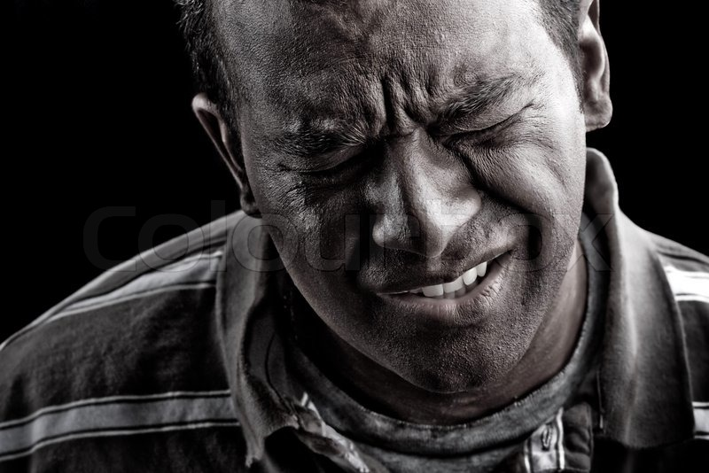
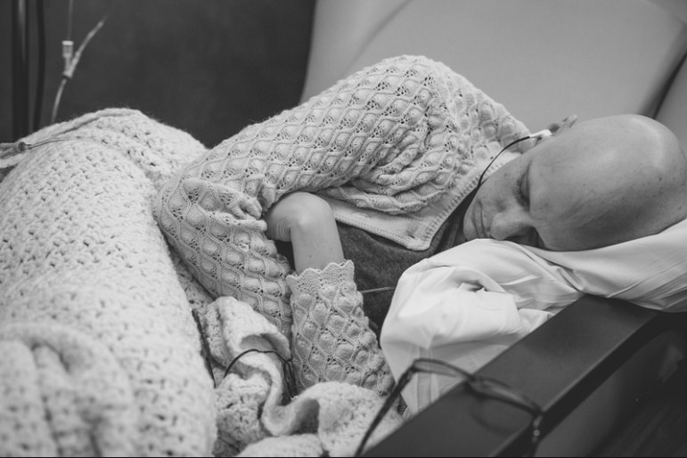

Slide 6
James 5:13-18 (ESV)
¹³ Is anyone among you suffering? Let him pray. Is anyone cheerful? Let him sing praise. ¹⁴ Is anyone among you sick? Let him call for the elders of the church, and let them pray over him, anointing him with oil in the name of the

Slide 7
James 5:13-18 (ESV)
¹³ Is anyone among you suffering? Let him pray. Is anyone cheerful? Let him sing praise. ¹⁴ Is anyone among you sick? Let him call for the elders of the church, and let them pray over him, anointing him with oil in the name of the

Slide 8
James 5:13-18 (ESV)
¹³ Is anyone among you suffering? Let him pray. Is anyone cheerful? Let him sing praise. ¹⁴ Is anyone among you sick? Let him call for the elders of the church, and let them pray over him, anointing him with oil in the name of the

Slide 9
James 5:13-18 (ESV)
And the prayer of faith will save the one who is sick, and the Lord will raise him up. And if he has committed sins, he will be forgiven.

Slide 10
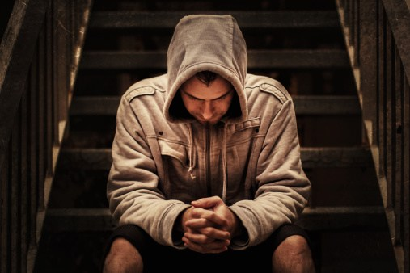
Faith looks to God for healing
but
rests in God when suffering continues.

Slide 11
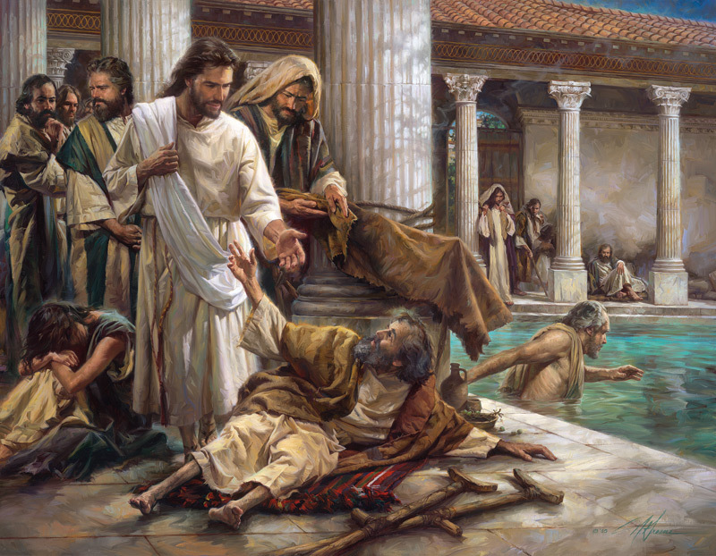
James 5:15b (ESV)
And if he has committed sins, he will be forgiven.

Slide 12
James 5:16 (ESV)
¹⁶ Therefore, confess your sins to one another and pray for one another, that you may be healed. The prayer of a righteous person has great power as it is working.

Slide 13
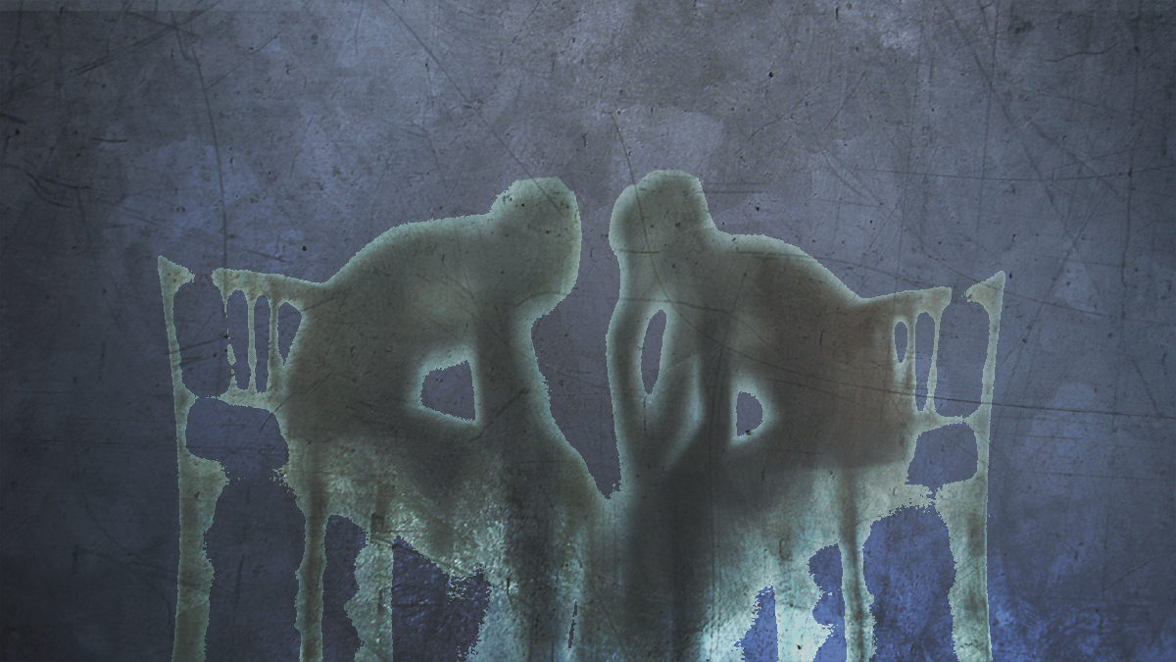
Guardrails to confession?

Slide 14
Other reasons for confession?

Slide 15
Dangers of confession?

Slide 16
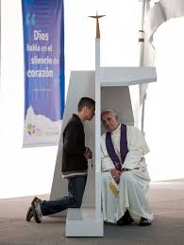

Slide 17
James 5:16 (ESV)
Therefore, confess your sins to one another and pray for one another, that you may be healed. The prayer of a righteous person has great power as it is working.

Slide 18
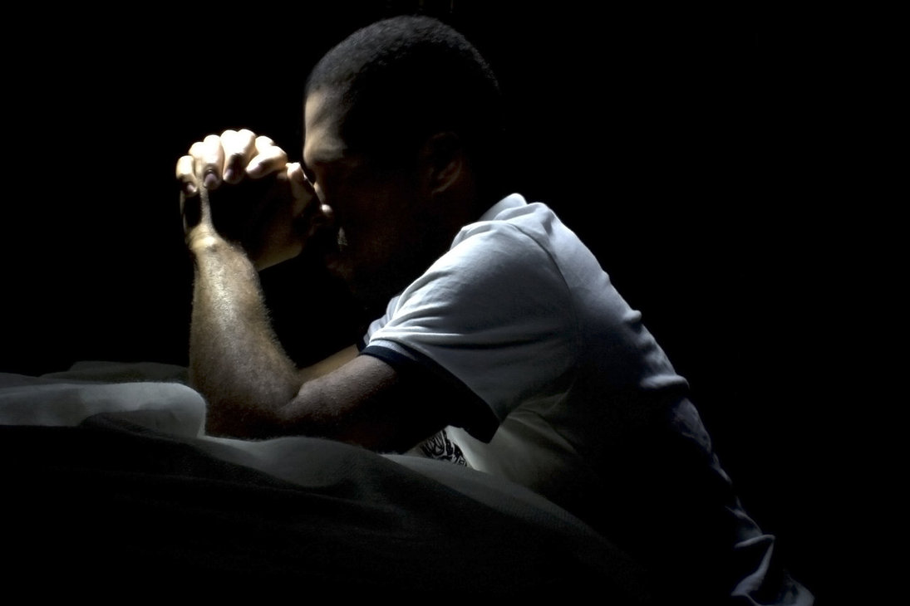

Slide 19
James 5:13-18 (ESV)
¹⁶ Therefore, confess your sins to one another and pray for one another, that you may be healed. The prayer of a righteous person has great power as it is working.

Slide 20
James 5:17-18 (ESV)
¹⁷ Elijah was a man with a nature like ours, and he prayed fervently that it might not rain, and for three years and six months it did not rain on the earth. ¹⁸ Then he prayed again, and heaven gave rain, and the earth bore its fruit.

Slide 21
Even righteous prayer warriors share the same nature we do.

Slide 22
Righteous prayer warriors determine to make their prayers as big as their nation’s spiritual problems.

Slide 23
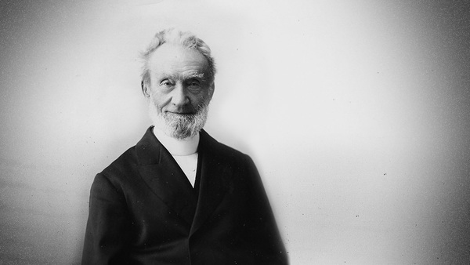
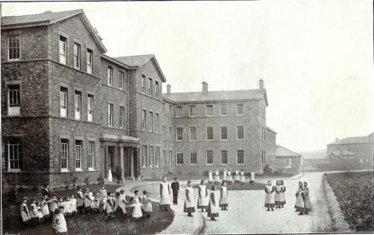
George Mueller
(1805-1897)

Slide 24
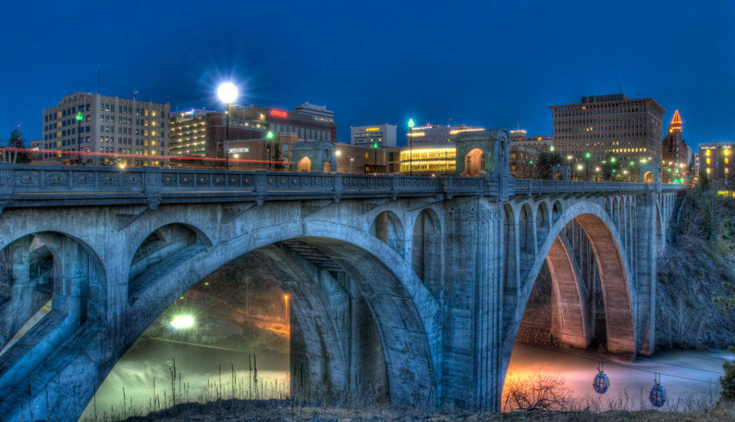
What are the problems our city faces?

Slide 25
