Slide 2
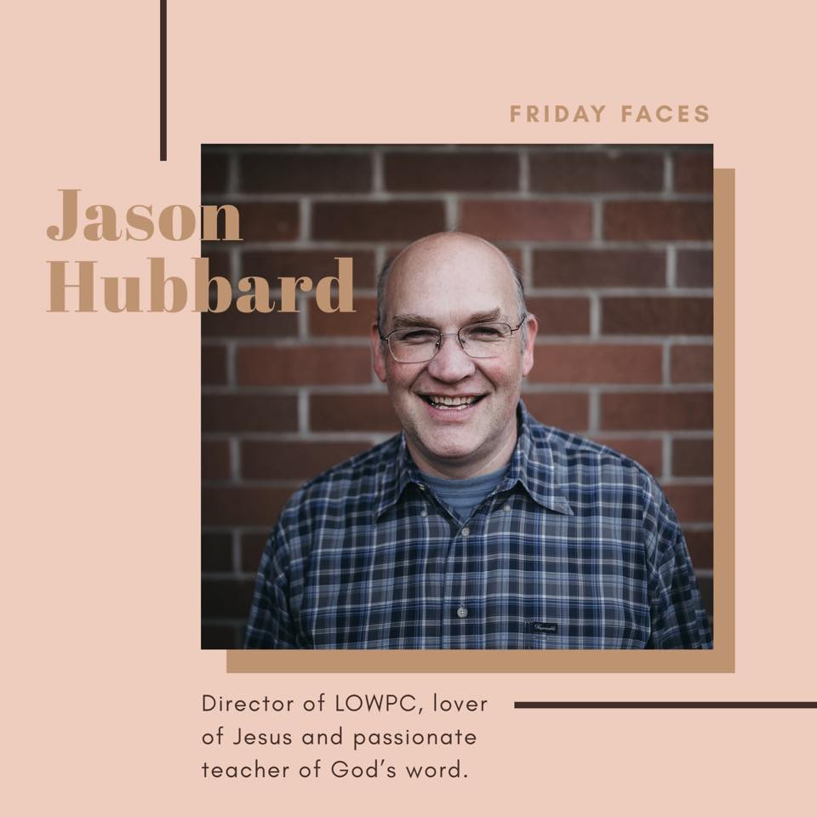

Slide 3
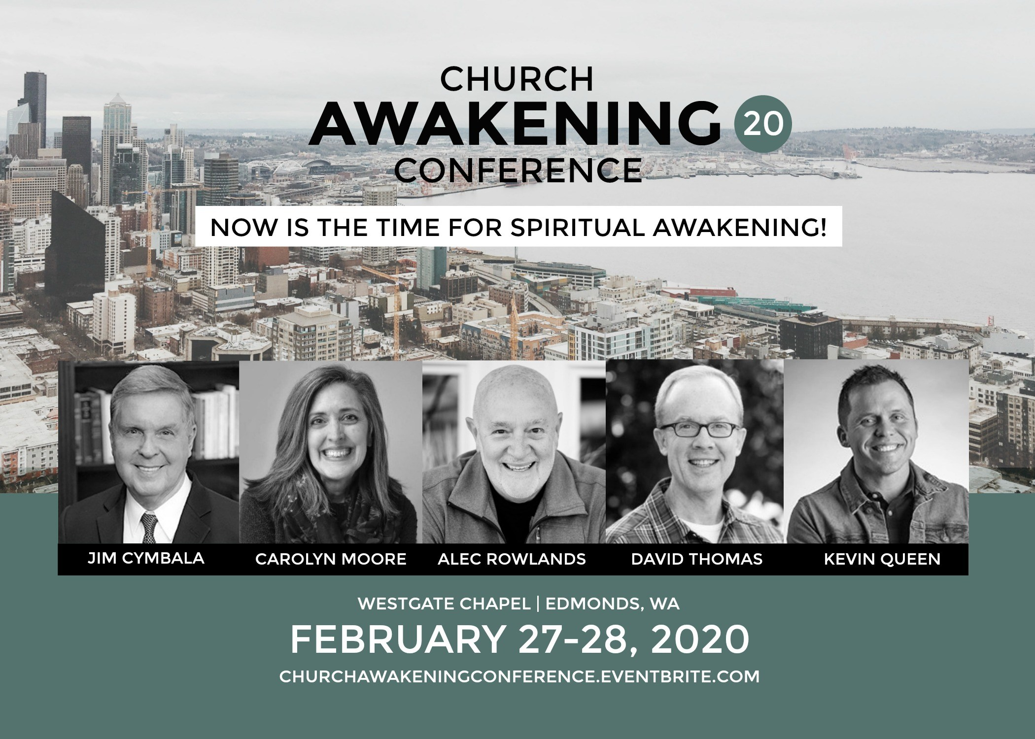
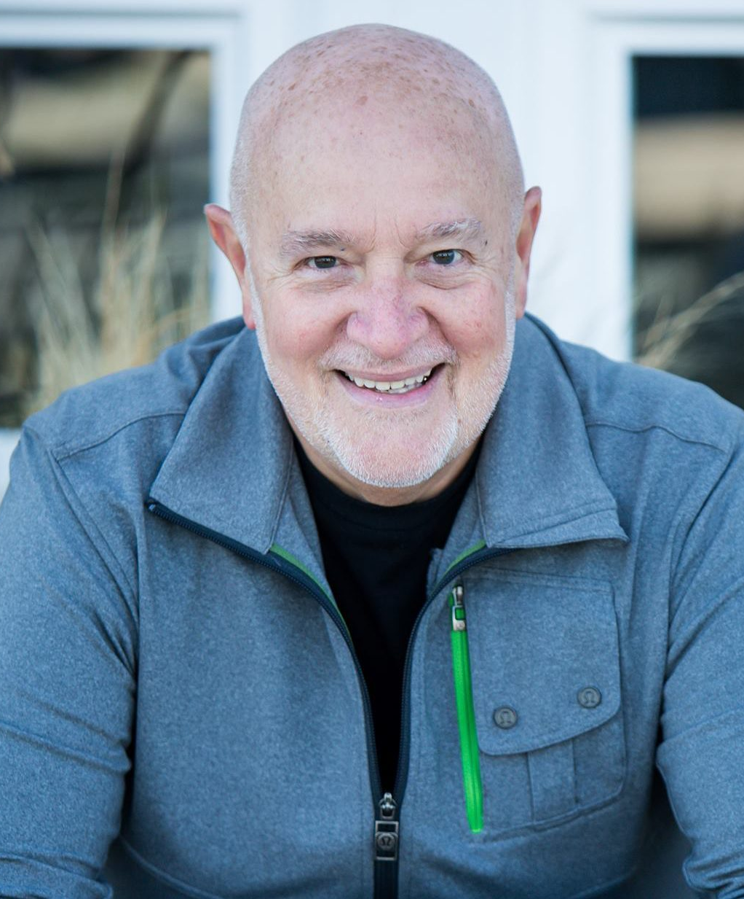

Slide 6
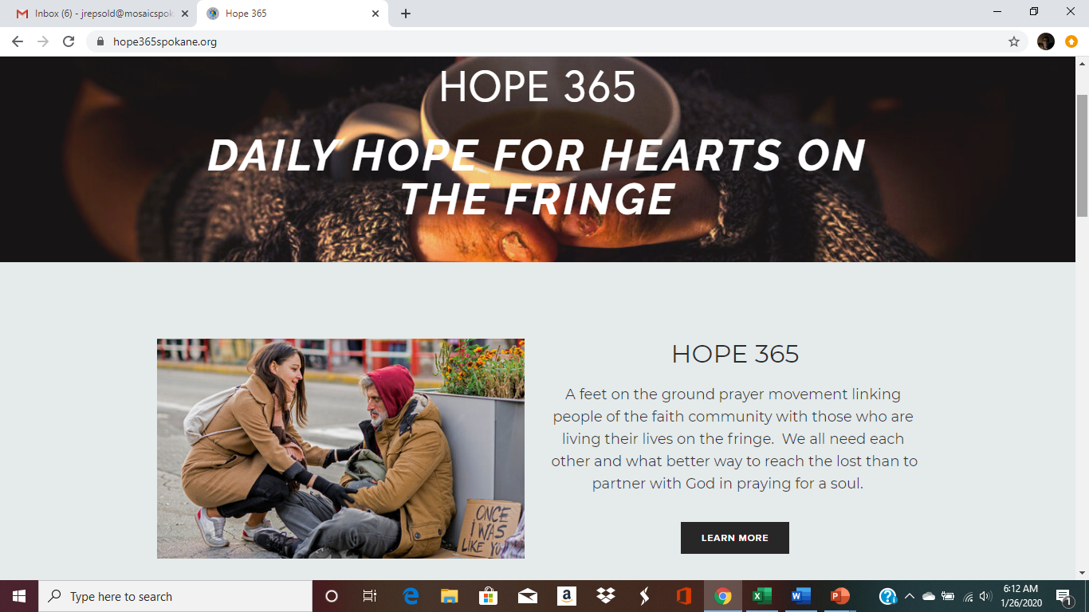
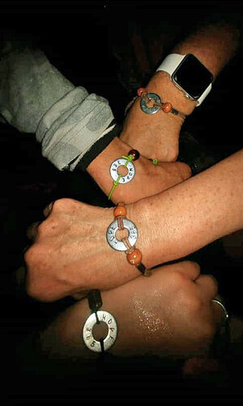

Slide 9
What’s an experience in life that has helped you develop more faith?

Slide 11
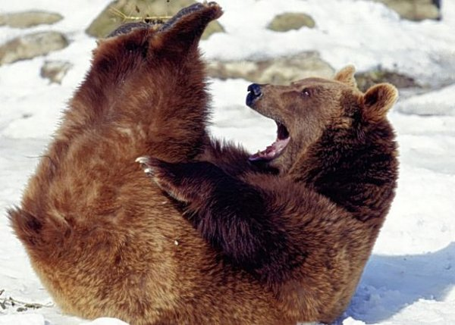
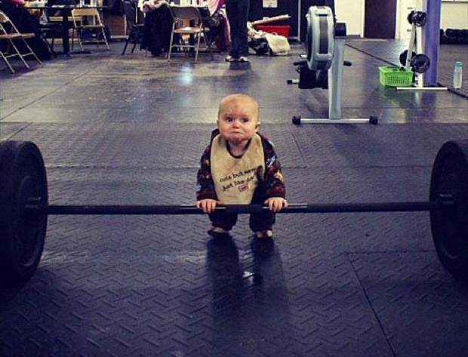
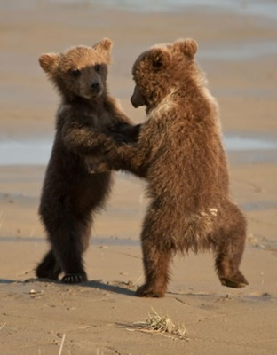
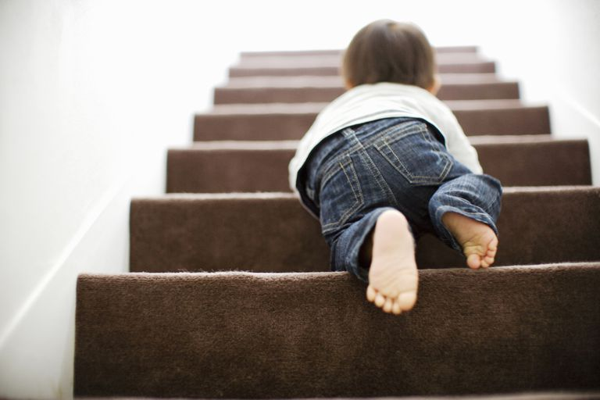
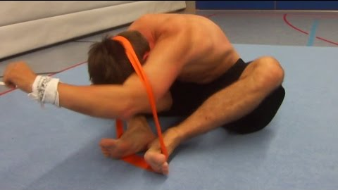
Strength training???

Slide 13
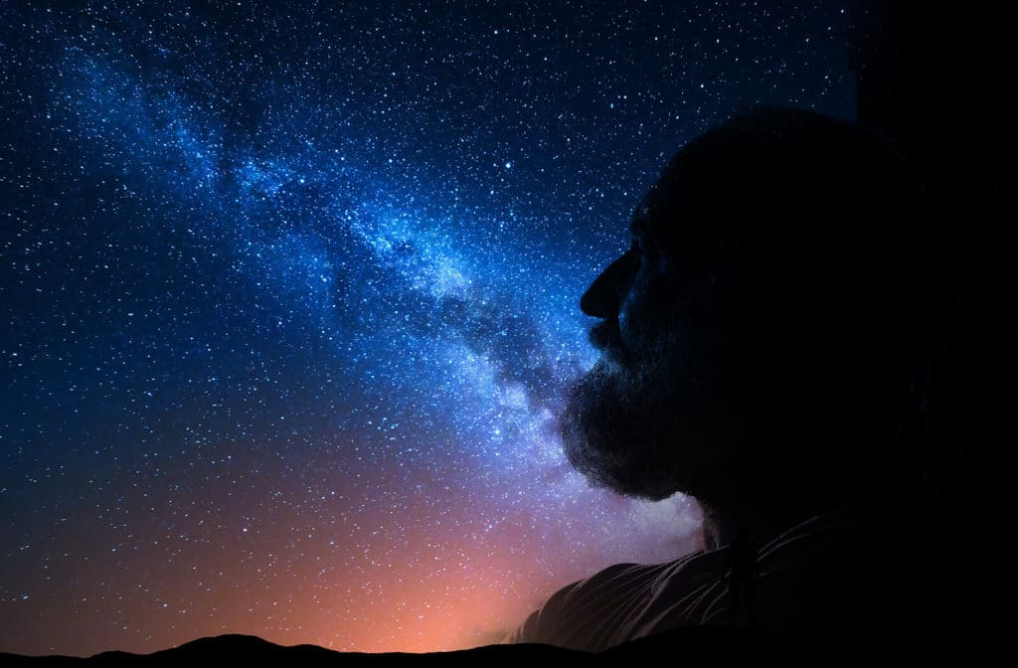
Romans 4
“Abraham believed God and it was credited to him as righteousness.”

Slide 14
Romans 4
¹³ For the promise to Abraham and his offspring that he would be heir of the world did not come through the law but through the righteousness of faith. ¹⁴ For if it is the adherents of the law who are to be the heirs, faith is null and the promise is void. ¹⁵ For the law brings wrath, but where there is no law there is no transgression.

Slide 15
Romans 4
¹³ For the promise to Abraham and his offspring that he would be heir of the world did not come through the law but through the righteousness of faith. ¹⁴ For if it is the adherents of the law who are to be the heirs, faith is null and the promise is void. ¹⁵ For the law brings wrath, but where there is no law there is no transgression.

Slide 16
The Collective Promise of God to Abraham…
The promise of MANY DESCENDANTS
Genesis 12:2—The Lord had said to Abram, “Go from your country, your people and your father’s household to the land I will show you. ² I will make you into a great nation, and I will bless you….”

Slide 17
The Collective Promise of God to Abraham…
The promise of POSSESSING the LAND
Genesis 13:15-17--All the land that you see I will give to you and your offspring forever. ¹⁶ I will make your offspring like the dust of the earth, so that if anyone could count the dust, then your offspring could be counted. ¹⁷ Go, walk through the length and breadth of the land, for I am giving it to you.”

Slide 18
The Collective Promise of God to Abraham…
3. The promise of BLESSING ALL PEOPLE
Genesis 12:3—
I will make your name great, and you will be a blessing. ³ I will bless those who bless you, and whoever curses you I will curse; and all peoples on earth will be blessed through you.”

Slide 19
Romans 4
¹³ For the promise to Abraham and his offspring that he would be heir of the world did not come through the law but through the righteousness of faith. ¹⁴ For if it is the adherents of the law who are to be the heirs, faith is null and the promise is void. ¹⁵ For the law brings wrath, but where there is no law there is no transgression.

Slide 20
Romans 4
¹⁴ For if it is the adherents of the law who are to be the heirs, faith is null and the promise is void. ¹⁵ For the law brings wrath, but where there is no law there is no transgression.

Slide 21
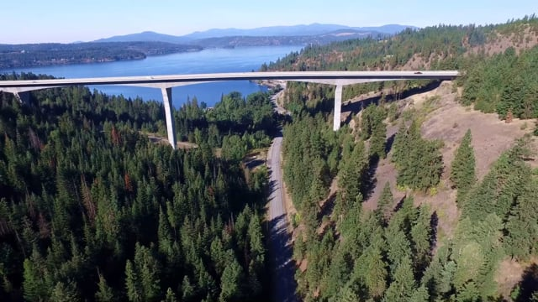
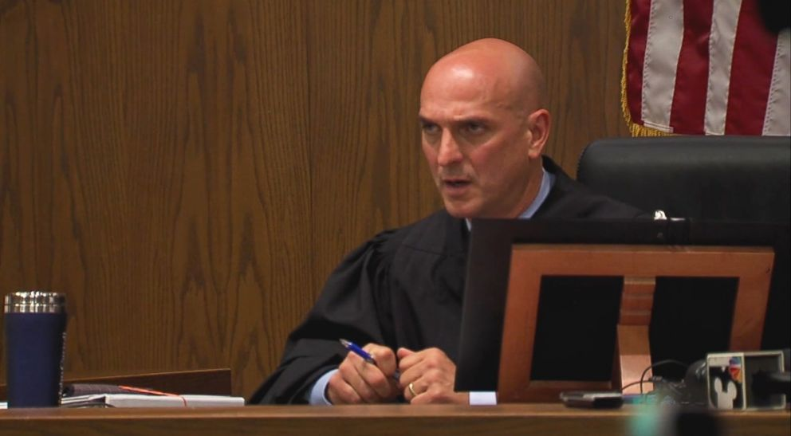

Slide 22
Romans 4
¹⁶ That is why it depends on faith, in order that the promise may rest on grace and be guaranteed to all his offspring—

Slide 23
Romans 4
¹⁶ That is why it depends on faith, in order that the promise may rest on grace and be guaranteed to all his offspring—

Slide 24
Romans 4
¹⁶ That is why it depends on faith, in order that the promise may rest on grace and be guaranteed to all his offspring—not only to the adherent of the law but also to the one who shares the faith of Abraham, who is the father of us all, ¹⁷ as it is written, “I have made you the father of many nations.”

Slide 25
SALVATION
God’s Side Man’s Side
GRACE FAITH

Slide 27
Faith Strength-Training

Slide 28
¹⁶ That is why it depends on faith, in order that the promise may rest on grace and be guaranteed to all his offspring—not only to the adherent of the law but also to the one who shares the faith of Abraham, who is the father of us all, ¹⁷ as it is written, “I have made you the father of many nations”—in the presence of the God in whom he believed, who gives life to the dead and calls into existence the things that do not exist.

Slide 29
1.) Faith-training looks first at the nature and actions of God.
“—in the presence of the God in whom he believed, who gives life to the dead and calls into existence the things that do not exist.”

Slide 30
Hebrews 11:3
“By faith we understand that the universe was formed at God’s command, so that what is seen was not made out of what was visible”

Slide 31
Hebrews 11:17-19
¹⁷ By faith Abraham, when he was tested, offered up Isaac, and he who had received the promises was in the act of offering up his only son, ¹⁸ of whom it was said, “Through Isaac shall your offspring be named.” ¹⁹ He considered that God was able even to raise him from the dead, from which, figuratively speaking, he did receive him back.

Slide 32
WHEN is it most difficult to believe in a better future than the present you may be experiencing?
1.) Faith training must look first at the nature of God.

Slide 33
2.) Faith strength-training does some of its best workouts in the gymnasium of hopelessness.
Romans 4
¹⁸ In hope he believed against hope, that he should become the father of many nations, as he had been told, “So shall your offspring be.”

Slide 34
Romans 15:13
“May the God of hope fill you with all joy and peace as you trust in him, so that you may overflow with hope by the power of the Holy Spirit.”

Slide 35
3.) Faith strength-training doesn’t deny human reality; it embraces it right along with divine reality.
Romans 4
¹⁹ He did not weaken in faith when he considered his own body, which was as good as dead (since he was about a hundred years old), or when he considered the barrenness of Sarah's womb.

Slide 36
3.) Faith strength-training doesn’t deny human reality; it embraces it right along with divine reality.
Romans 4
²⁰ No unbelief made him waver concerning the promise of God….”

Slide 37
Romans 4
²⁰ No unbelief made him waver concerning the promise of God, “…but he grew strong in his faith as he gave glory to God, ²¹ fully convinced that God was able to do what he had promised. ²² That is why his faith was “counted to him as righteousness.” ²³ But the words “it was counted to him” were not written for his sake alone, ²⁴ but for ours also. It will be counted to us who believe in him who raised from the dead Jesus our Lord, ²⁵ who was delivered up for our trespasses and raised for our justification.

Slide 38
4.) Faith strength-training grips firmly the barbells of the ‘hope of the resurrection’.

