Slide 1
Tell someone either…
1.) your favorite country outside the U.S. that you have visited…and WHY it is your favorite.
OR
2.) a country you’d like to visit someday but haven’t yet…and WHY.

Slide 3
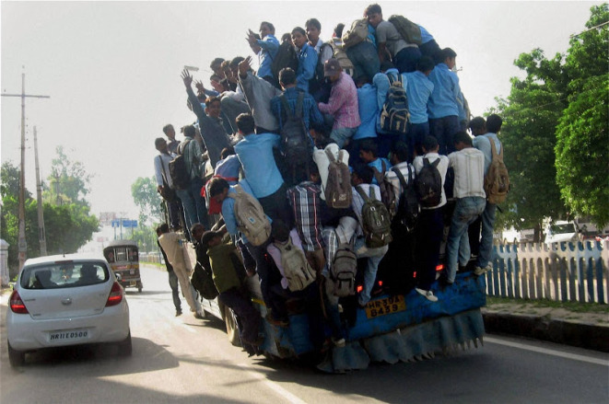
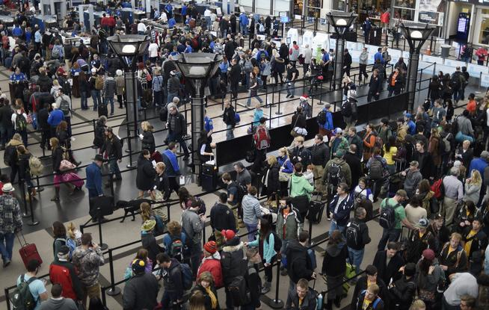
Planning on traveling this summer?

Slide 4
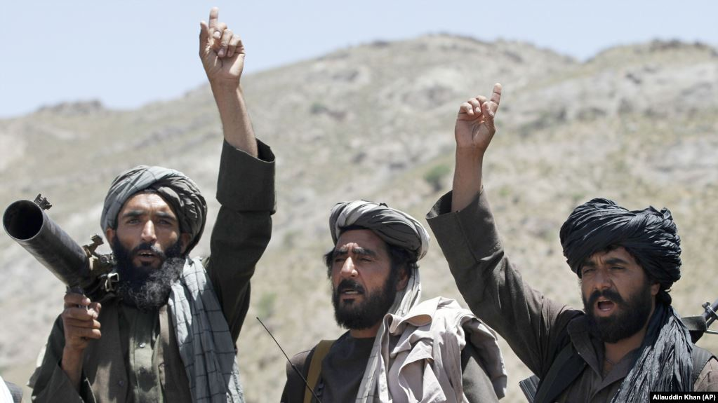
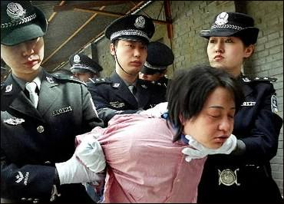
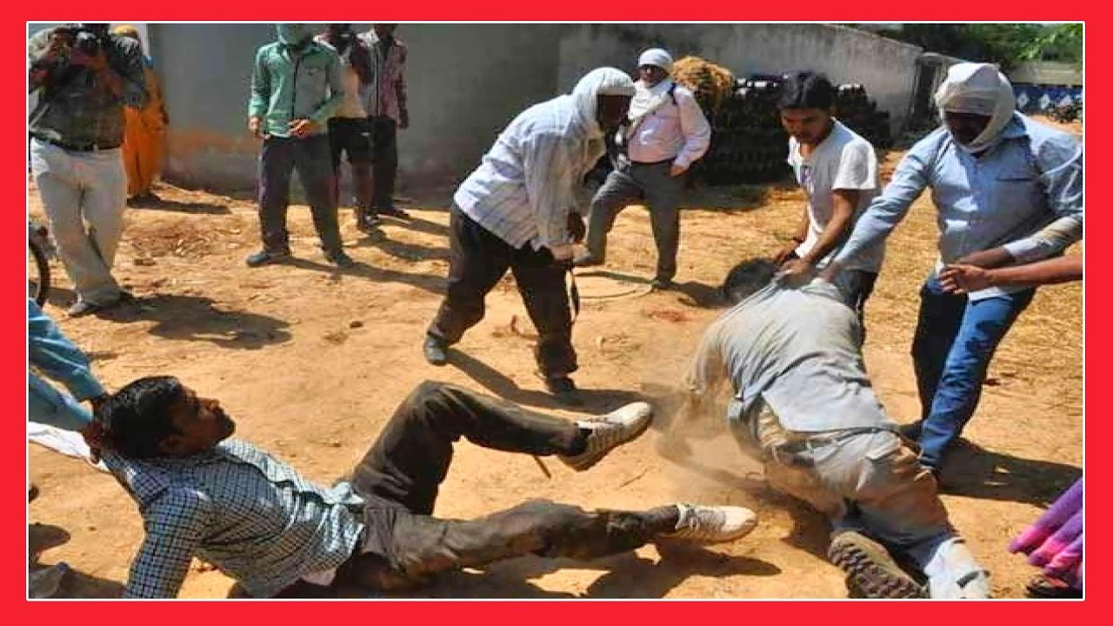

Slide 5
Philippians 4:14-23
Yet it was good of you to share in my troubles.
¹⁵ Moreover, as you Philippians know, in the early days of your acquaintance with the gospel, when I set out from Macedonia, not one church shared with me in the matter of giving and receiving, except you only; ¹⁶ for even when I was in Thessalonica, you sent me aid more than once when I was in need. ¹⁷ Not that I desire your gifts; what I desire is that more be credited to your account.

Slide 6
Philippians 4:14-23
¹⁸ I have received full payment and have more than enough. I am amply supplied, now that I have received from Epaphroditus the gifts you sent. They are a fragrant offering, an acceptable sacrifice, pleasing to God. ¹⁹ And my God will meet all your needs according to the riches of his glory in Christ Jesus.

Slide 7
“What kind of church and what kind of Christ-followers are needed to live out God’s command to each of us to “Go and make disciples of all nations….”?

Slide 8
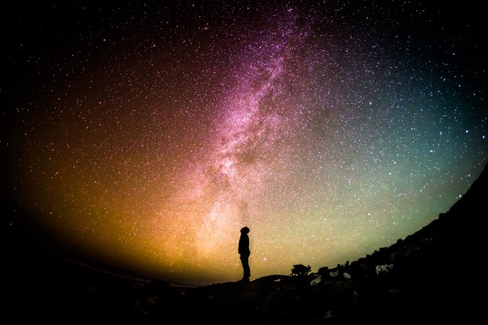
1.) God is looking for Christ-followers today who actually share in the pressures & burdens of His “cross-cultural ambassadors.”
Philippians 4:14
“Yet it was good of you to share in my troubles.”

Slide 9
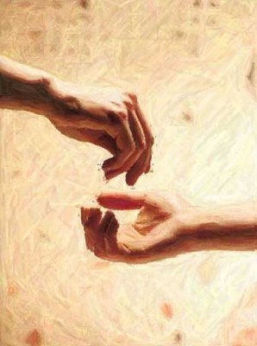
Philippians 4:14
“Yet it was good of you to share in my troubles.”
Sunkoinoneo (Greek)
…giving from one who has to one who is in need.

Slide 10
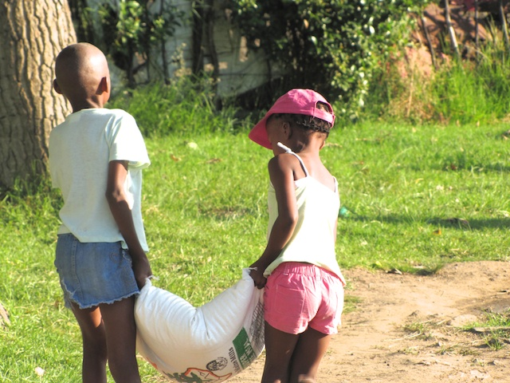
Whose burdens am I currently helping to carry in God’s family?

Slide 11
Philippians 4
¹⁵ Moreover, as you Philippians know, in the early days of your acquaintance with the gospel, when I set out from Macedonia, not one church shared with me in the matter of giving and receiving, except you only; ¹⁶ for even when I was in Thessalonica, you sent me aid more than once when I was in need.

Slide 12
2.) God is looking for Christ-followers whose involvement in the support of evangelistic outreach is early and often.

Slide 13
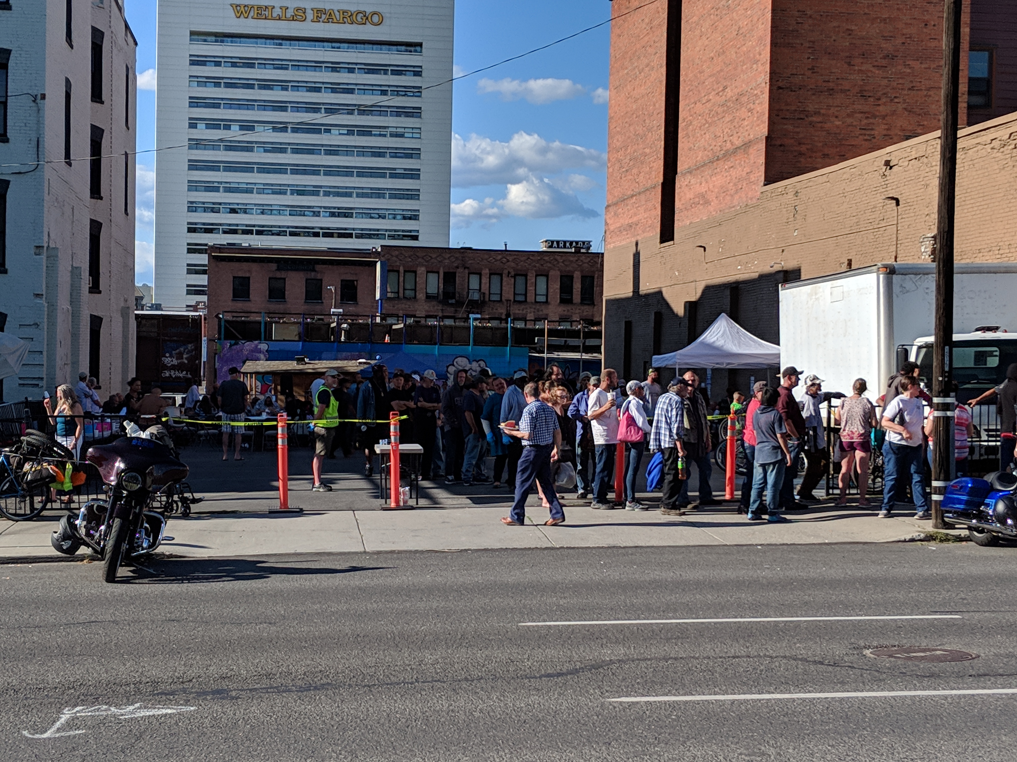

Slide 14
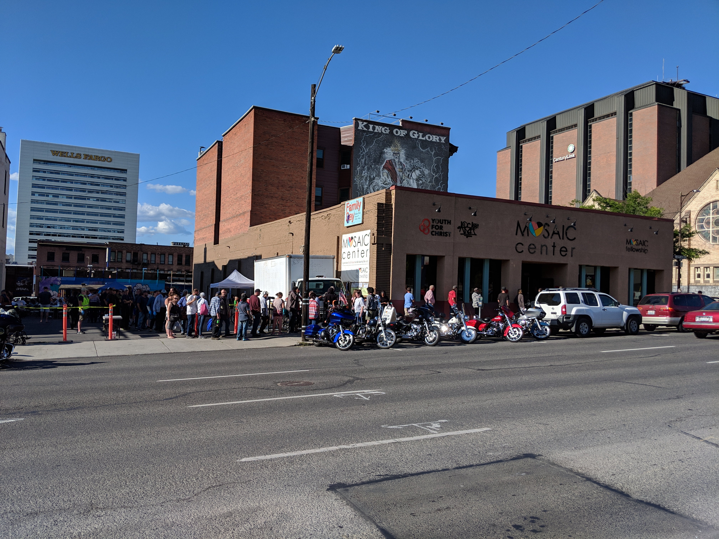

Slide 15
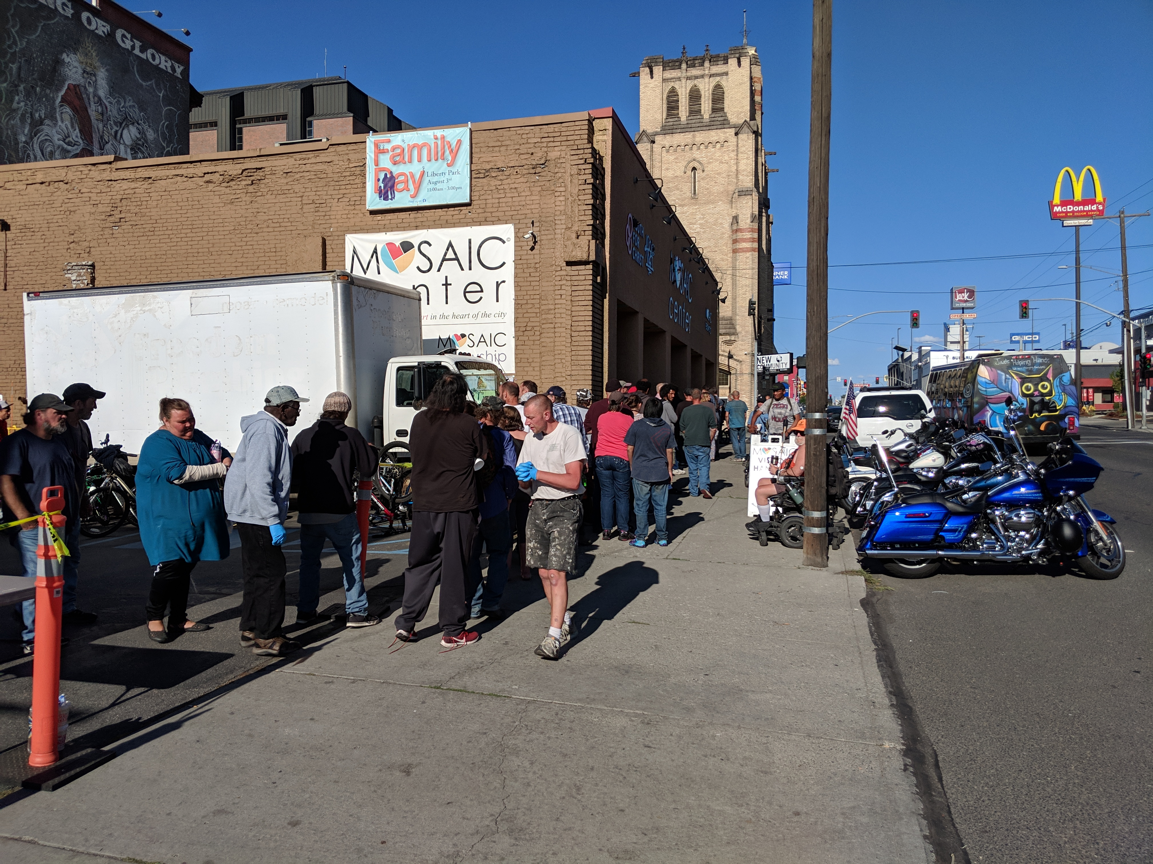

Slide 16
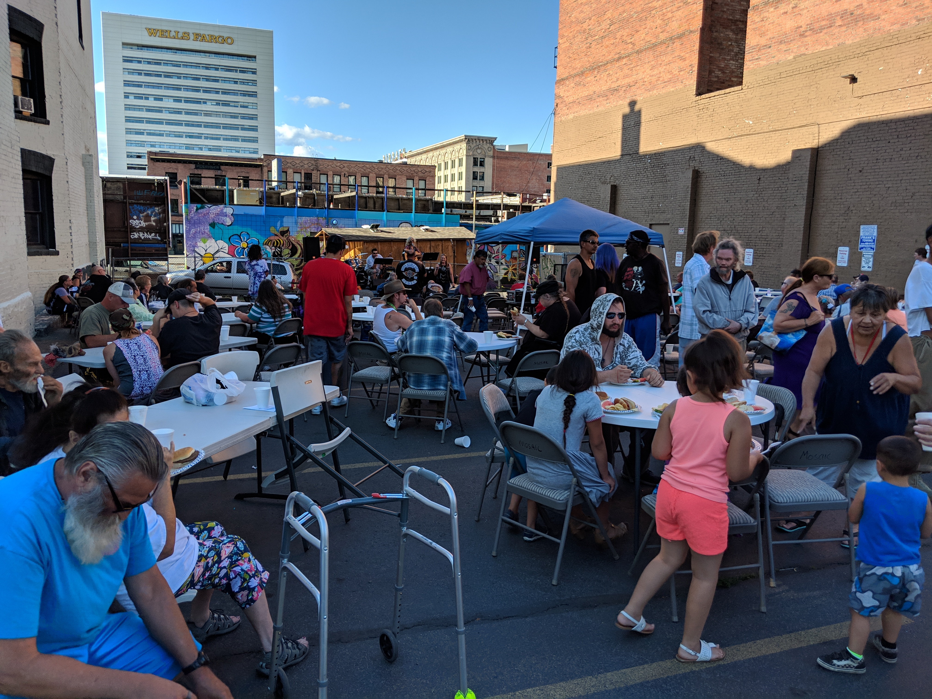

Slide 17
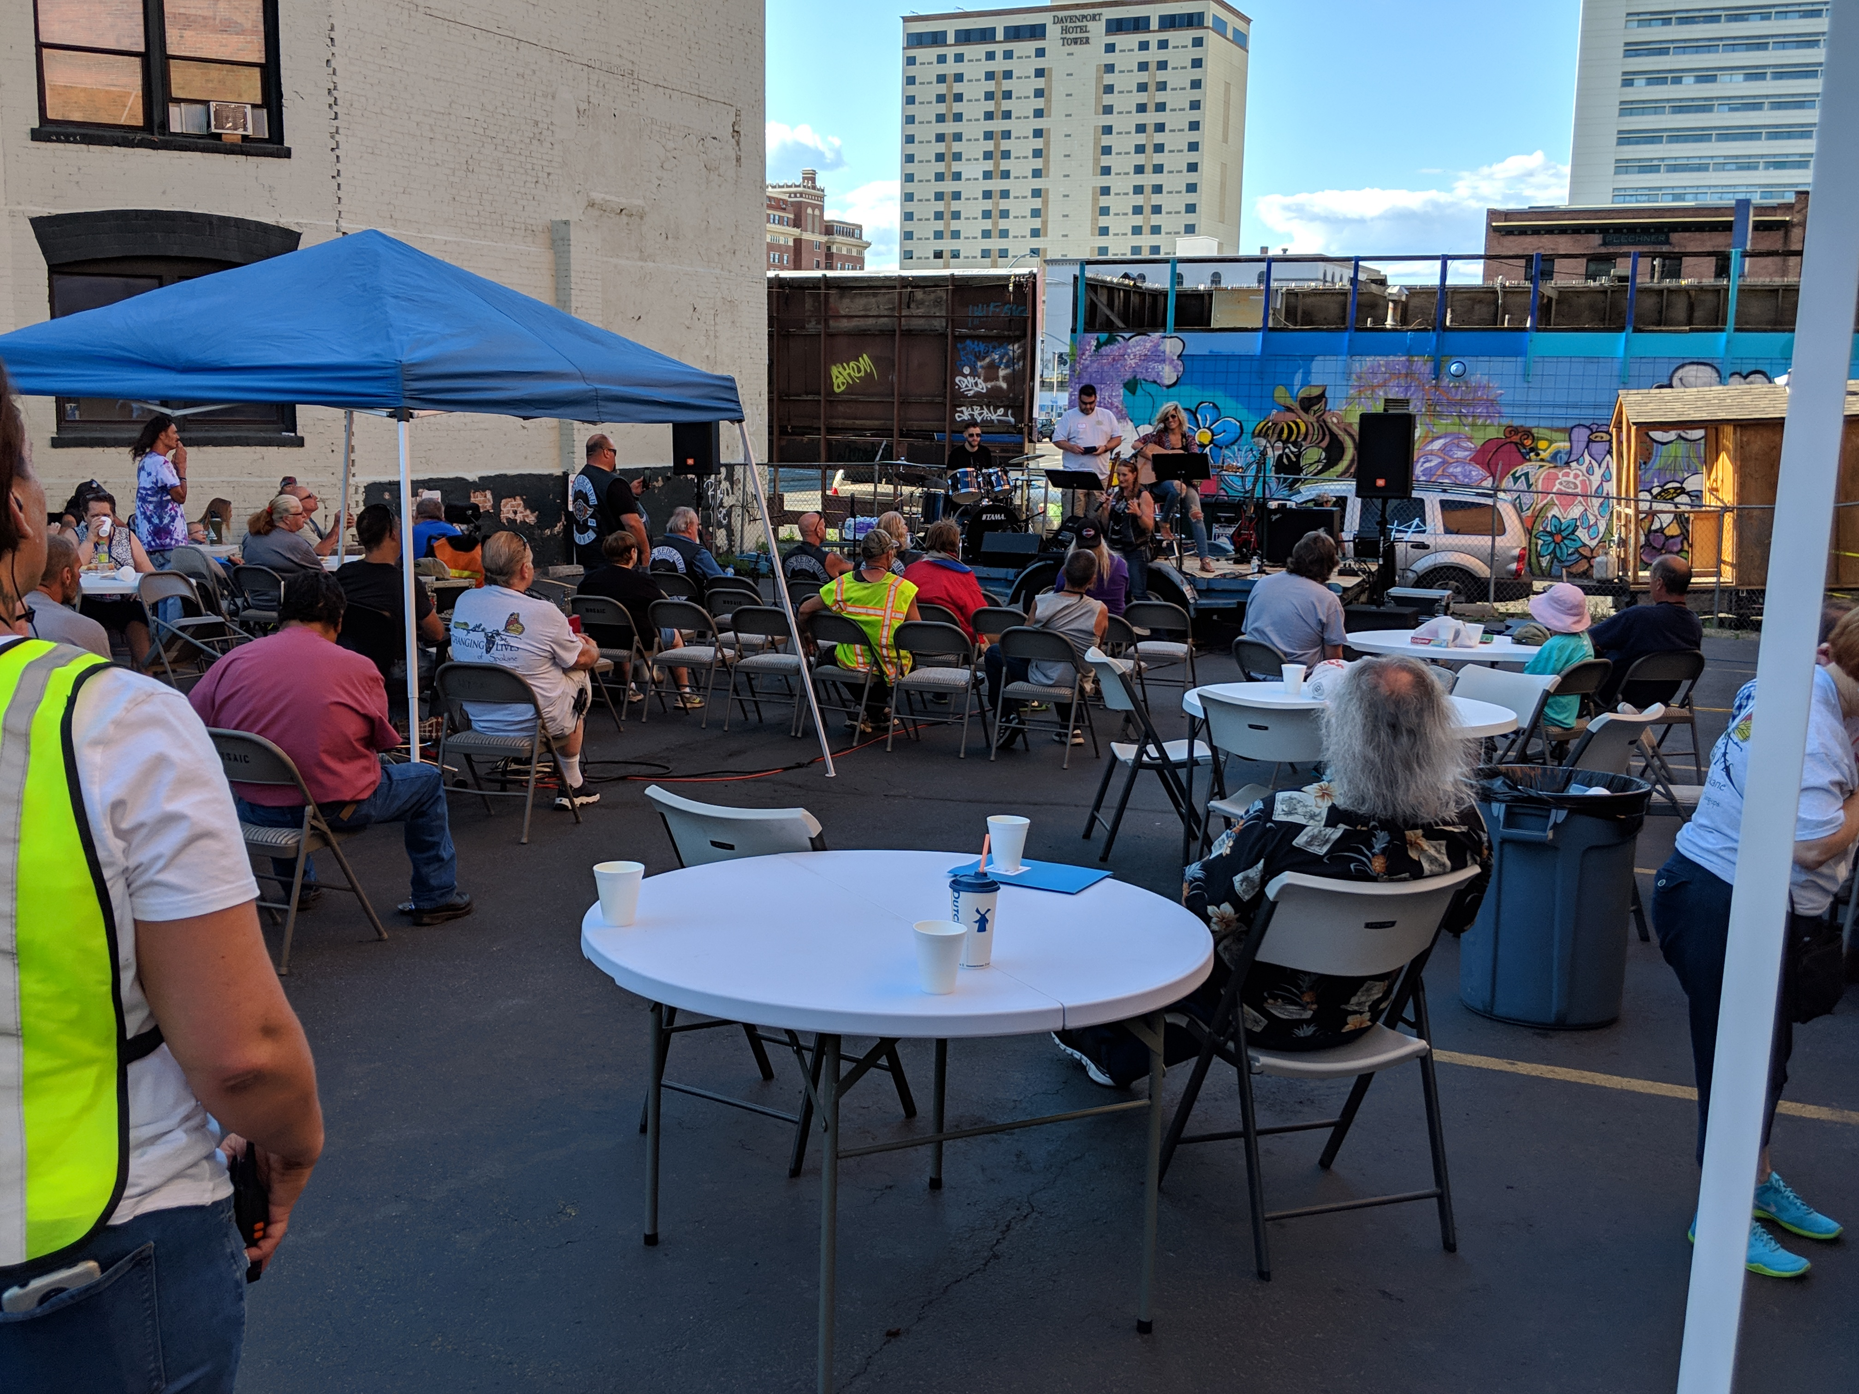

Slide 18
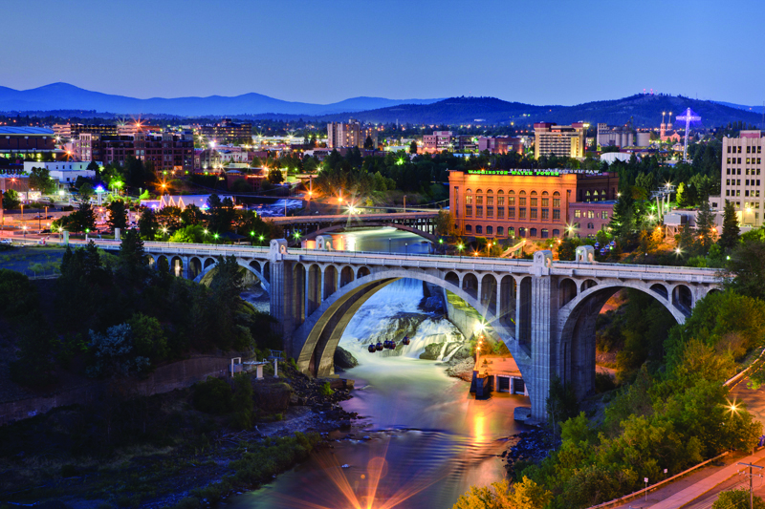
God wants my heart to be big enough for a lost world!

Slide 19
What are the most frequent responses Christians give as to WHY we don’t support missionaries?

Slide 20
What are the most frequent responses Christians give as to WHY we don’t support missionaries?
#1.) I don’t have enough money right now.
(A faith issue)

Slide 21
What are the most frequent responses Christians give as to WHY we don’t support missionaries?
#2.) I don’t know any missionaries needing support? (A relationship issue)

Slide 22
What are the most frequent responses Christians give as to WHY we don’t support missionaries?
#3) I’m not convinced it’s that important to me or to the world?
(A maturity issue)

Slide 23
3.) God is looking for churches full of Christ-followers who have an ETERNAL PERSPECTIVE on temporal resources (vs. 17)
Philippians 4
¹⁷ Not that I desire your gifts; what I desire is that more be credited to your account.

Slide 24
Philippians 4
¹⁷ Not that I desire your gifts; what I desire is that more be credited to your account.
Matthew 12:36 – “But I tell you that men will have to give account on the day of judgment for every careless word they have spoken.”

Slide 25
Philippians 4
¹⁷ Not that I desire your gifts; what I desire is that more be credited to your account.
Romans 14:10b-12 – “For we will all stand before God’s judgment seat. It is written: ‘As surely as I live,’ says the Lord, ‘every knee will bow before me; every tongue will confess to God.’ So then, each of us will give an account of himself to God.”

Slide 26
Does my handling of all my material resources demonstrate the reality that they can be used to
change eternity?

Slide 27
MOSAIC’S FUTURE MISSIONARIES
Jason (& Betsy) Abrams
Josh & Skyla Brumley
Derik & Zoe Flensburg
Eli & Michaela McKinnon
Alfred & Jewel Ottosson
(Micah & Haley Bittner)

Slide 28
When will I start to set aside something each month to invest in sharing the Gospel world-wide?
Am I open to God inviting me to partner more this year with our new missionaries?

