Slide 1
Malachi
:a call for pure worship

Slide 2
Question of the morning:
Is the God of the OT different
than the God of the NT?

Slide 3
Addressing an objection…
The problem with Christianity today:
“Our incessant habit of reaching back into the Old Covenant concepts, teachings, sayings, and narratives.” (p. 91)
Modern Christianity relies too much on the Old Testament.
Proposed Solution:
“Unhitching our teaching of what it means to follow Jesus
from all things Old Covenant.” (p. 315)

Slide 4
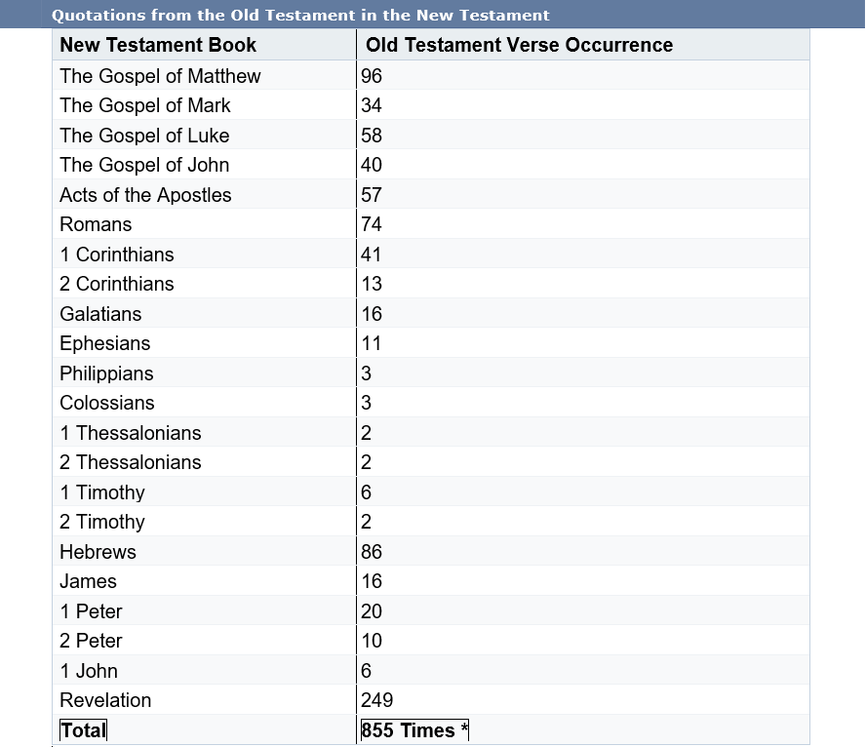

Slide 5
Background
Date: Malachi was most likely a contemporary of
Ezra and Nehemiah (mid-fifth century B.C.)
Circumstances:
- Political insignificance
- Subjugation to a foreign power
- Persistent opposition from their neighbors
- An inferior temple

Slide 6
Reading section by section…
Main points/themes.
Does this present God with a different character than what we see in the NT?
Potential applications for today:

Slide 7
Section 1: Mal. 1:1-5
God has a covenantal love for the Israelites.
Does God have a covenantal love for His people today?
Potential applications for today:

Slide 8
Section 2: Mal. 1:6-2:9
God is rejecting Israel because they no longer honor or fear him.
Does God expect honor and fear from His people today?
Potential applications for today:

Slide 9
Section 3: Mal. 2:10-16
God judges Israel because of faithless husbands. (husbands divorcing their wives)
Does God still demand husbands be faithful to their wives?
Potential applications for today:

Slide 10
Section 4: Mal. 2:17... (grievance 1)
God judges Israel because they declare evil to be good.
Does God still condemn evil and those who declare evil to be good?
Potential applications for today:

Slide 11
Section 4: Mal. 2:17… (grievance 2)
The Israelites accuse God of being unjust.
Are we allowed to accuse God of being unjust today?
Potential applications for today:

