Slide 1
James 4:7-10
Submit yourselves, then, to God.
Resist the devil, and he will flee from you.
⁸ Come near to God and he will come near to you.
Wash your hands, you sinners, and purify your hearts, you double-minded.

Slide 2
James 4:7-10
⁹ Grieve, mourn and wail. Change your laughter to mourning and your joy to gloom.
¹⁰ Humble yourselves before the Lord, and he will lift you up.

Slide 3
James 4:11, 12 Brothers and sisters, do not slander one another. Anyone who speaks against a brother or sister or judges them speaks against the law and judges it. When you judge the law, you are not keeping it, but sitting in judgment on it. 12)There is only one Lawgiver and Judge, the one who is able to save and destroy. But you—who are you to judge your neighbor?

Slide 4
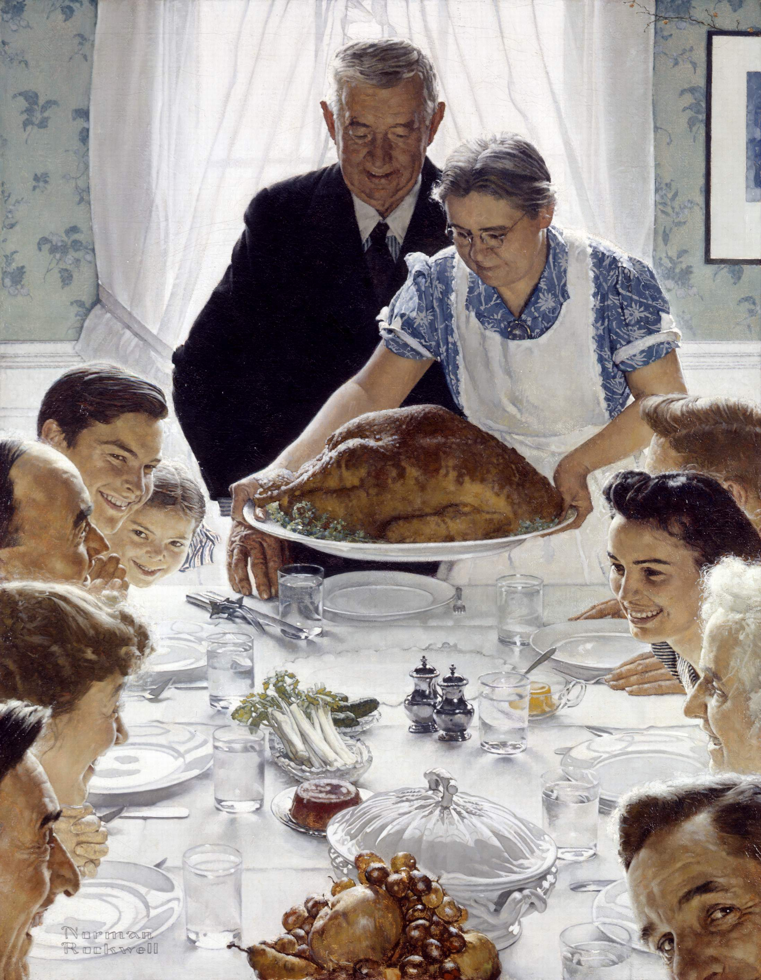

Slide 7
James 4:7-10
Submit yourselves, then, to God.
Resist the devil, and he will flee from you.
⁸Come near to God and he will come near to you.
Wash your hands, you sinners, and purify your hearts, you double-minded.

Slide 8
James 4:7-10
⁹ Grieve, mourn and wail. Change your laughter to mourning and your joy to gloom.
¹⁰ Humble yourselves before the Lord, and he will lift you up.

Slide 9
1.) Healthy relationships come from God-submitted people.

Slide 10
Submit unconditionally to God’s will for SALVATION/ RELATIONSHIP WITH HIM by trusting in Jesus Christ.

Slide 11
Romans 10:3-4,
“Since they did not know the righteousness of God and sought to establish their own, they did not submit to God’s righteousness.”
“Christ is the culmination of the law so that there may be righteousness for everyone who believes.”

Slide 12
B.) Submit unconditionally to GOD’S PERSON—who He really is.

Slide 13
C.) Submit unconditionally to GOD’S WORD.

Slide 14
D. Submit unconditionally to GOD’S PROVIDENTIAL DEALINGS WITH YOU… and others.

Slide 15
Healthy relationships come from Satan-resisting saints.
“Resist the devil, and he will flee from you.”

Slide 16
3.) Healthy relationships come from HEARTFELT PURSUIT OF GOD through PURIFICATION FROM SIN. “Come near to God and he will come near to you. Wash your hands, you sinners, and purify your hearts, you double-minded.”

Slide 18
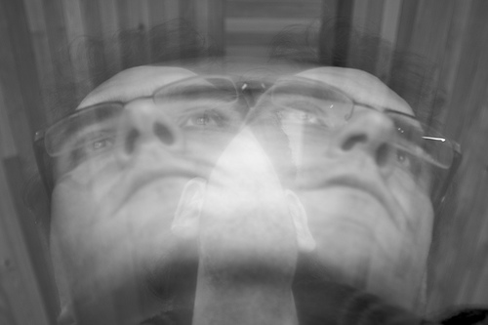
Double Minded???

Slide 19
3.) Healthy relationships come from HEARTFELT PURSUIT OF GOD through PURIFICATION FROM SIN. Vs. 9, “Grieve, mourn and wail. Change your laughter to mourning and your joy to gloom.”

Slide 20
4.) Healthy relationships come from HUMILITY before God. Vs. 10—“Humble yourselves before the Lord, and he will lift you up.”

