Slide 1
Christian citizenship & immigration

Slide 2
POP QUIZ
T/F—Someone in my family was an immigrant to this country in the past 4 generations?

Slide 3
POP QUIZ
T/F—Most of the key characters in the Bible were immigrants at some time in their lifetime?

Slide 4
POP QUIZ
T/F—I’ve opened up my home to immigrants and taken them in to live with me at some time.

Slide 5
POP QUIZ
T/F—I’ve been an immigrant at some time in my life?

Slide 6
POP QUIZ
T/F—There is little difference between an immigrant and a refugee.

Slide 7
POP QUIZ
T/F—This month marks the 400th Anniversary of the arrival of the first community of successful English immigrants to America?

Slide 8
POINTS OF AGREEMENT ON IMMIGRATION?

Slide 9
FACTS & STATISTICS ON IMMIGRATION?

Slide 10
What’s the problem?

Slide 11
Extremes on Immigration

Slide 12
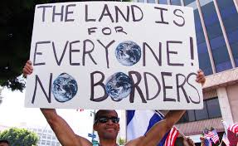
Extremes on Immigration

Slide 13
Is there a biblical argument against…

Slide 14
The Problem of Proximal Responsibility

Slide 15
The Problem of Proximal Responsibility
1st Timothy 5:8—family first
Galatians 6:10—saints second
Luke 10—Neighbors next
Matthew 28:19-20—The world

Slide 16
The Problem of Proximal Responsibility
Acts 17:26-27
(The NET Bible)
From one man he made every nation of the human race to inhabit the entire earth,
determining their set times and the fixed limits of the places where they would live, ²⁷ so that they would search for God and perhaps grope around for him and find him, though he is not far from each one of us.

Slide 17
The Problem of Proximal Responsibility
RESPONSIBILITY
PROXIMITY

Slide 18
The Problem of Proximal Responsibility
GOD
RESPONSIBILITY
PROXIMITY

Slide 19
The Problem of Proximal Responsibility
GOD
Family
RESPONSIBILITY
PROXIMITY

Slide 20
The Problem of Preferential Love
GOD
Family
Church family
RESPONSIBILITY
PROXIMITY

Slide 21
The Problem of Proximal Responsibility
GOD
Family
Church family
‘Near Neighbor’
RESPONSIBILITY
PROXIMITY

Slide 22
The Problem of Proximal Responsibility
GOD
Family
Church family
‘Near Neighbor’
RESPONSIBILITY
‘Far Neighbor’
???
PROXIMITY

Slide 23
How we are to treat immigrants
Exodus 22:21—Don’t mistreat or oppress an immigrant, because you were once immigrants in the land of Egypt.
Exodus 23:9—Don’t oppress an immigrant. You know what it’s like to be an immigrant, because you were immigrants in the land of Egypt.

Slide 24
How we are to treat immigrants
Leviticus 19:33-34—When a stranger sojourns with you in your land, you shall not do him wrong. You shall treat the stranger who sojourns with you as the native among you, and you shall love him as yourself, for you were strangers in the land of Egypt; I am the Lord your God.

Slide 25
How we are to treat immigrants
Deuteronomy 10:18-19—He [God] enacts justice for orphans and widows, and he loves immigrants, giving them food and clothing. That means you must also love immigrants because you were immigrants in Egypt.

Slide 26
How we are to treat immigrants
Numbers 15:15-16—“The assembly will have the same regulation for you and for the immigrant. The regulation will be permanent for all time. You and the immigrant will be the same in the Lord’s presence. There will be one set of instructions and one legal norm for the immigrant and for you.

Slide 27
How we are to treat immigrants
Deuteronomy 26:12—When you have finished paying the entire tenth part of your produce on the third year—that is the year for paying the tenth-part—you will give it to the Levites, the immigrants, the orphans, and the widows so they can eat in your cities until they are full.

Slide 28
How we are to treat immigrants
Jeremiah 7:5-7—No, if you truly reform your ways and your actions, if you treat each other justly, if you stop taking advantage of the immigrant, orphan, or widow; if you don’t shed the blood of the innocent in this place, or go after other gods to your own ruin, only then will I dwell with you in this place, in the land that I gave long ago to your ancestors for all time.

Slide 29
How we are to treat immigrants
Malachi 3:5—So I will come to put you on trial. I will be quick to testify against sorcerers, adulterers and perjurers, against those who defraud laborers of their wages, who oppress the widows and the fatherless, and deprive the foreigners among you of justice, but do not fear me,” says the Lord Almighty.

Slide 30
What does the N.T. say about immigrants?
God’s people are to show HOSPITALITY
Matthew 25:36—“For I was hungry and you gave me food, I was thirsty and you gave me drink, I was a stranger and you welcomed me….”
Luke 10:36-37—Parable of the Good Samaritan

Slide 31
What does the N.T. say about immigrants?
God’s people are to show HOSPITALITY
Romans 12:13—“Contribute to the needs of the saints and seek to show hospitality.”
Hebrews 13:2—“Do not forget to show hospitality to strangers, for by so doing some people have shown hospitality to angels without knowing it.”

Slide 32
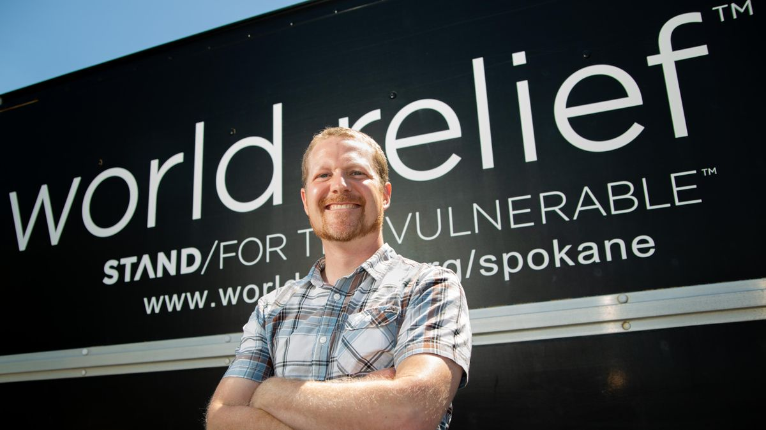
worldreliefspokane.org

Slide 33
What does the N.T. say about immigrants?
God’s people are to submit to government and just laws
Romans 13:1-7
I Peter 2:13-17
Acts 4

Slide 34
Why would God give us so many instructions about immigrants?

Slide 35
What do immigrants potentially bring to a nation…positively and negatively?

Slide 36
Expressing God’s heart for immigrants…
PLEASE

Slide 37
Expressing God’s heart for immigrants…
PLEASE
RAY

Slide 38
Expressing God’s heart for immigrants…
PLEASE
RAY
ISTEN

Slide 39
Expressing God’s heart for immigrants…
PLEASE
RAY
ISTEN
MPOWER

Slide 40
Expressing God’s heart for immigrants…
PLEASE
RAY
ISTEN
MPOWER
DVOCATE

Slide 41
Expressing God’s heart for immigrants…
PLEASE
RAY
ISTEN
MPOWER
DVOCATE
ERVE

Slide 42
Expressing God’s heart for immigrants…
PLEASE
RAY
ISTEN
MPOWER
DVOCATE
ERVE
VANGELIZE

Slide 43
QUESTIONS???

Slide 44
Revelation 7:9-10 (ESV)
After this I looked, and behold, a great multitude that no one could number, from
every nation, from all tribes and peoples and languages, standing before the throne and before the Lamb, clothed in white robes, with palm branches in their hands, and crying out with a loud voice, “Salvation belongs to our God who sits on the throne, and to the Lamb.”

