Slide 1
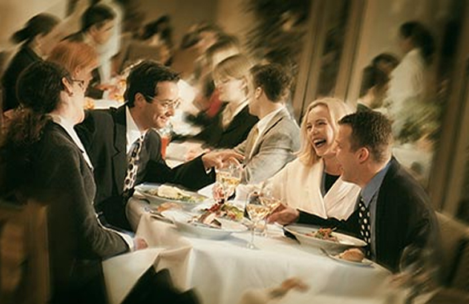
Duty
Assignment
Demand
Privilege
Otpion
Invitation

Slide 2
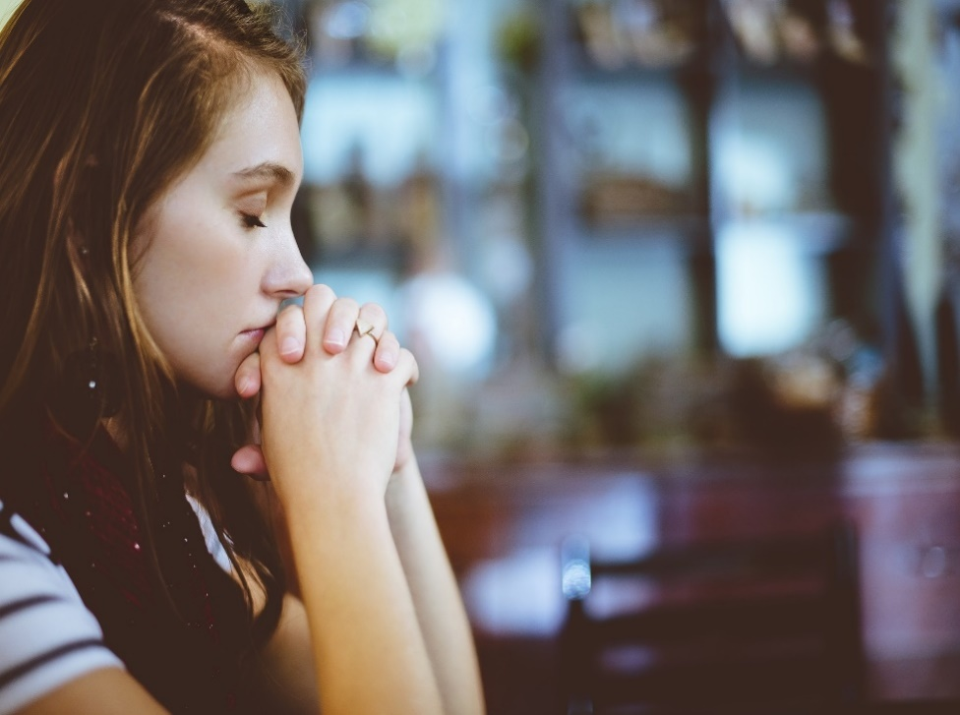
Meeting Jesus
In
Prayer
Matthew 6:9-15

Slide 3
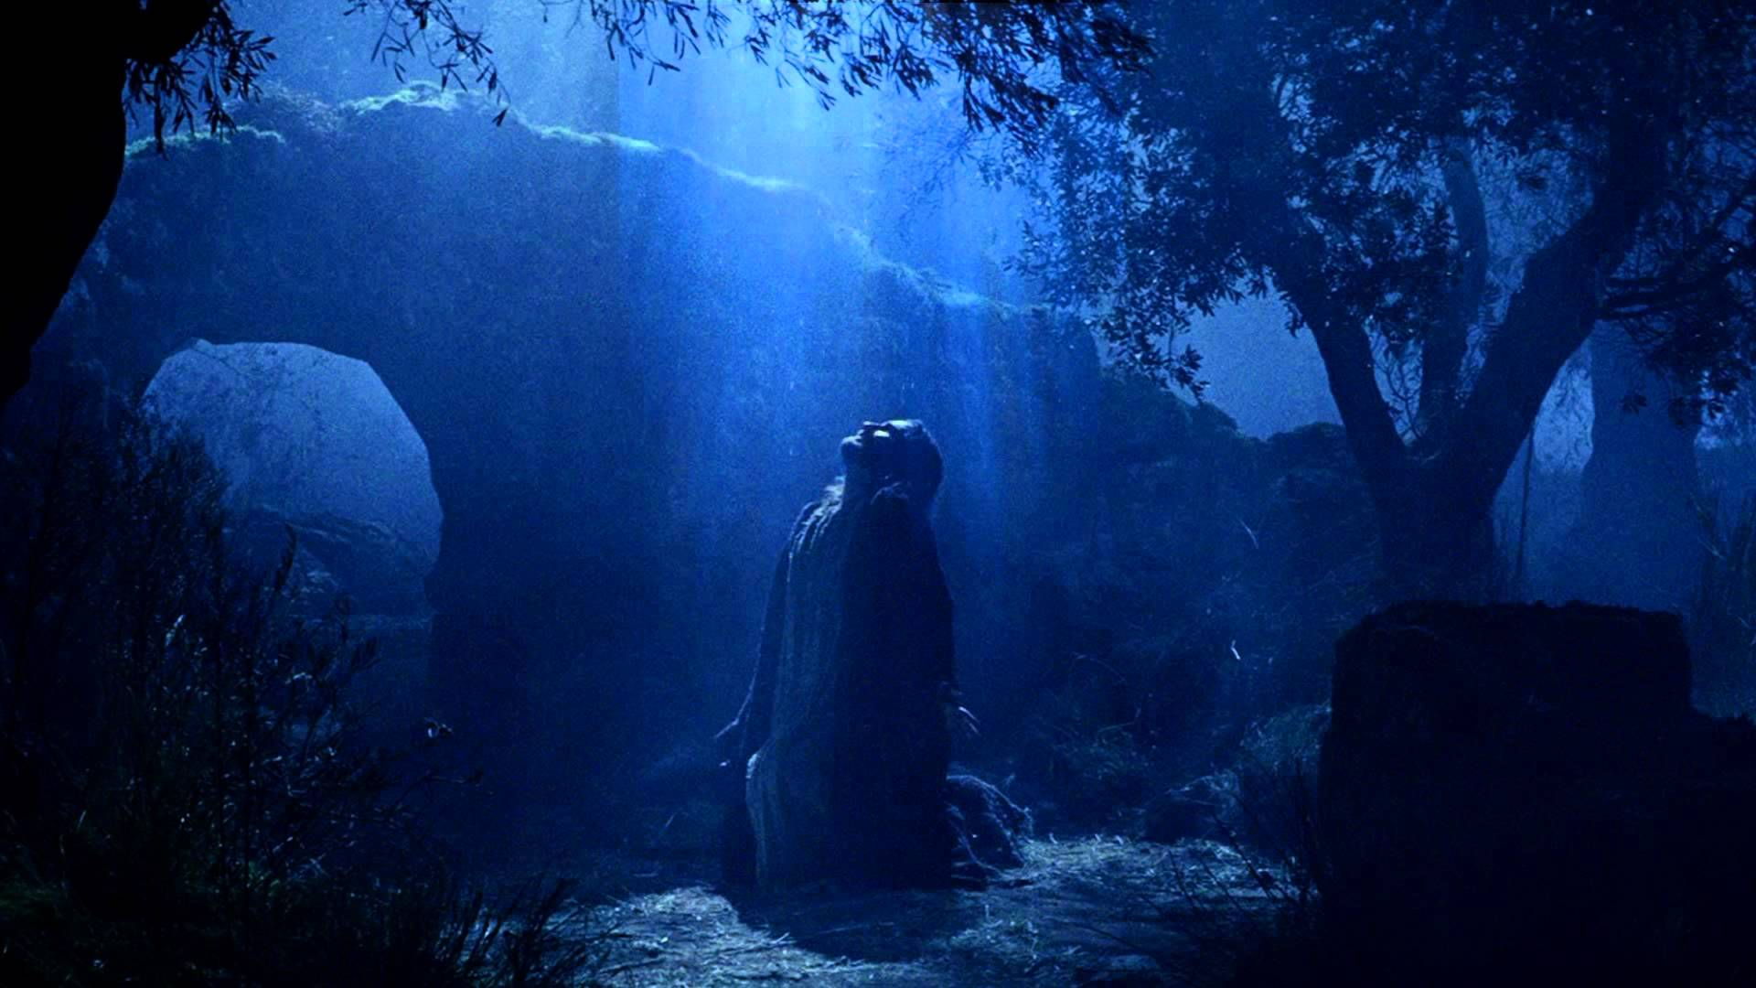
“Our Father in heaven, hallowed be your name…..”

Slide 4
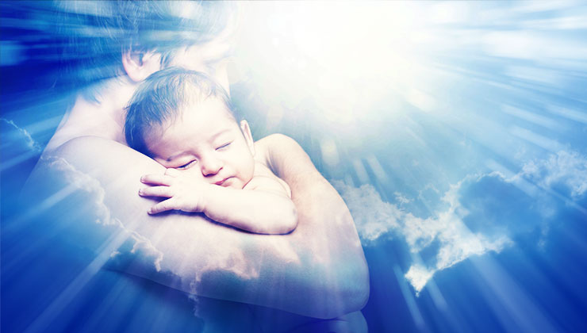
FATHER
HEAVEN
HOLY

Slide 5
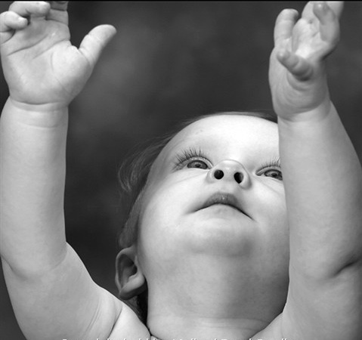
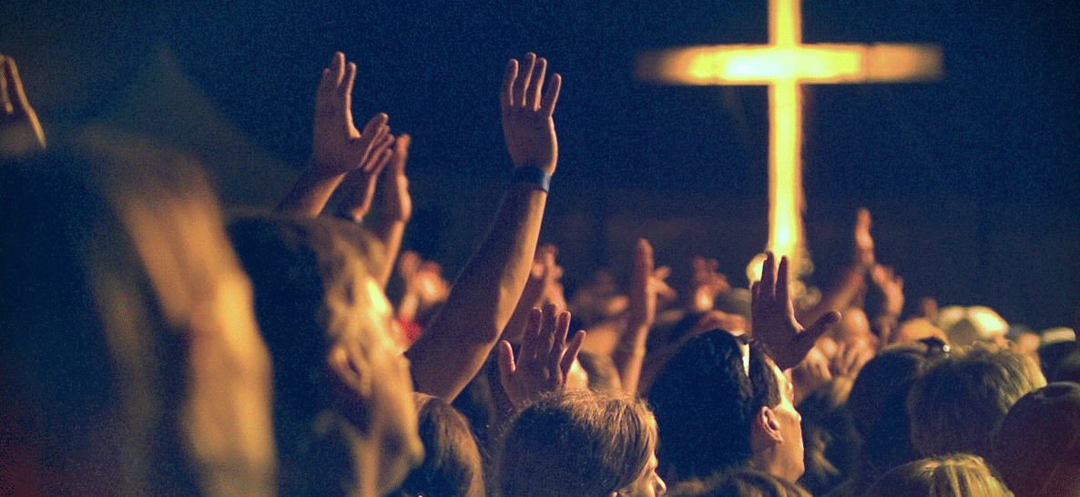

Slide 9
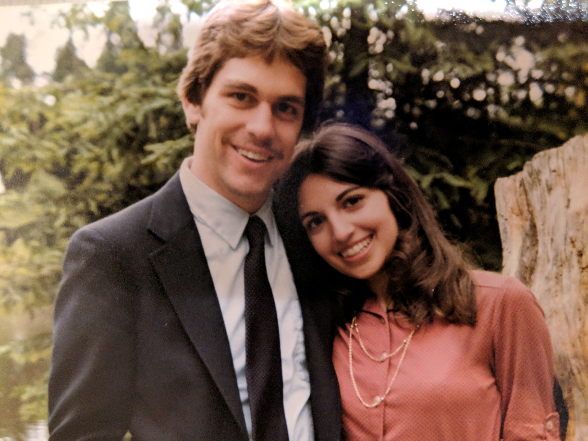

Slide 10
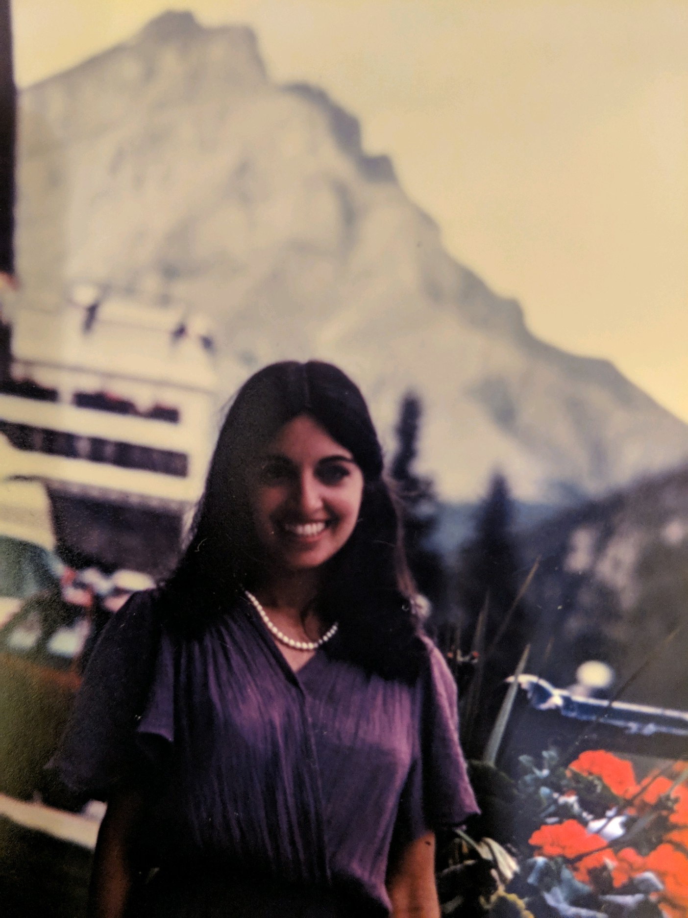

Slide 12
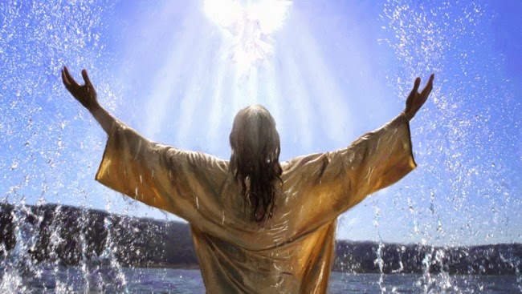
Prayer is
the love language of a heart hungry for God.

Slide 13
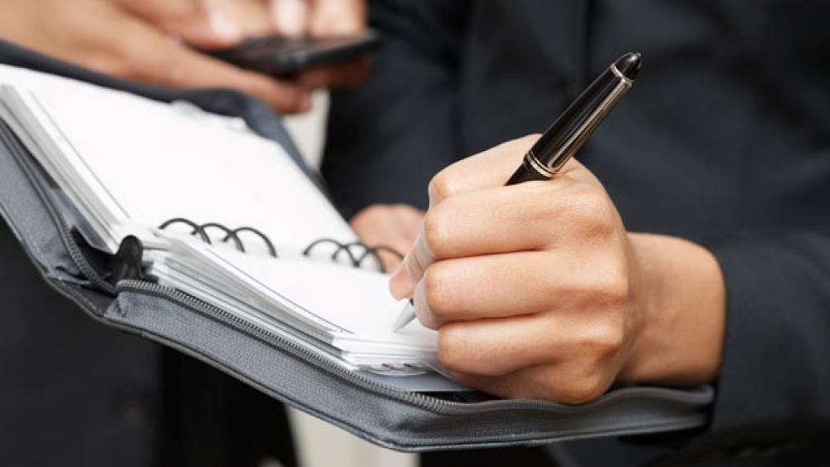

Slide 14
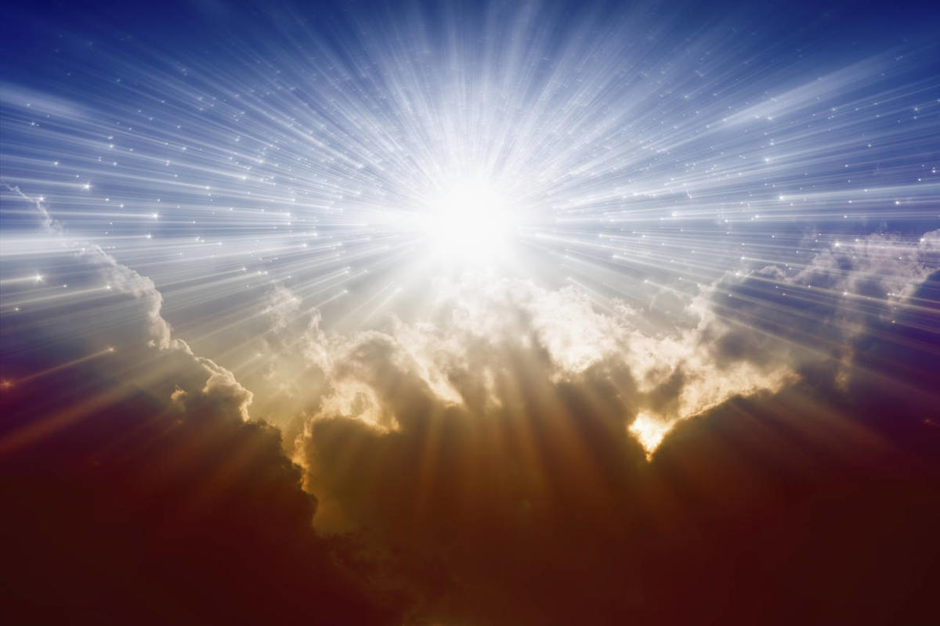
Matthew 6:10
“Your kingdom come, your will be done, on earth as it is in heaven.”

Slide 15
What does praying God’s will require?
Growing knowledge of God’s will.
Clear grasp and grip on the Word of God.
SUBMISSION to God in everything we don’t know or understand clearly.
Perseverance in prayer

Slide 16
Think of someone or something in your life where you want to see God’s will be done.

Slide 17
Matthew 6:11
“Give us this day our daily bread.”

Slide 18
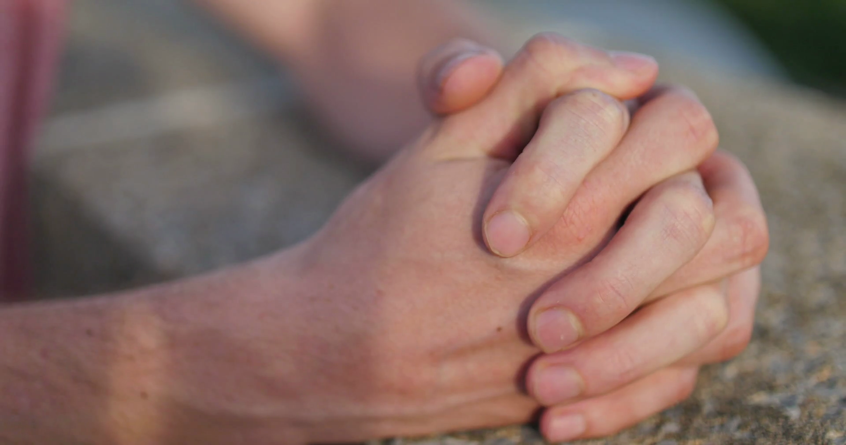
Matthew 6:12
“And forgive us our debts,
as we also have forgiven
our debtors.”

Slide 19
Matthew 5:21-22
Matthew 5:23-24
Matthew 5:31-32
Matthew 5:38-41
Matthew 5:44

Slide 20
Matthew 6:14-15
“For if you forgive other people when they sin against you, your heavenly Father will also forgive you. But if you do not forgive others their sins, your Father will not forgive your sins.”

Slide 21
Matthew 5:13
‘And lead us not into temptation, but deliver us from the evil one.’

Slide 22
Worship: standing
Submission: kneeling
Asking: hands receiving
Forgiving: clasped hands
Spiritual battle: walking

Slide 23
