Slide 2
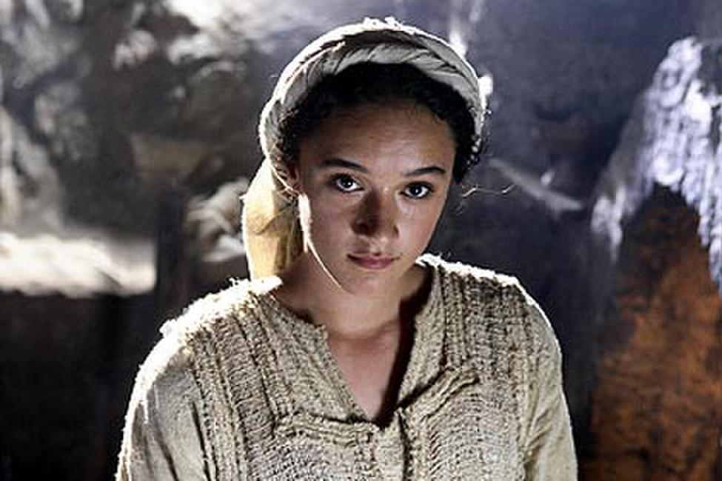

Slide 3
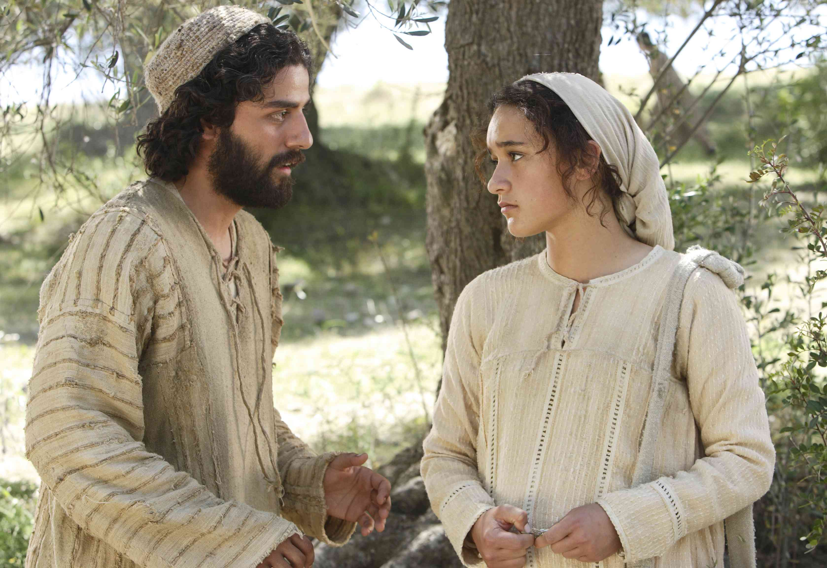

Slide 4
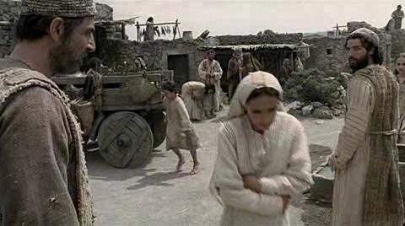

Slide 6
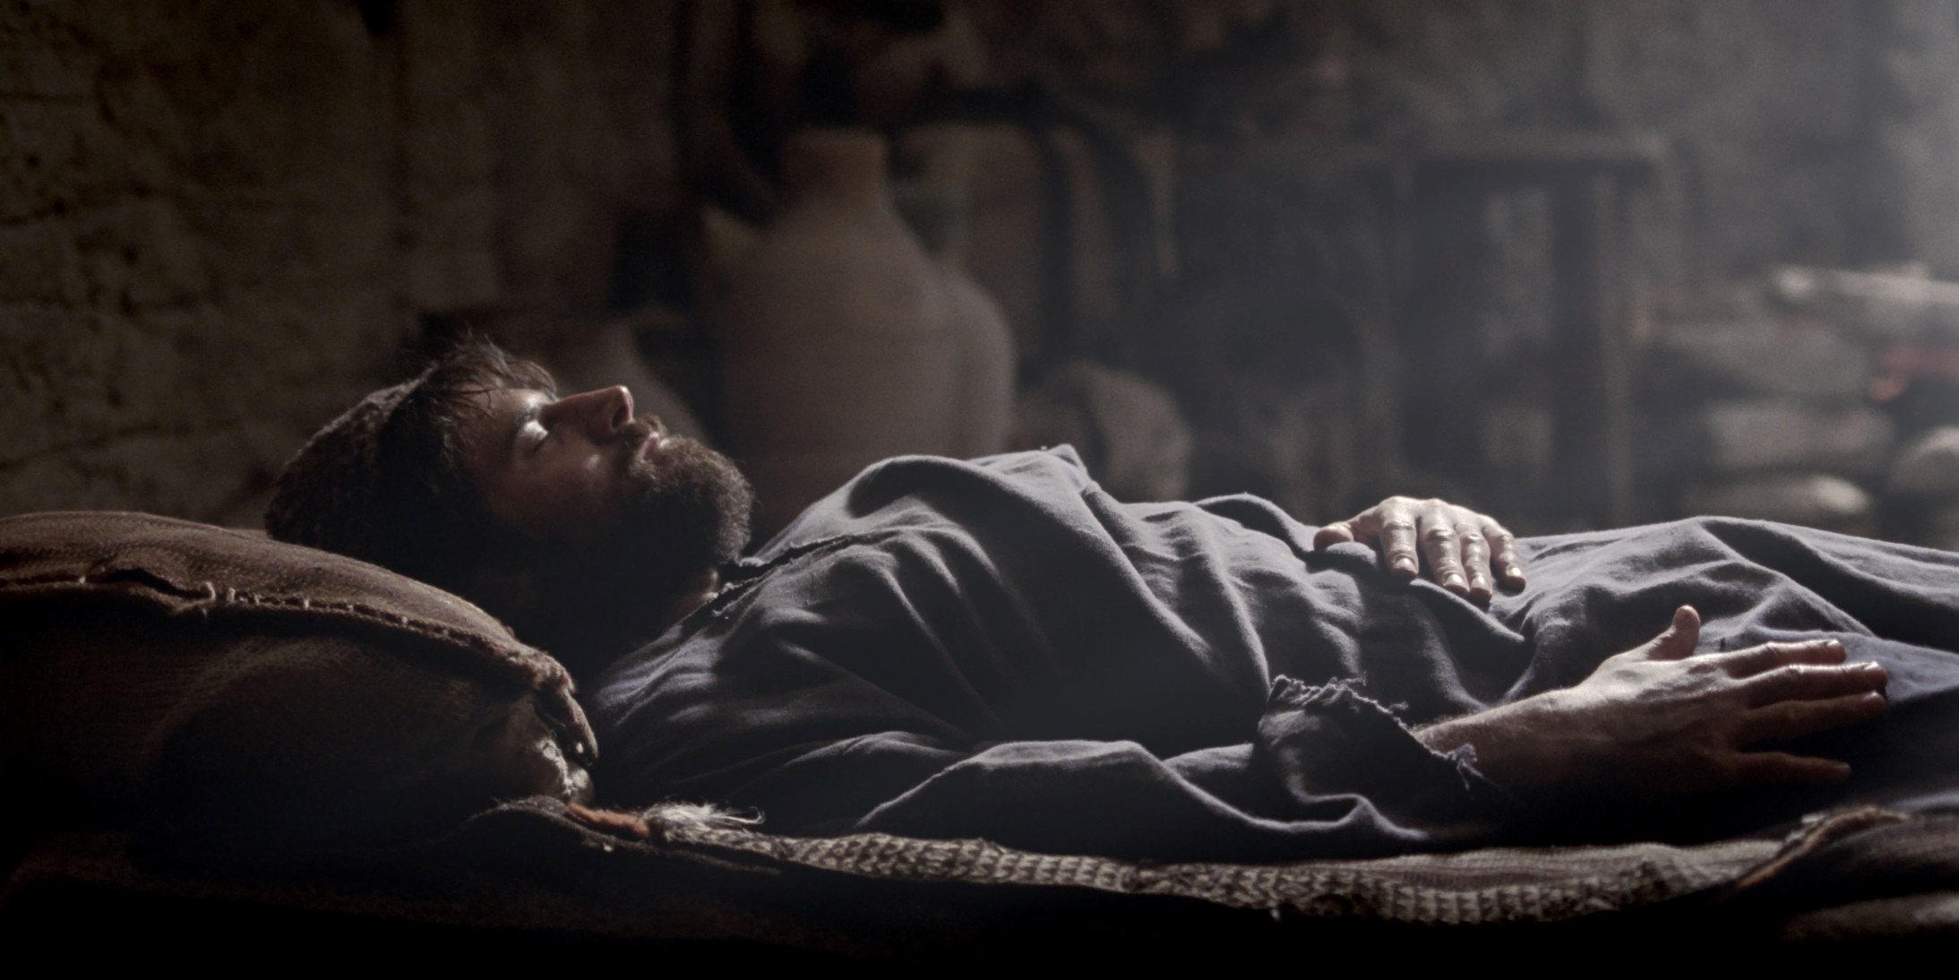
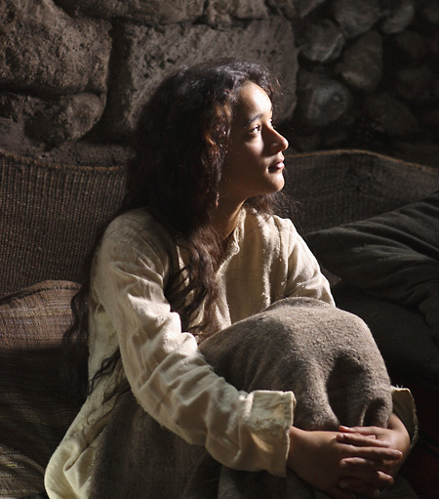

Slide 7
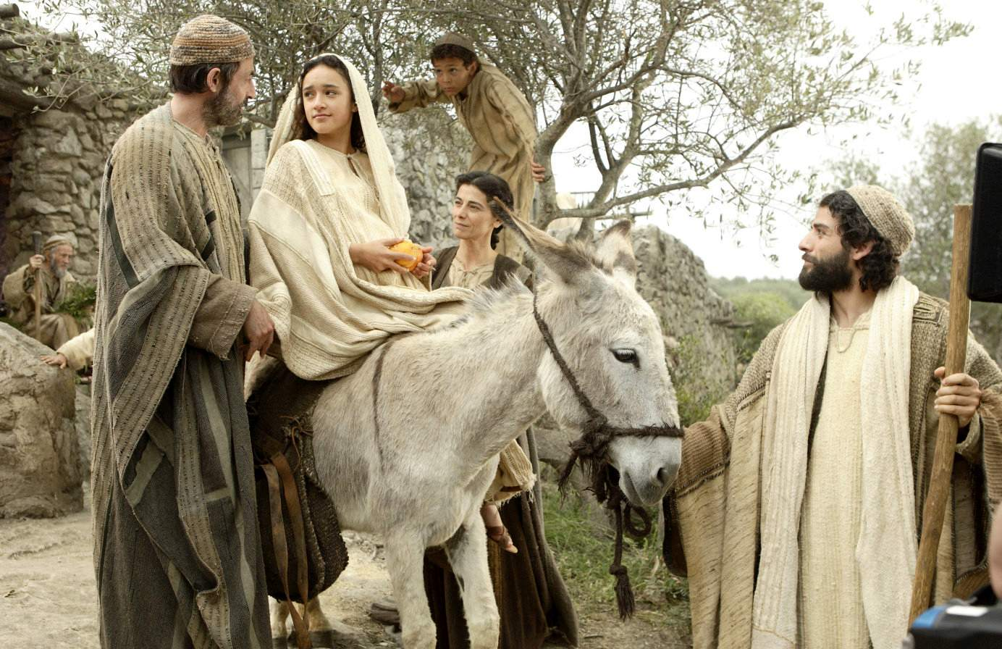

Slide 8
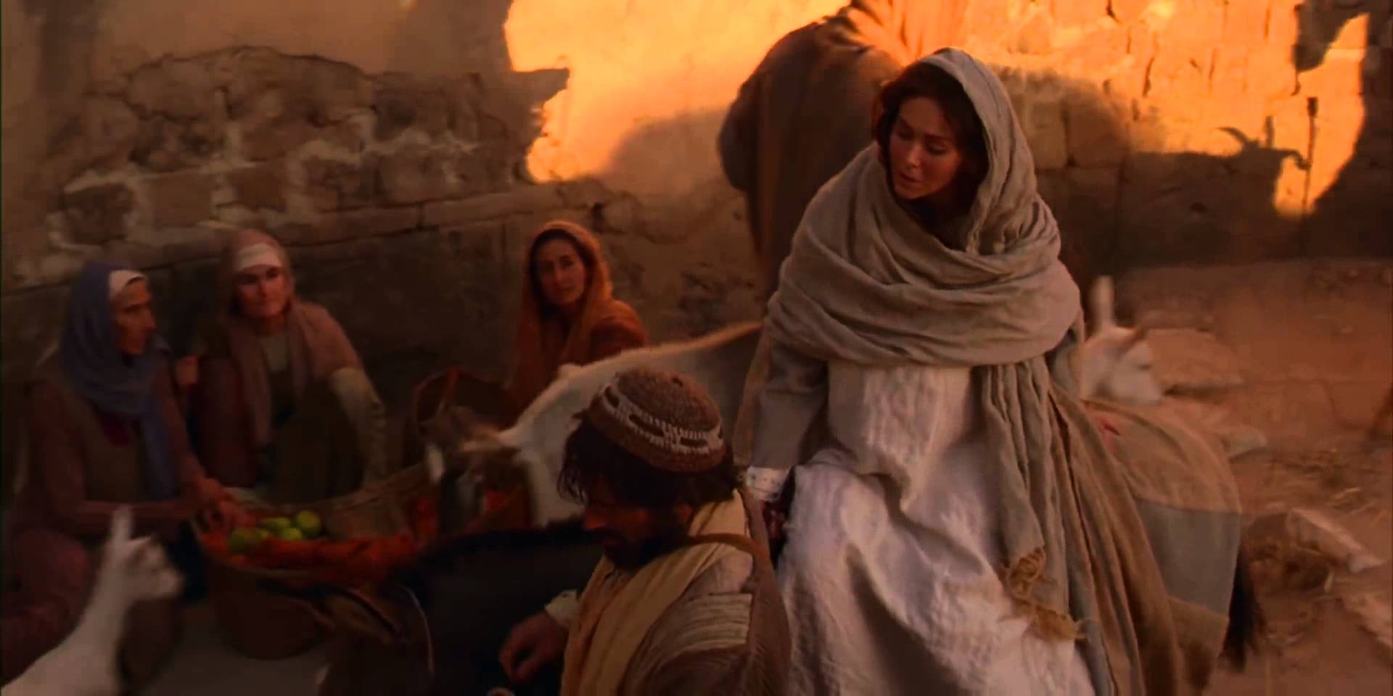

Slide 9
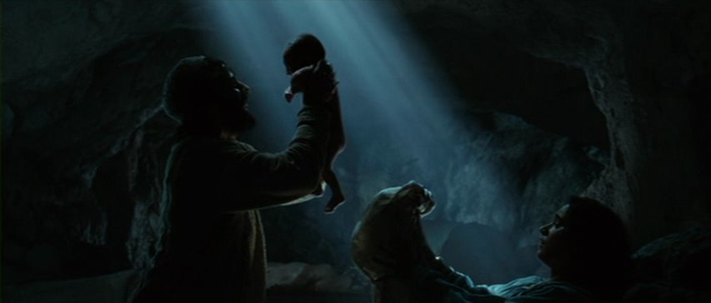

Slide 10
Micah 5:2 “But you, Bethlehem Ephrathah, though you are small among the clans of Judah, out of you will come for me one who will be ruler over Israel, whose origins are from of old, from ancient times.”

Slide 12
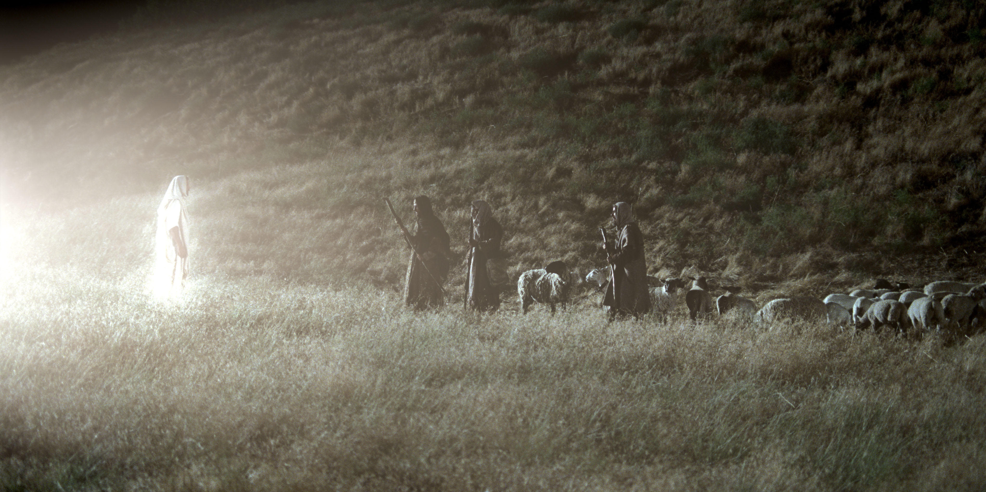

Slide 13
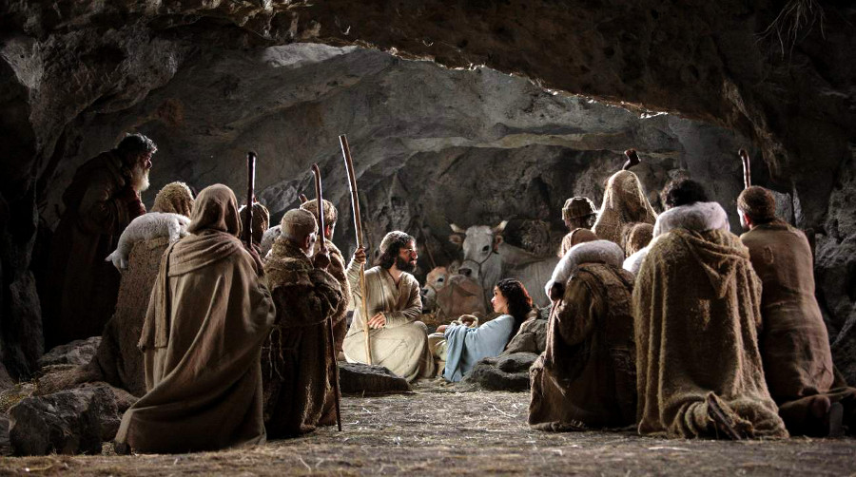

Slide 14
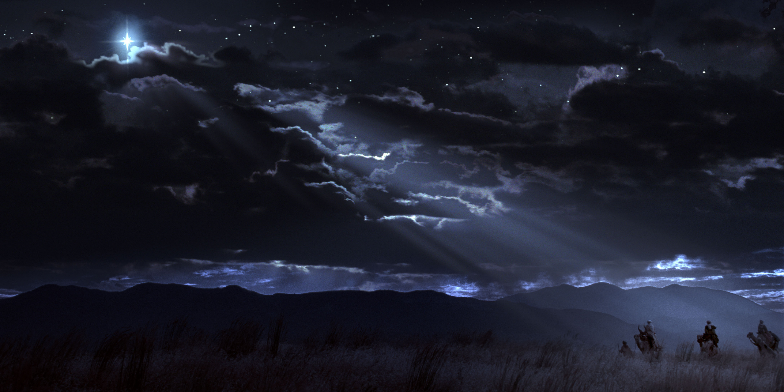

Slide 15
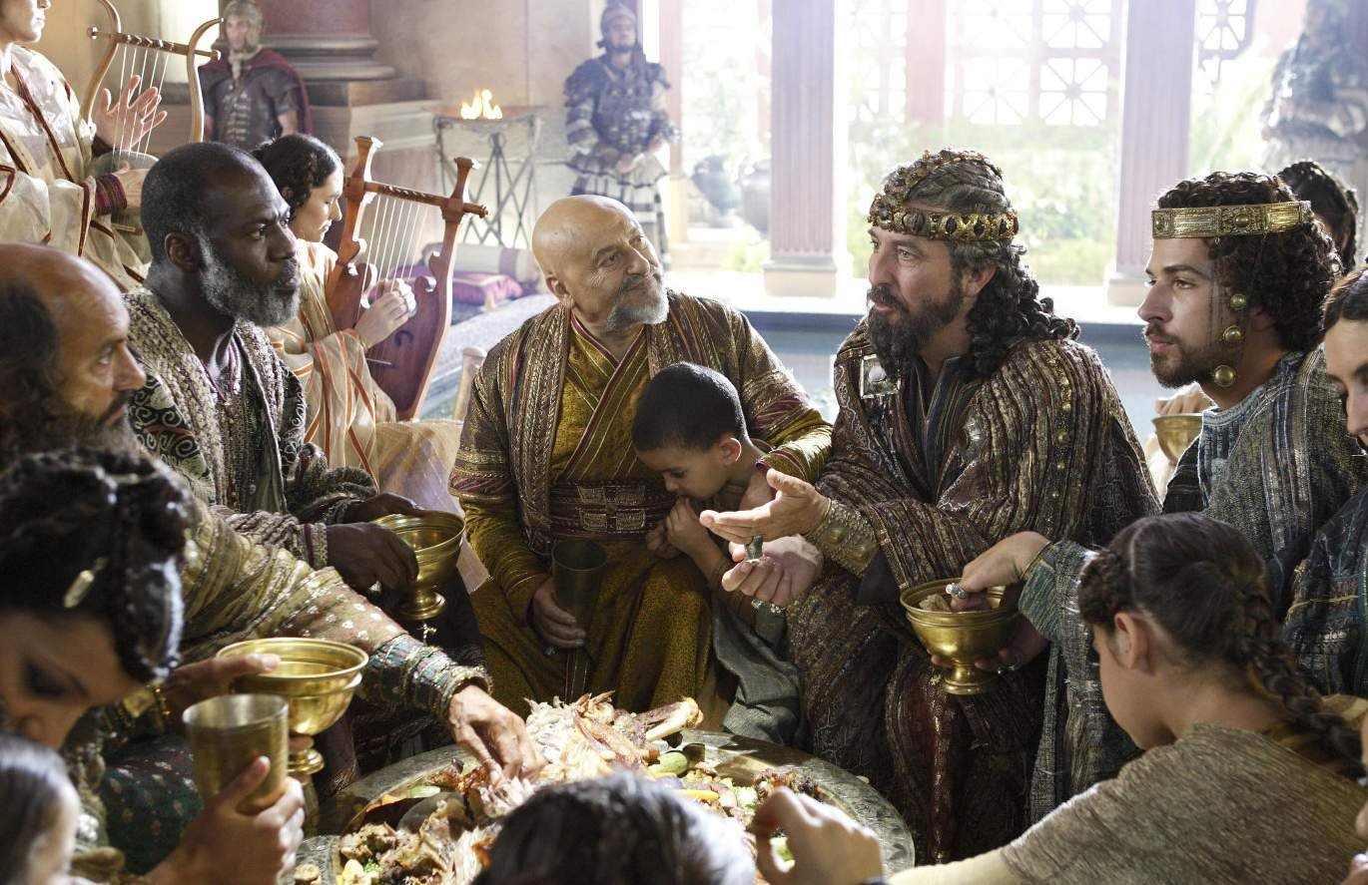

Slide 16
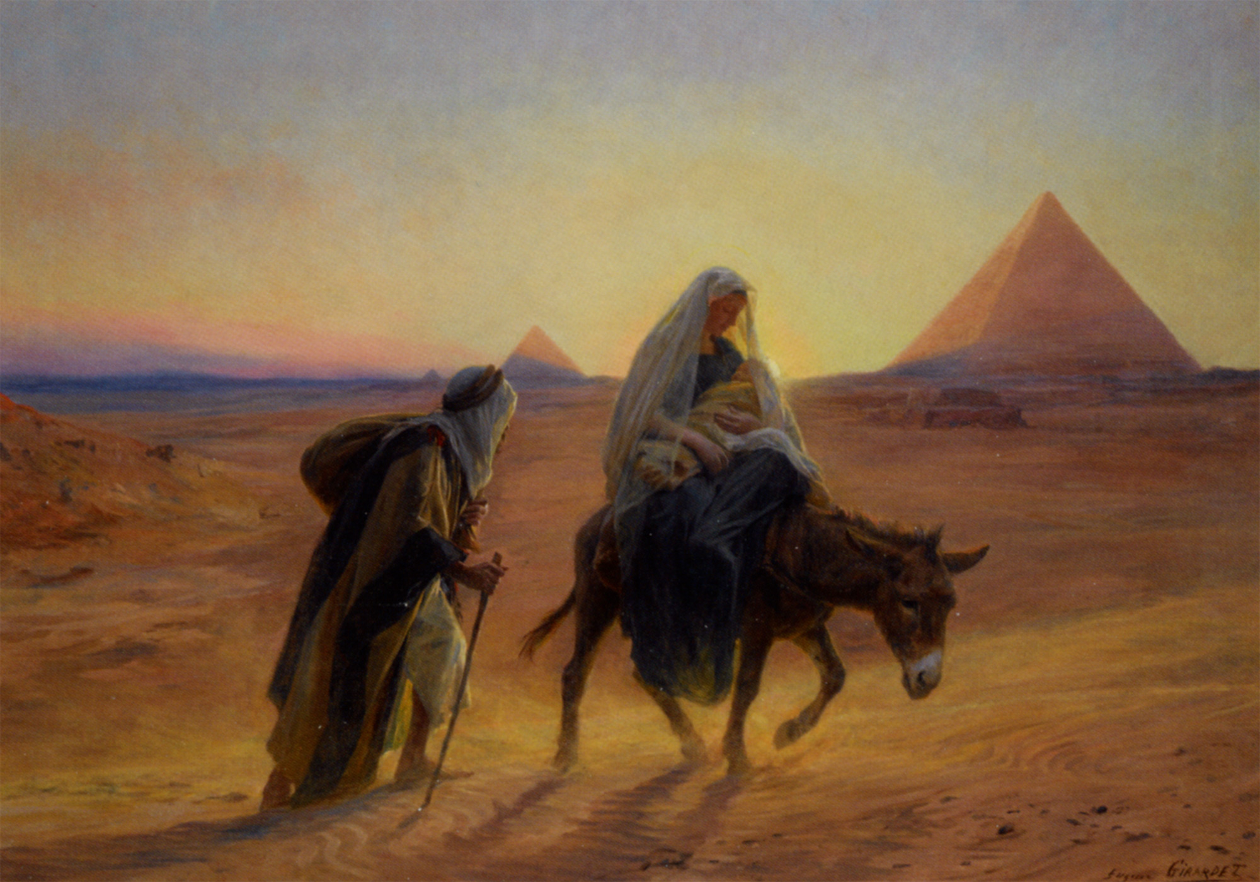

Slide 17
Jeremiah 31:15 This is what the Lord says: “A voice is heard in Ramah, mourning and great weeping, Rachel weeping for her children and refusing to be comforted, because they are no more.”

Slide 18
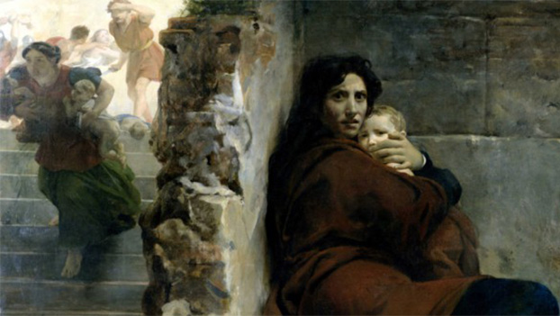

Slide 19
John 1:5 The light shines in the darkness, and the darkness has not overcome it.

Slide 20
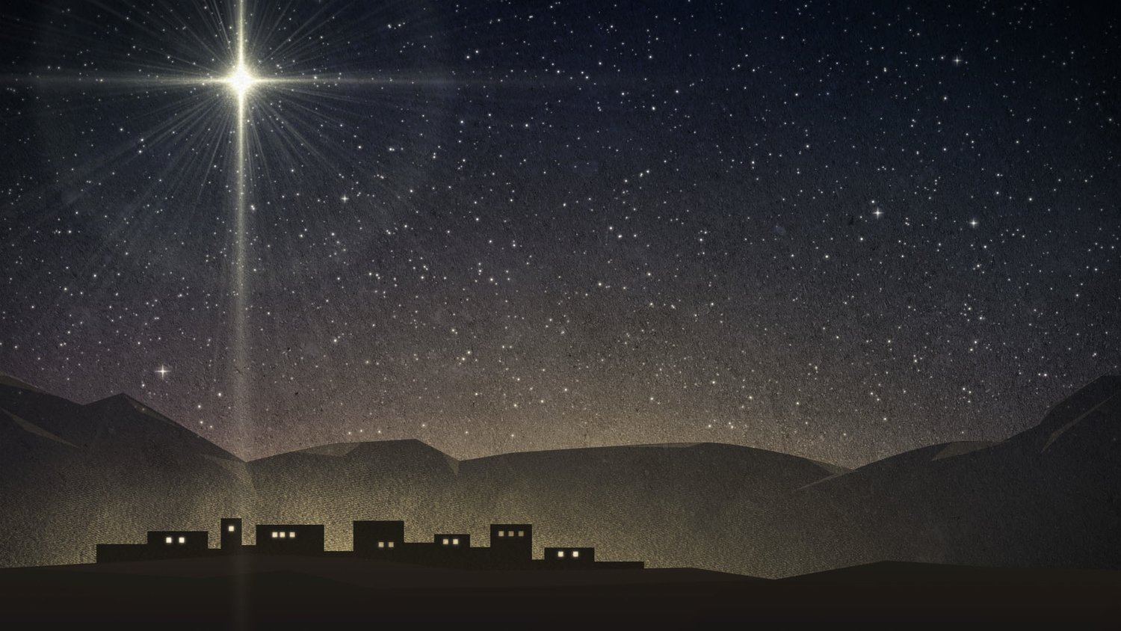
(Jesus)
“I am the light of the world.
Whoever follows me will never walk in darkness, but will have the light of life.”

