Slide 1
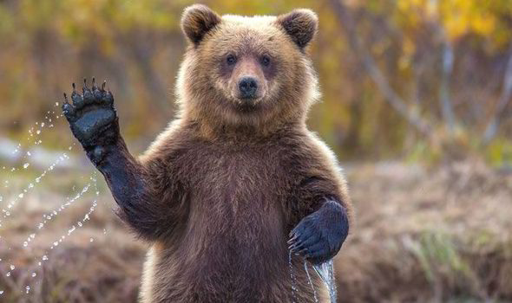
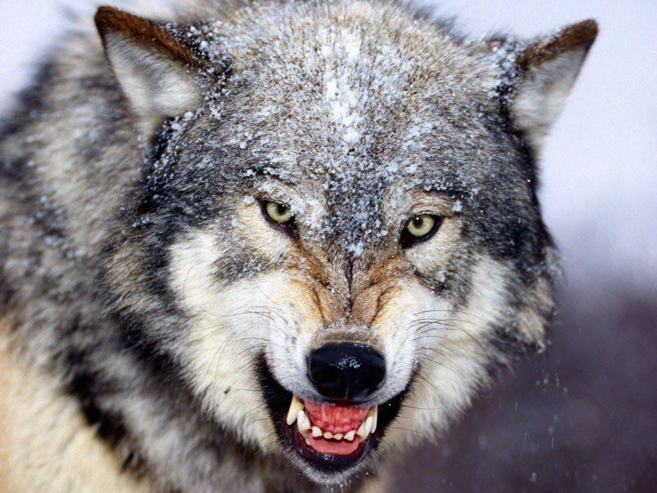
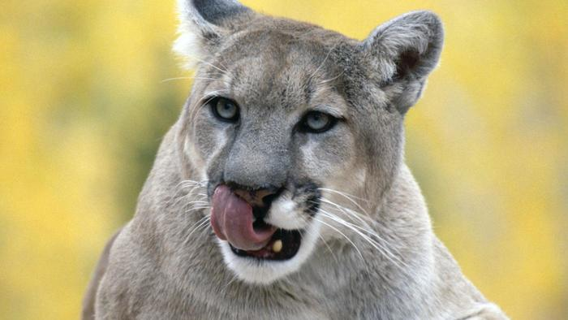
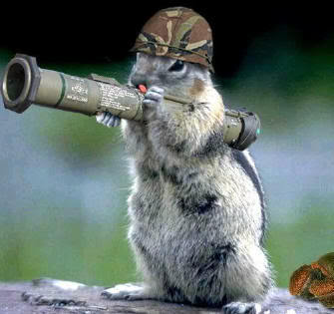
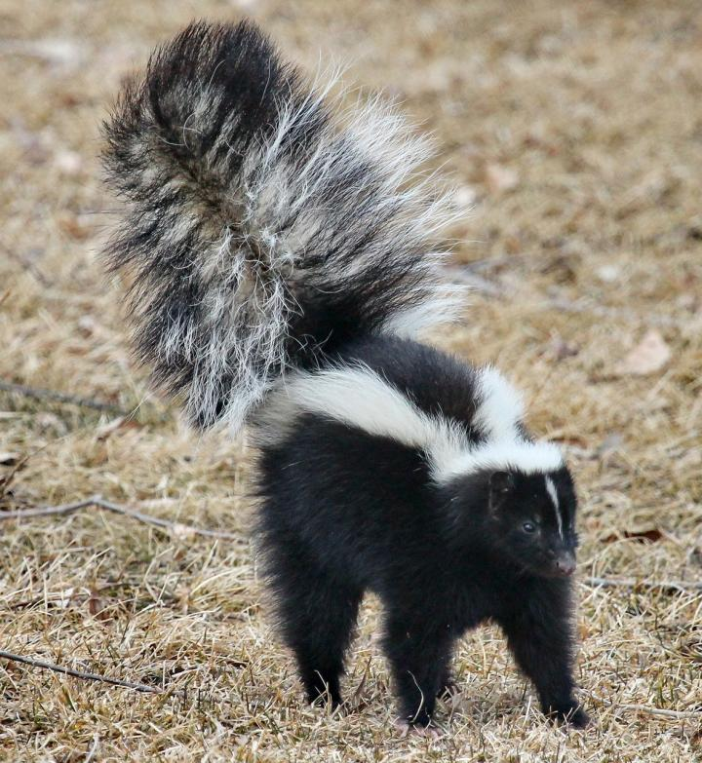

Slide 2
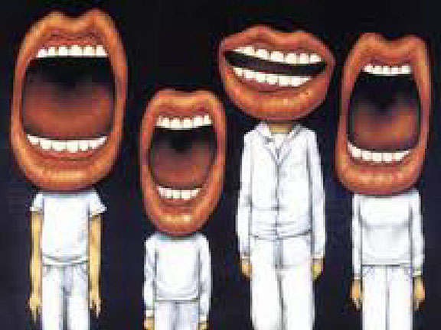
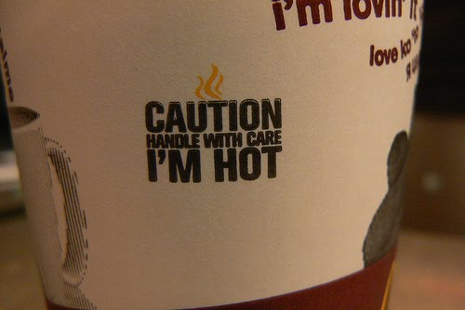

Slide 4
Blessings our tongues can bring us and others?
Damage our tongues can do?

Slide 5
James 3:1
Not many of you should become teachers, my fellow believers, because you know that we who teach will be judged more strictly.
The use of our tongue has eternal consequences.

Slide 6
Matthew 5:19
Therefore anyone who sets aside one of the least of these commands and teaches others accordingly will be called least in the kingdom of heaven, but whoever practices and teaches these commands will be called great in the kingdom of heaven.

Slide 7
James 3:2
We all stumble in many ways. Anyone who is never at fault in what they say is perfect, able to keep their whole body in check.
We’re all on common ground when it comes to our tongues: imperfect!

Slide 8
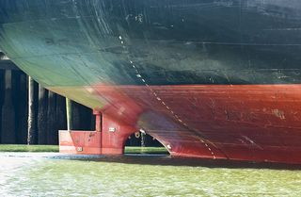
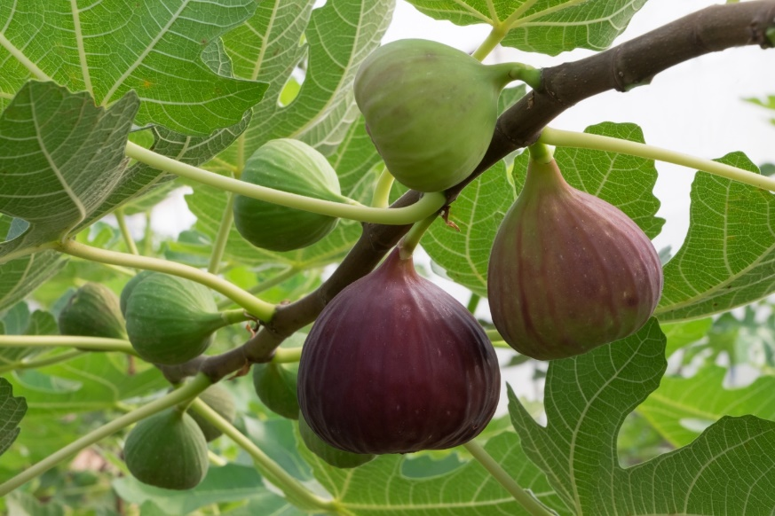
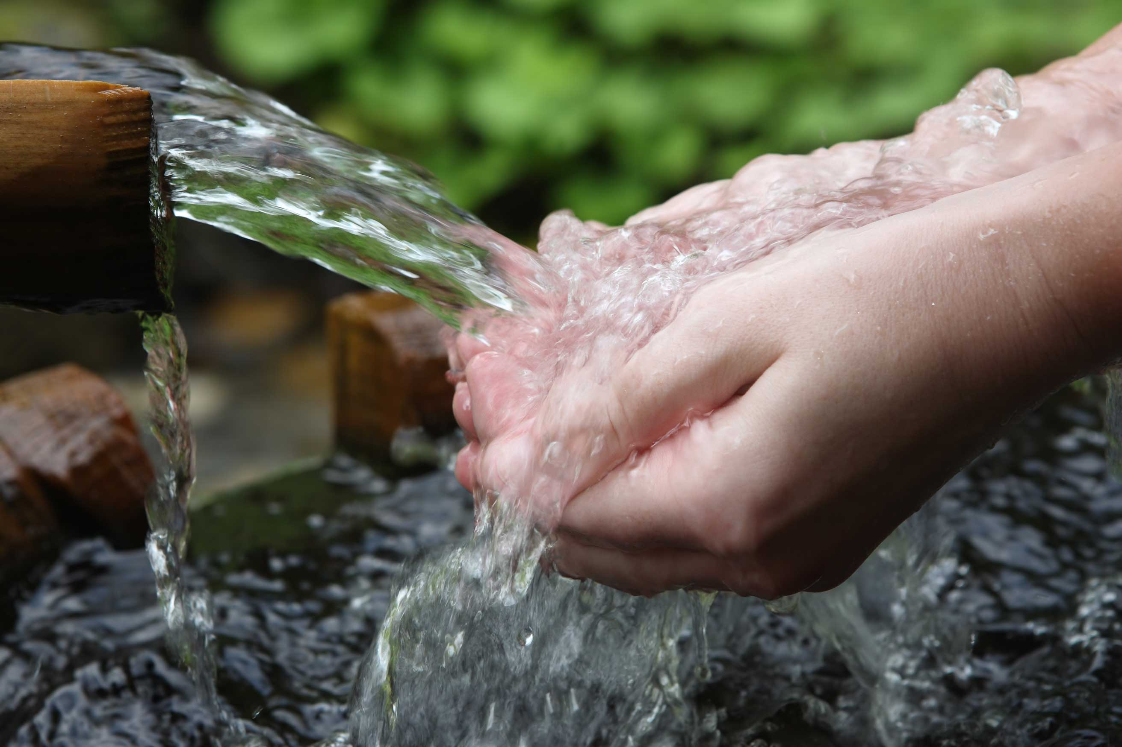
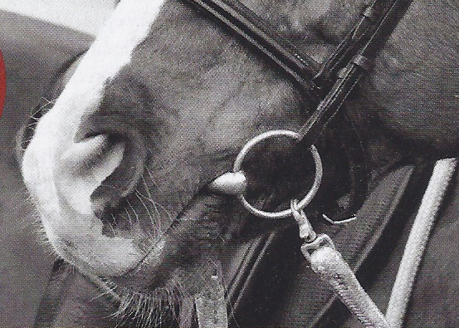
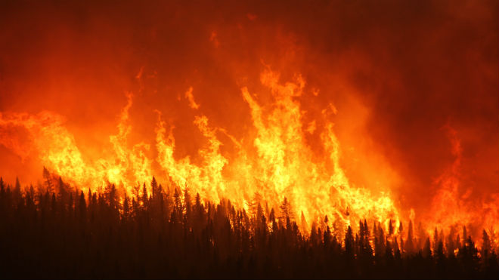
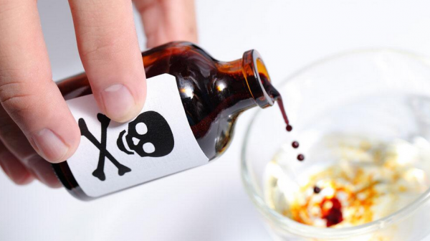

Slide 9
James 3:3, 4
When we put bits into the mouths of horses to make them obey us, we can turn the whole animal. ⁴ Or take ships as an example. Although they are so large and are driven by strong winds, they are steered by a very small rudder wherever the pilot wants to go.
Our tongue has the power to direct our entire lives.

Slide 10
James 3:7, 8
All kinds of animals, birds, reptiles and sea creatures are being tamed and have been tamed by mankind, ⁸ but no human being can tame the tongue. It is a restless evil, full of deadly poison.

Slide 11
Ephesians 4--²⁵ Therefore each of you must put off falsehood and speak truthfully to your neighbor, for we are all members of one body. ²⁶ “In your anger do not sin”: Do not let the sun go down while you are still angry, ²⁷ and do not give the devil a foothold.
²⁹ Do not let any unwholesome talk come out of your mouths, but only what is helpful for building others up according to their needs, that it may benefit those who listen. ³⁰ And do not grieve the Holy Spirit of God, with whom you were sealed for the day of redemption. ³¹ Get rid of all bitterness, rage and anger, brawling and slander, along with every form of malice. ³² Be kind and compassionate to one another, forgiving each other, just as in Christ God forgave you.

Slide 12
James 3:5-6
Likewise, the tongue is a small part of the body, but it makes great boasts. Consider what a great forest is set on fire by a small spark. ⁶ The tongue also is a fire, a world of evil among the parts of the body. It corrupts the whole body, sets the whole course of one’s life on fire, and is itself set on fire by hell.

Slide 13
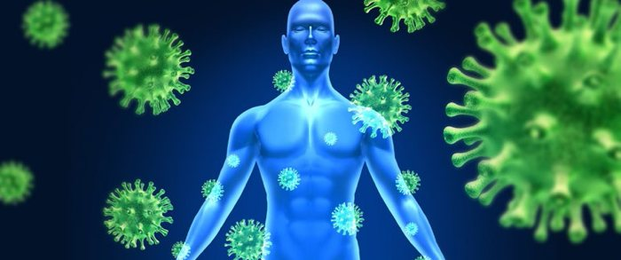

Slide 14
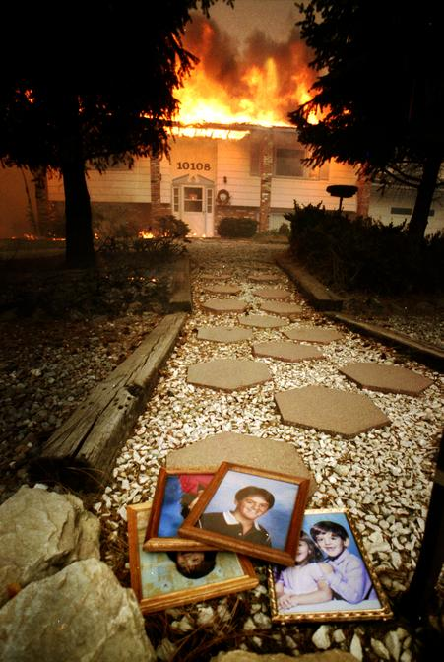
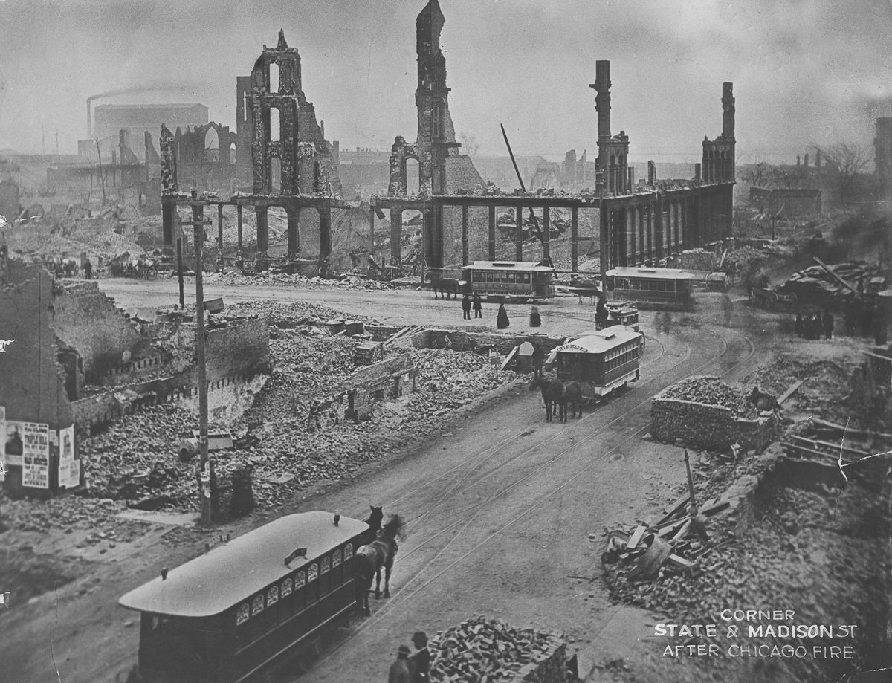
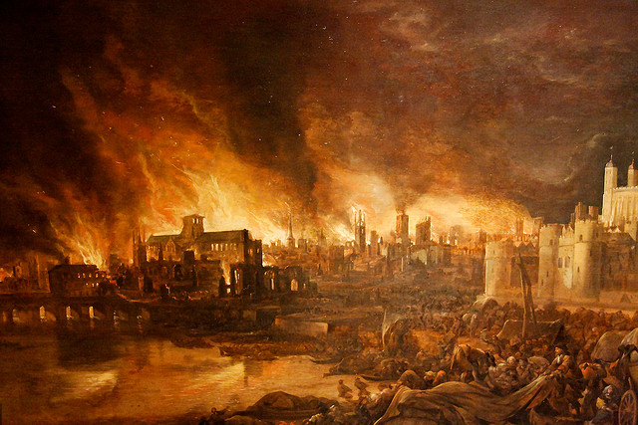

Slide 16
James 3
⁹ With the tongue we praise our Lord and Father, and with it we curse human beings, who have been made in God’s likeness. ¹⁰ Out of the same mouth come praise and cursing. My brothers and sisters, this should not be. ¹¹ Can both fresh water and salt water flow from the same spring? ¹² My brothers and sisters, can a fig tree bear olives, or a grapevine bear figs? Neither can a salt spring produce fresh water.

