Slide 1
PARTIALLY CONVINCED Christ-Encounters from John 3

Slide 2
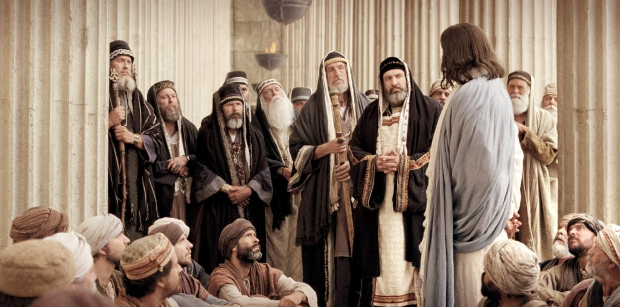

Slide 3
John 3
¹⁾Now there was a Pharisee, a man named Nicodemus who was a member of the Jewish ruling council. ²⁾ He came to Jesus at night and said, “Rabbi, we know that you are a teacher who has come from God. For no one could perform the signs you are doing if God were not with him.”

Slide 4
Find out what people think of Jesus.
What’s your opinion of Jesus?
To you, who is Jesus?

Slide 5
What are the most frequent answers you’ll hear to the question, “So, in your opinion, who is Jesus?”

Slide 6
What are the most frequent answers you’ll hear to the question, “So, in your opinion, who is Jesus?”
A great man
A good moral teacher
The Son of God
A religious figure
A folk-tale/fiction

Slide 7
To those who deny Jesus historic existence:
How did you develop that opinion of Him?
What’s convinced you that Jesus never actually existed?

Slide 8
To those who see Jesus as a good teacher, moral leader or even the “Son of God”…
C.S. Lewis’ argument: Jesus is either a LIAR, a LUNATIC, or LORD.

Slide 9
Jesus didn’t seem to worry about making sure the Gospel was simple or easy to understand.

Slide 12
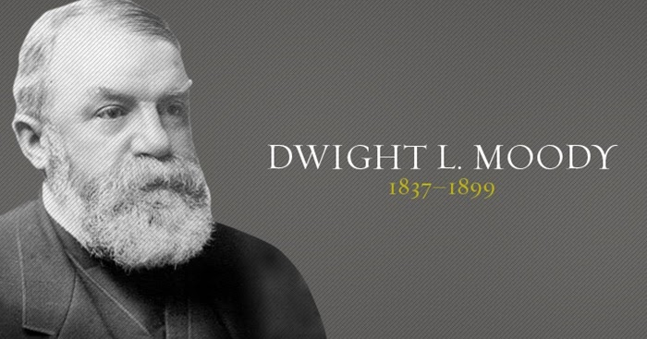

Slide 13
Questions about being Born Again
“Are you familiar with the phrase ‘born again’?
“What do you think Jesus meant when he said we couldn’t know God unless we’re born again?”
“Have you been ‘born again’?”

Slide 14
John 3
⁵ Jesus answered, “Very truly I tell you, no one can enter the kingdom of God unless they are born of water and the Spirit. ⁶ Flesh gives birth to flesh, but the Spirit gives birth to spirit. ⁷ You should not be surprised at my saying, ‘You must be born again.’ ⁸ The wind blows wherever it pleases. You hear its sound, but you cannot tell where it comes from or where it is going. So it is with everyone born of the Spirit.”

Slide 15
John 3
⁹ “How can this be?” Nicodemus asked.
¹⁰ “You are Israel’s teacher,” said Jesus, “and do you not understand these things? ¹¹ Very truly I tell you, we speak of what we know, and we testify to what we have seen, but still you people do not accept our testimony. ¹² I have spoken to you of earthly things and you do not believe; how then will you believe if I speak of heavenly things? ¹³ No one has ever gone into heaven except the one who came from heaven—the Son of Man.”

Slide 16
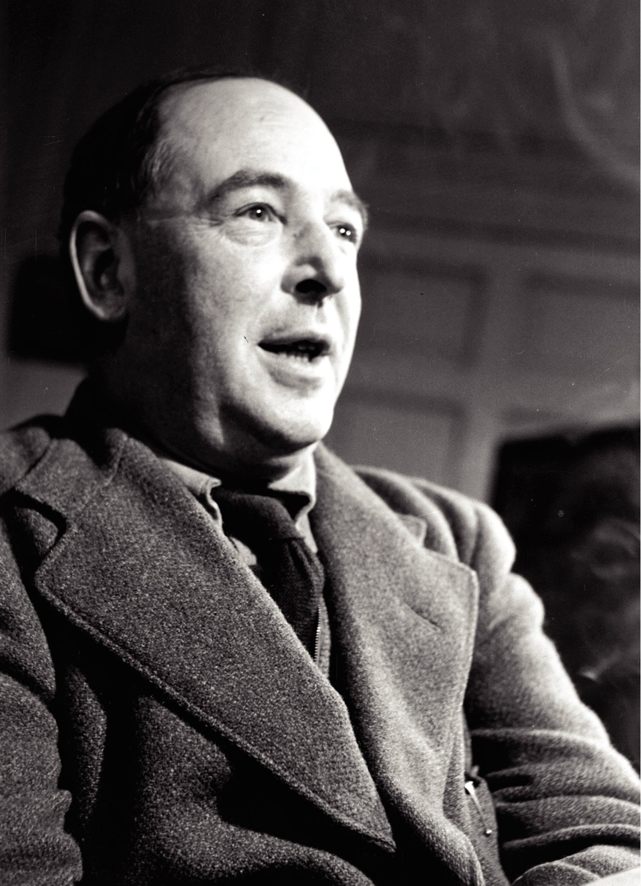
“I am trying here to prevent anyone saying the really foolish thing that people often say about Him [that is, Christ]: ‘I’m ready to accept Jesus as a great moral teacher, but I don’t accept His claim to be God.’ That is the one thing we must not say. A man who was merely a man and said the sort of things Jesus said would not be a great moral teacher. He would either be a lunatic–on a level with the man who says he is a poached egg–or else he would be the Devil of Hell. You must make your choice. Either this man was, and is, the Son of God: or else a madman or something worse…. You can shut Him up for a fool, you can spit at Him and kill Him as a demon; or you can fall at His feet and call Him Lord and God. But let us not come up with any patronizing nonsense about His being a great human teacher. He has not left that open to us. He did not intend to.”

Slide 17
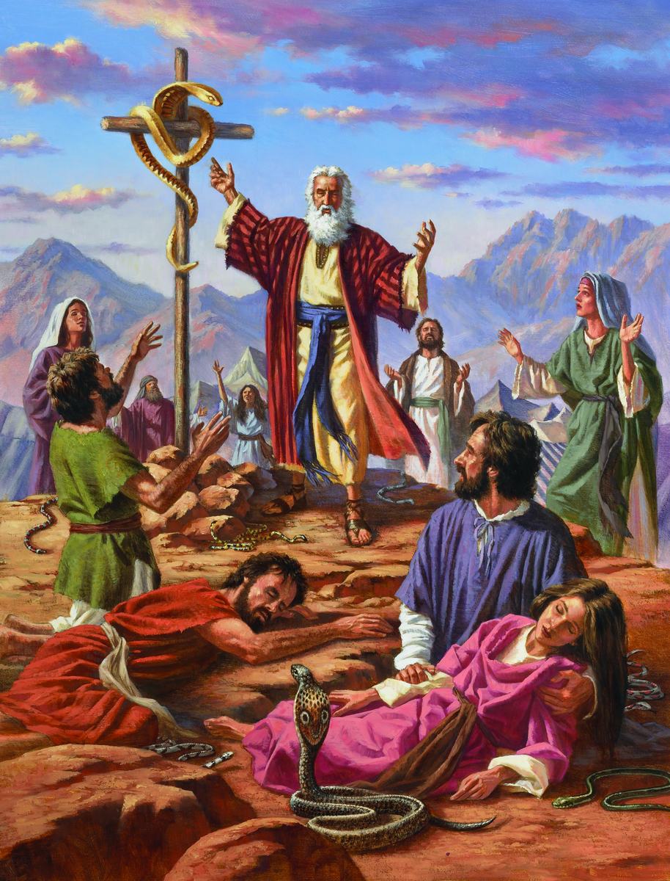
John 3
¹⁴ Just as Moses lifted up the snake in the wilderness, so the Son of Man must be lifted up, ¹⁵ that everyone who believes may have eternal life in him.”

Slide 18
John 3
¹⁶ For God so loved the world that he gave his one and only Son, that whoever believes in him shall not perish but have eternal life. ¹⁷ For God did not send his Son into the world to condemn the world, but to save the world through him. ¹⁸ Whoever believes in him is not condemned, but whoever does not believe stands condemned already because they have not believed in the name of God’s one and only Son.

Slide 19
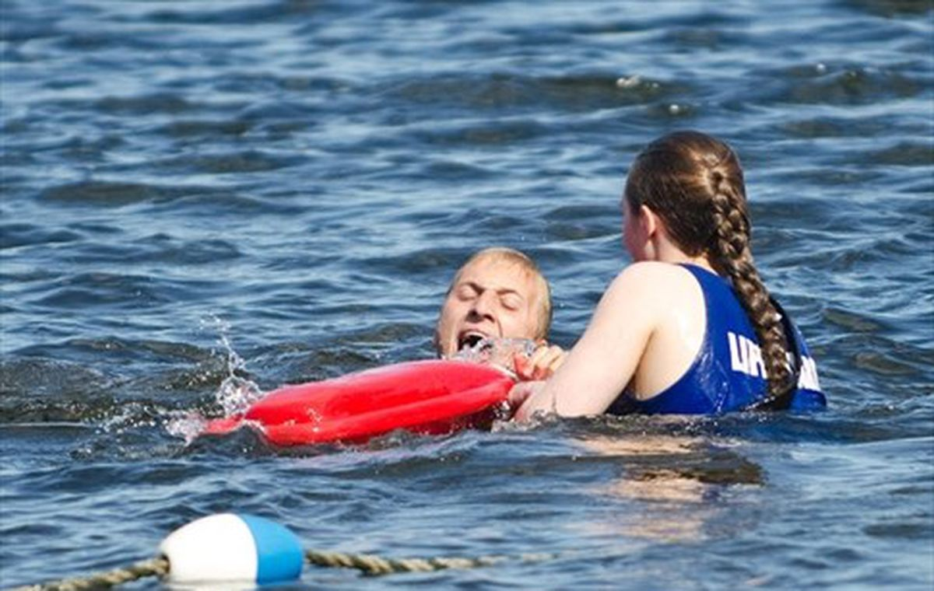

Slide 20
John 7:50-51
John 19:39

