Slide 1
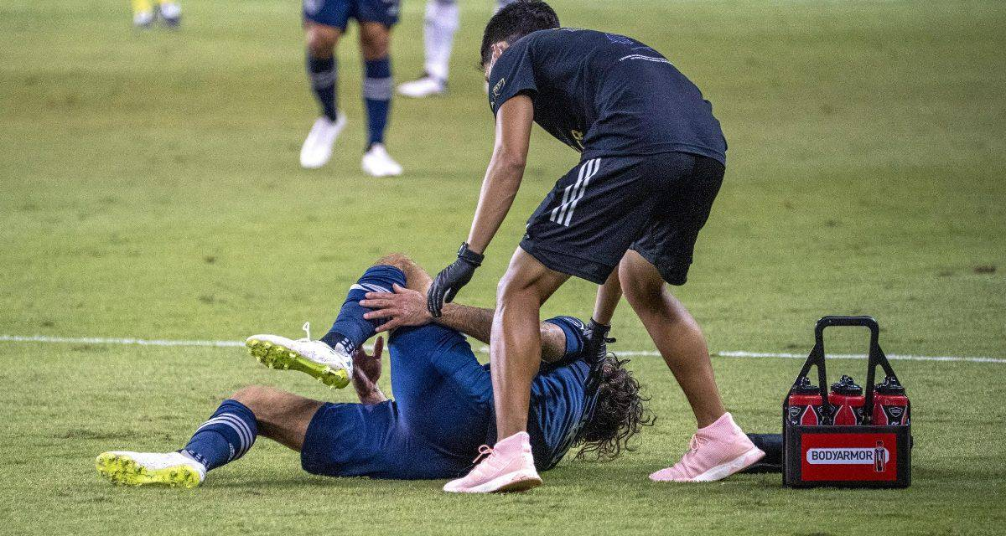
SIDELINED
or
Strengthened?

Slide 2
1 Thessalonians 3
¹ Therefore when we could bear it no longer, we were willing to be left behind at Athens alone, ² and we sent Timothy, our brother and God's coworker in the gospel of Christ, to establish and exhort you in your faith, ³ that no one be moved by these afflictions. For you yourselves know that we are destined for this. ⁴ For when we were with you, we kept telling you beforehand that we were to suffer affliction, just as it has come to pass, and just as you know. ⁵ For this reason, when I could bear it no longer, I sent to learn about your faith, for fear that somehow the tempter had tempted you and our labor would be in vain.

Slide 3
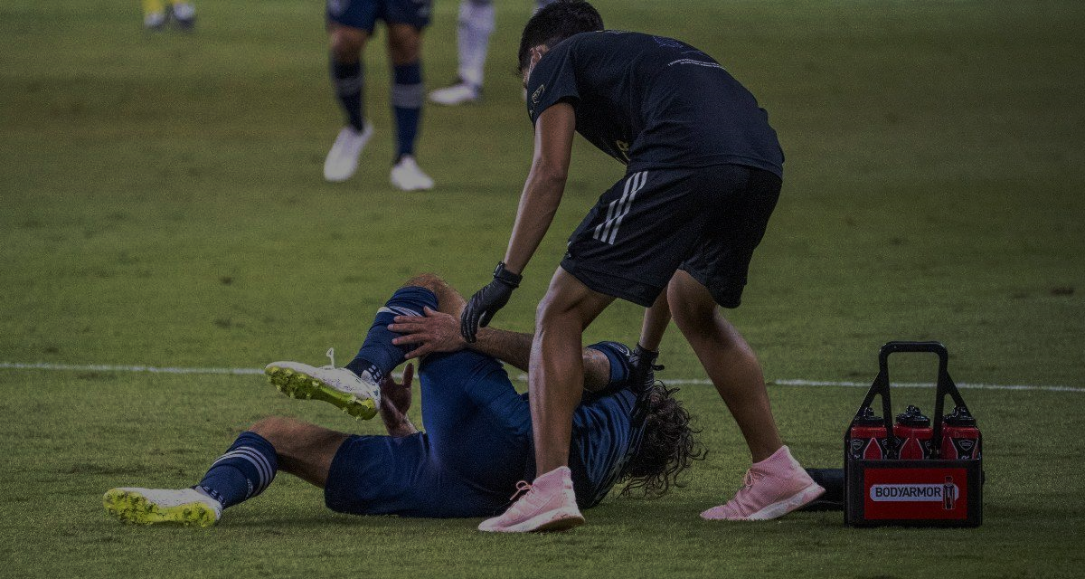
Think of a time when you got sidelined spiritually?
How did it happen?

Slide 4
1 Thessalonians 3
¹ Therefore when we could bear it no longer, we were willing to be left behind at Athens alone, ² and we sent Timothy, our brother and God's coworker in the gospel of Christ, to establish and exhort you in your faith….

Slide 5
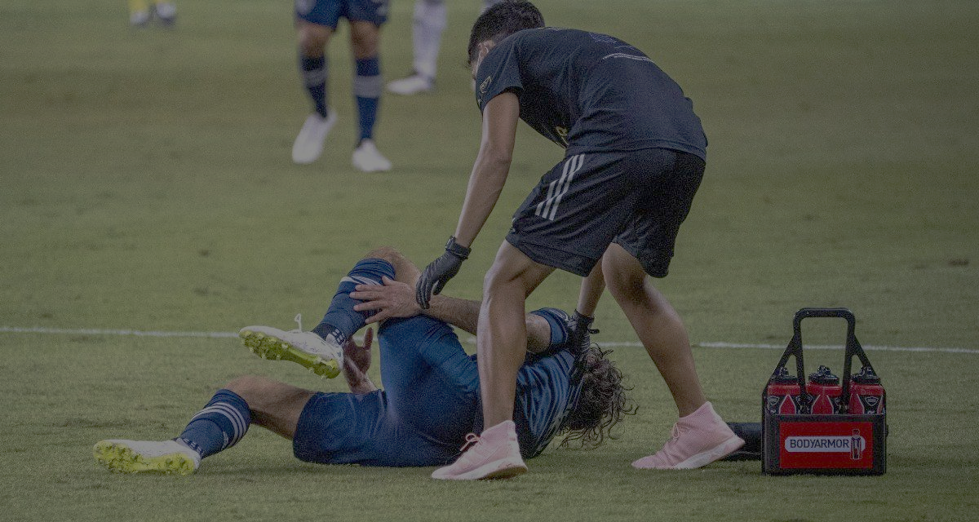
When our concern for each other overrides our commitment to the status quo of our lives, the life of Christ together will triumph.

Slide 6
sterizo = to strengthen, make firm, make stable, set fast

Slide 7
parakaleō = to strengthen, encourage, instruct

Slide 8
1 Thessalonians 3
² … we sent Timothy, our brother and God's coworker in the gospel of Christ, to establish and exhort you in your faith,
³ that no one be moved by these afflictions. For you yourselves know that we are destined for this.

Slide 9
AFFLICTIONS in the Greek (thlepsis) is used in two ways in the New Testament:
1.) [lit.] a pressing, pressing together, pressure
2.) [metaph.] oppression, affliction, tribulation, distress

Slide 11
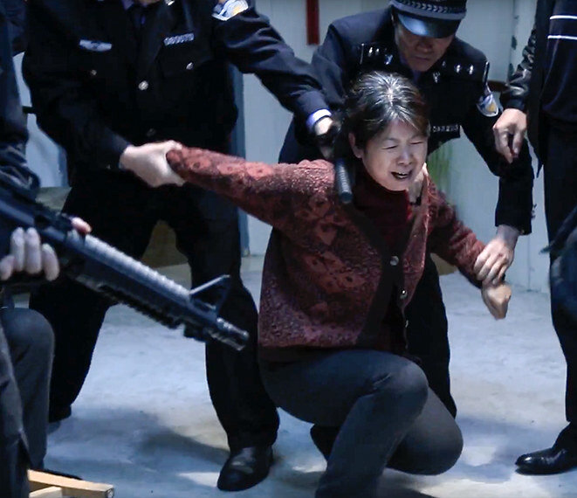
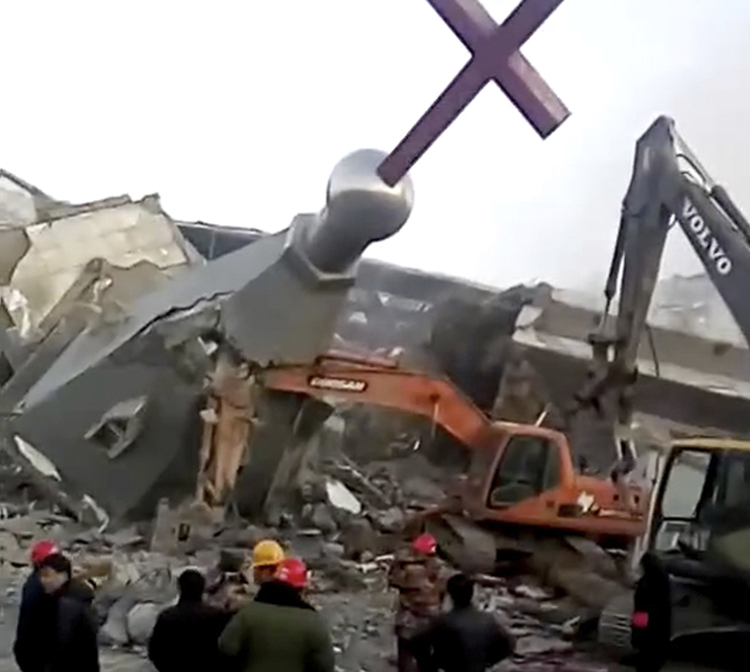
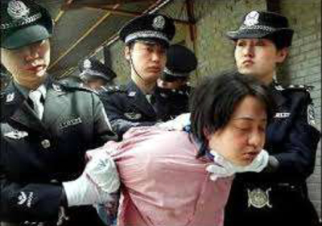

Slide 12
1 Thessalonians 3
³ that no one be moved by these afflictions.
^{5 “}For this reason, when I could bear it no longer, I sent to learn about your faith, for fear that somehow the tempter had tempted you and our labor would be in vain.”

Slide 13
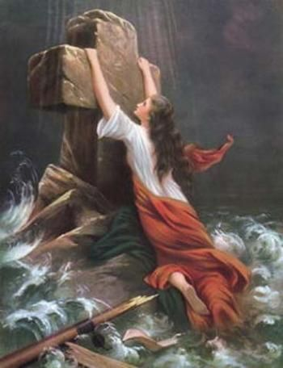
What are the temptations that ‘the tempter’ uses to ‘move’ us off of Christ in suffering?

Slide 14
What are the temptations that ‘the tempter’ uses to ‘move’ us off of Christ in suffering?
1.) An inaccurate belief about God

Slide 15
What are the temptations that ‘the tempter’ uses to ‘move’ us off of Christ in suffering?
1.) An inaccurate belief about God
2.) A shallow experience with the Word of God

Slide 16
What are the temptations that ‘the tempter’ uses to ‘move’ us off of Christ in suffering?
1.) An inaccurate belief about God
2.) A shallow experience with the Word of God
3.) Getting us to tone down our testimony about Christ
Rev. 12:11 “…they triumphed over him by the blood of the Lamb and by the word of their testimony; they did not love their lives so much as to shrink from death.”

Slide 17
What are the temptations that ‘the tempter’ uses to ‘move’ us off of Christ in suffering?
1.) An inaccurate belief about God
2.) A shallow experience with the Word of God
3.) Getting us to tone down our testimony about Christ
4.) Unfulfilled, unbiblical expectations

Slide 18
What are the temptations that ‘the tempter’ uses to ‘move’ us off of Christ in suffering?
1.) An inaccurate belief about God
2.) A shallow experience with the Word of God
3.) Getting us to tone down our testimony about Christ
4.) Unfulfilled, unbiblical expectations
5.) Failure to believe what is already
revealed by God as truth

Slide 19
What strengthens us in
our times of affliction?
⁶ But Timothy has just now come to us from you and has brought good news about your faith and love and reported that you always remember us kindly and long to see us, as we long to see you— ⁷ for this reason, brothers, in all our distress and affliction we have been comforted about you through your faith. ( 1 Thess. 3)

Slide 21
Numbers 6:24-26
²⁴ “The Lord bless you and keep you; ²⁵ The Lord make His face shine upon you, And be gracious to you; ²⁶ The Lord lift up His countenance upon you, And give you peace.” ’

