Slide 2
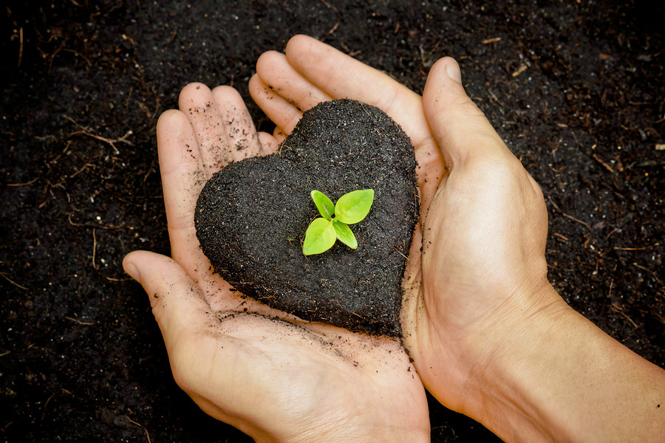
Soil-Boosters for the Soul
Comfort
Encouragement
Fellowship
Compassion

Slide 3
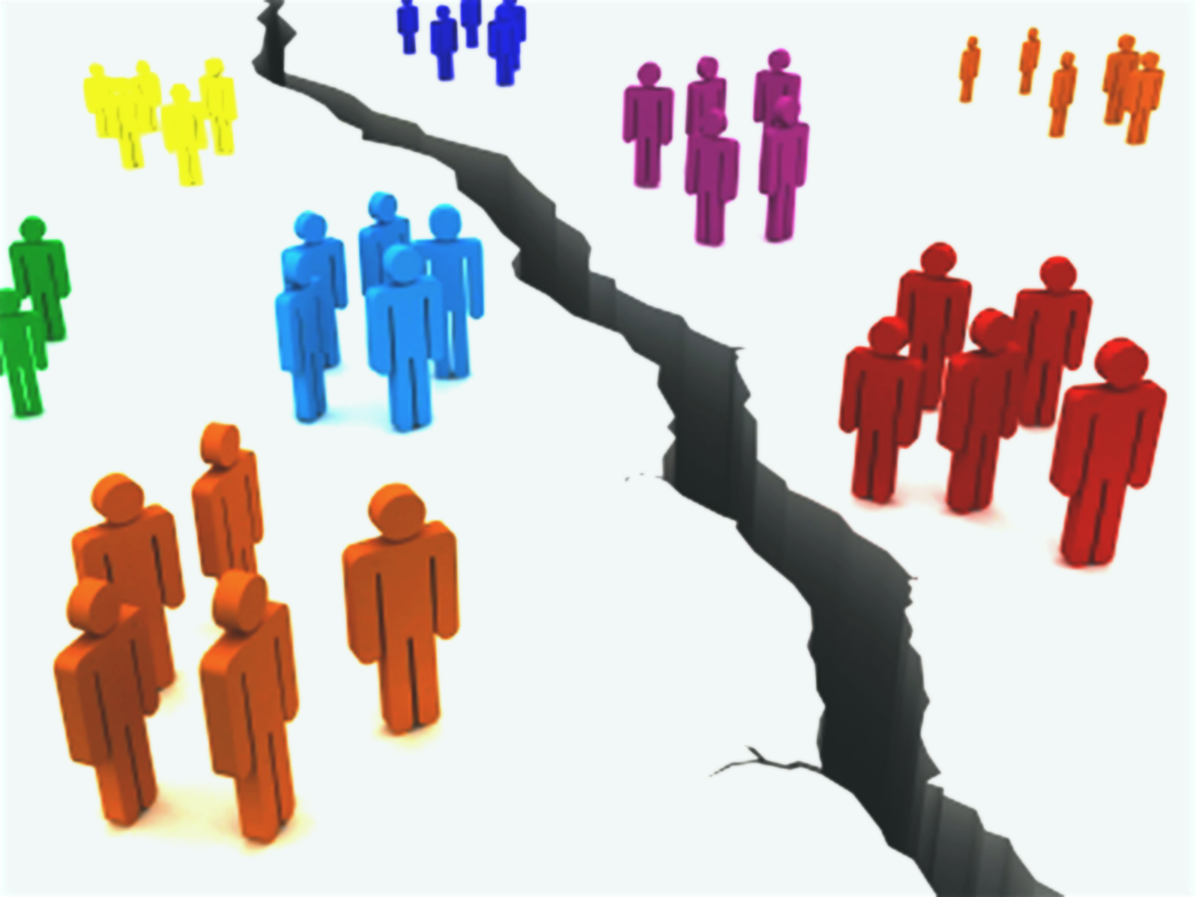

Slide 4
Philippians 2:2
Make my joy complete by being like-minded, having the same love, being one in spirit and of one mind.

Slide 5
Getting on the same page…
…JESUS’ page.

Slide 6
Philippians 2:3-4 ³ Do nothing out of selfish ambition or vain conceit. Rather, in humility value others above yourselves, ⁴ not looking to your own interests but each of you to the interests of the others.”
What are the 2 prohibitions?
What are the two positive commands?

Slide 7
Philippians 2:3-4 ³ Do nothing out of selfish ambition or vain conceit. Rather, in humility value others above yourselves, ⁴ not looking to your own interests but each of you to the interests of the others.”

Slide 8
Philippians 2:3-4 ³ Do nothing out of selfish ambition or vain conceit. Rather, in humility value others above yourselves, ⁴ not looking to your own interests but each of you to the interests of the others.”

Slide 9
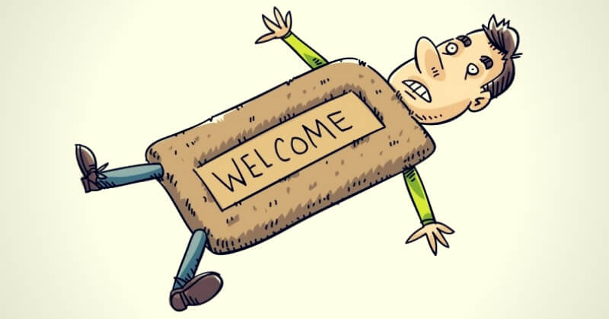

Slide 10
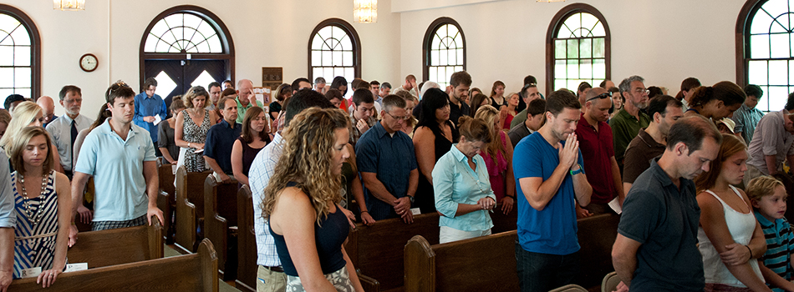
HUMILITY

Slide 11
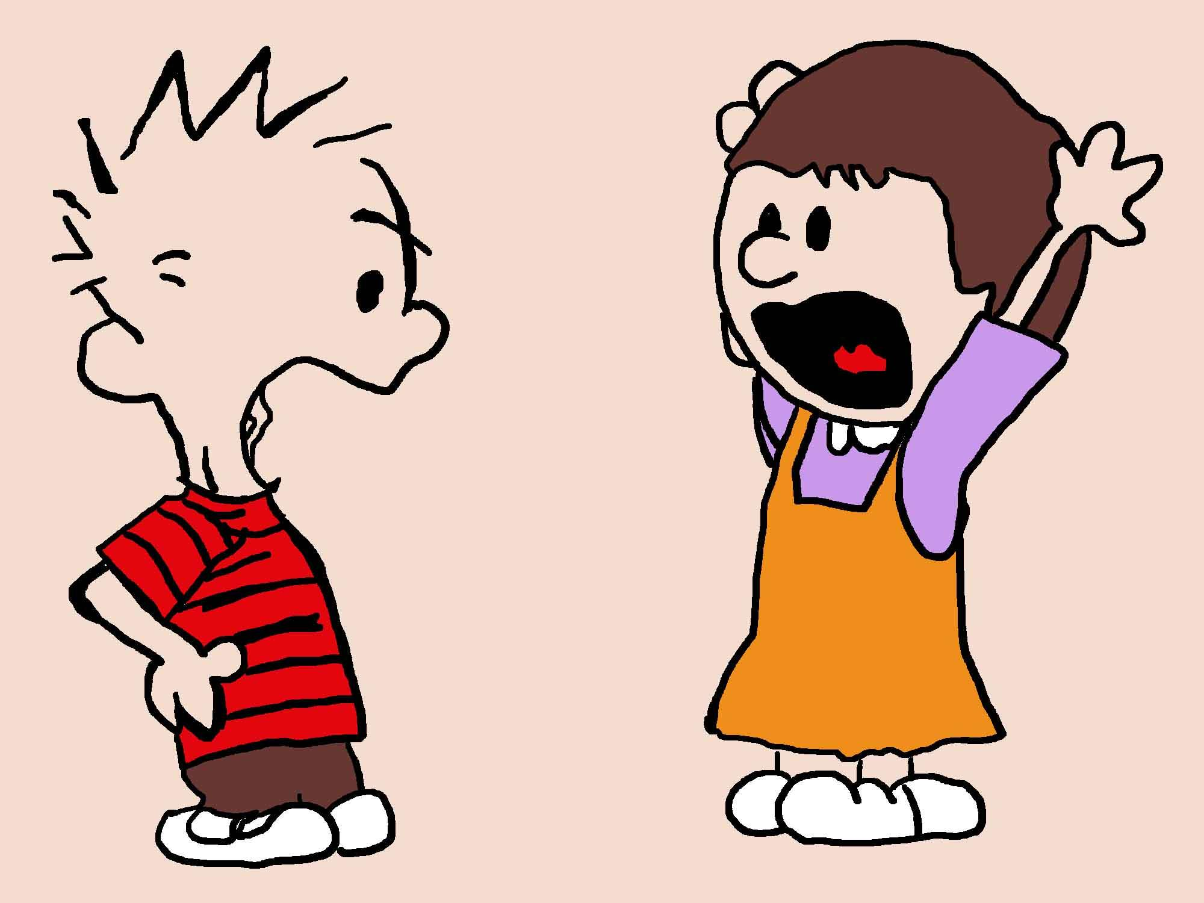

Slide 13
Philippians 2:3-4 ³ Do nothing out of selfish ambition or vain conceit. Rather, in humility value others above yourselves, ⁴ not looking to your own interests but each of you to the interests of the others.”

Slide 14
HUMILITY
GOD HIMSELF

Slide 16
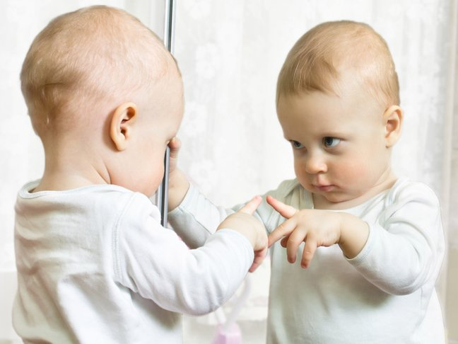
Humility must involve… RECONGINZING THE REALITY OF WHO YOU ARE.

Slide 17
Philippians 2:5-6 ⁵ Have this mind among yourselves, which is yours in Christ Jesus, ⁶ who, though he was in the form of God, did not count equality with God a thing to be grasped…. (ESV)

Slide 19
Humility must value
the “success” of others.

Slide 20
Philippians 2:3-4 ³ Do nothing out of selfish ambition or vain conceit. Rather, in humility value others above yourselves, ⁴ not looking to your own interests but each of you to the interests of the others.”

Slide 21
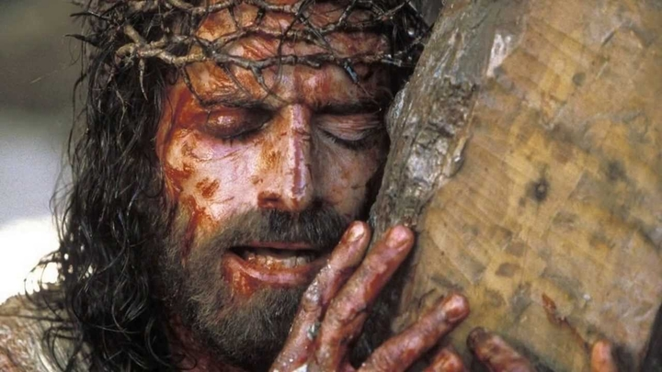
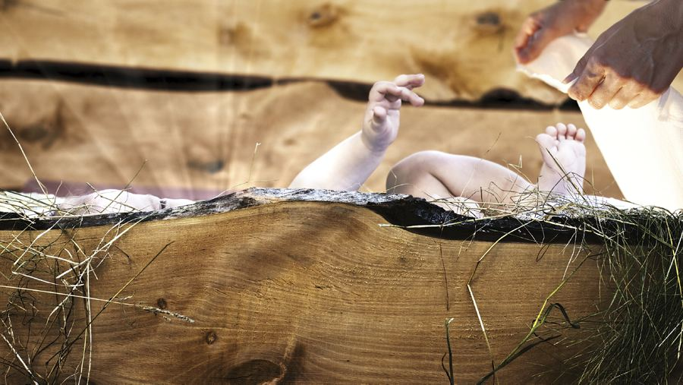

Slide 22
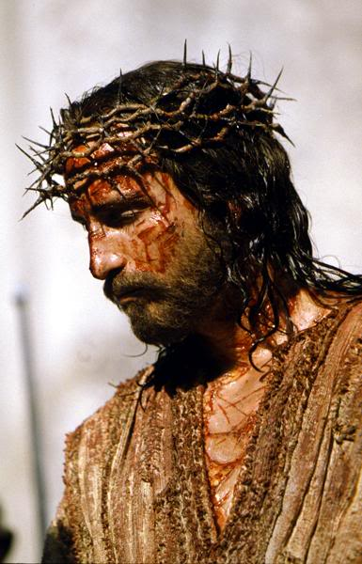

Slide 23
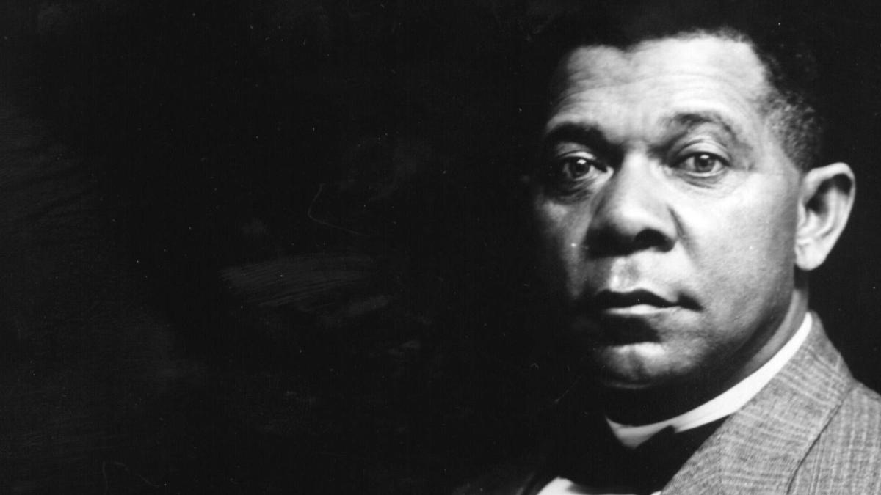
Booker T.
Washington

Slide 24
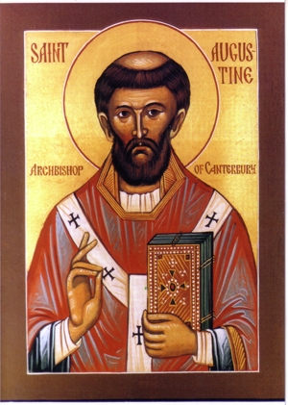

Slide 25
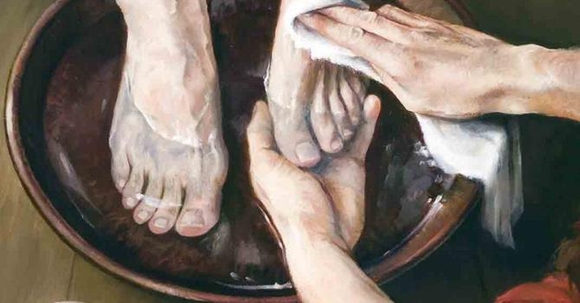

Slide 26
HUMBLE SERVICE may involve real SACRIFICE
Philippians 2:8
And being found in appearance as a man, he humbled himself by becoming obedient to death—even death on a cross!

Slide 27
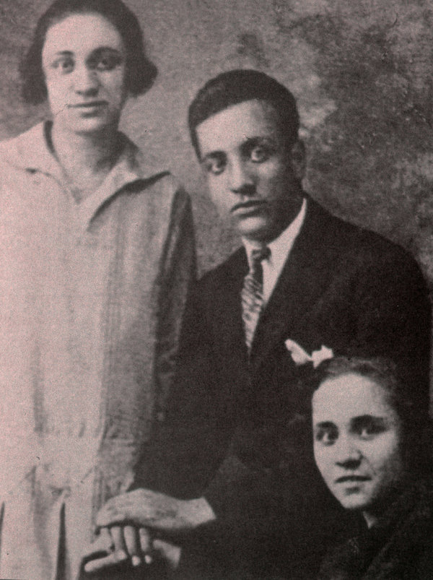
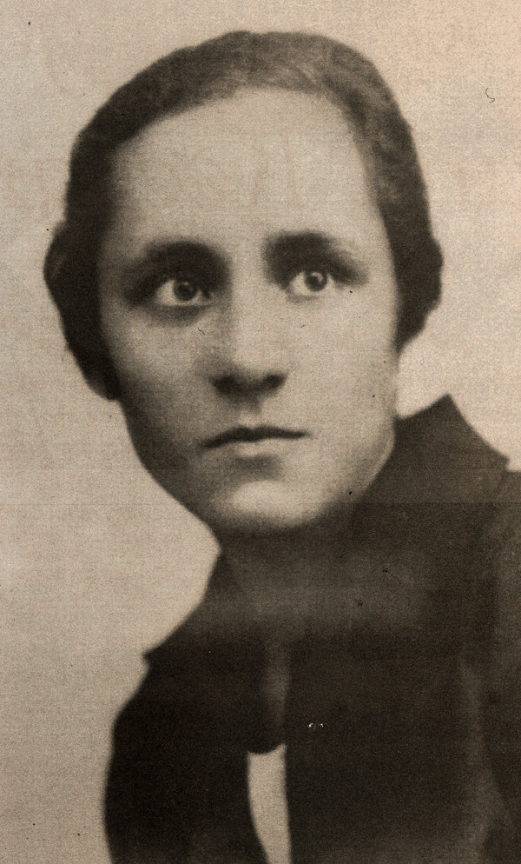
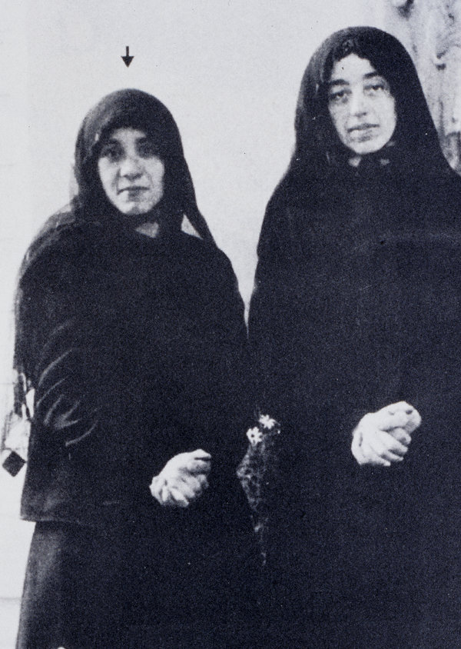
Agnes Gonxhe Bojaxhiu

Slide 28
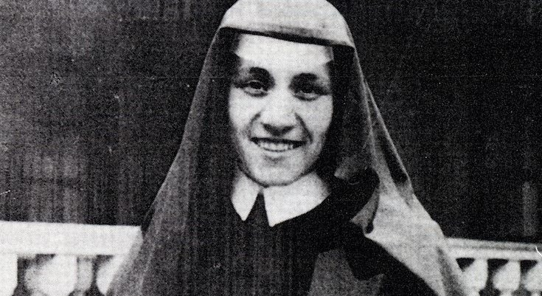

Slide 29
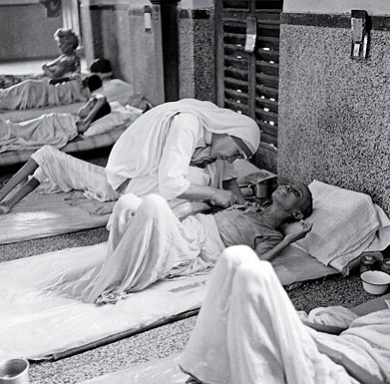
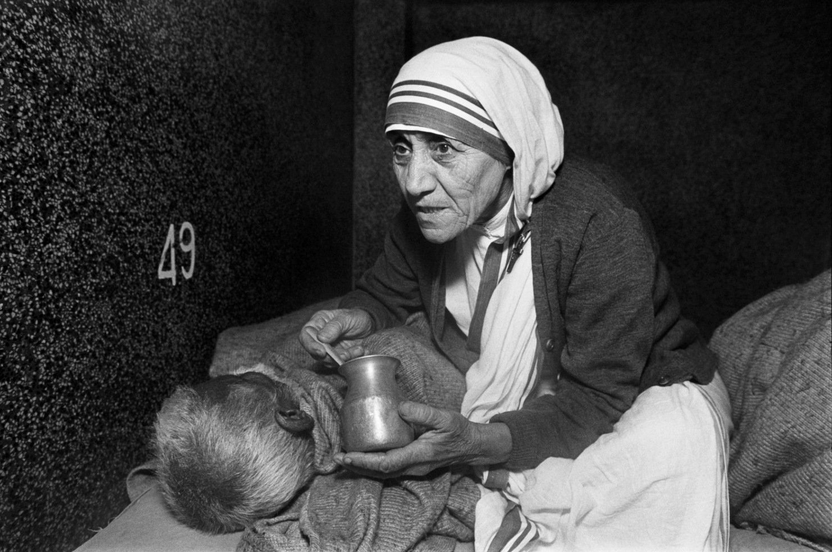

Slide 30
