Slide 1
Acts 14:27-28 ²⁷ On arriving there, they gathered the church together and reported all that God had done through them and how he had opened a door of faith to the Gentiles. ²⁸ And they stayed there a long time with the disciples.

Slide 2
Isaiah 26:12 “Lord, you establish peace for us; all that we have accomplished you have done for us.”

Slide 5
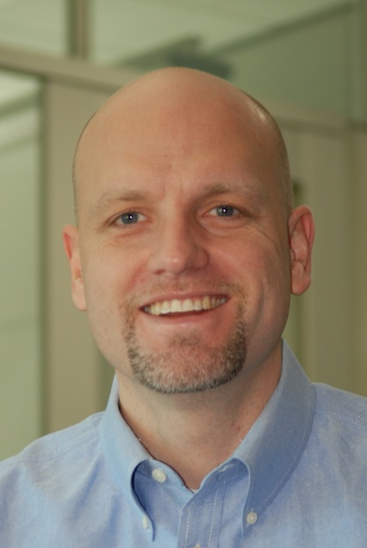
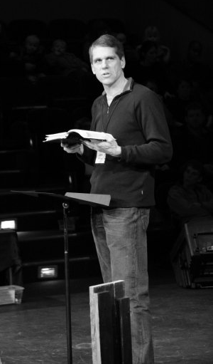
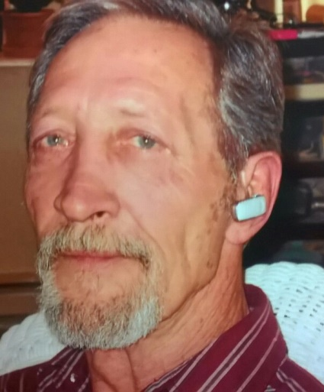
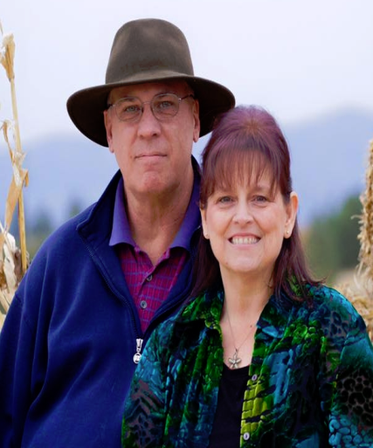
Management Leadership team (MLT)

Slide 6
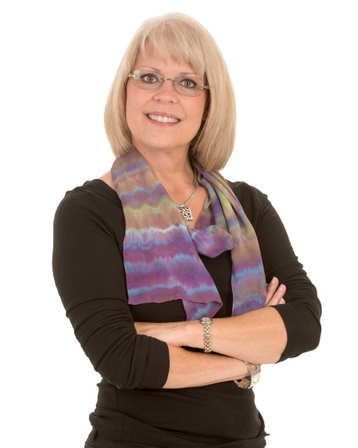
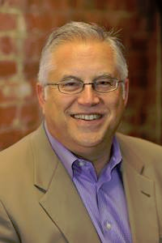
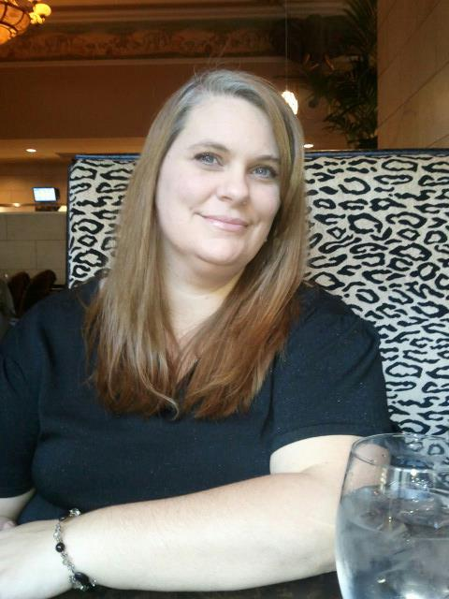
Finance council (fc)

Slide 7
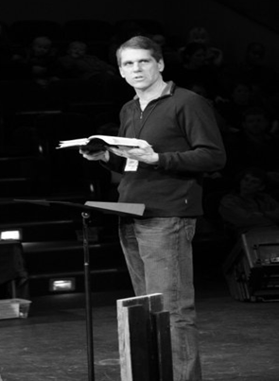
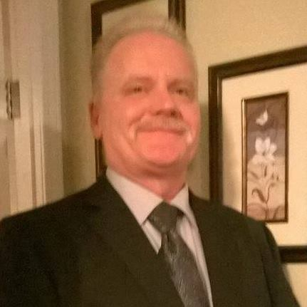
Staff

Slide 8
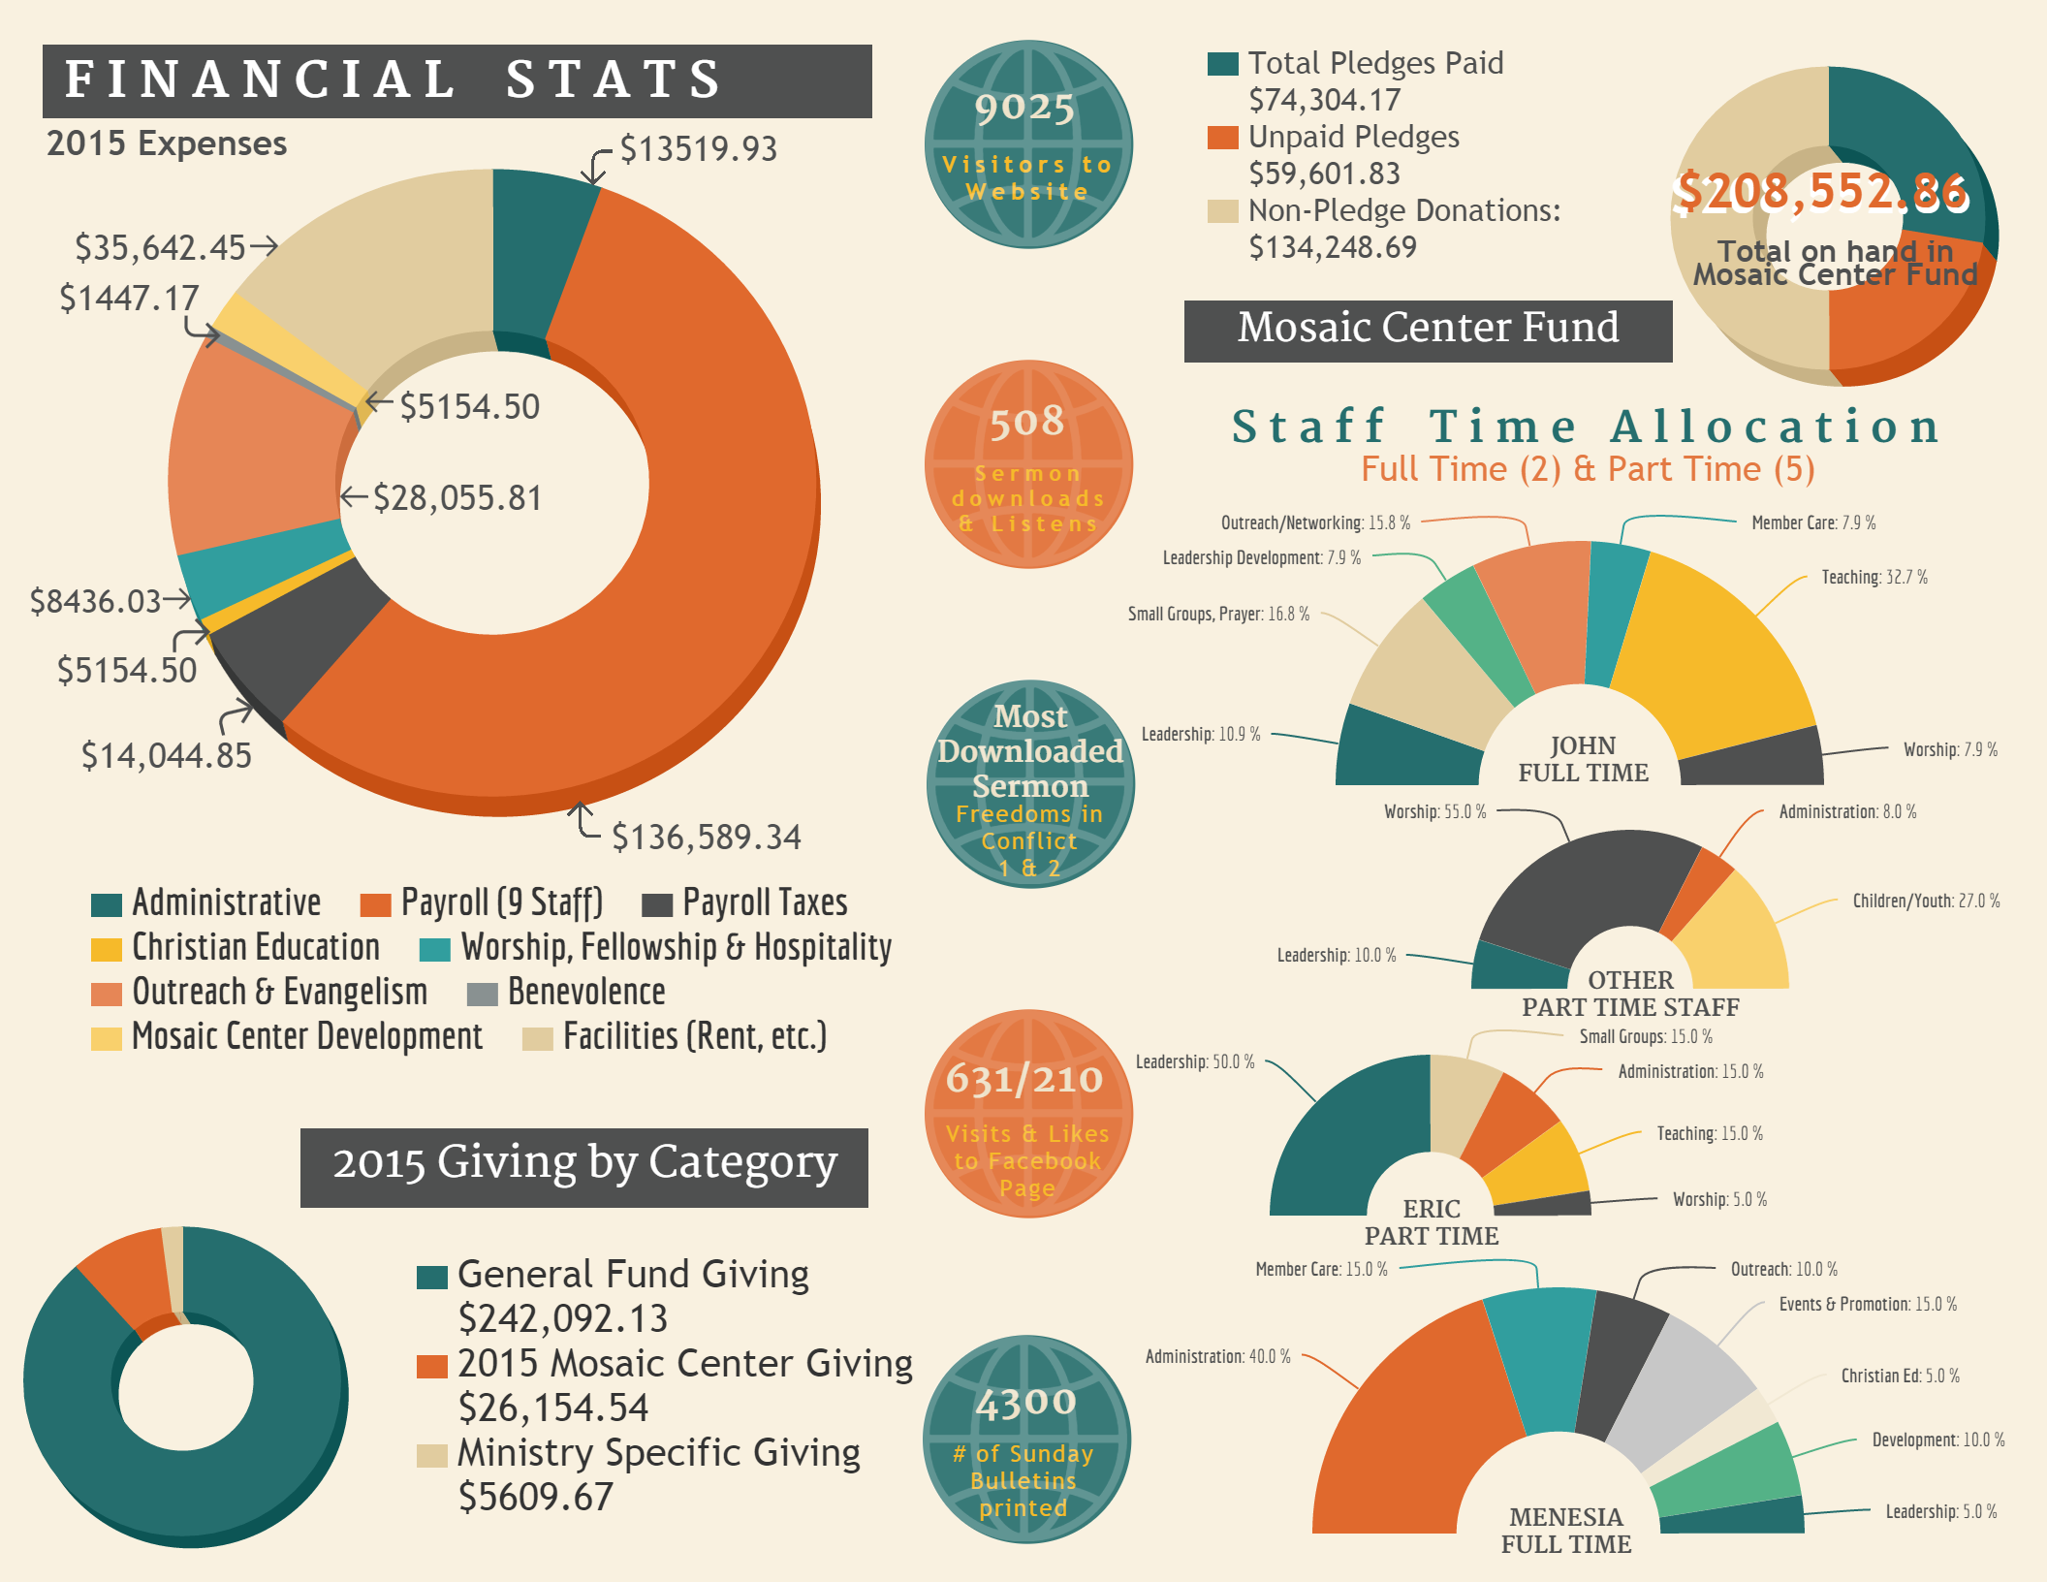

Slide 9
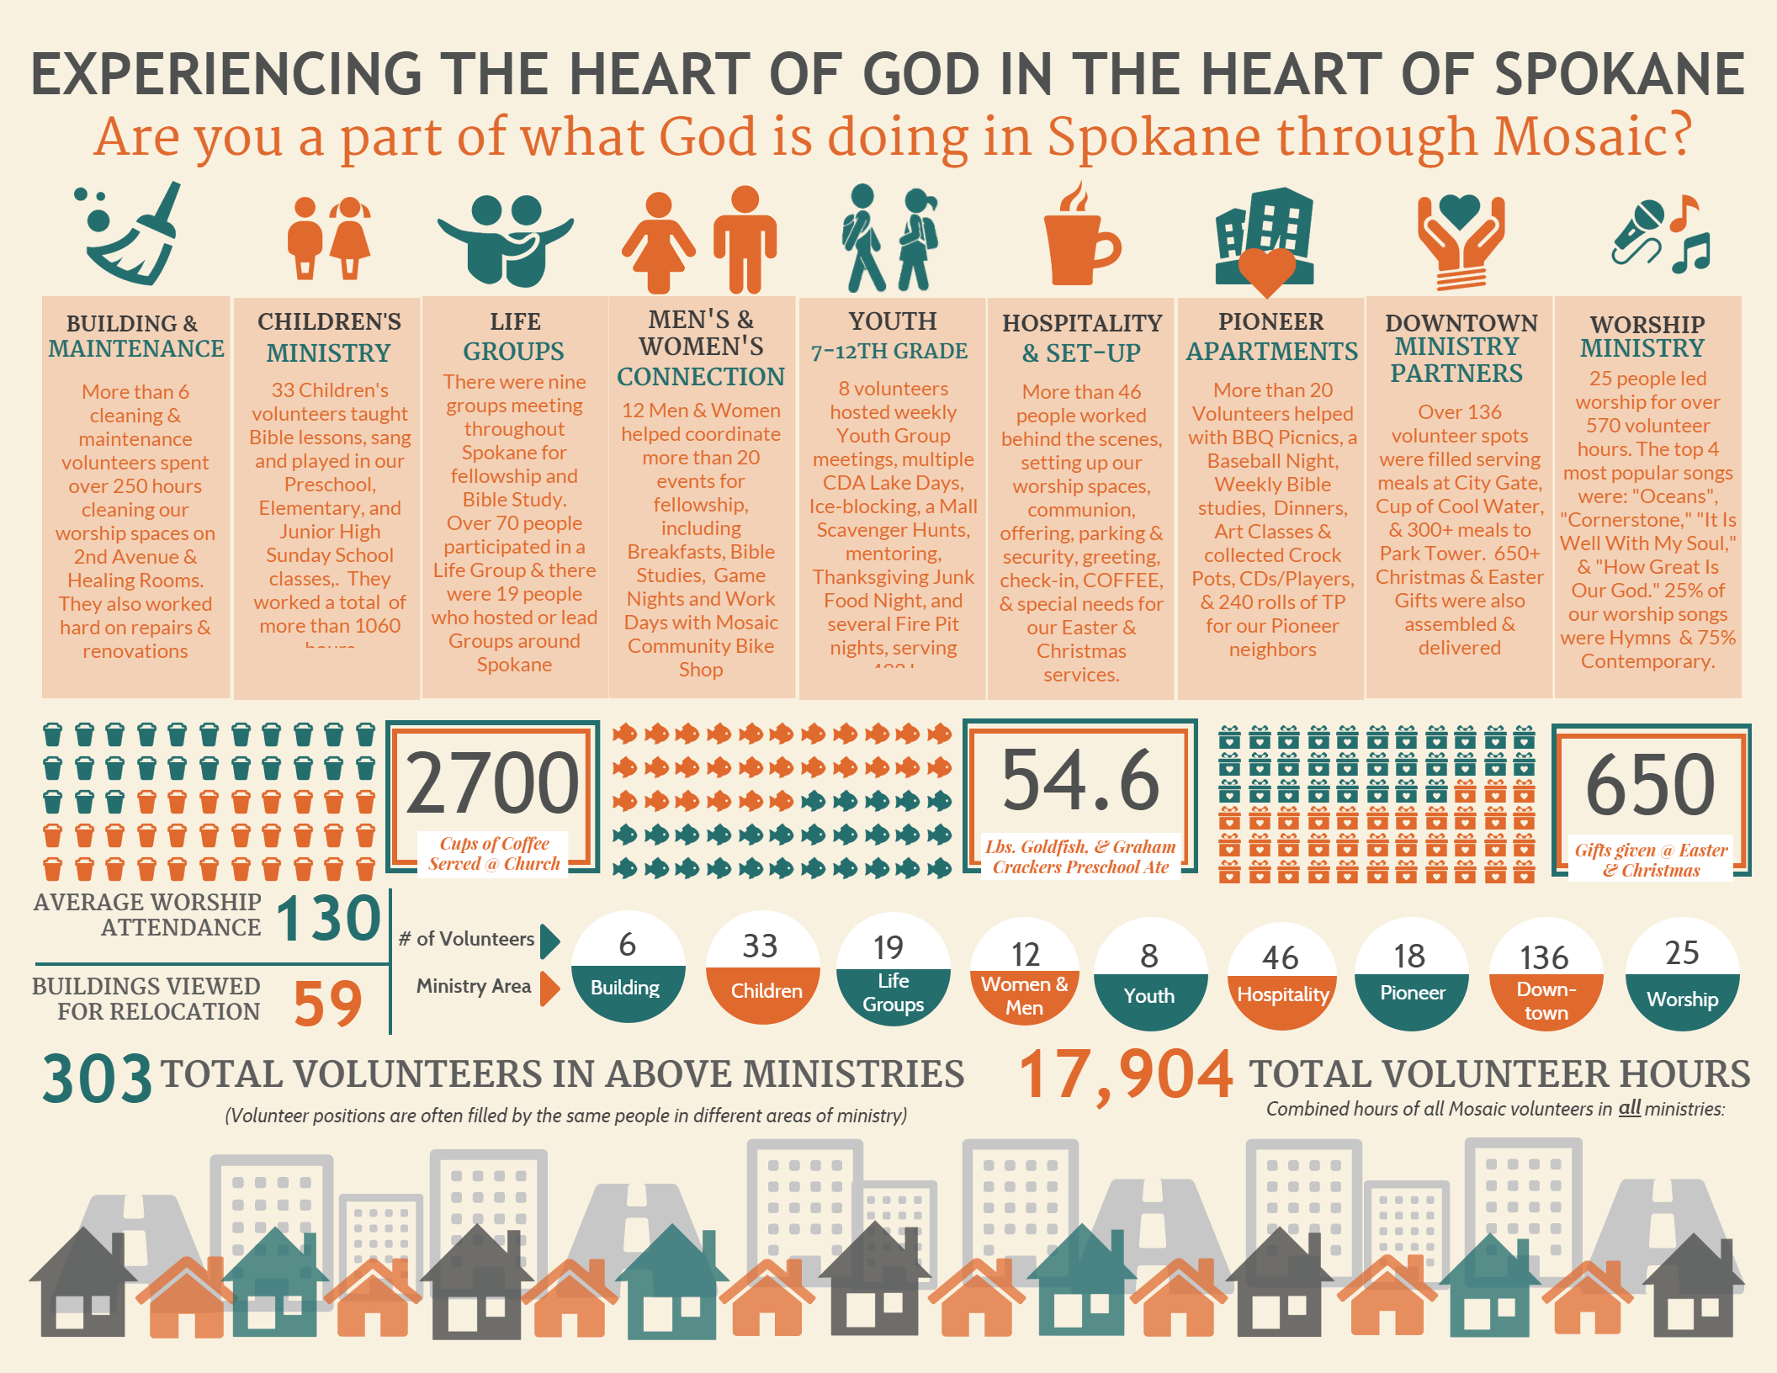

Slide 10
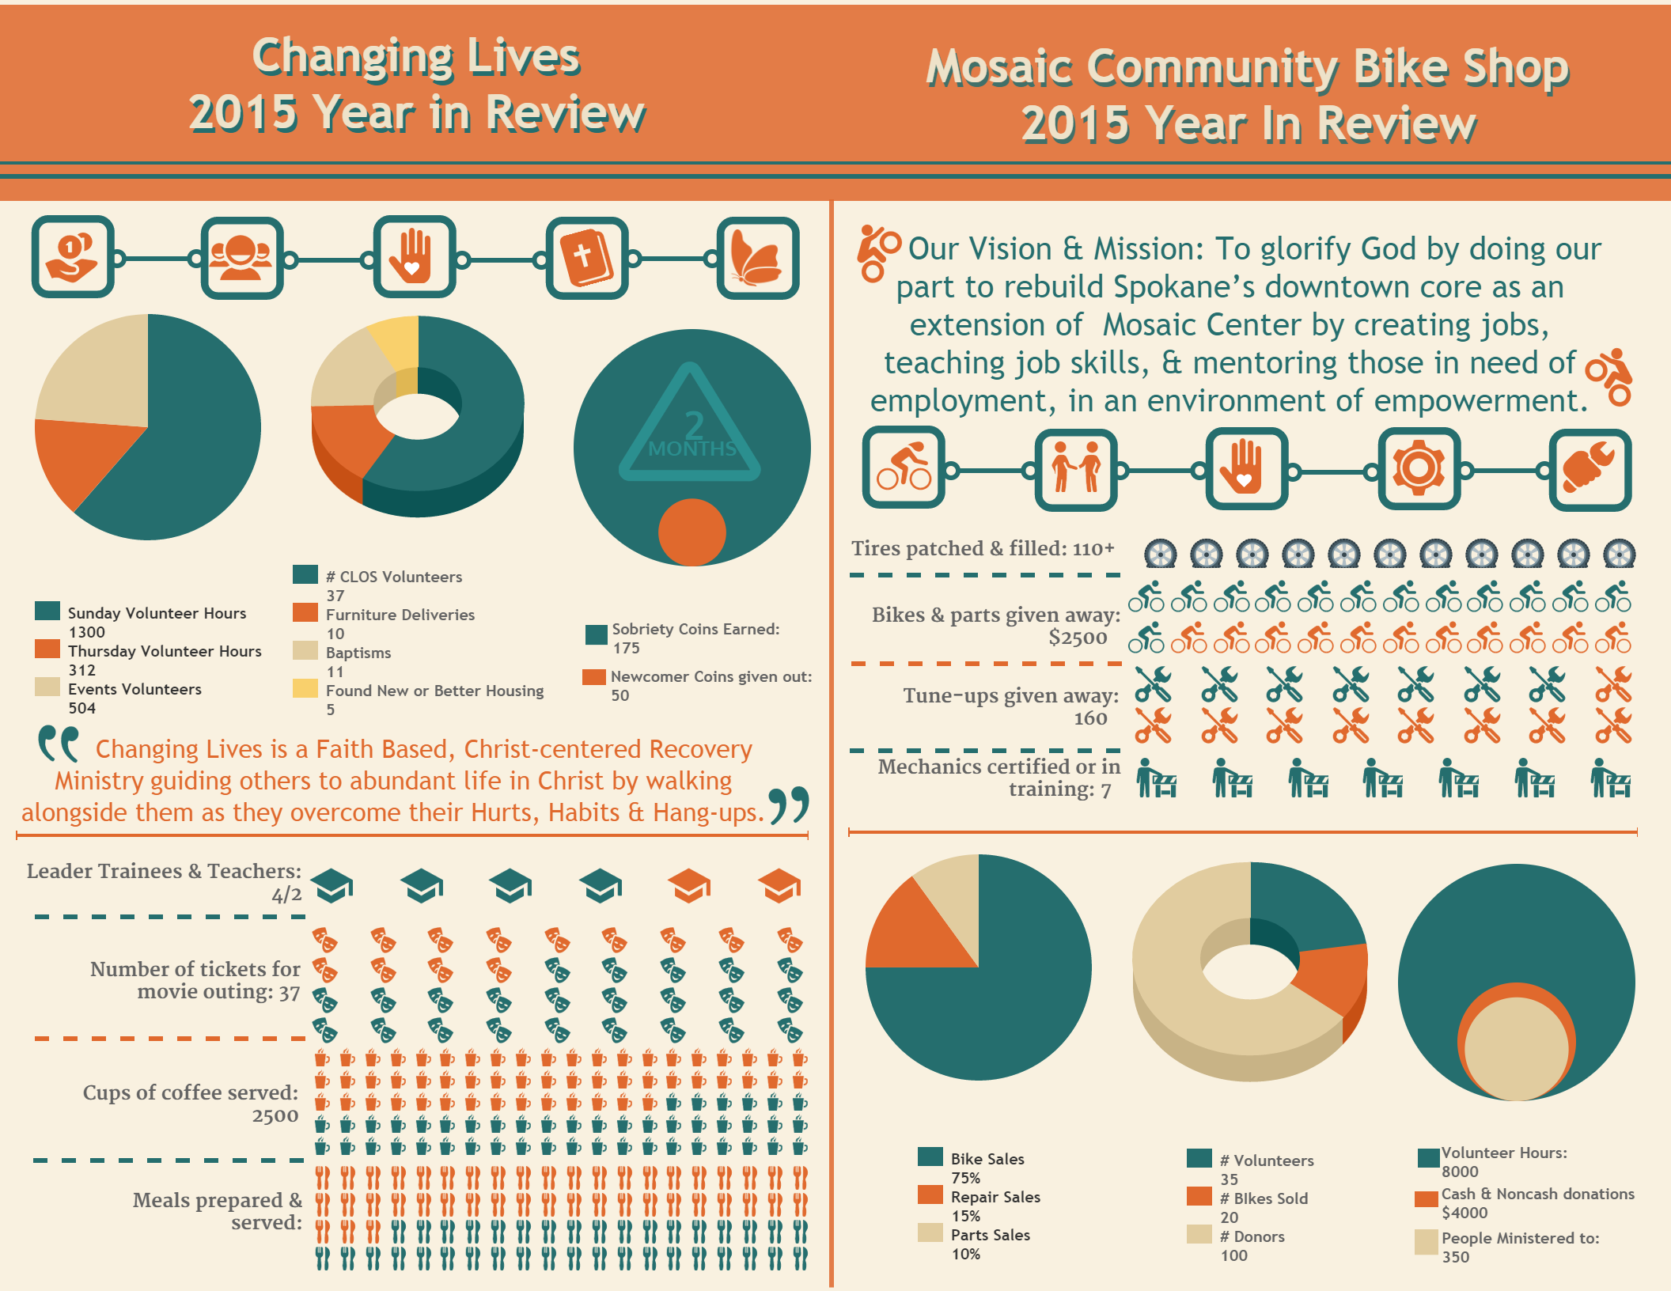

Slide 11
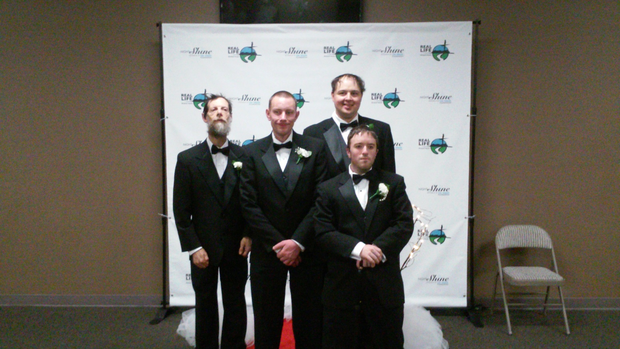
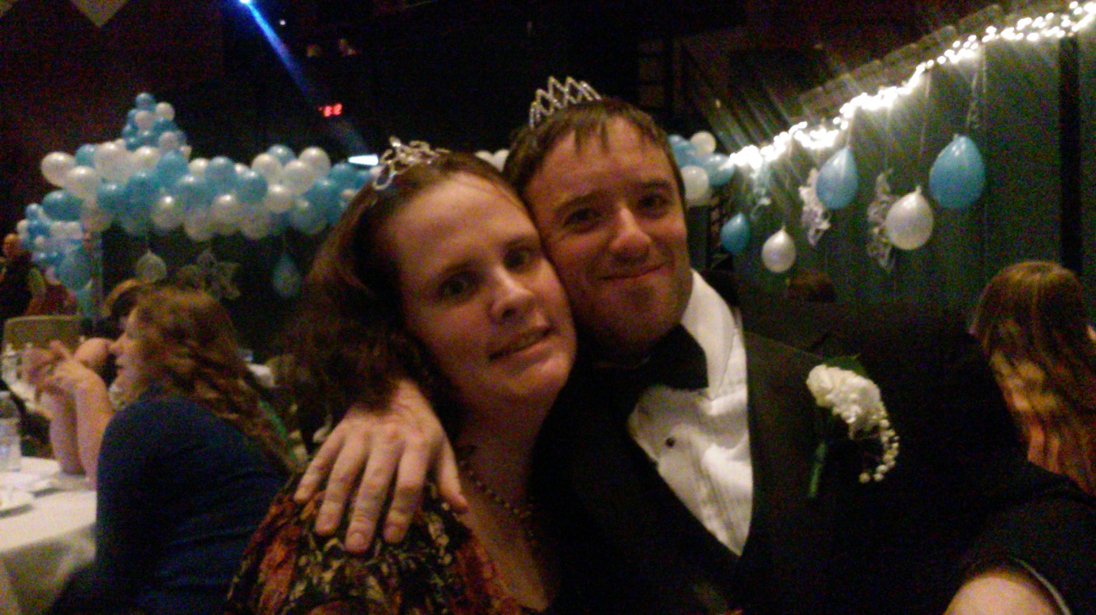
Changing Lives

Slide 12
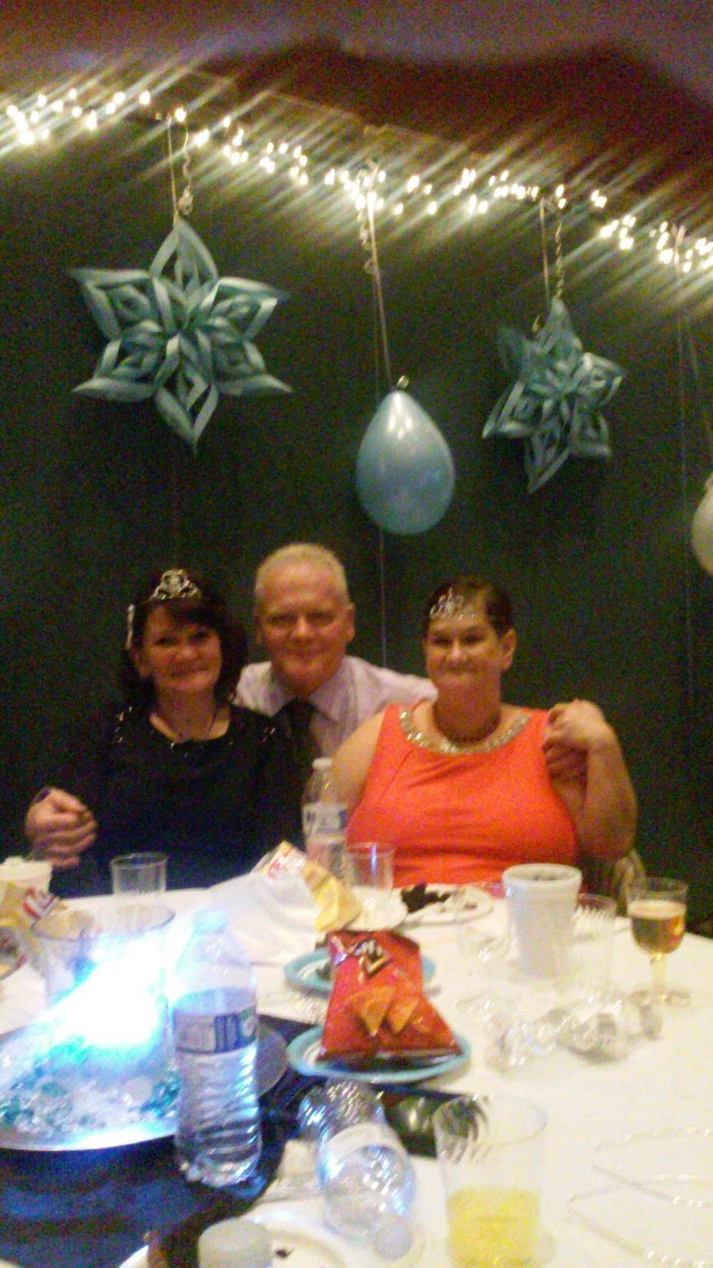
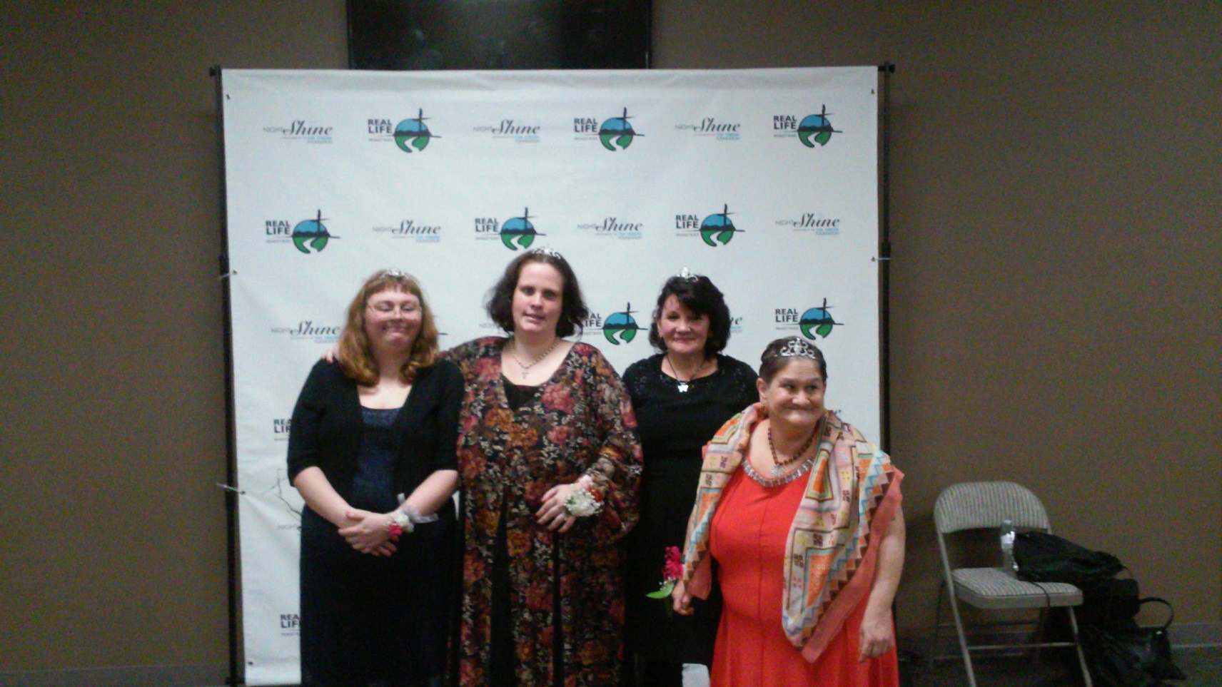
Changing Lives

Slide 13
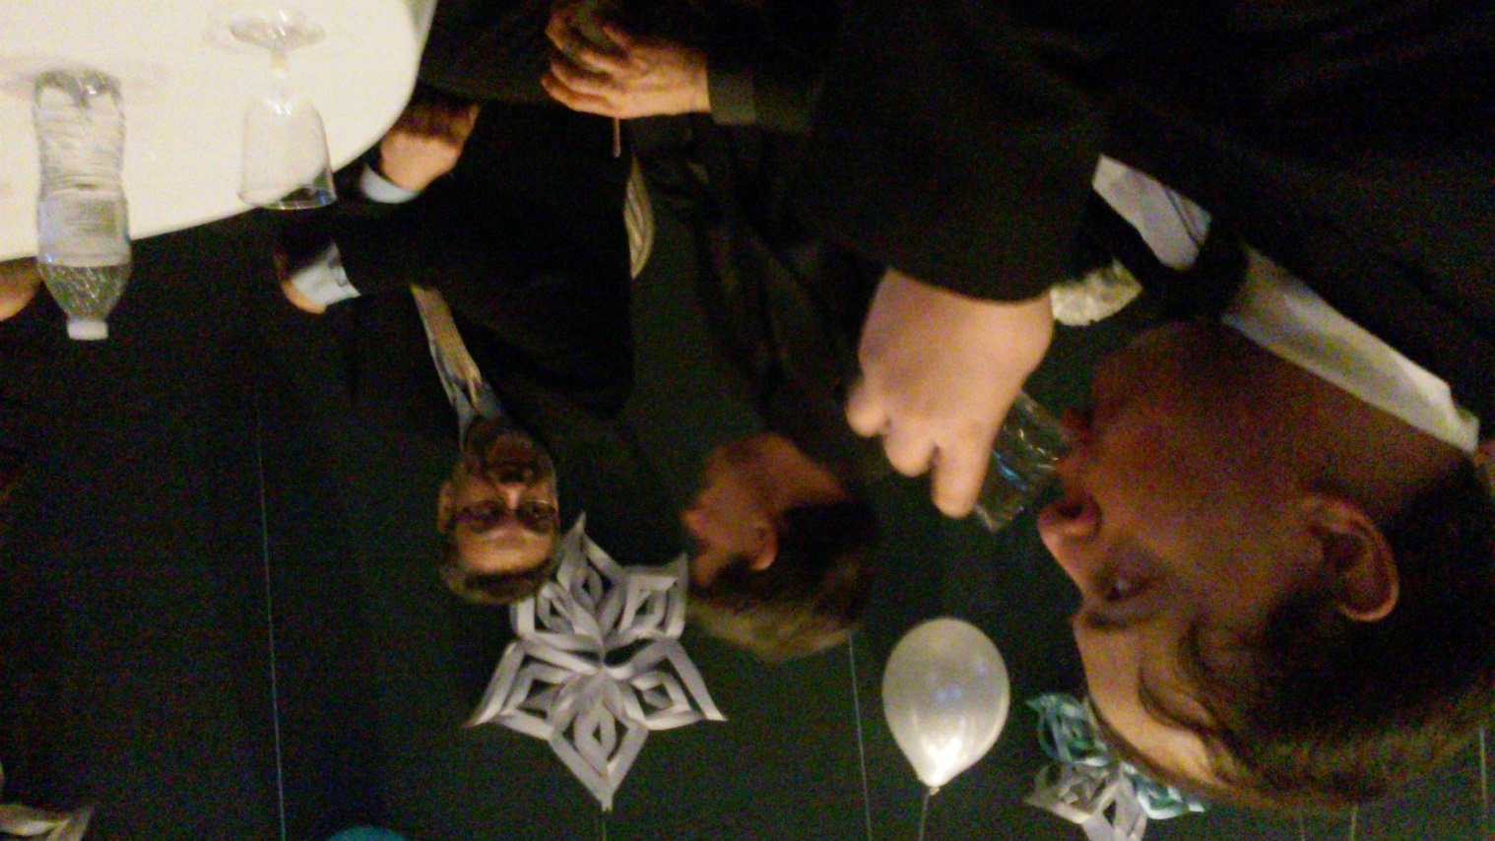
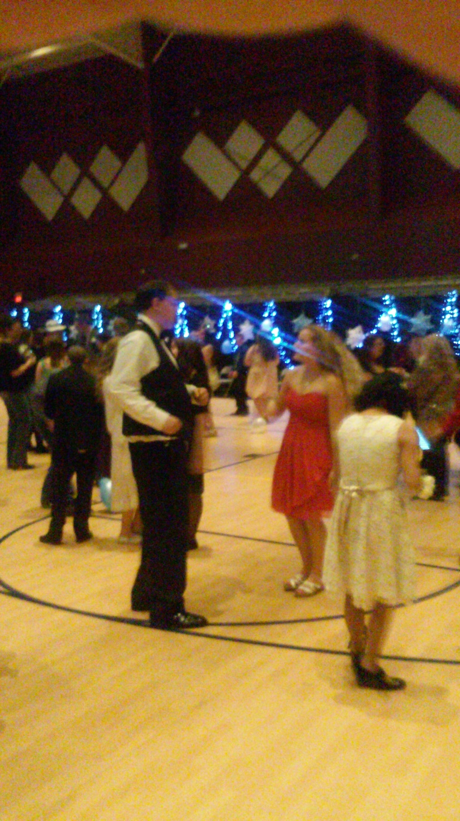
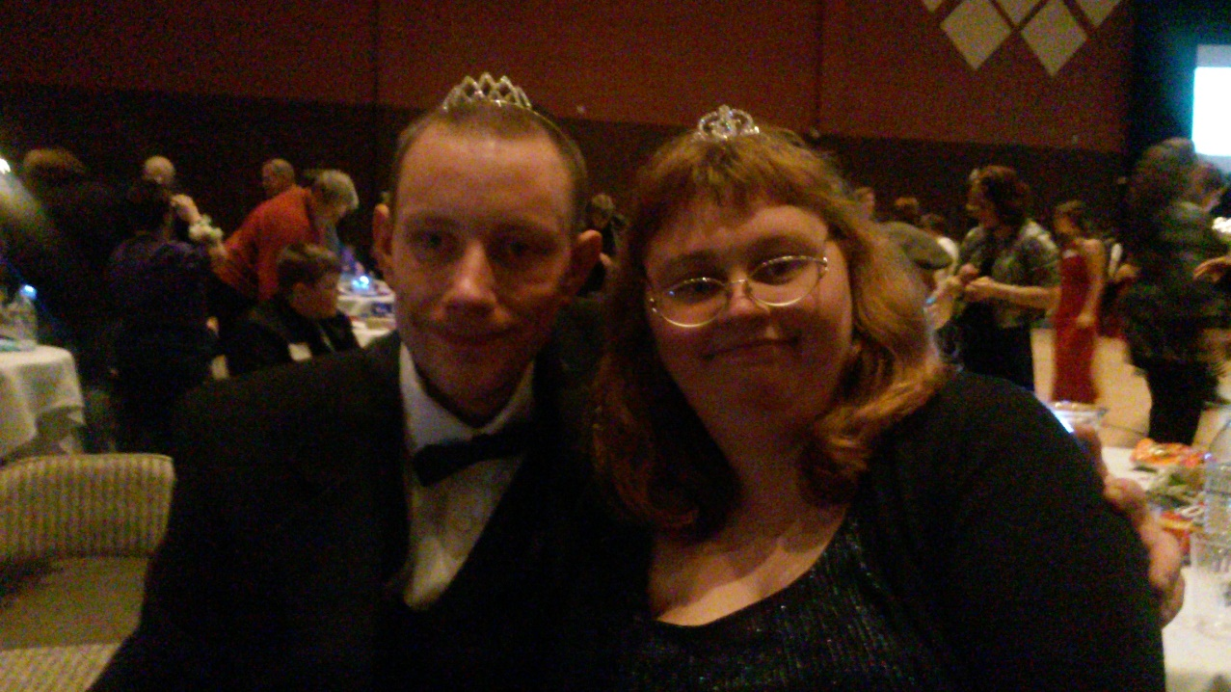
Changing Lives

Slide 14
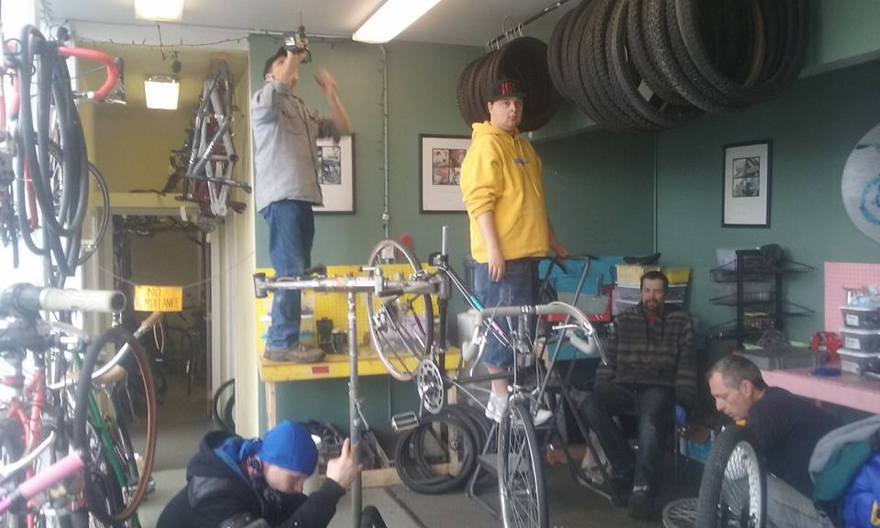
Mosaic Community Bike Shop

Slide 15
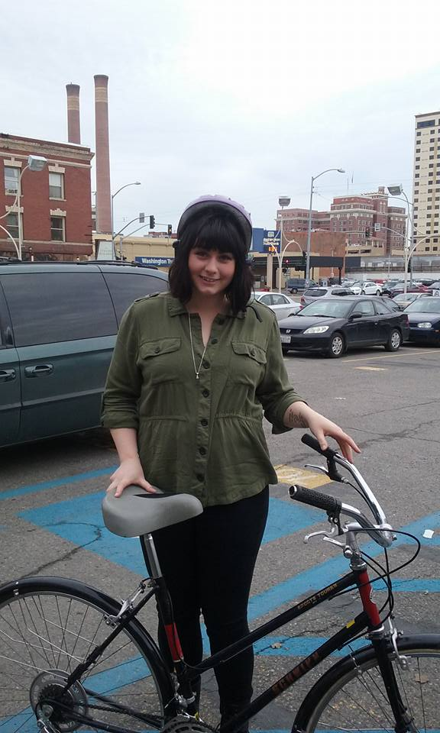
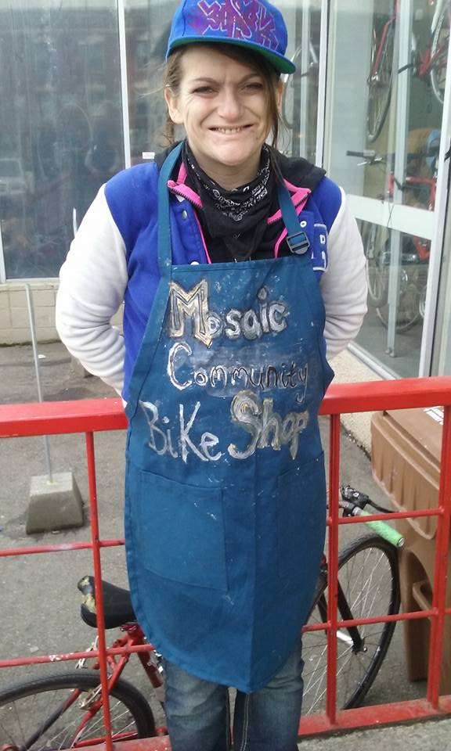
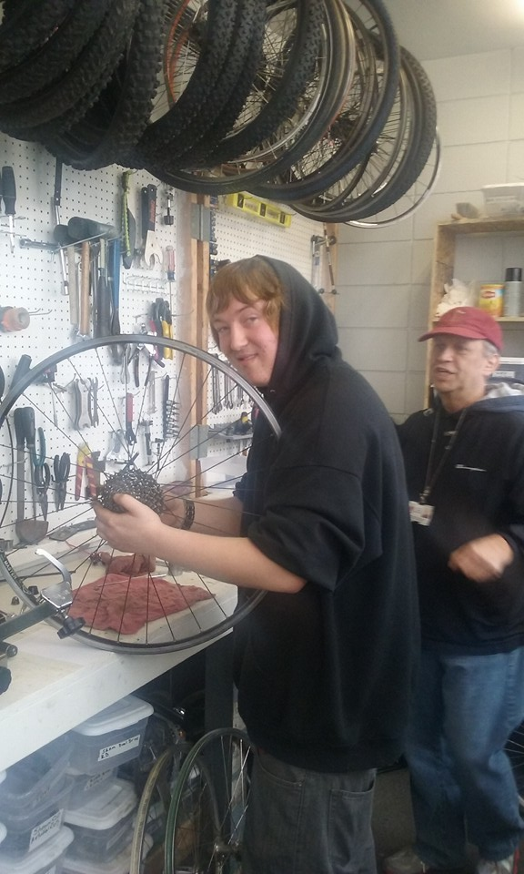

Slide 16
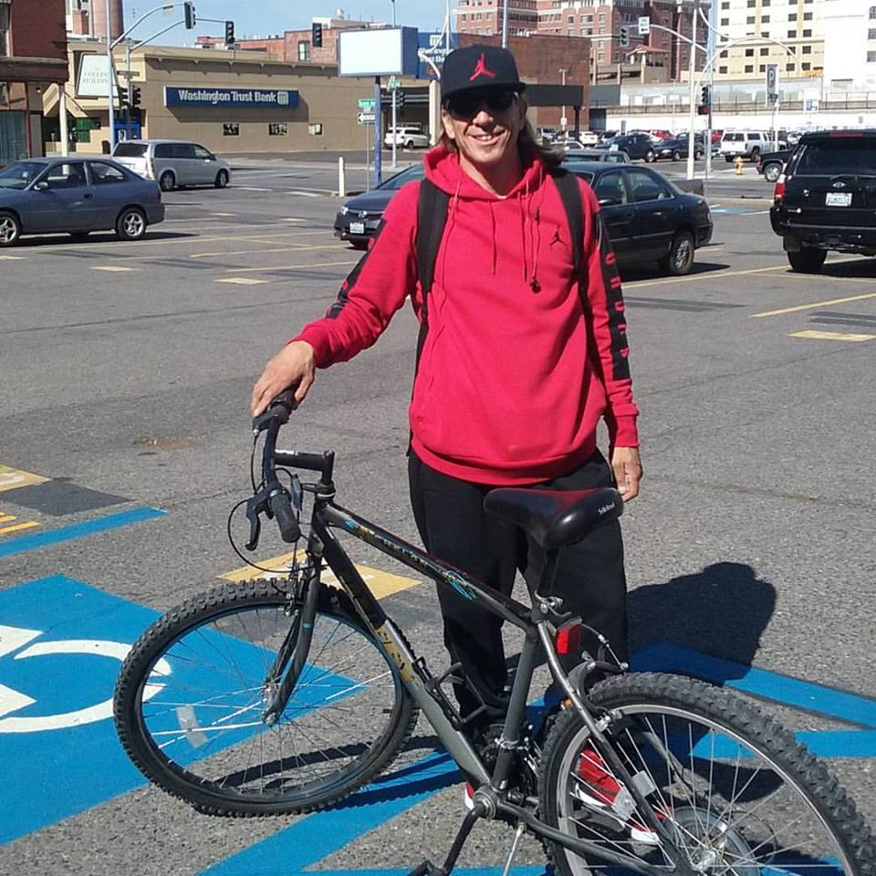
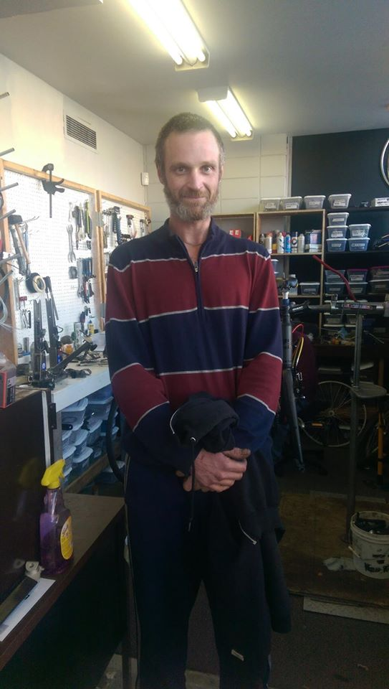
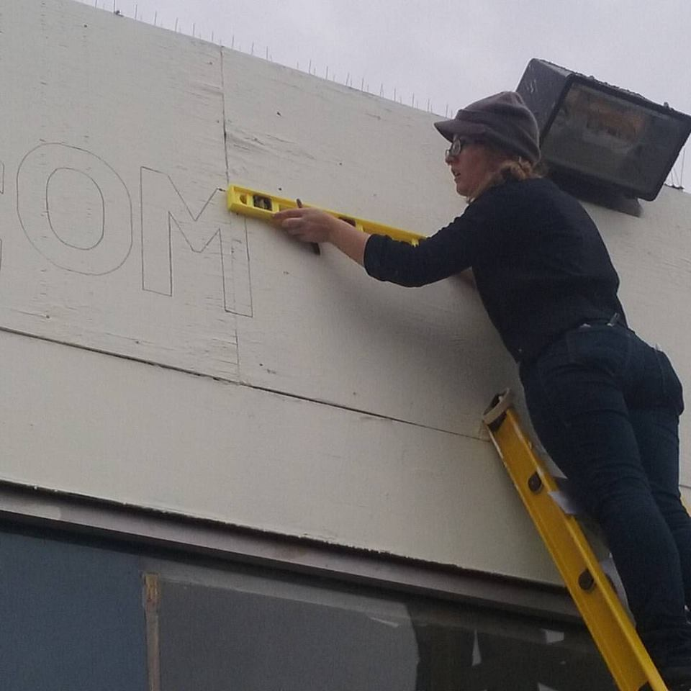

Slide 17
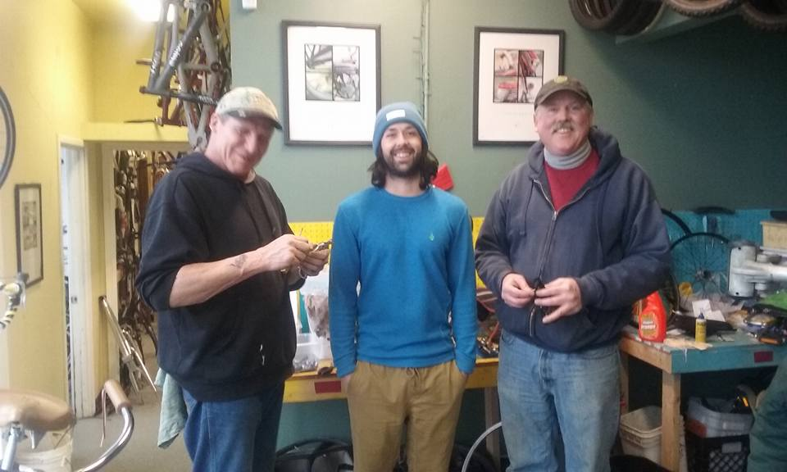
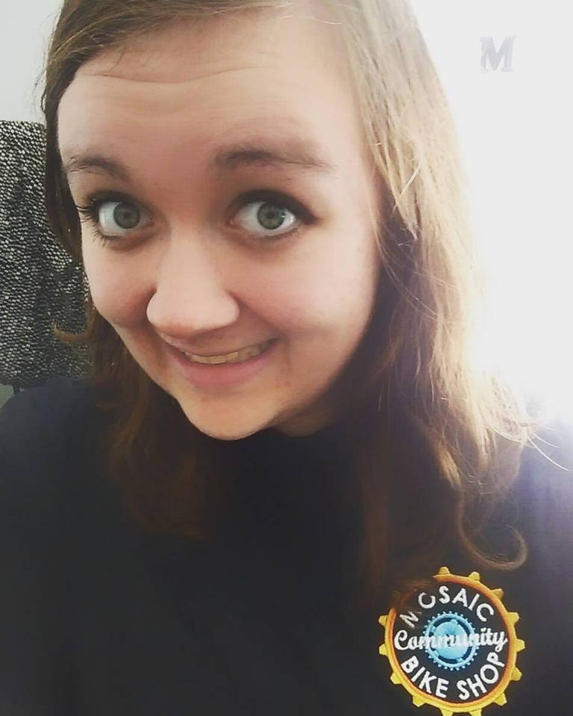
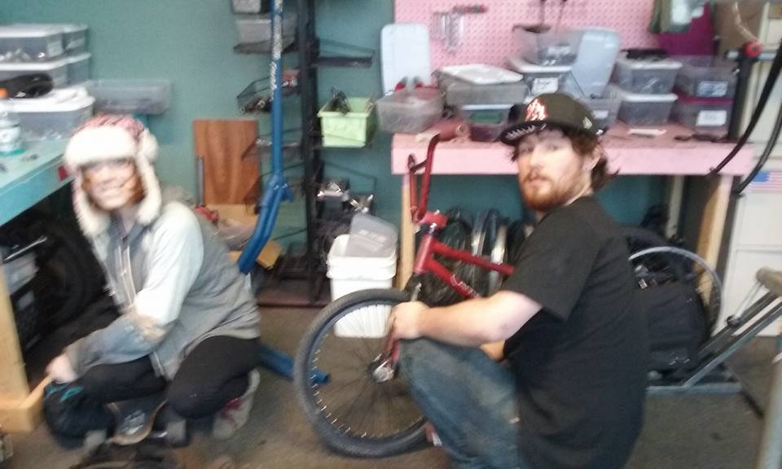

Slide 19
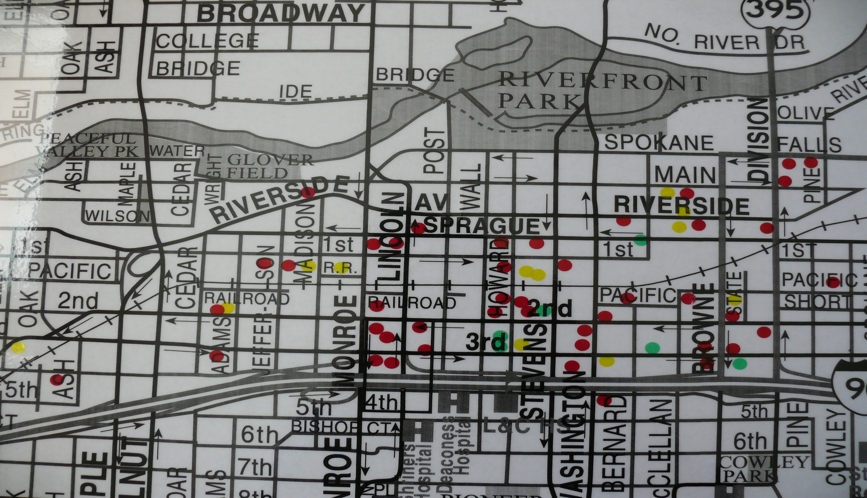

Slide 21
So what’s ahead?

Slide 22
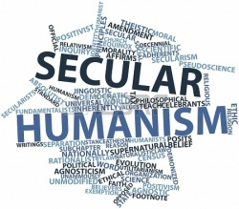
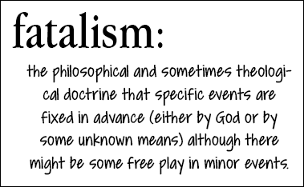

Slide 24
I Chronicles 28:1-12
¹ David summoned all the officials of Israel to assemble at Jerusalem.
² King David rose to his feet and said: “Listen to me, my fellow Israelites, my people. I had it in my heart to build a house as a place of rest for the ark of the covenant of the Lord, for the footstool of our God, and I made plans to build it.³ But God said to me, ‘You are not to build a house for my Name, because you are a warrior and have shed blood.

Slide 25
I Chronicles 28:1-12⁶ He said to me: ‘Solomon your son is the one who will build my house and my courts, for I have chosen him to be my son, and I will be his father. ⁷ I will establish his kingdom forever if he is unswerving in carrying out my commands and laws, as is being done at this time.’
⁸ “So now I charge you in the sight of all Israel and of the assembly of the Lord, and in the hearing of our God: Be careful to follow all the commands of the Lord your God, that you may possess this good land and pass it on as an inheritance to your descendants forever.

Slide 26
I Chronicles 28:1-12
⁹ “And you, my son Solomon, acknowledge the God of your father, and serve him with wholehearted devotion and with a willing mind, for the Lord searches every heart and understands every desire and every thought. If you seek him, he will be found by you; but if you forsake him, he will reject you forever.¹⁰ Consider now, for the Lord has chosen you to build a house as the sanctuary. Be strong and do the work.”

Slide 27
I Chronicles 28:1-12
¹¹ Then David gave his son Solomon the plans for the portico of the temple, its buildings, its storerooms, its upper parts, its inner rooms and the place of atonement. ¹² He gave him the plans of all that the Spirit had put in his mind for the courts of the temple of the Lord and all the surrounding rooms, for the treasuries of the temple of God and for the treasuries for the dedicated things.

Slide 28
Psalm 20:4-- May [the LORD] give you the desire of your heart and make all your plans succeed.
Proverbs 16:3,4-- Commit to the Lord whatever you do, and he will establish your plans.
⁴ The Lord works out everything to its proper end— even the wicked for a day of disaster.
Proverbs 16:9-- In their hearts humans plan their course, but the Lord establishes their steps.

Slide 29
Isaiah 32:5-8
5 No longer will the fool be called noble nor the scoundrel be highly respected. 6 For fools speak folly, their hearts are bent on evil: They practice ungodliness and spread error concerning the Lord; the hungry they leave empty and from the thirsty they withhold water.

Slide 30
Isaiah 32:5-8
7 Scoundrels use wicked methods, they make up evil schemes to destroy the poor with lies, even when the plea of the needy is just. 8 But the noble make noble plans, and by noble deeds they stand.

Slide 31
Jeremiah 29:11-13
“11) For I know the plans I have for you,” declares the Lord, “plans to prosper you and not to harm you, plans to give you hope and a future.12) Then you will call on me and come and pray to me, and I will listen to you.13) You will seek me and find me when you seek me with all your heart.”

Slide 32
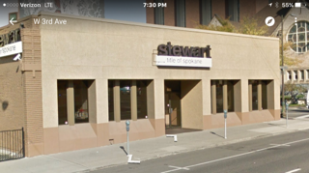
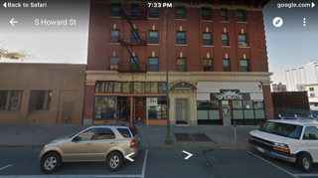
#1. If the Lord wills…we will acquire property and the use of property in the heart of our city that enables us to move forward with multiple ministries that impact our city for Christ.

Slide 33
#2. If the Lord wills…we will continue to reach into our community with the Gospel of Jesus Christ through strategic ministries, partnerships and businesses.

Slide 34
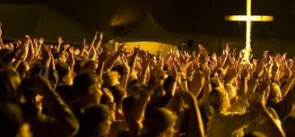
#3. If the Lord wills…we will seek to significantly strengthen the experience of spiritual community and shared growth in Jesus Christ in Mosaic.

Slide 35
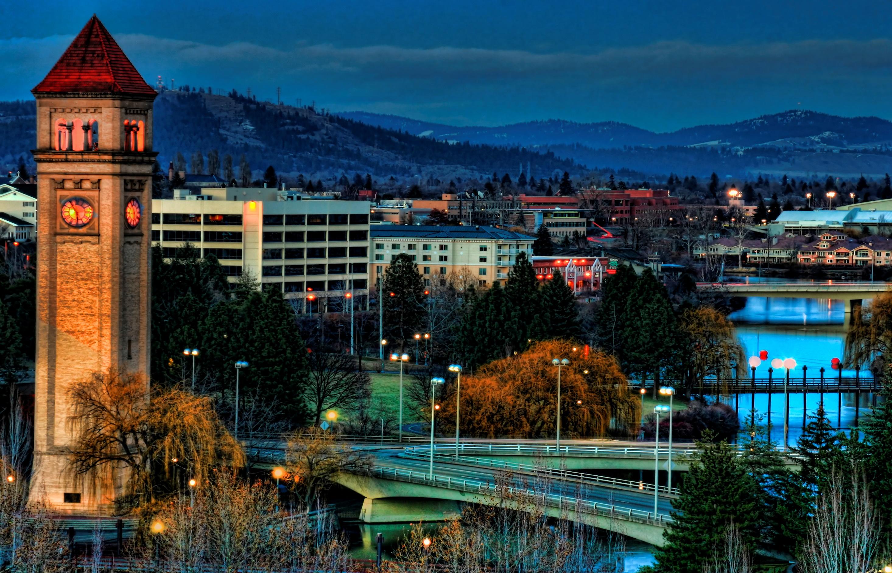
QUESTIONS?

Slide 36
So what is God calling you to do?
What “noble deeds” will you engage in to see these “noble plans” come into existence?
What is your NEXT STEP in “experiencing the heart of God in the heart of our city?”

