Slide 2
A strong, regular, repeated pattern of movement or sound.

Slide 3
Movement, change, or variation marked by the regular recurrence of related elements.

Slide 5
Important Truths from God
about Resolutions
Making plans is a godly, God-like activity. Seeing them fulfilled is a gracious human-divine partnership.
Jeremiah 29:11—For I know the plans I have for you,” declares the Lord, “plans to prosper you and not to harm you, plans to give you hope and a future.

Slide 6
Making plans is a godly, God-like activity. Seeing them fulfilled is a gracious human-divine partnership.
Psalms 20:4—“May he give you the desire of your heart and make all your plans succeed.”
Isaiah 26:12—Lord, you establish peace for us; all that we
have accomplished you have done for us.
1 Corinthians 15:10— But by the grace of God I am what I am, and his grace to me was not without effect. No, I worked harder than all of them—yet not I, but the grace of God that was with me.

Slide 7
All plans for Christ-followers must be dependent upon God’s grace and will.
James 4:13-15—Now listen, you who say, “Today or tomorrow we will go to this or that city, spend a year there, carry on business and make money.” ¹⁴ Why, you do not even know what will happen tomorrow. What is your life? You are a mist that appears for a little while and then vanishes. ¹⁵ Instead, you ought to say, “If it is the Lord’s will, we will live and do this or that.”

Slide 8
All plans for Christ-followers must be dependent upon God’s grace and will.
Prov. 16:3-4—Commit to the Lord whatever you do and he will establish your plans. ⁴ The Lord works out everything to its proper end—even the wicked for a day of disaster.

Slide 9
Plans should be led of the Holy Spirit.
1 Chronicles 28:11-12—Then David gave his son Solomon the plans for the portico of the temple, its buildings, its storerooms, its upper parts, its inner rooms and the place of atonement. ¹² He gave him the plans of all that the Spirit had put in his mind for the courts of the temple of the Lord and all the surrounding rooms, for the treasuries of the temple of God and for the treasuries for the dedicated things.

Slide 10
Plans will either be evil or good. They reflect our moral and spiritual character.
Proverbs 12:5—The plans of the righteous are just, but the advice of the wicked is deceitful.
Isaiah 32:8—But the noble make noble plans, and by noble deeds they stand.

Slide 11
Plans are no substitute for action; action is no substitute for planning.
Proverbs 21:5—The plans of the diligent lead to profit as surely as haste leads to poverty.

Slide 12
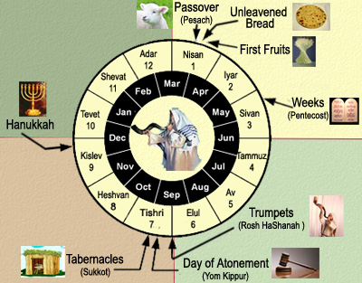

Slide 13
PRACTICAL STEPS to EXPERIENCING FRUITFUL RESOLUTIONS
INVITE God to guide your planning.

Slide 14
PRACTICAL STEPS to EXPERIENCING FRUITFUL RESOLUTIONS
INVITE God to guide your planning.
Take 30 seconds of silence before God.
Take 30 seconds of surrender (your frustrations, fears, concerns, disappointments, hopes, dreams, etc.)

Slide 15
PRACTICAL STEPS to EXPERIENCING FRUITFUL RESOLUTIONS
IDENTIFY the important areas of your life where making plans will help you experience greater blessing with God.
Relationship with God
Friendships/fellowship
Health/body
Hobbies/fun/entertainment
Intellect/mind
Family (spouse, children, parents, grandchildren)
Career/school/work
Finances
Service/volunteering

Slide 16
PRACTICAL STEPS to EXPERIENCING FRUITFUL RESOLUTIONS
DEFINE/ENVISION/DREAM what growth would look like in each of these areas.

Slide 17
PRACTICAL STEPS to EXPERIENCING FRUITFUL RESOLUTIONS
PRIORITIZE the order in which you think God would have you tackle them.

Slide 18
PRACTICAL STEPS to EXPERIENCING FRUITFUL RESOLUTIONS
PRACTICE ACCOUNTABILITY with myself and others.
Next to the resolution, write the name of the person or group who you would like to help you.

Slide 19
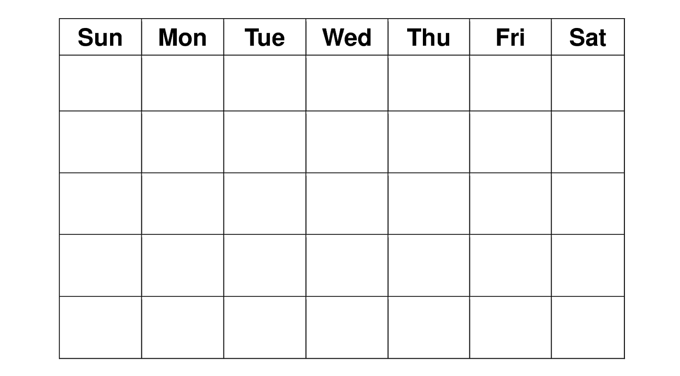
PRACTICAL STEPS to EXPERIENCING FRUITFUL RESOLUTIONS
SCHEDULE your resolutions and rhythms.

Slide 20
PRACTICAL STEPS to EXPERIENCING FRUITFUL RESOLUTIONS
REVIEW & ADJUST

Slide 21
1 Timothy 4:7-10
⁷ Have nothing to do with godless myths and old wives’ tales; rather, train yourself to be godly. ⁸ For physical training is of some value, but godliness has value for all things, holding promise for both the present life and the life to come. ⁹ This is a trustworthy saying that deserves full acceptance. ¹⁰ That is why we labor and strive, because we have put our hope in the living God, who is the Savior of all people, and especially of those who believe.

Slide 22
Hebrews 5:14—But solid food is for the mature, for those who have their powers of discernment trained by constant practice to distinguish good from evil.
Hebrews 12:11—For the moment all discipline seems painful rather than pleasant, but later it yields the peaceful fruit of righteousness to those who have been trained by it.

