Slide 1
Romans 1:16
“For I am not ashamed of the gospel, because it is the power of God that brings salvation to everyone who believes….”

Slide 2
What did the Holy Spirit say to me?
What is God asking me to do with/about that?
How can I help you do that?

Slide 3
Gospel Power… & Your Past

Slide 6
Revelation 20:12
“The dead were judged according to what they had done as recorded in the books.”

Slide 7
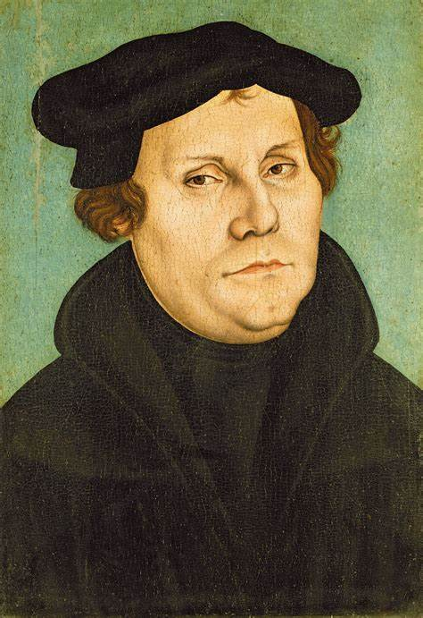
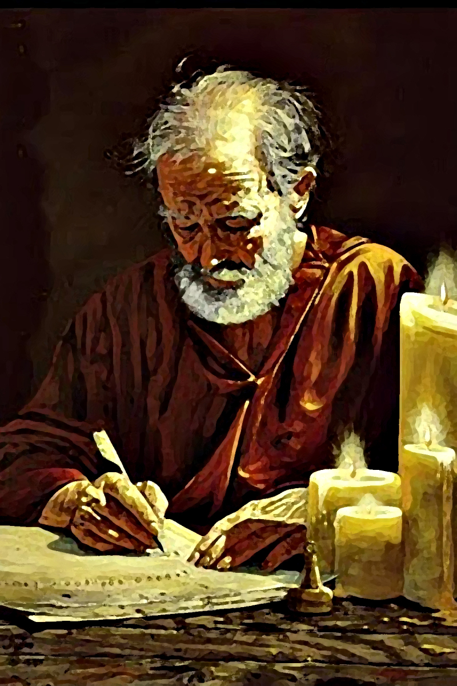
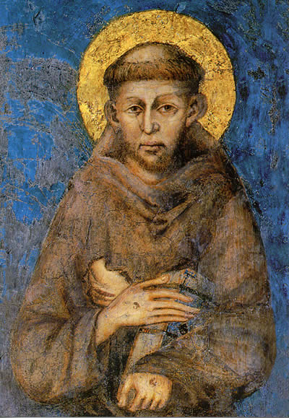
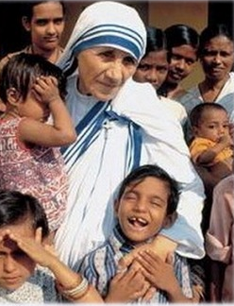
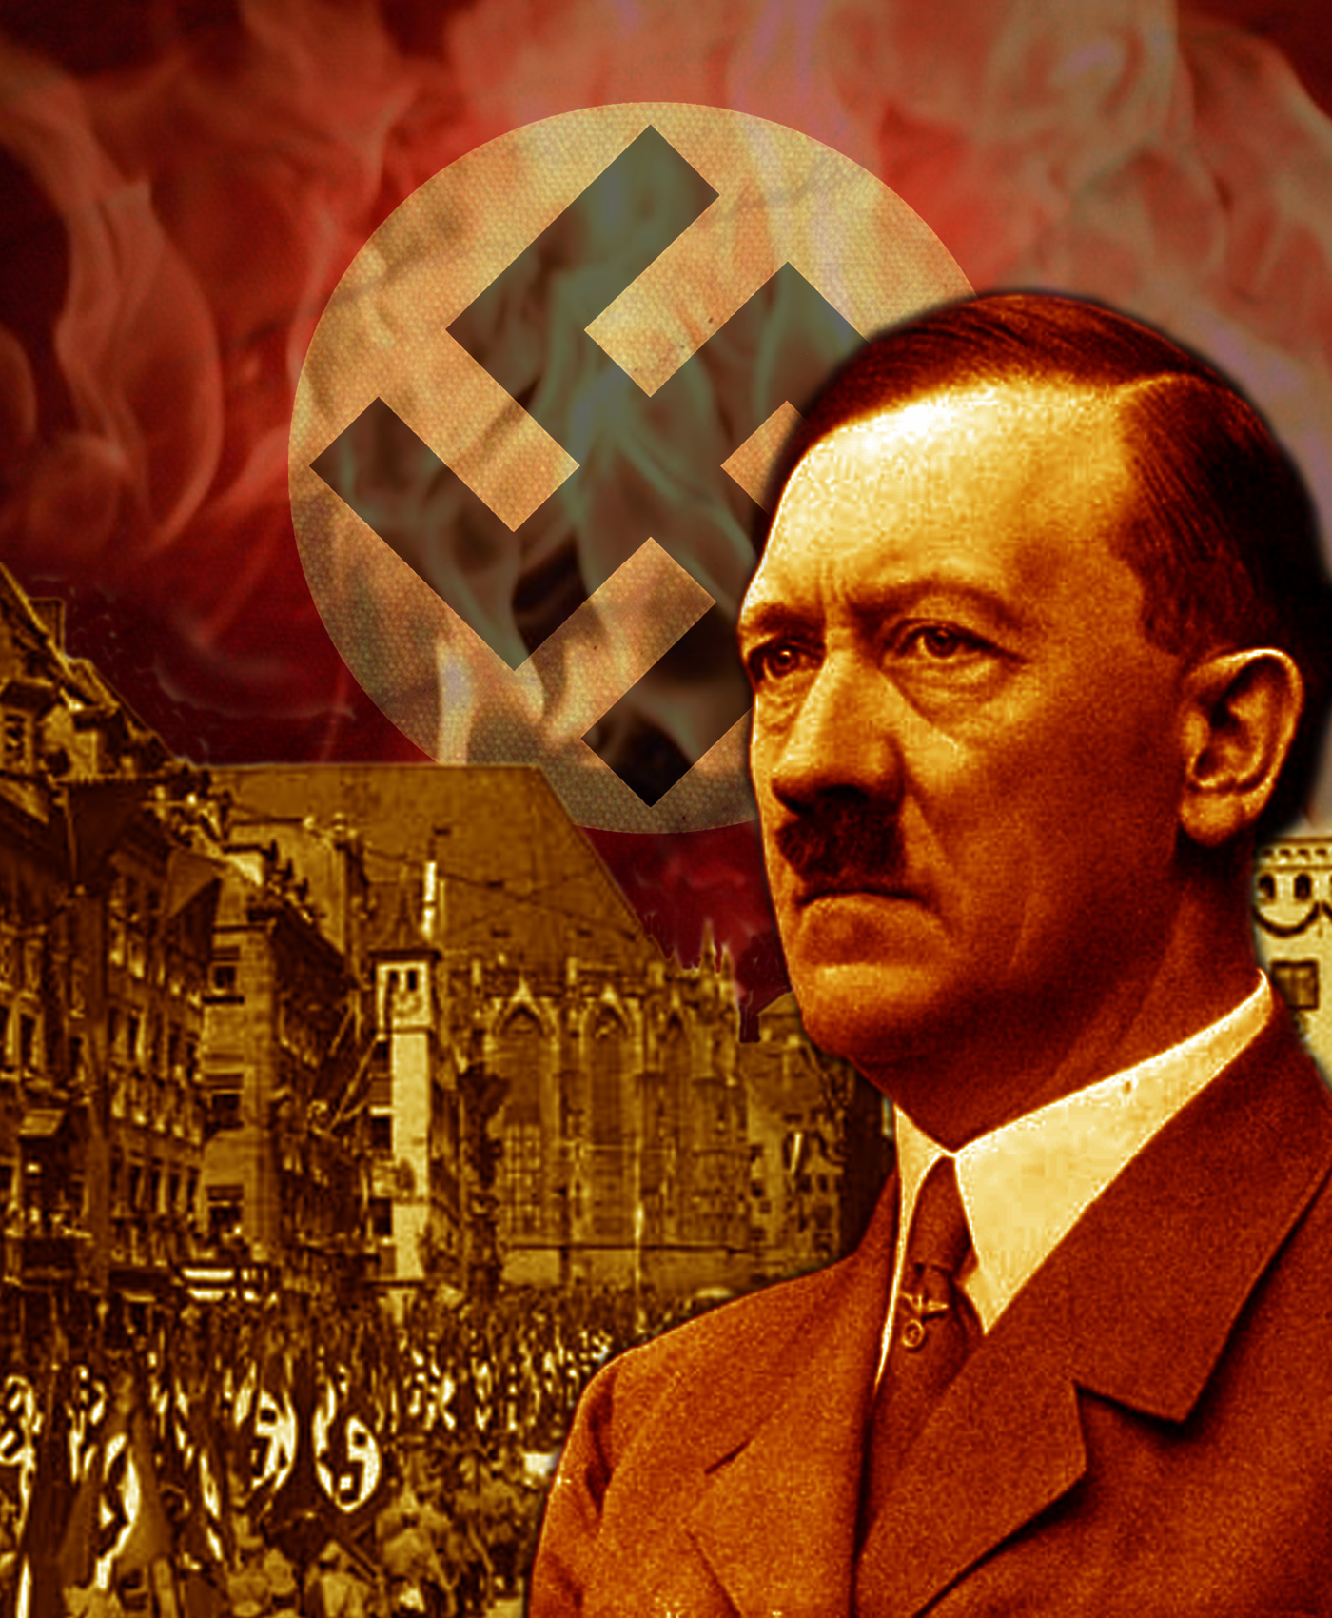
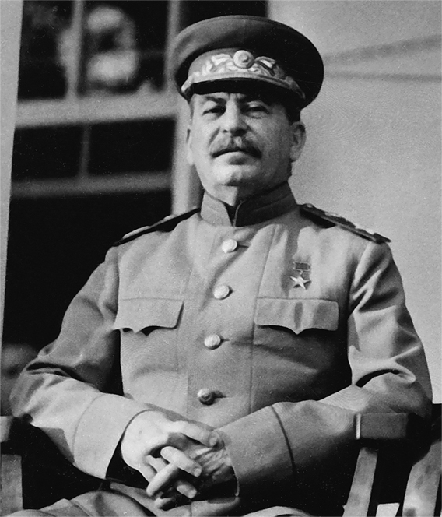
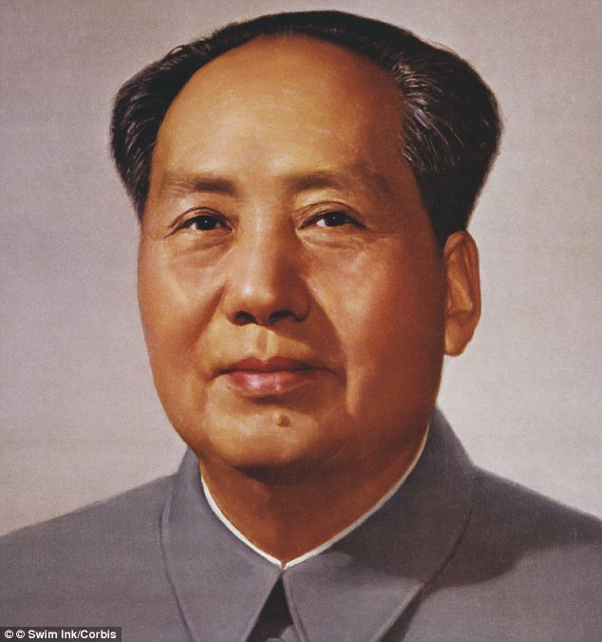
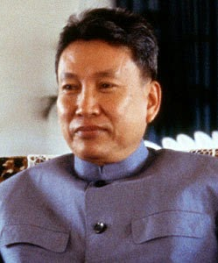
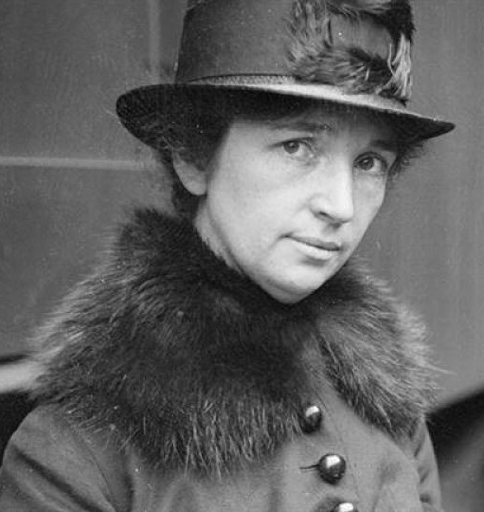
GOOD
YOU?
EVIL

Slide 8
Romans 3:9-10, 20
⁹ For we have already made the charge that Jews and Gentiles alike are all under the power of sin. ¹⁰ As it is written: “There is no one righteous, not even one….”
²⁰ Therefore no one will be declared righteous in God’s sight by the works of the law; rather, through the law we become conscious of our sin.

Slide 10
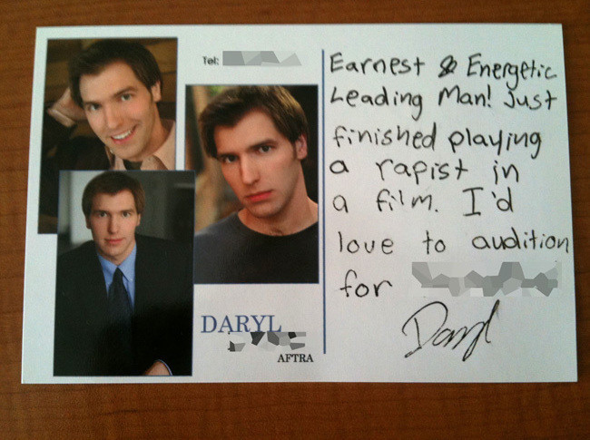

Slide 11
ROMANS 3
²² This righteousness is given through faith in Jesus Christ to all who believe.
There is no difference between Jew and Gentile, ²³ for all have sinned and fall short of the glory of God, ²⁴ and all are justified freely by his grace through the redemption that came by Christ Jesus.

Slide 12
ROMANS 3
²⁵ God presented Christ as a sacrifice of atonement, through the shedding of his blood—to be received by faith. He did this to demonstrate his righteousness, because in his forbearance he had left the sins committed beforehand unpunished—

Slide 13
ROMANS 3
²⁶ he did it to demonstrate his righteousness at the present time, so as to be just and the one who justifies those who have faith in Jesus.

Slide 14
ROMANS 3
²² This righteousness is given through faith in Jesus Christ to all who believe. There is no difference between Jew and Gentile, ²³ for all have sinned and fall short of the glory of God, ²⁴ and all are justified freely by his grace
through the redemption that came by Christ Jesus. ²⁵ God presented Christ as a sacrifice of atonement, through the shedding of his blood—to be received by faith. He did this to demonstrate his righteousness, because in his forbearance he had left the sins committed beforehand unpunished— ²⁶ he did it to demonstrate his righteousness at the present time, so as to be just and the one who justifies those who have faith in Jesus.

Slide 15
The message of Christianity is that
we are more sinful
than we ever realized,
BUT we are more loved
and accepted
than we ever could have imagined in Jesus Christ.

Slide 16
The Bad News: I am so sinful that Jesus had to die for me.
The Good News: I am so loved that Jesus chose to die for me.

Slide 17
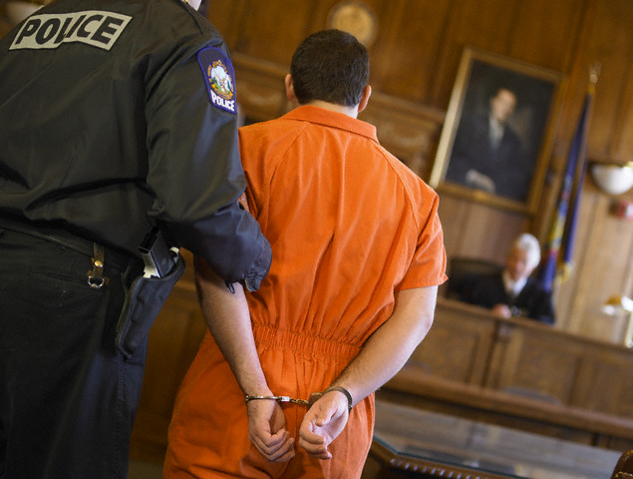

Slide 18
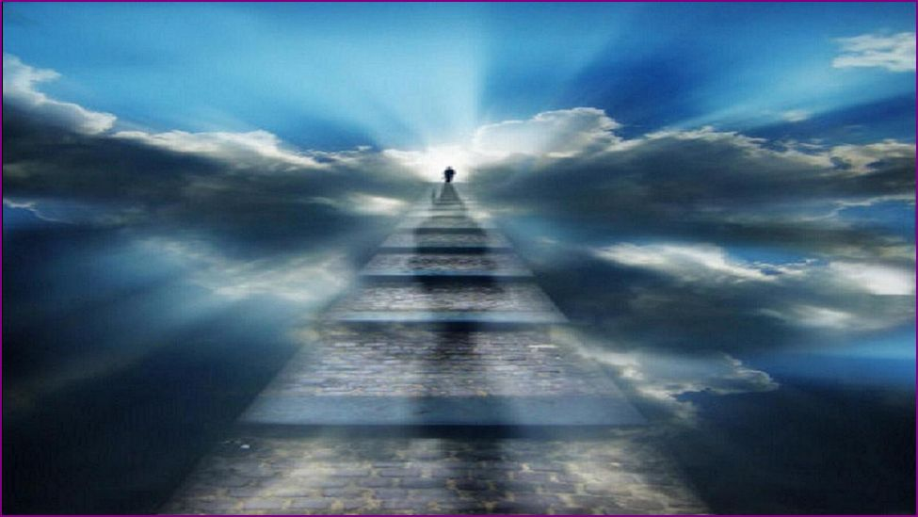

Slide 19
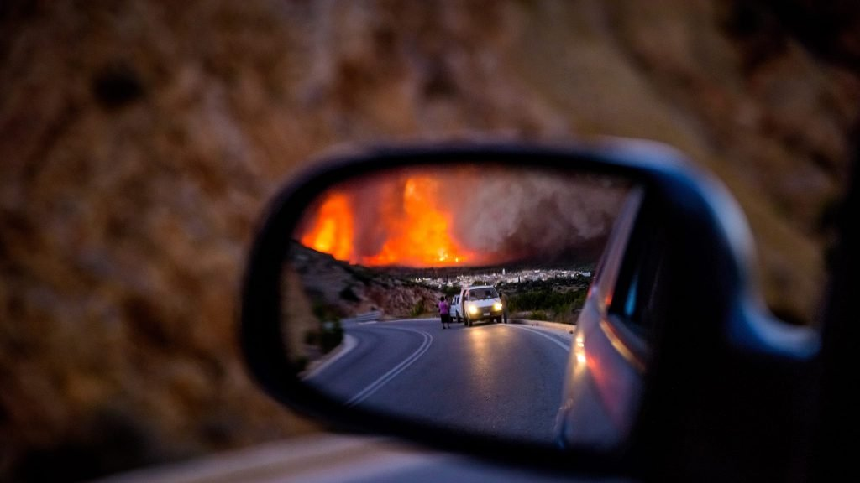
What difference does the Gospel make
to our past?

Slide 20
The Gospel replaces our past with…

Slide 21
The Gospel replaces our past with… JESUS CHRIST.

