Slide 1
Share one of your most recent joys in life…something that happened in your day or week that brought JOY to you in some small or big way.
Really living!

Slide 3
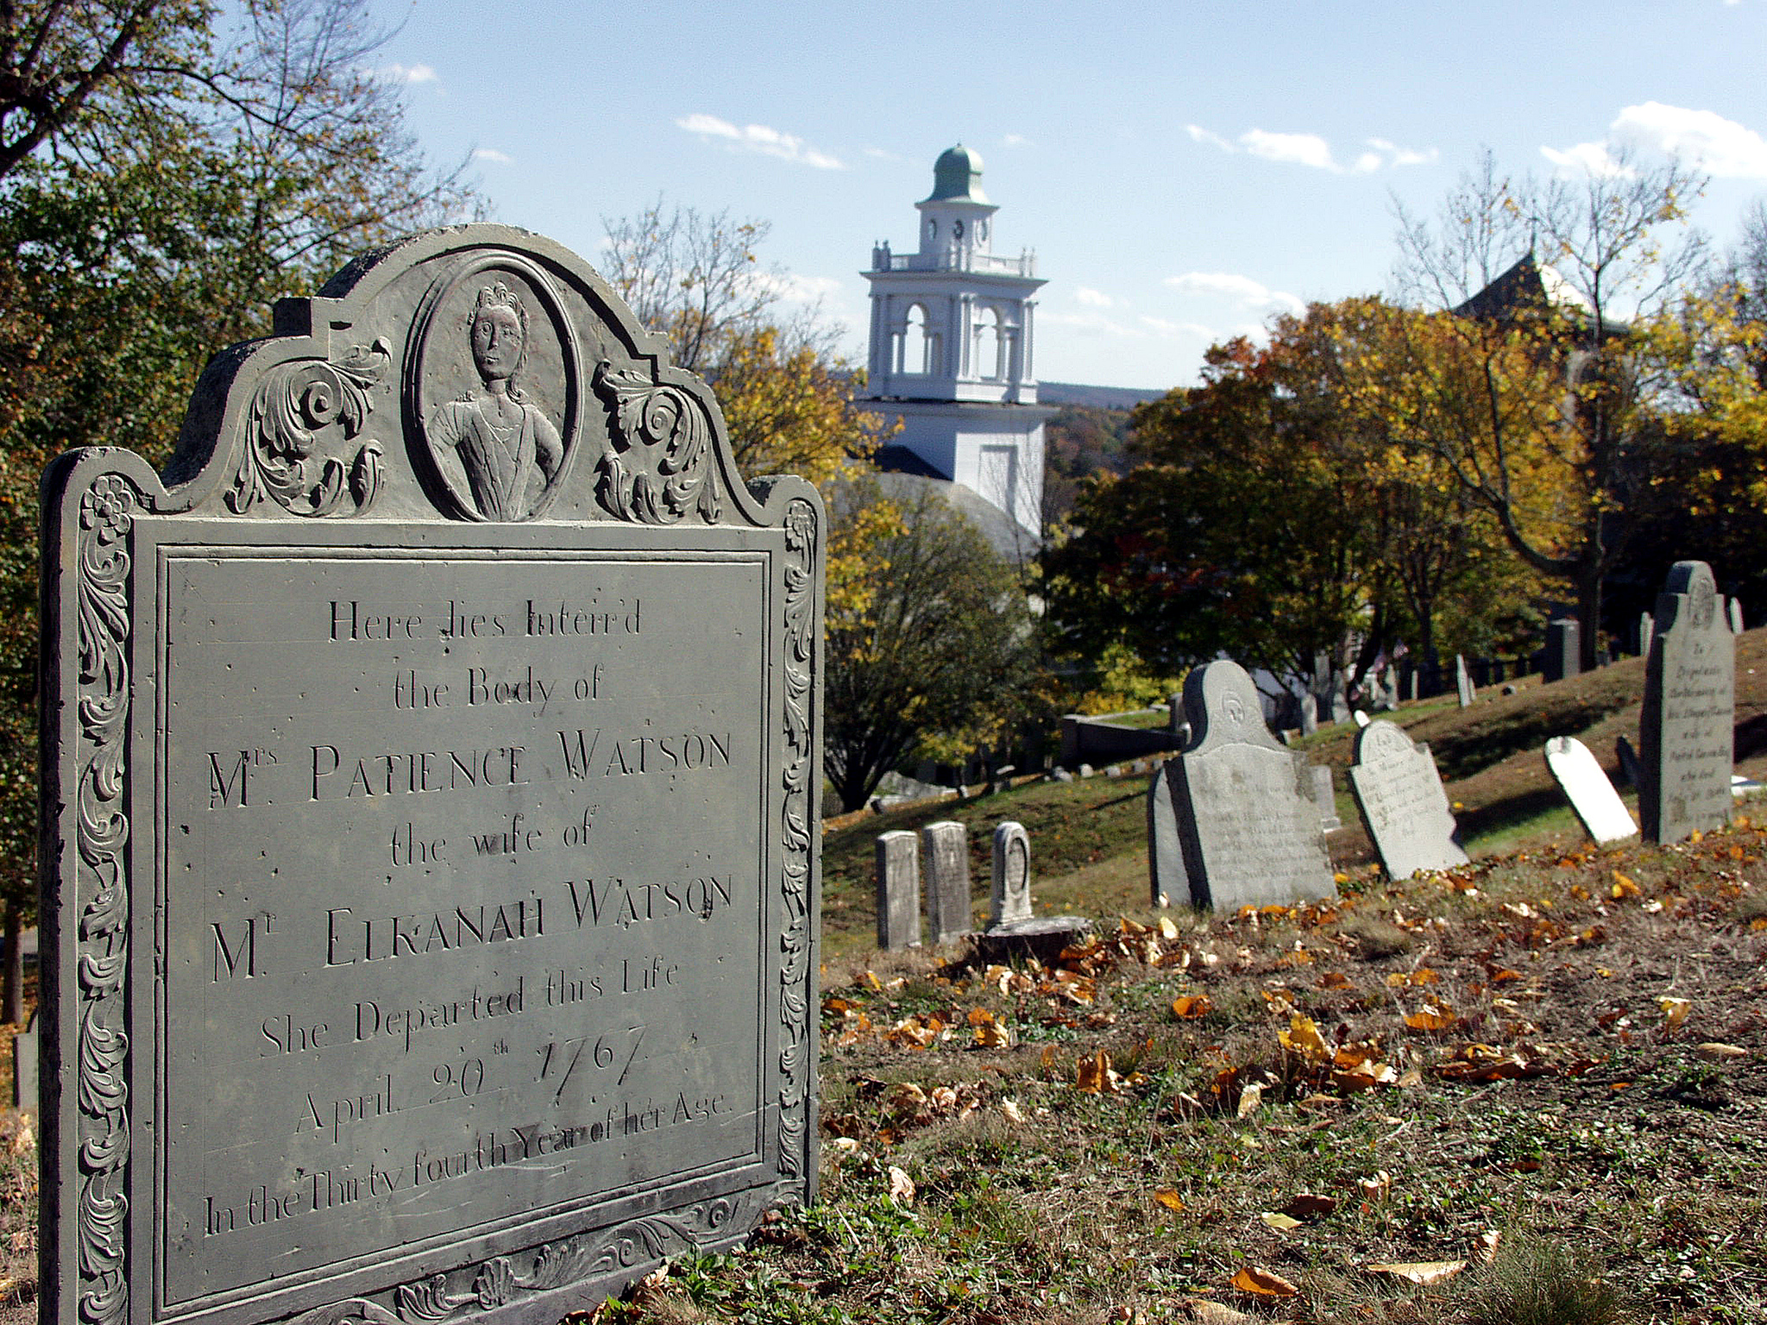

Slide 4
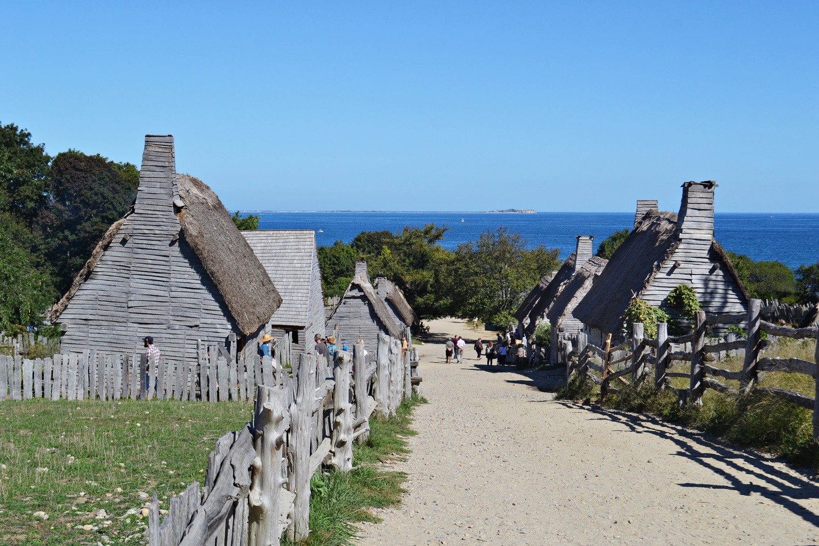

Slide 5
PHILIPPIANS 1:19-26

Slide 6
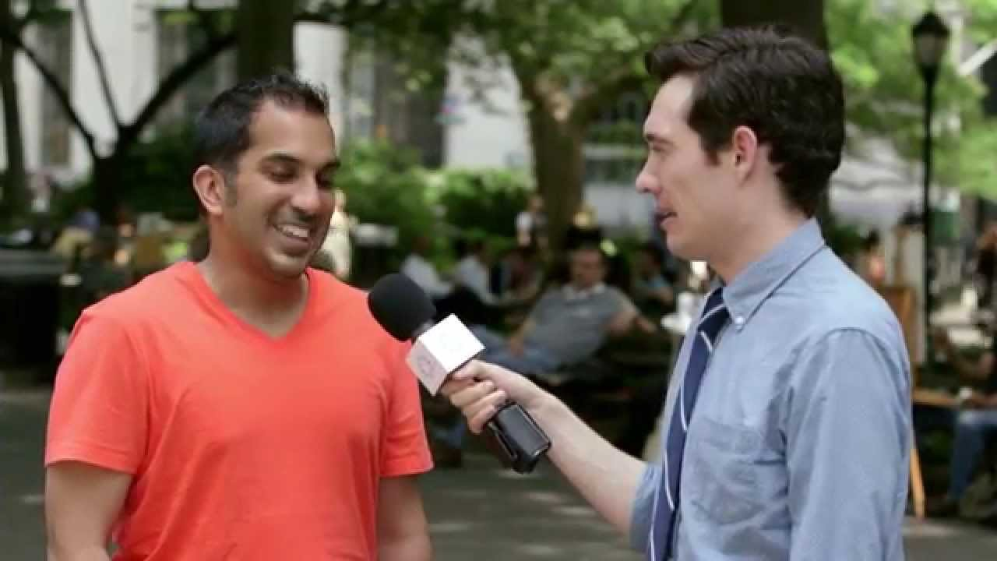
When is life really good?

Slide 7
1.) Enduring joy comes from seeing the life-changing power of the Gospel advanced…everywhere.

Slide 8
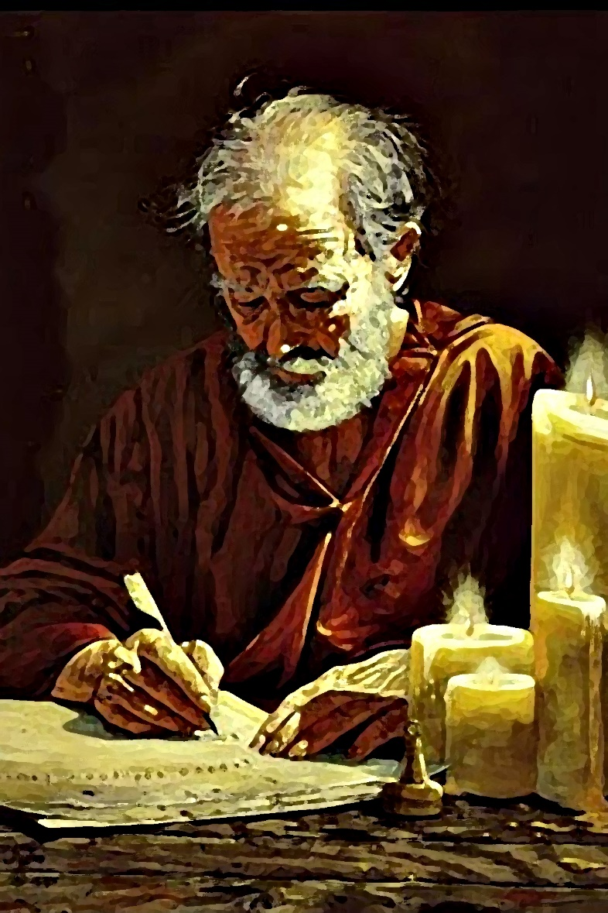
Philippians 1:
¹⁵It is true that some preach Christ out of envy and rivalry, but others out of goodwill.
¹⁶The latter do so out of love, knowing that I am put here for the defense of the gospel.
¹⁷The former preach Christ out of selfish ambition, not sincerely, supposing that they can stir up trouble for me while I am in chains. ¹⁸But what does it matter? The important thing is that in every way, whether from false motives or true, Christ is
preached. And because of this I rejoice.

Slide 9
What am I doing consistently to share the Gospel of Christ with others?

Slide 10
Philippians 1:
¹⁵It is true that some preach Christ out of envy and rivalry, but others out of goodwill.
¹⁶The latter do so out of love, knowing that I am put here for the defense of the gospel.
¹⁷The former preach Christ out of selfish ambition, not sincerely, supposing that they can stir up trouble for me while I am in chains. ¹⁸But what does it matter? The important thing is that in every way, whether from false motives or true, Christ is
preached. And because of this I rejoice.

Slide 11
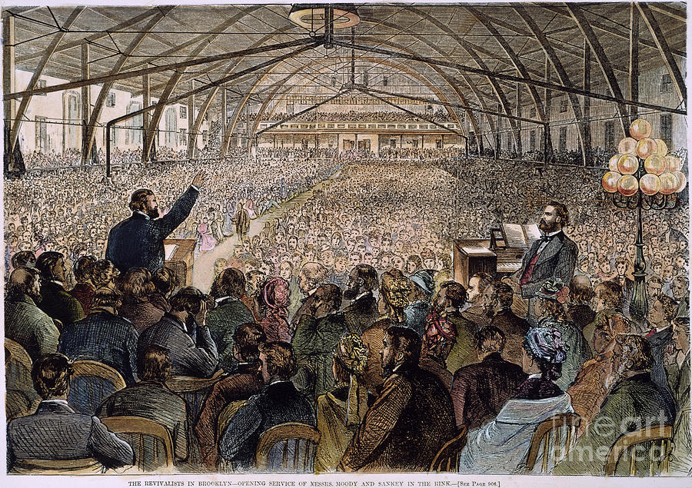

Slide 12
Philippians 1:18b-21
Yes, and I will continue to rejoice, ¹⁹for I know that through your prayers and God’s provision of the Spirit of Jesus Christ what has happened to me will turn out for my deliverance. ²⁰I eagerly expect and hope that I will in no way be ashamed, but will have sufficient courage so that now as always Christ will be exalted in my body, whether by life or by death.
²¹For to me, to live is Christ and to die is gain.

Slide 13
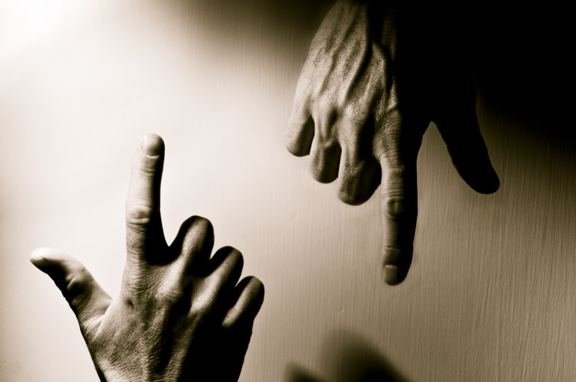
#2. Enduring joy comes by experiencing the “saving” work of Christ in every experience of life…
good or bad.

Slide 14
Philippians 2:12-13
“…continue to work out your salvation with fear and trembling, for it is God who works in you to will and to act according to his good purpose.”
What are you being saved from today?

Slide 15
Philippians 1
²⁰ I eagerly expect and hope that I will in no way be ashamed, but will have sufficient courage so that now as always Christ will be exalted in my body, whether by life or by death.

Slide 16
Philippians 1:21
“For to me,
to live is Christ
and to die is gain.”

Slide 17
Philippians 1:22-24
“If I am to go on living in the body, this will mean fruitful labor for me. Yet what shall I choose? I do not know! ²³I am torn between the two: I desire to depart and be with Christ, which is better by far; ²⁴but it is more necessary for you that I remain in the body.

Slide 18
What is LIFE really all about
for me?

Slide 19
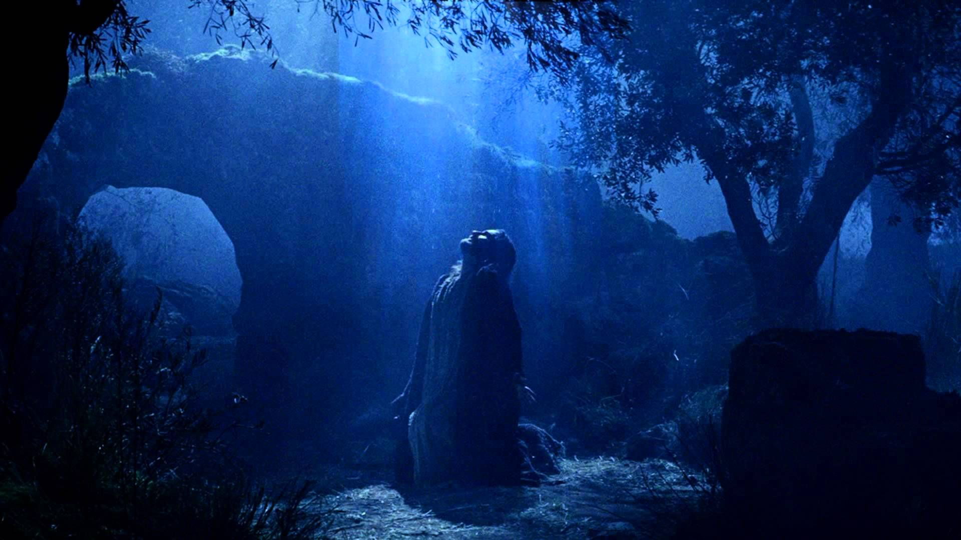
Hebrews 12:2
“…fix our eyes on Jesus, the pioneer and perfecter of faith. For the joy set before
him he endured the cross, scorning its shame, and sat down at the right hand of the throne of God.”

Slide 20
Philippians 1:21-26
For to me, to live is Christ and to die is gain. ²²If I am to go on living in the body, this will mean fruitful labor for me. Yet what shall I choose? I do not know! ²³I am torn between the two: I desire to depart and be with Christ, which is better by far; ²⁴but it is more necessary for you that I remain in the body. ²⁵Convinced of this, I know that I will remain, and I will continue with all of you for your progress and joy in the faith, ²⁶so that through my being with you again your boasting in Christ Jesus will abound on account of me.

Slide 21
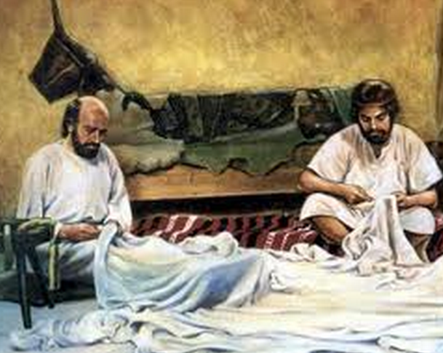
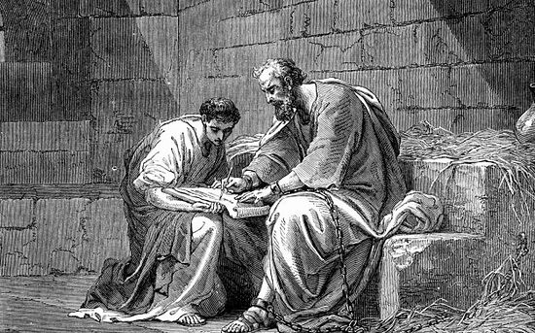
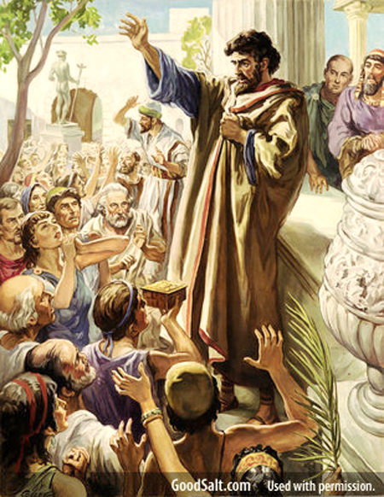
#3. Joy comes from being of benefit to others in the kingdom work of Christ.

Slide 22
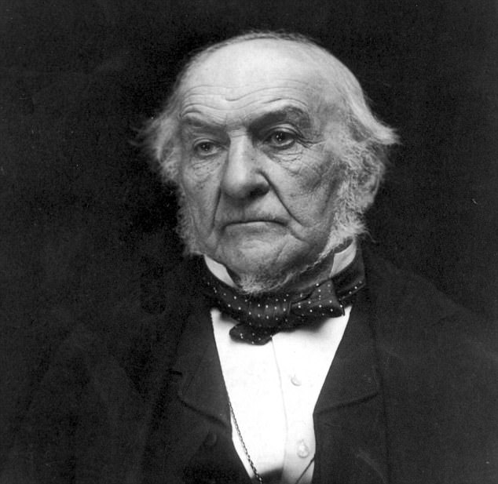
W.E. Gladstone
Prime Minister of Great Britain
from
1868-1894

Slide 23
When knowing Jesus
in every experience of life
becomes my reason for living
then nothing in life will be able
to separate me
from JOY.

