Slide 1
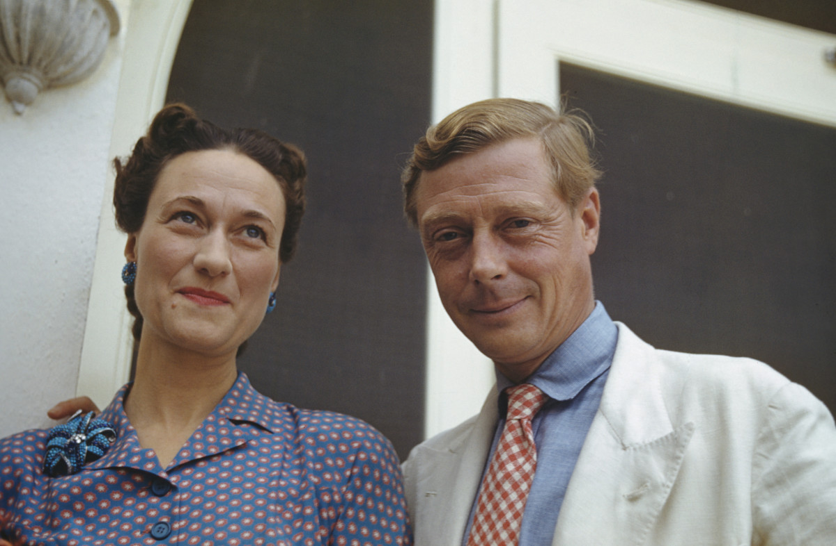
“The thing that impresses me most about America is the way parents obey their children.”

Slide 3
Colossians 3:20
Children, obey your parents in everything, for this pleases the Lord.
Ephesians 6:1-3
Children, obey your parents in the Lord, for this is right. “Honor your father and mother”—which is the first commandment with a promise—“so that it may go well with you and that you may enjoy long life on the earth.”

Slide 4
“Obey your parents in everything….” “Obey your parents in the Lord….”

Slide 5
God’s blessing on your life as children begins with listening.

Slide 6
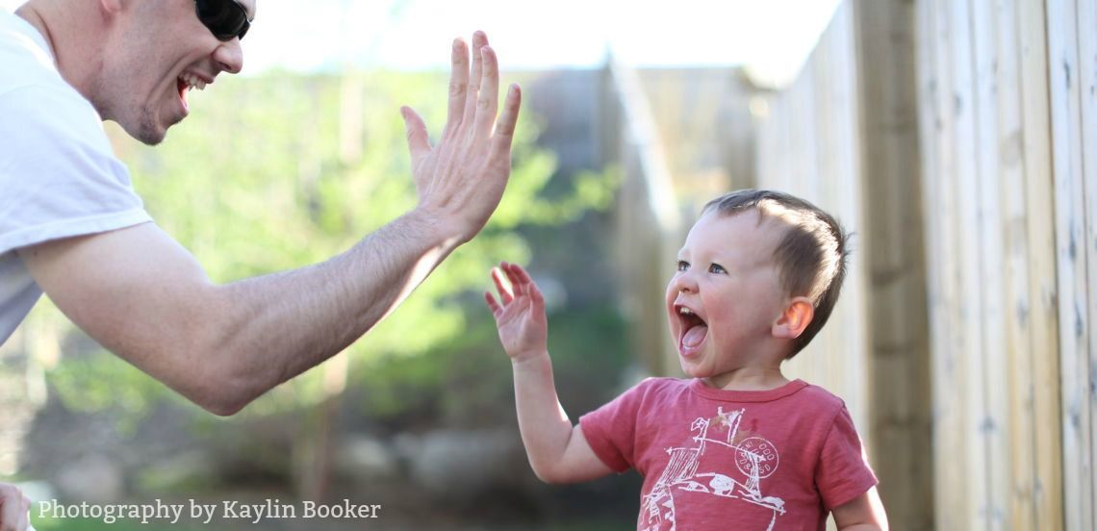

Slide 7
“…pleasing in the Lord.”

Slide 8
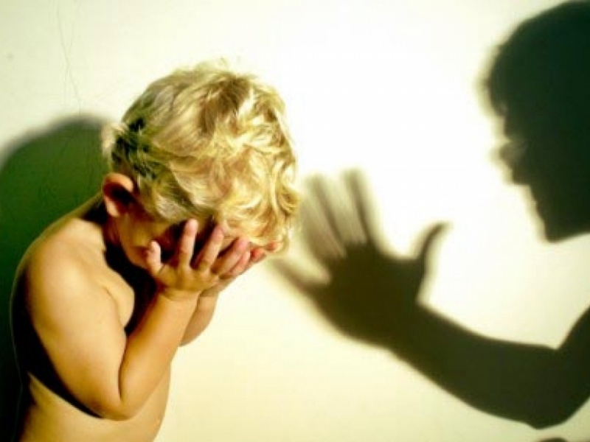

Slide 9
Colossians 3:21 Fathers, do not embitter your children, or they will become discouraged. Ephesians 6:4 “Fathers, do not exasperate your children; instead, bring them up in the training and instruction of the Lord.”

Slide 10
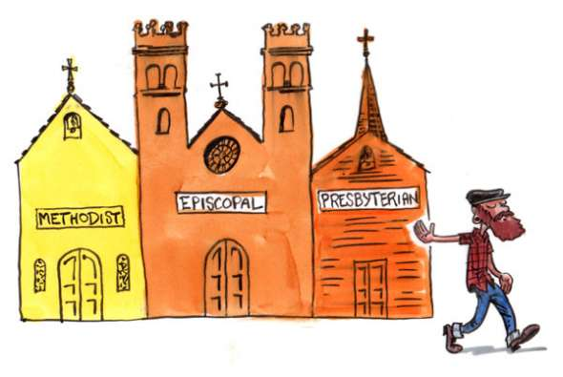

Slide 11
Colossians 3:21 Fathers, do not embitter your children, or they will become discouraged. Ephesians 6:4 “Fathers, do not exasperate your children; instead, bring them up in the training and instruction of the Lord.”

Slide 12
Discouraging to Children
Encouraging to Children

Slide 13
