Slide 1
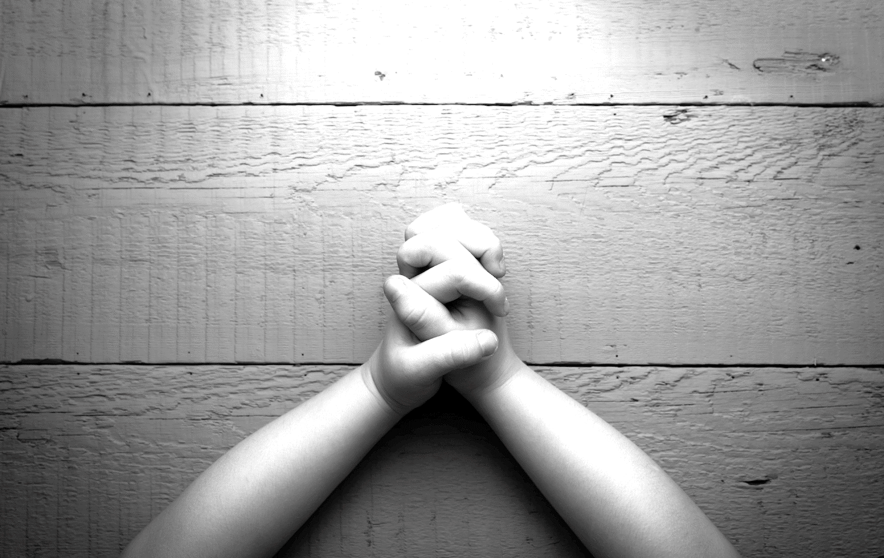
Colossians 2:6, 7—So then, just as you received Christ Jesus as Lord, continue to live your lives in him, ⁷ rooted and built up in him, strengthened in the faith as you were taught, and overflowing with thankfulness.

Slide 2
Colossians 3:15, 17—Let the peace of Christ rule in your hearts, since as members of one body you were called to peace. And be thankful. ¹⁷ And whatever you do, whether in word or deed, do it all in the name of the Lord Jesus, giving thanks to God the Father through him.

Slide 3
Colossians 4:2—
Devote yourselves to prayer, being watchful and thankful.

Slide 4
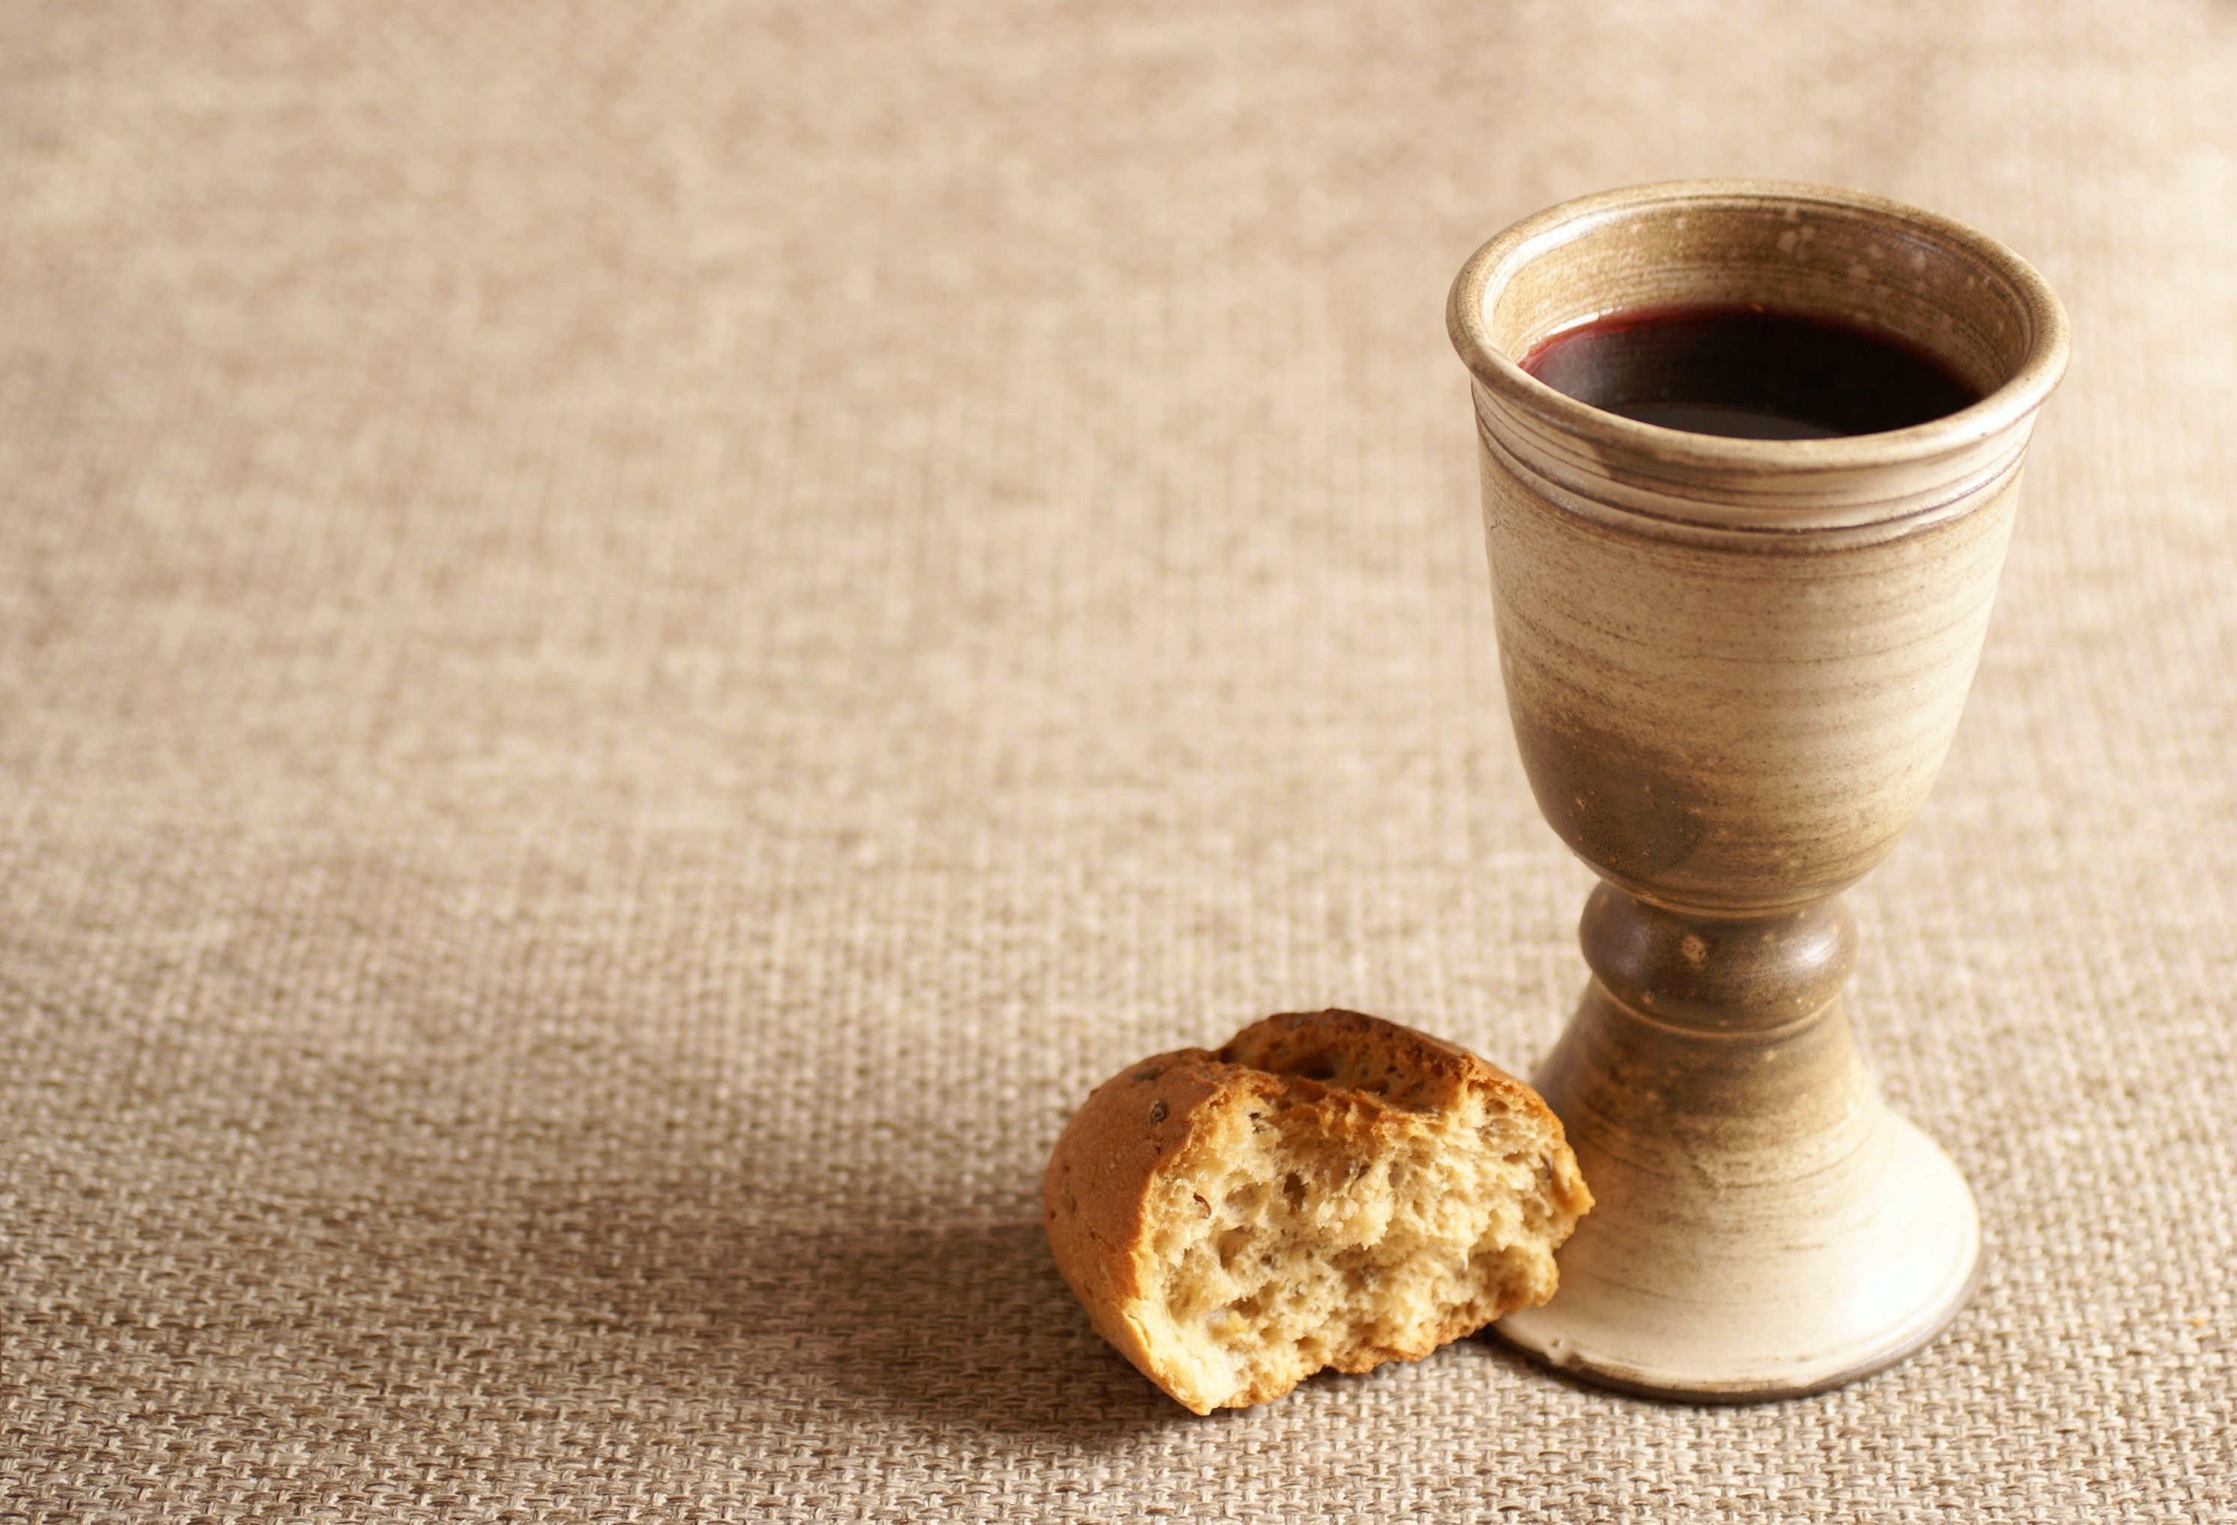
I Corinthians 10:16
Is not the cup of thanksgiving
for which we give thanks a participation in the blood of Christ? And is not the bread that we break a participation in the body of Christ?

Slide 5
I Corinthians 10:16
Is not the cup of thanksgiving for which we give thanks a participation in the blood of Christ? And is not the bread that we break a participation in the body of Christ?

Slide 6
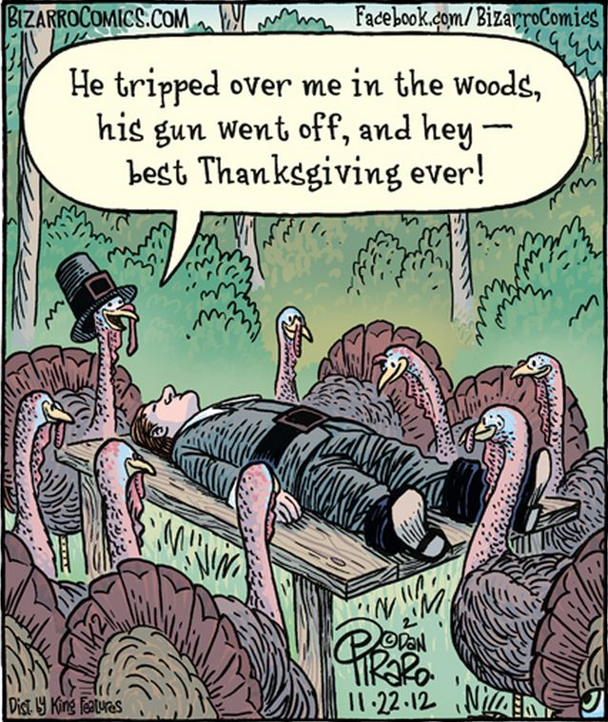
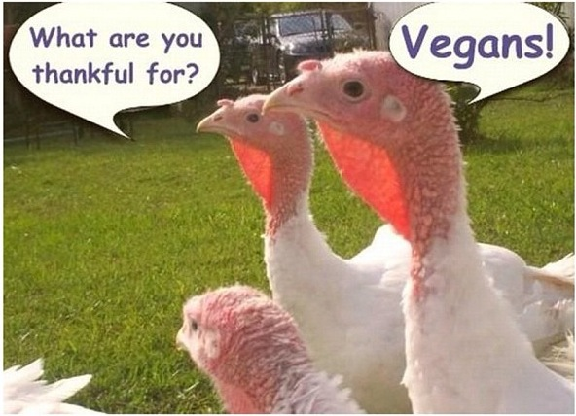

Slide 7
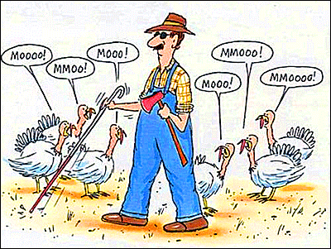
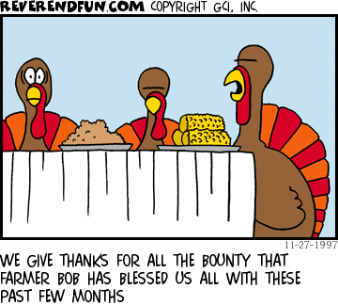

Slide 8
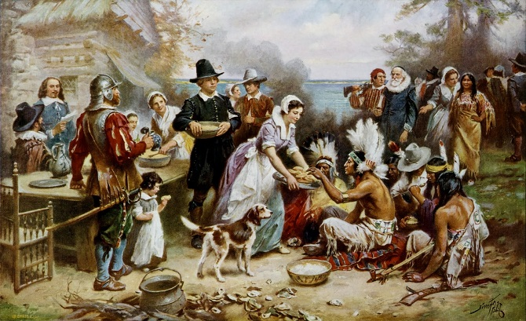

Slide 9
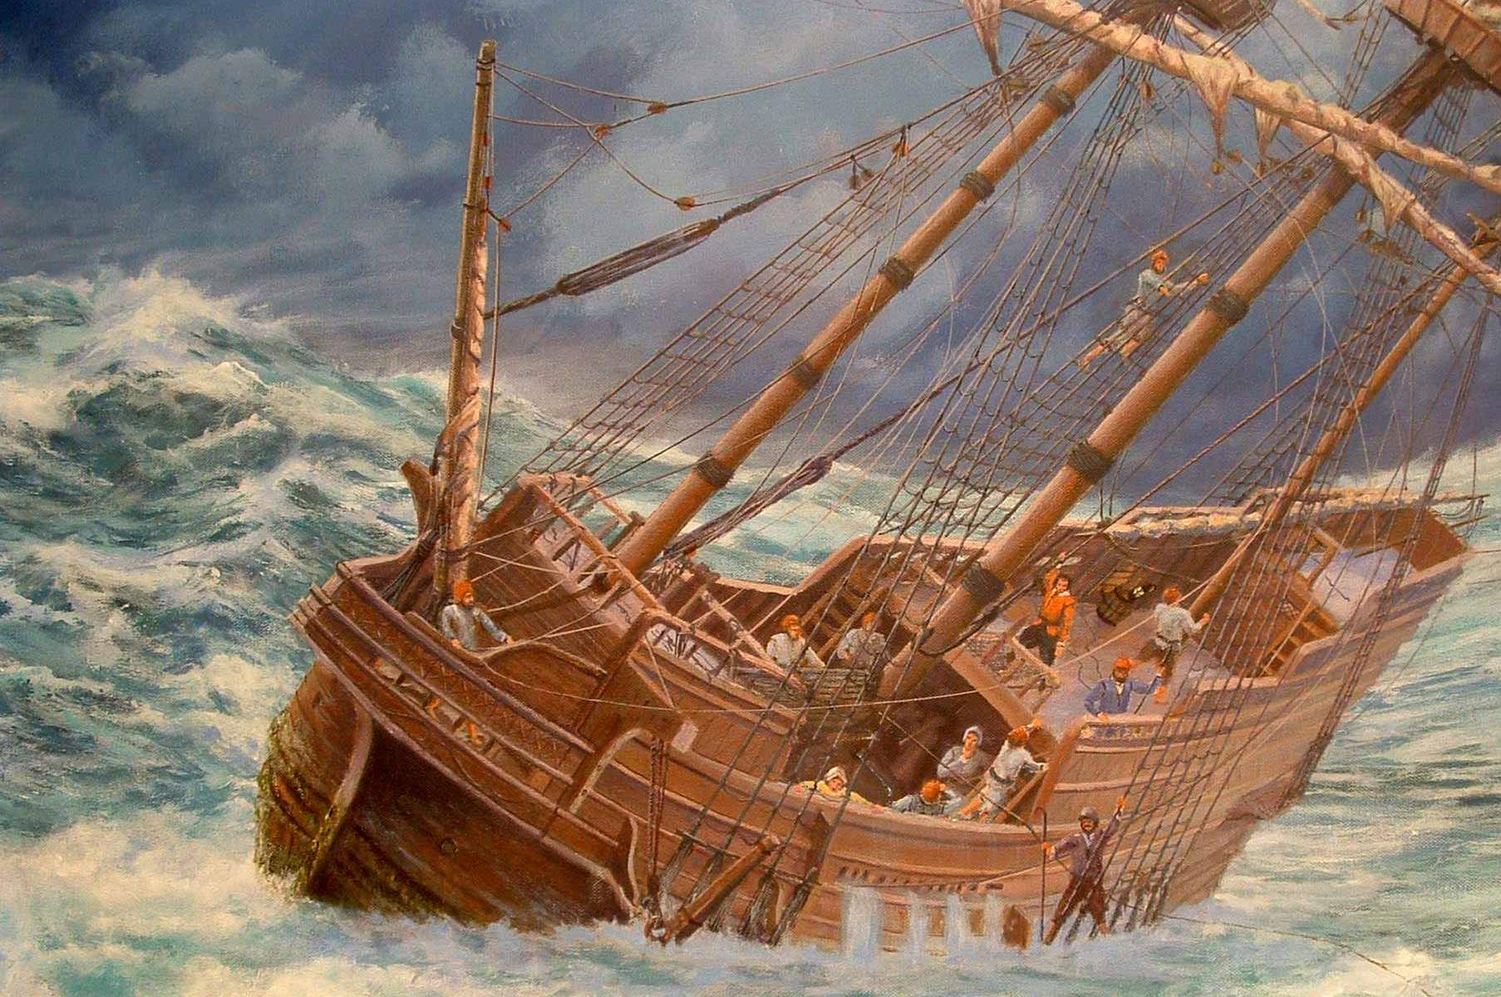

Slide 10
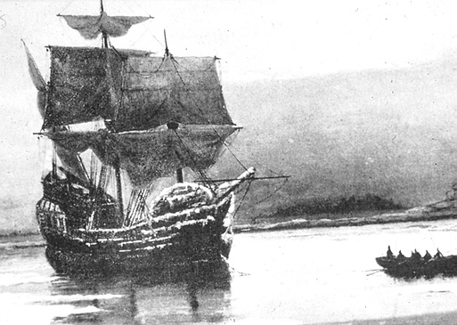

Slide 11
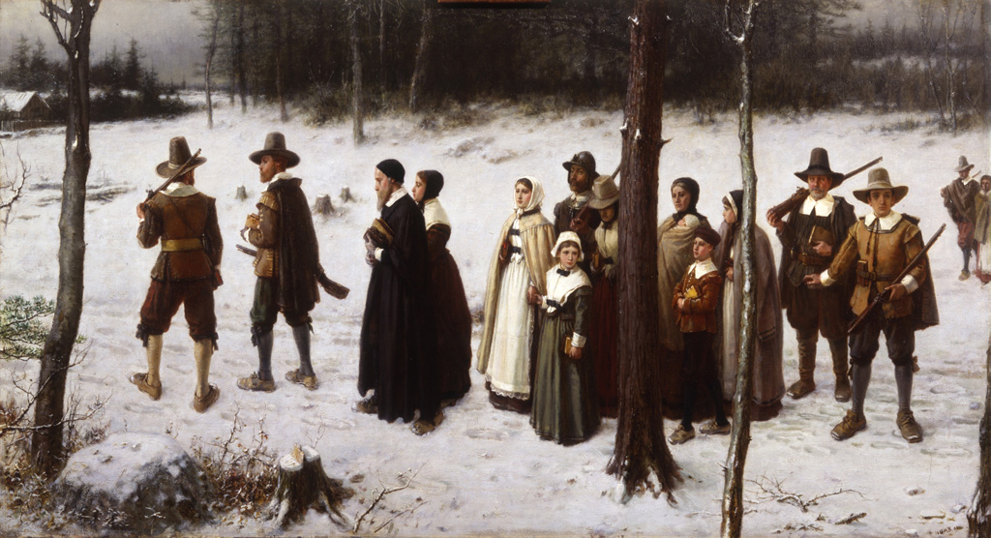

Slide 12
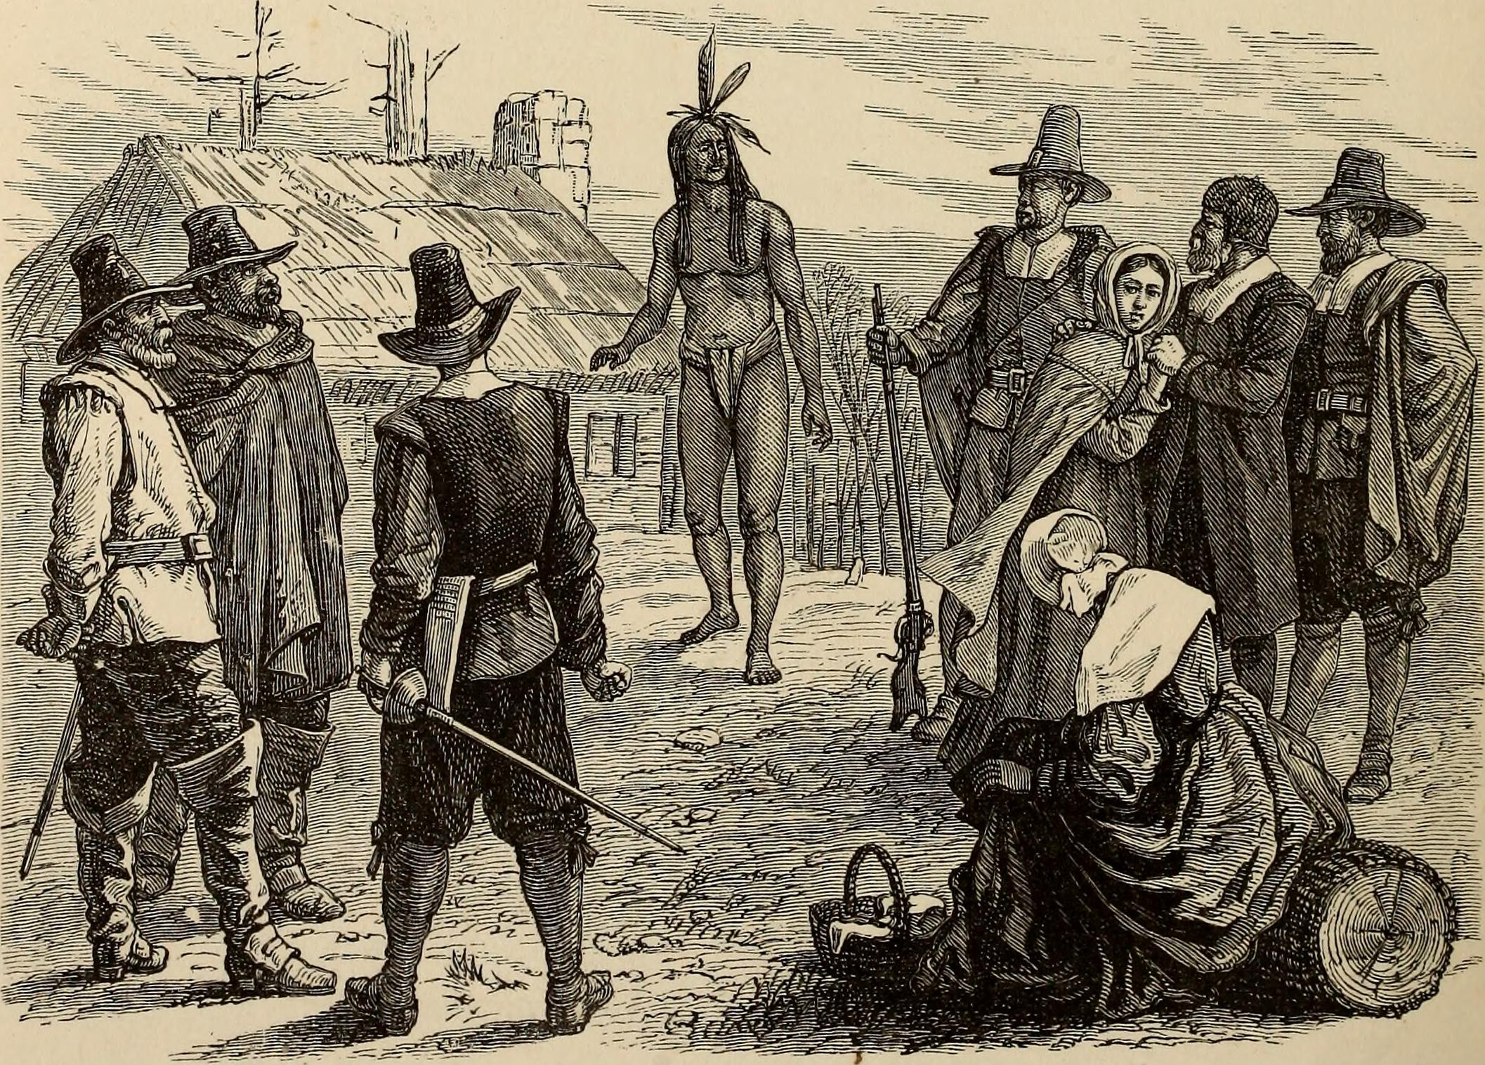

Slide 13
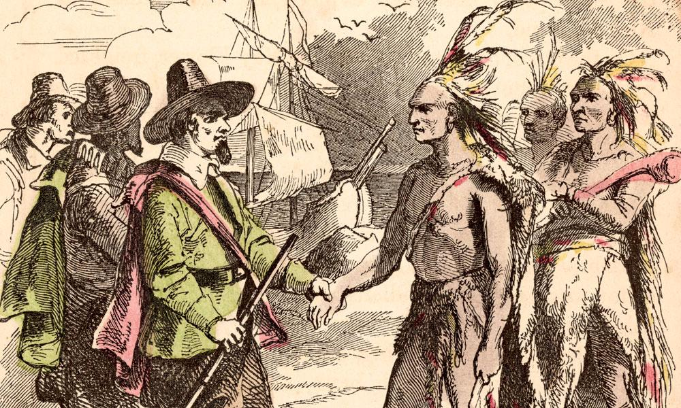

Slide 15
Colossians 1:3, 4
“We always thank God, the Father of our Lord Jesus Christ, when we pray for you, ⁴ because we have heard of your faith in Christ Jesus and of the love you have for all God’s people….”

Slide 16
Colossians 4:2—
“Devote yourselves to prayer, being watchful and thankful.”

Slide 17
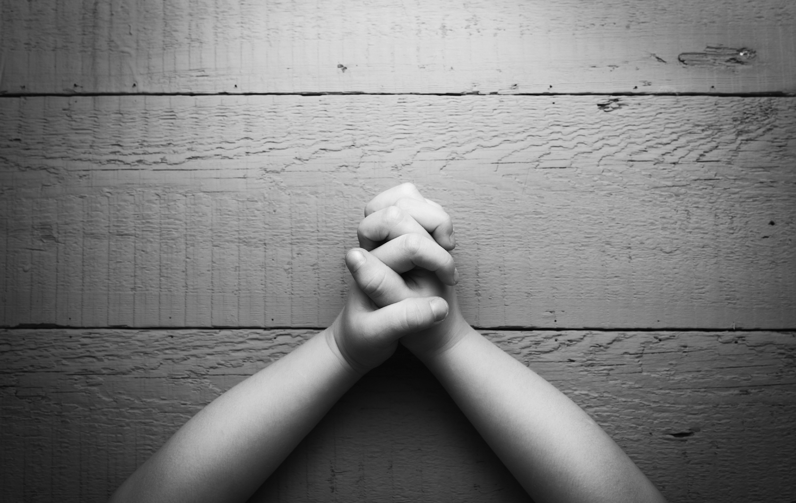
1.) PRAYER is THE chief way to be thankful to God.

Slide 19
Colossians 2:6, 7
⁶ So then, just as you received Christ Jesus as Lord, continue to live your lives in him, ⁷ rooted and built up in him, strengthened in the faith as you were taught, and overflowing with thankfulness.

Slide 20
2.) Life “lived [by faith] in Christ Jesus” as our Lord will be a life of overflowing thankfulness.

Slide 21
Colossians 3:15-17
¹⁵ Let the peace of Christ rule in your hearts, since as members of one body you were called to peace. And be thankful. ¹⁶ Let the message of Christ dwell among you richly as you teach and admonish one another with all wisdom through psalms, hymns, and songs from the Spirit, singing to God with gratitude in your hearts.

Slide 22
Colossians 3:15-17
¹⁷ And whatever you do, whether in word or deed, do it all in the name of the Lord Jesus, giving thanks to God the Father through him.

Slide 23
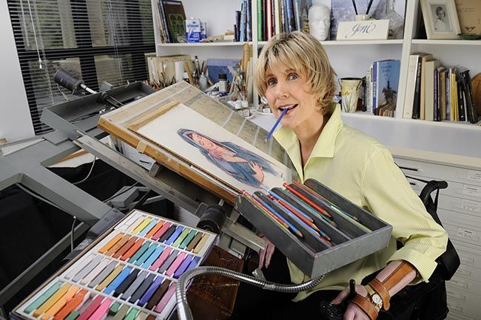

Slide 24
James 1:2, 3
Consider it pure joy, my brothers and sisters, whenever you face trials of many kinds, ³ because you know that the testing of your faith produces perseverance.

Slide 25
Daniel 6:10
Now when Daniel learned that the decree had been published, he went home to his upstairs room where the windows opened toward Jerusalem. Three times a day he got down on his knees and prayed, giving thanks to his God, just as he had done before.

Slide 26
Colossians 3:17
And whatever you do, whether in word or deed, do it all in the name of the Lord Jesus, giving thanks to God the Father through him.

Slide 27
Themes to Major on in Thanksgiving
1.) Growth that trials, tribulations & needs bring
2.) Other believers in God’s family
3.) Spiritual blessings in Christ
4.) Physical provisions of God

