Slide 1
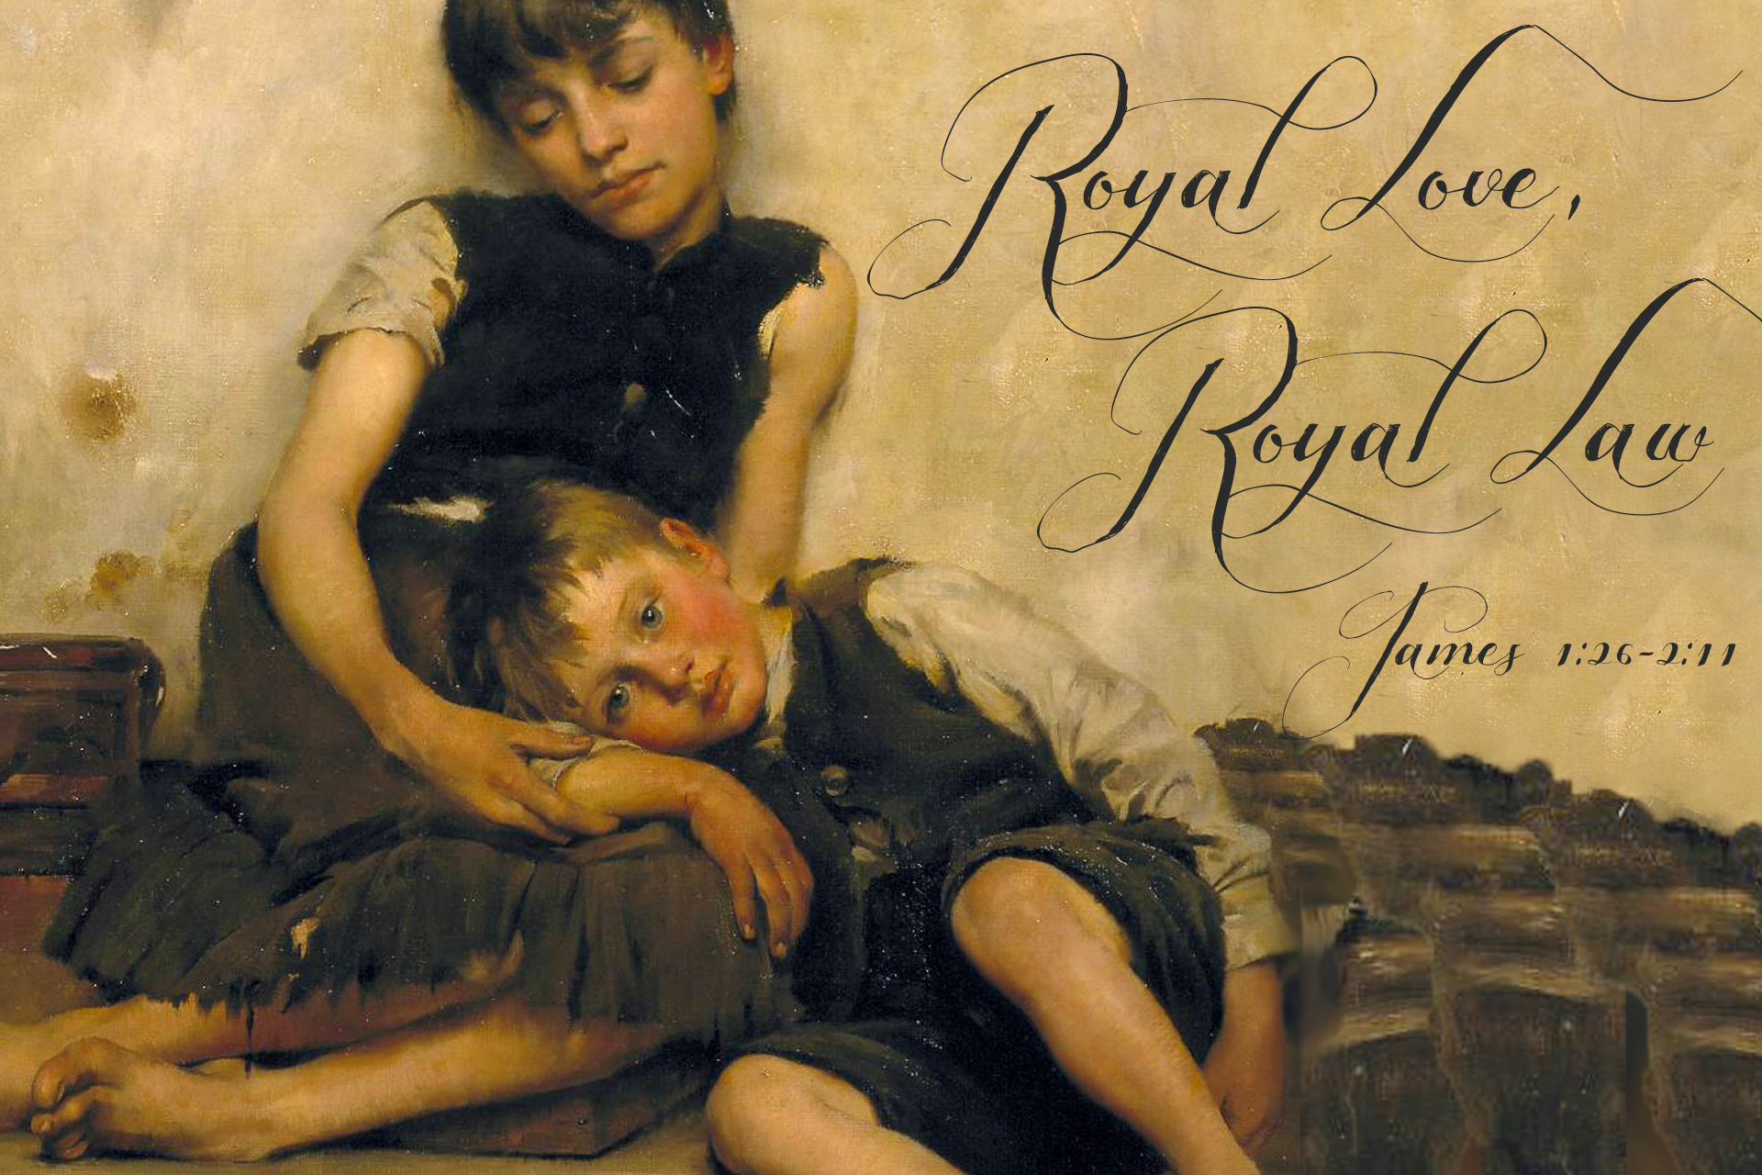

Slide 2
James 1:27
Religion that God our Father accepts as pure and faultless is this: to look after orphans and widows in their distress and to keep oneself from being polluted by the world.
James 2:8, 9
If you really keep the royal law found in Scripture, “Love your neighbor as yourself,” you are doing right. ⁹ But if you show favoritism, you sin and are convicted by the law as lawbreakers.

Slide 3
James 2:12, 13
Speak and act as those who are going to be judged by the law that gives freedom,
¹³ because judgment without mercy will be shown to anyone who has not been merciful. Mercy triumphs over judgment.

Slide 4
Important Statistics about Orphans
150 million children worldwide who have lost either one or both parents.
18-25 million are “double orphans” who have lost both parents.
THE most important statistical number is 1: “orphans” are cared for 1 life at a time!

Slide 5
MOSAIC Facts about Orphans
How many of you as children were “orphaned” at some period in your life—either by the loss/virtual absence of 1 parent or the loss of both parents?
How many as adults here have engaged in adoption OR foster parenting OR step-parenting at some time in your life?

Slide 6
James 2:8, 9 (It doesn’t say…)
“If you really kept at some point in your life the royal law found in Scripture, “Love your neighbor as yourself,” you are then presently doing right…you are not showing favoritism.”

Slide 7
James 2:8, 9 (NIV)
If you really keep the royal law found in Scripture, “Love your neighbor as yourself,” you are doing right. ⁹ But if you show favoritism, you sin and are convicted by the law as lawbreakers.

Slide 8
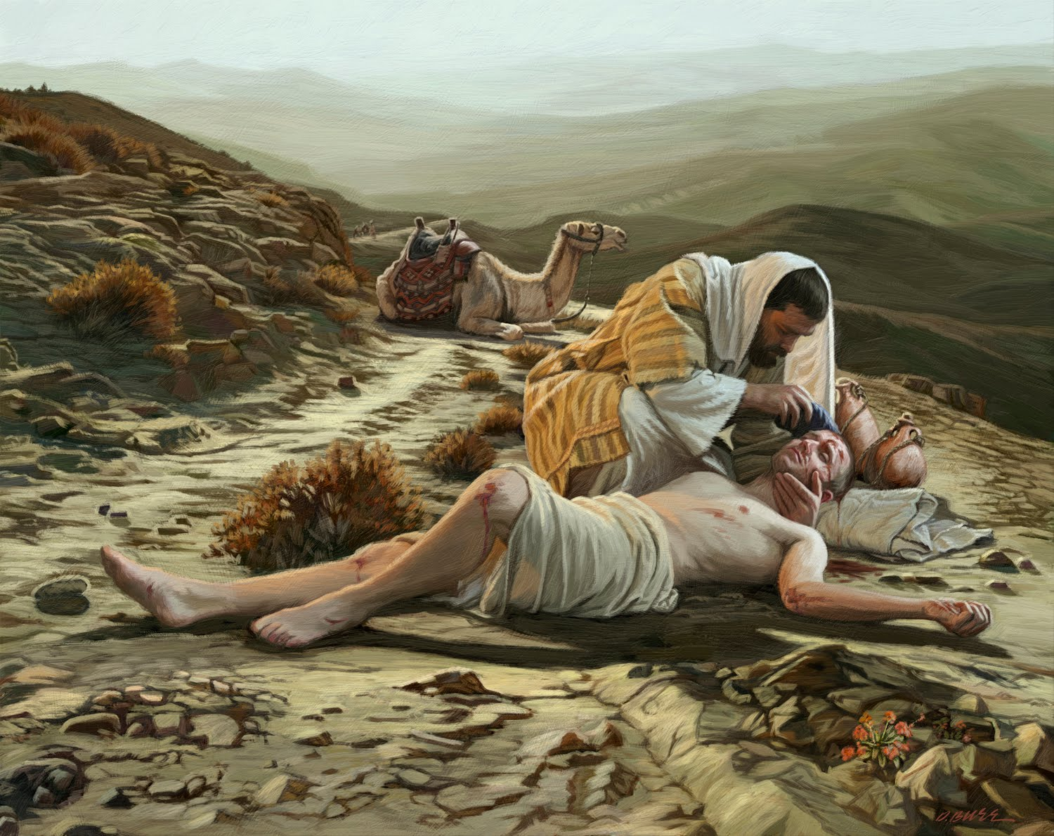
Luke 10—The Good Samaritan

Slide 9
Why is the care of widows and orphans so central to God’s heart?
What is the connection between God’s compassion for widows and orphans and what he wants all of His children to BE?

