Slide 1
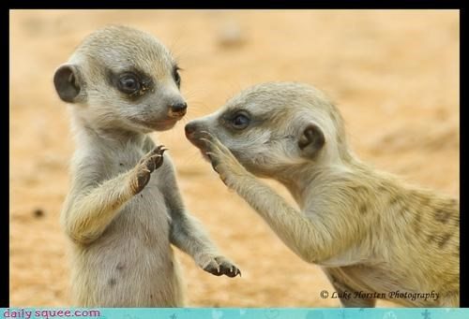
Speaker-Listener Technique Each person takes turns speaking while his or her partner listens and paraphrases what the speaker said. General Rules: 1. The speaker has the floor (indicated by the object used). 2. Share the floor. Take turns letting each person be the speaker. 3. Don't problem-solve. Focus on having a good discussion, not finding a solution.

Slide 2
Rules for the Speaker: 1. Speak for yourself. Express your feelings and thoughts, using "I“ statements. 2. Be brief. Don't go on and on each time. 3. Stop and let the listener paraphrase. Rules for the Listener: 1. Paraphrase what you heard in your own words to let your partner know you understand what they are saying. Wait till your turn as speaker to ask more questions. 2. Focus on the speaker's message. Don't rebut. Remember: your job is understand what your partner is saying.

Slide 3
James 1:19-22 (ESV) “Know this, my beloved brothers: let every person be quick to hear, slow to speak, slow to anger; ²⁰ for the anger of man does not produce the righteousness of God. ²¹ Therefore put away all filthiness and rampant wickedness and receive with meekness the implanted word, which is able to save your souls. ²² But be doers of the word, and not hearers only, deceiving yourselves.”

Slide 4
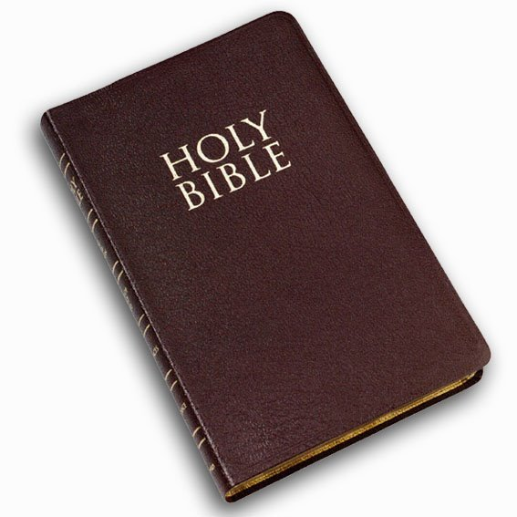

Slide 7
James 1:19, 20
“Let every person be quick to hear, slow to speak, slow to anger; ²⁰ for the anger of man does not produce the righteousness of God.”

Slide 9
James 1:20
“…the anger of man does not produce the righteousness of God.”

Slide 10
James 1:19, 20
“Let every person be quick to hear, slow to speak, slow to anger; ²⁰ for the anger of man does not produce the righteousness of God.”

Slide 11
Proverbs 14:29--Whoever is slow to anger has great understanding, but he who has a hasty temper exalts folly.
Proverbs 16:32-- Whoever is slow to anger is better than the mighty, and he who rules his spirit than he who takes a city.

Slide 12
What to DO when anger comes knocking:
Quote Scripture
Challenge assumptions
Examine disappointed expectations
Walk it off
Take constructive action

Slide 13
James 1:21
“Therefore put away all filthiness and rampant wickedness and receive with meekness the implanted word, which is able to save your souls.”

Slide 14
James 1:22-25
But be doers of the word, and not hearers only, deceiving yourselves.²³ For if anyone is a hearer of the word and not a doer, he is like a man who looks intently at his natural face in a mirror. ²⁴ For he looks at himself and goes away and at once forgets what he was like. ²⁵ But the one who looks into the perfect law, the law of liberty, and perseveres, being no hearer who forgets but a doer who acts, he will be blessed in his doing.

Slide 15
DECEIVERS

Slide 16
James 1:22-25
“But be doers of the word, and not hearers only, deceiving yourselves.”
How are we deceiving ourselves when we listen to but do not ACT UPON the word of God?

Slide 17
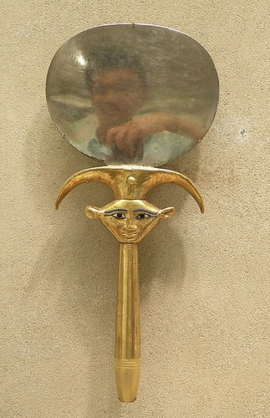
James 1:23-24
“…He is like a man who looks intently at his natural face in a mirror. ²⁴ For he looks at himself and goes away and at once forgets what he was like.”

Slide 18
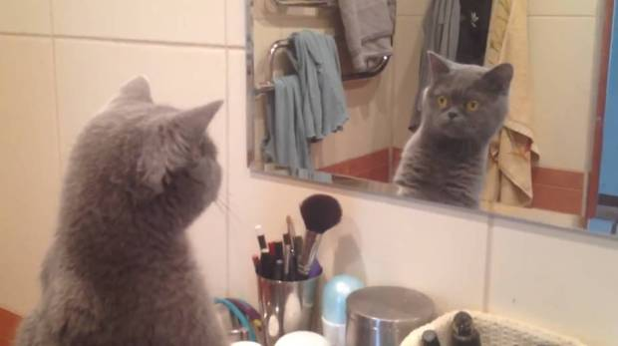
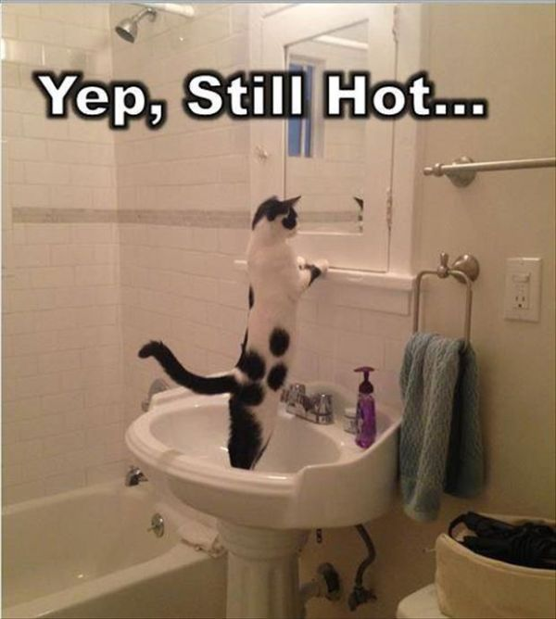

Slide 19
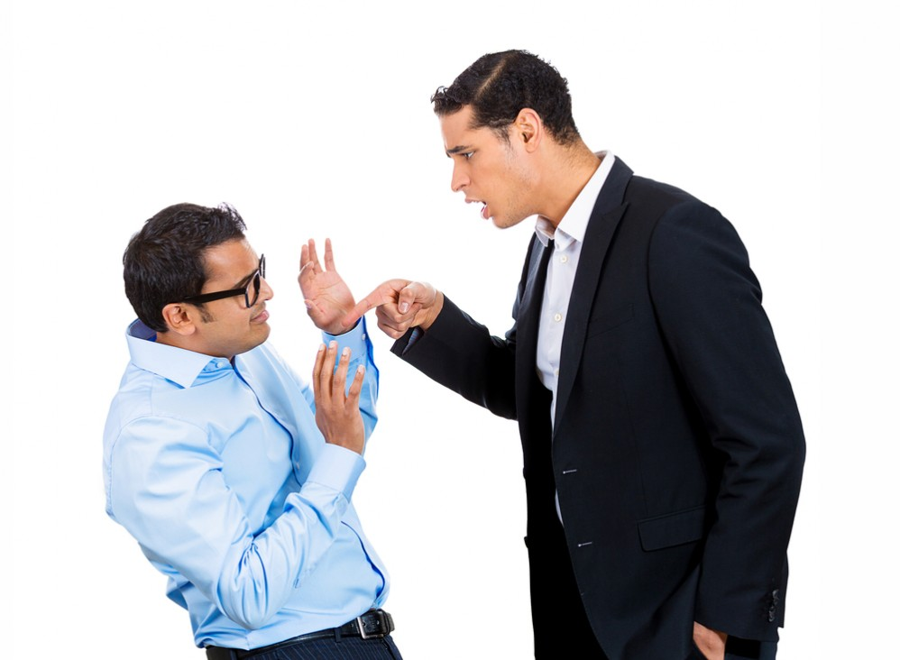

Slide 20
James 1:25
But the one who looks into the perfect law, the law of liberty, and perseveres, being no hearer who forgets but a doer who acts, he will be blessed in his doing.

Slide 21
1. HOW & WHEN are you going to “look” into God’s word this week?
2. WHAT are you going to do to “persevere” in that look?

Slide 22
1. HOW & WHEN are you going to “look” into God’s word this week?
2. WHAT are you going to do to “persevere” in that look?
WHAT is this passage talking about?
HOW does that relate to my life/experience/ world/family/etc.?
WHAT does God want me to DO with that?

Slide 23
1. HOW & WHEN are you going to “look” into God’s word this week?
2. WHAT are you going to do to “persevere” in that look?
3. What ACTION will you take this day/week with God’s help to obey God’s call on your life from this passage?

