Slide 1
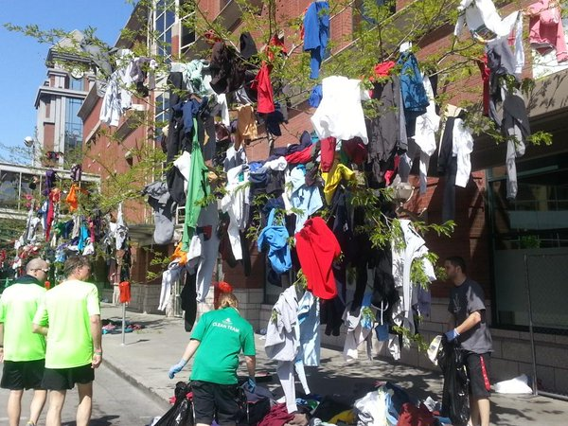
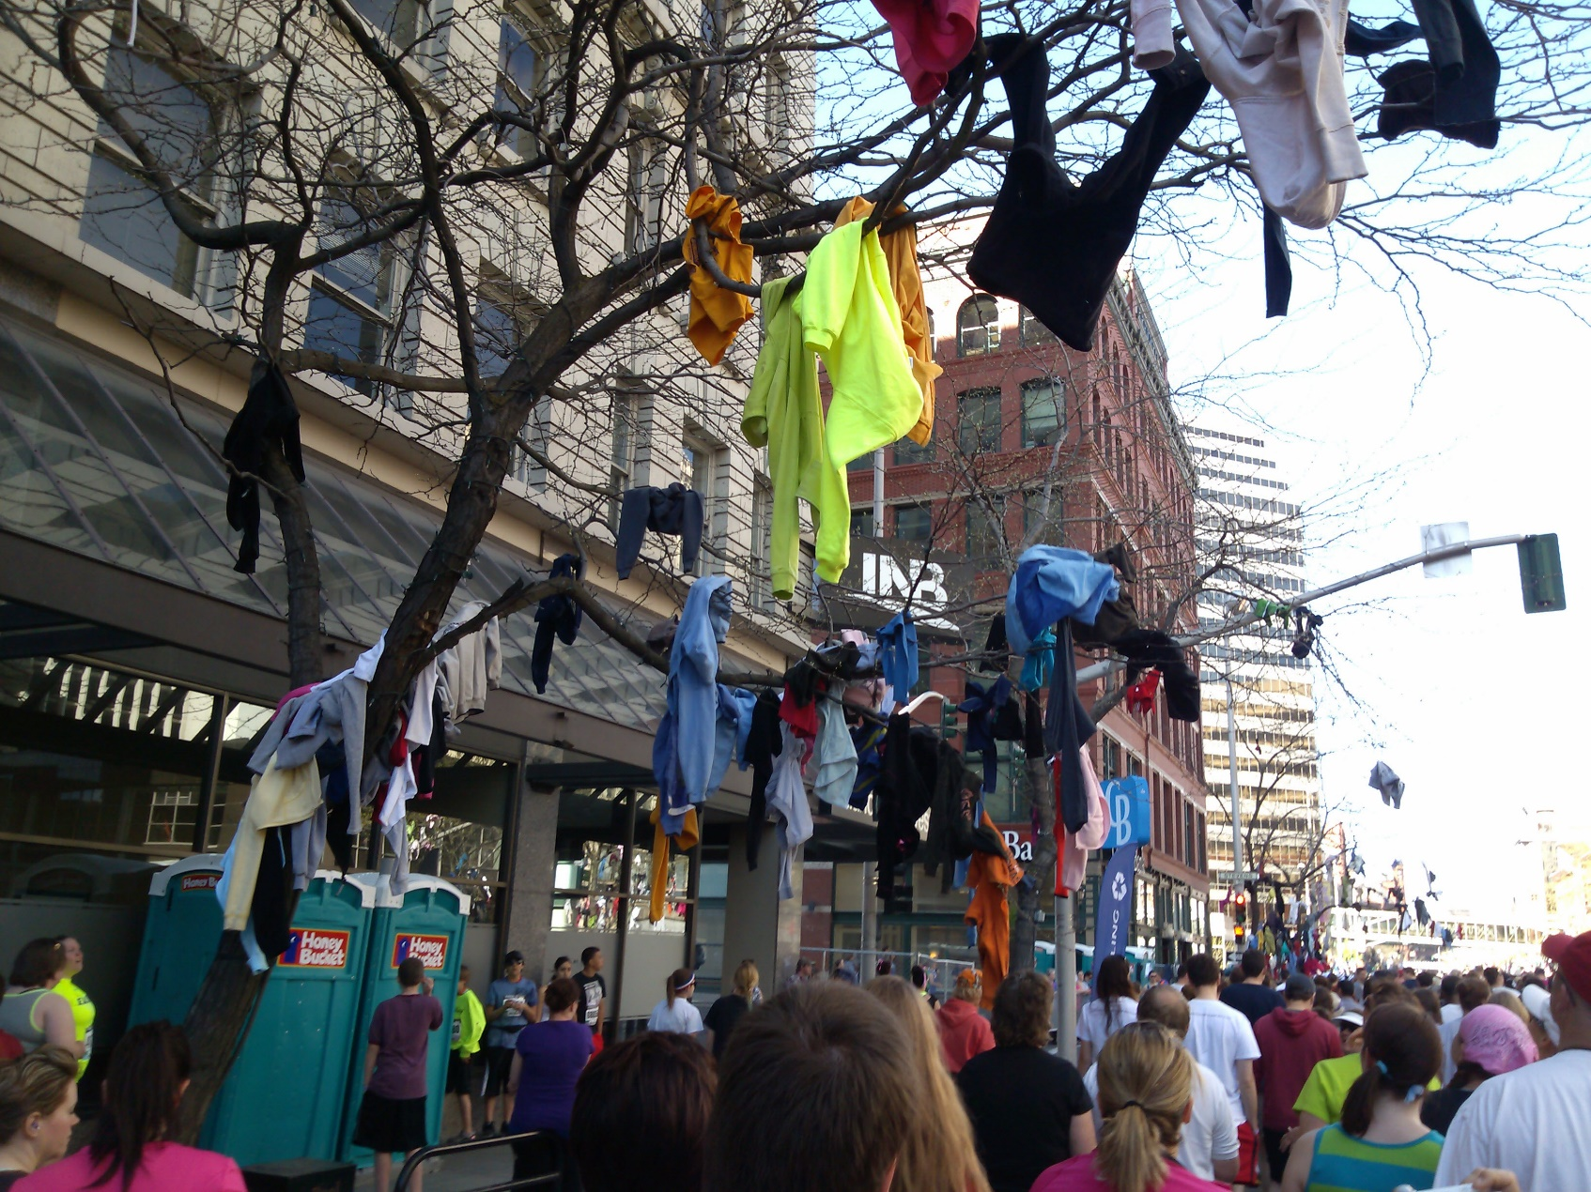
HEBREWS 12:1-2 Therefore, since we are surrounded by such a great cloud of witnesses, let us throw off everything that hinders and the sin that so easily entangles. And let us run with perseverance the race marked out for us, ² fixing our eyes on Jesus, the pioneer and perfecter of faith.

Slide 2
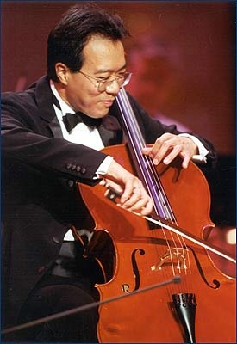
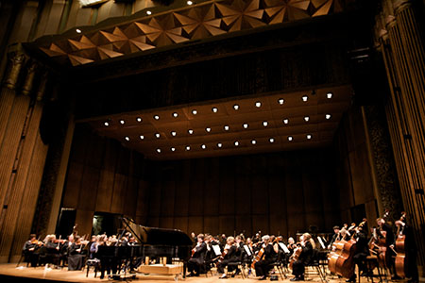
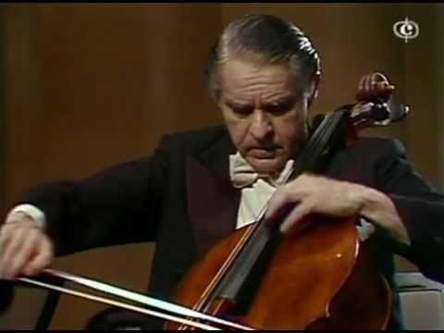

Slide 3
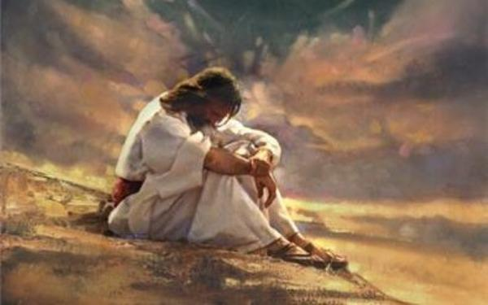

Slide 5
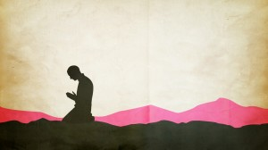
“Be careful not to practice your righteousness in front of others to be seen by them” (Matthew 6:1)

Slide 6
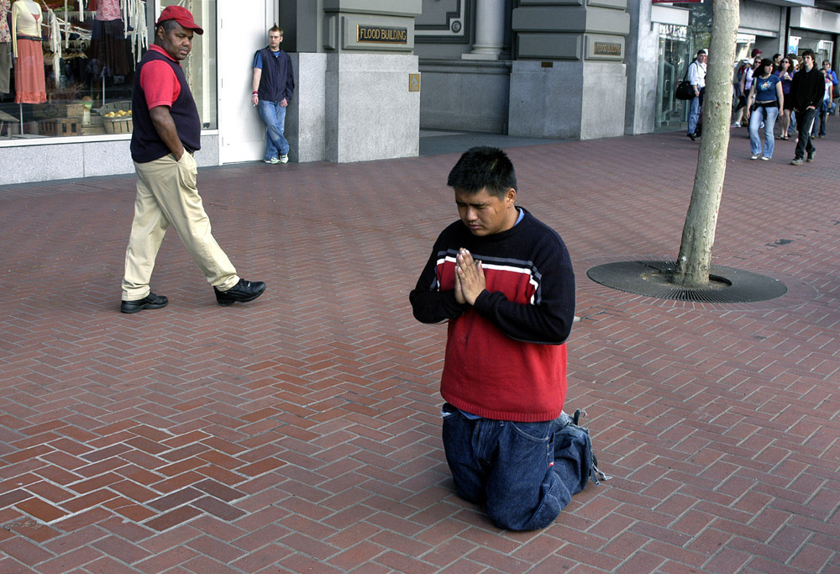
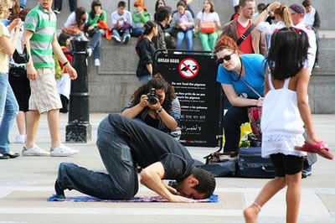

Slide 7
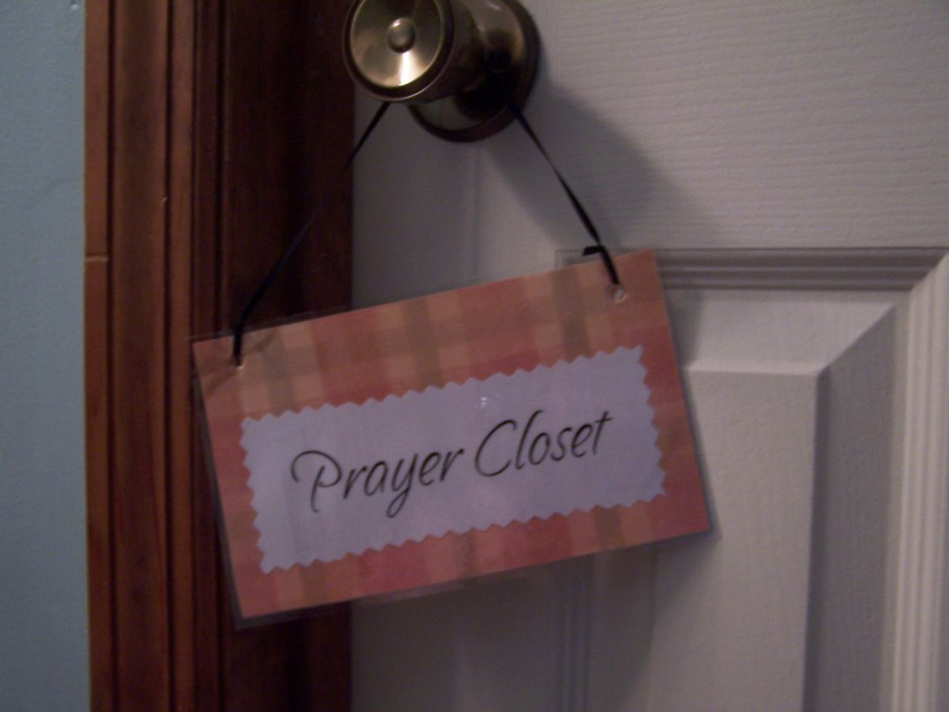

Slide 8
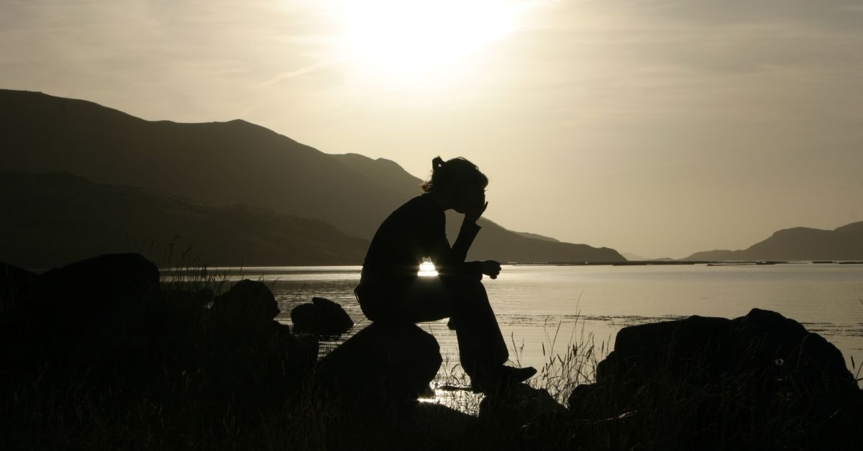
If the only prayers God answered in your world were the ones you made in secret…in your own private prayer life with God…what would the world look like?

Slide 10
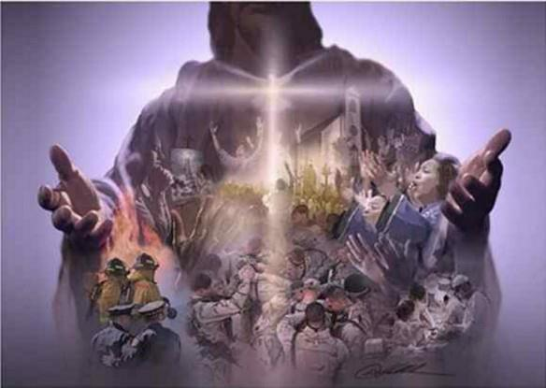
“Your kingdom come, your will be done, on earth as it is in heaven.”

Slide 11
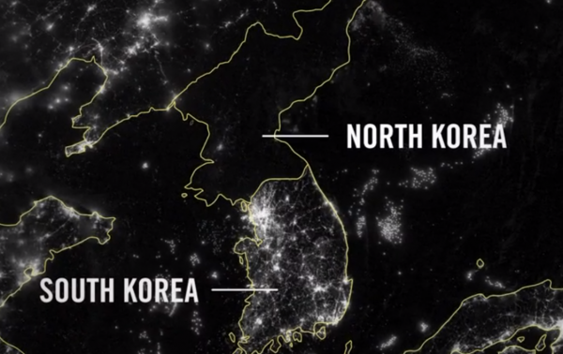
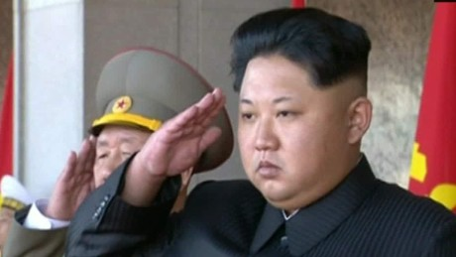
“Your kingdom come, your will be done, on earth as it is in heaven.”

Slide 12
“Your kingdom come, your will be done, on earth as it is in heaven.”

Slide 13
“And lead us not into temptation, but deliver us from the evil one.” (Matthew 6:13)
“Watch and pray so that you will not fall into temptation. The spirit is willing, but the flesh is weak” (Mt. 26:41).

Slide 14
EAST—EVERY DAY NEEDS. “Give us today our daily bread” (Matthew 6:11)
E

Slide 15
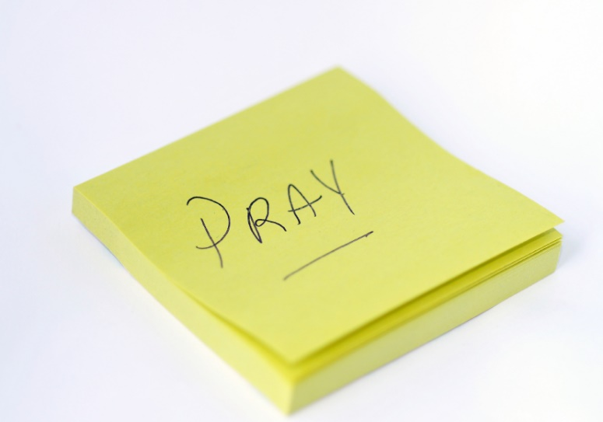
Organizing Your Prayer Life

Slide 17
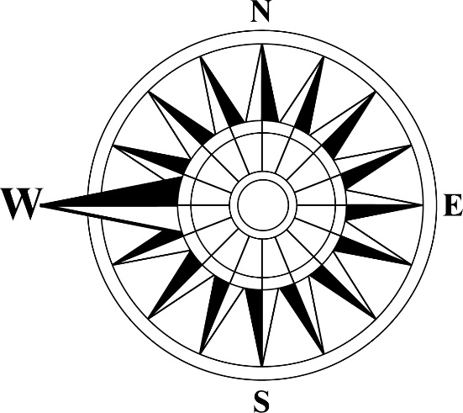
WEST: WILLING REPENTANCE, FORGIVENESS & RELEASE of offenses.
“And forgive us our debts, as we also have forgiven our debtors.”
Matthew 6:12

Slide 18
WEST: WILLING REPENTANCE, FORGIVENESS & RELEASE of offenses.
¹⁴ For if you forgive other people when they sin against you, your heavenly Father will also forgive you. ¹⁵ But if you do not forgive others their sins, your Father will not forgive your sins. (Matthew 6:14, 15)

Slide 19
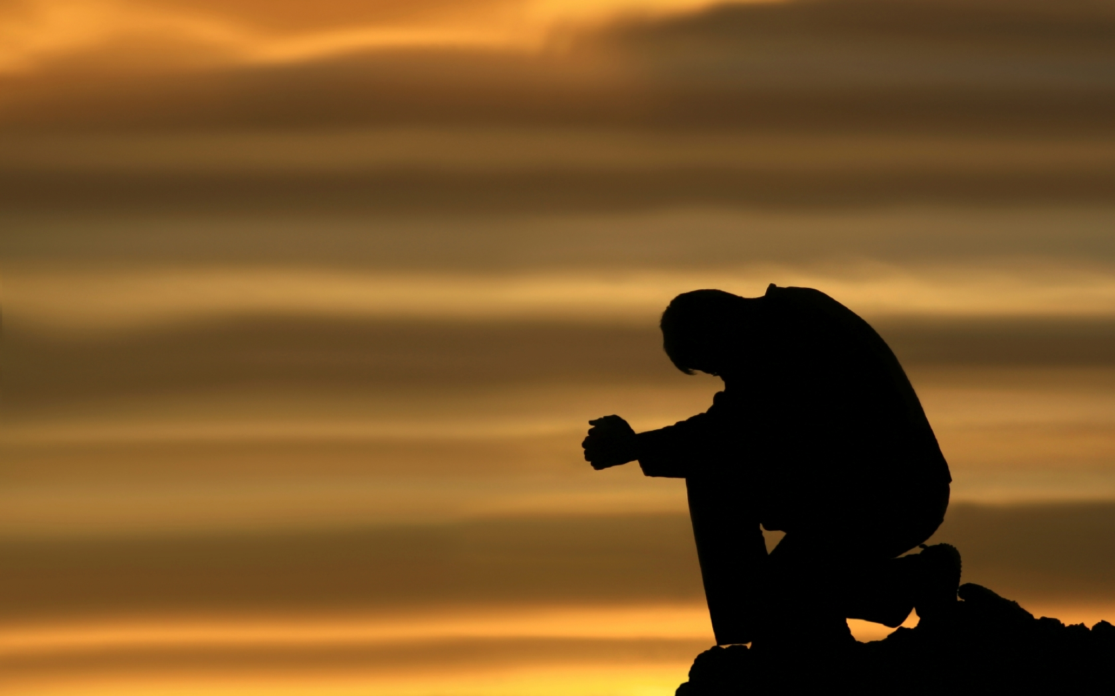
“This, then, is how you should pray: “‘Our Father in heaven, hallowed be your name, ¹⁰ your kingdom come, your will be done, on earth as it is in heaven. ¹¹ Give us today our daily bread. ¹² And forgive us our debts, as we also have forgiven our debtors. ¹³ And lead us not into temptation, but deliver us from the evil one.’

